Slide 1


AstraRoute
TCS AI E NGINE ER ING HACKATHON 2026- CHALLENGE 05
AI R E g UE STS
Autonomous AI Finops & Intelligent Model Routing
The cheapest model is not always right. The most powerful model is not always necessary.
COST + QUALITY + LATENCY + GOVERNANCE
Every request is a trade-off
COST
Unnecessary expensive inference
Q UAL I TY
Cheap routing can reduce quality
LATE NCY
Extra calls increase response time
GOVERNANCE
Privacy, budget and criticality matter
Team MindX

Slide 2

One Control Loop for Every AI Request
02 — OUR SOLUTION
01
UNDERSTAND
02 03
FILTER ******* ROUTE
04
EXECUTE
*******
Closed loop — every outcome informs the next decision
08
ADAPT
07
NEASURE
06
RECOVER
05
VERIFY
SLI'ñ
Fast pre-routing
POLICY
Eligibility + constraints
ROUTER
Cost / quality / latency decision
GUARDIAN
Verify + recover
FEEDBACK
Finops telemetry
Historical performance
Future routing decisions
Team IindX TCS AI Engineering Hackathon 2026 Challenge 05
02 / 05

Slide 3
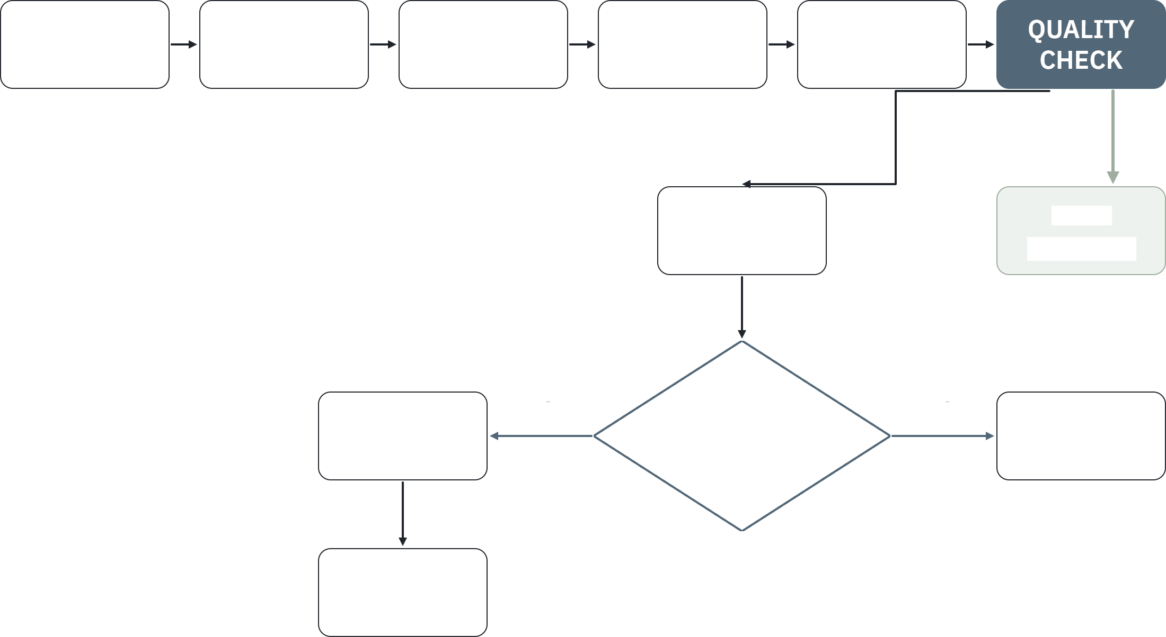
The Difference Happens When a Model Fails
03 — DECISION I NTE LLIG ENCE
REQUEST
SLI'ñ
POLICY
ROUTER
I’ñODEL
EXAI'ñ PLE
Required quality
85%
Medium model
Recovery checks
FAIL
Recovery
PASS
Response
62%- FAIL
Eligible model budget latency criticality expected quality gain
Advanced ode 93”o PASS
Escalation is triggered only when expected improvement justifies additional cost and latency.
NEXT MODEL
YES
Is escalation worthwhile?
NO
SAFE FAILURE
VERIFY
Pass
respond Fail
re-decide
Team IindX TCS AI Engineering Hackathon 2026 Challenge 05
03/ 05

Slide 4
Inside AstraRoute AI
04 — SYSTEM ARCHITE CT U RE
REQUEST
API Gateway
-•
Request Analyzer
-•
SLM Pre-Router
DECISION
Policy & Eligibility
I‘ñodel Registry
-•
Intelligent Router
EXECUTION
Small
-•
Medium
-•
Advanced
Provider
Abstraction
Model
VERIFY & RECOVER
Quality Guardian
-•
Recovery Engine
-•
Re-verify
Safe Failure
OBSERVABIL IT › FINOPS
Request Traces
Cost Ledger Historical Performance
Fu ure Rou in Es i a es
Routing Arena
Policy Simulator
Obse ved Resu s
TECH STACK
React Tailwind FastAPI Python PostgreSgL/Supabase SL I + LL I APIs Pandas Docker
Team MindX TCS AI Engineering Hackathon 2026 Challenge 05
04/05

Slide 5

From AI Cost Management to Closed-Loop AI Control
05 — N OVELTY, DI FFERE NTIATION & TCS ALIG NME NT
INDUSTRY
ASTRAROUT E — CONNECTS THEI'4
TCS ALIG NI' ENT
REASoN Understand request
PLAN Select strategy
POLICY ROUTE EXECUTE VERIFY RECOVER MEASURE ADAPT
Four differentiators
areua i a FinOps
Econo ic ecove
FinOps
Cost / budgets / optimization
AI Gateways
Routing/ caching/ governance
ACT
Execute
Observability
Usage / latency / reliability
Cos pe successfu ou come
VERIFY
Validate outcome
Evidence d iven adap a ion
ADAPT
Learn from telemetry
Model Evaluation
Quality measurement
“We don't claim to invent the individual capabilities. We connect them into a request-level closed loop where AI economics directly influence execution decisions.”
Team MindX TCS AI Engineering Hackathon 2026 Challenge 05
05/05

