Slide 1

`
Electronics & Communication Technology
Mini Project Guide
Dr. CH. V. NAGA BHASKAR
Assistant Professor
Team Members
A. Jaya Aswanth (22A81A1401)
Y. Rupa Sri (22A81A1466)
K. Pradeepthi (22A81A1425)
K. Mahitha Devi (22A81A1426)

Slide 2

PDF TRANSLATOR

Slide 3
INTRODUCTION
PDF translator allows users to easily convert text within PDF documents from one language to another, maintaining the original formatting and layout.
It offers support for multiple languages, enabling global accessibility and communication for individuals and businesses dealing with multilingual documents.

Slide 4
Literature Review
Authors | Title | Published | Conclusion | Limitations
[1] Narayan S. Adhikari | A Text Mining Tool for Extracting Information from PDF Documents | 2024, IEEE Access | Combines text extraction with NLP for accurate parsing of technical PDFs. | Struggles with unstructured content like complex tables and images.
[2] Jingchuan Luo | Text Mining and Machine Learning Methods for Analyzing PDF Documents | 2023, Journal of Information Science | Integrates text mining and machine learning for metadata extraction and categorization in PDFs. | High computational cost and reliance on quality datasets; performance varies with document diversity.

Slide 5
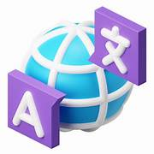
Problem Statement
Organizations and individuals often struggle with translating PDF files into different languages due to manual processes, lack of intuitive tools, and inefficiencies in text extraction.
This project addresses these challenges by offering an automated solution that extracts and translates text from PDFs seamlessly, providing a streamlined and accessible approach to multilingual document management.

Slide 6
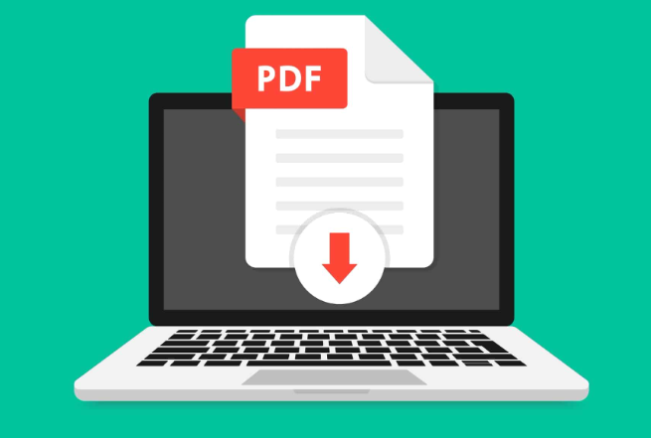
Abstract
Overview: The PDF Translator application allows users to upload PDF documents and translate extracted text into various languages using Flask and Google Translate [4].
User Interface: It features a simple and responsive design with a home page and a translation page, styled with Bootstrap and custom CSS for enhanced usability.
Technical Functionality: The application uses PyMuPDF [3] for text extraction and Googletrans [4] for translation, displaying the translated text after submission.

Slide 7
Objective
The objective of this project is to develop a tool that can read text-based PDF files, translate the extracted text into a selected language, and displays the translated text while preserving the original formatting.
01
02
Text-Based
Multi Languages
03
Translate

Slide 8
Design and Implementation
Client Side (Browser)
Design:
Frontend: Simple HTML pages for file upload and language selection.
Backend: Flask handles routing , PyMuPDF [3] extracts text, and Googletrans [4] translates.
Flask Server
PyMuPDF for Extraction Text
Googletrans for Translation
Render Text

Slide 9
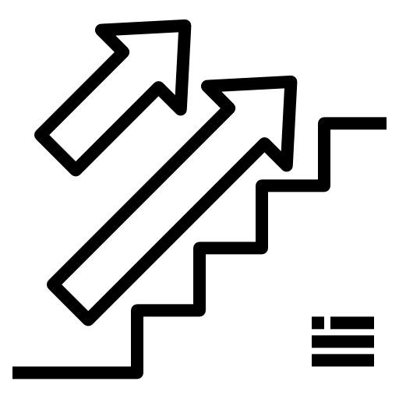
Methodology
User Input : Uploads PDF and selects translation language.
File Handling : PDF saved temporarily for processing.
Text Extraction : PyMuPDF library extracts text from PDF.
Translation : Text is translated using Googletrans based on the selected language.
Output : Translated text displayed on result page.
Tools : Flask (backend), PyMuPDF (text extraction), Googletrans (translation)

Slide 10
Results
Initial Findings:
Successfully extracted text from multiple PDF formats.
Accurate translation across selected languages, with minor variations in language structure.
Interpretation:
Effectiveness: The app reliably handles diverse PDFs and translates text accurately.
Limitations: Complex layouts (e.g., tables) may affect extraction quality, highlighting areas for further enhancement.

Slide 11
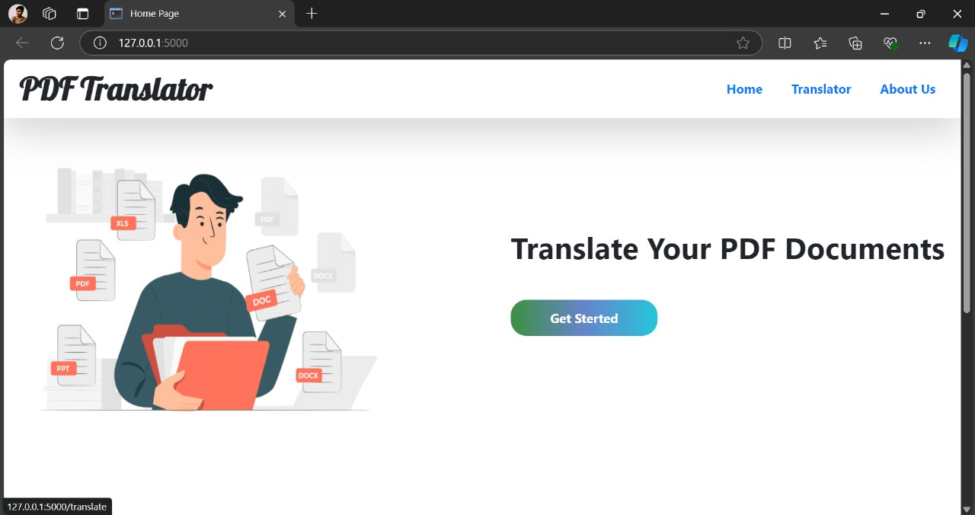
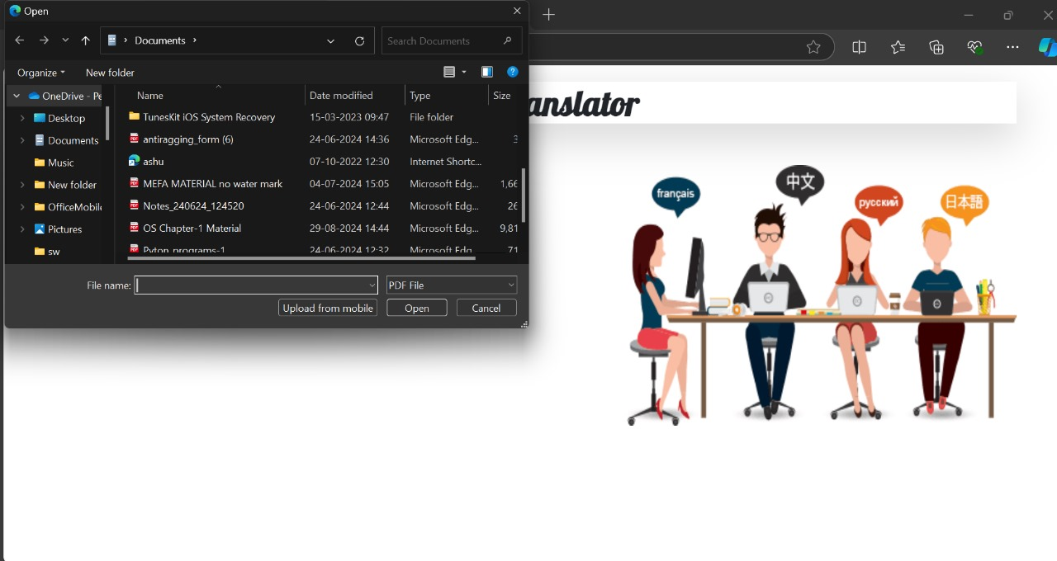
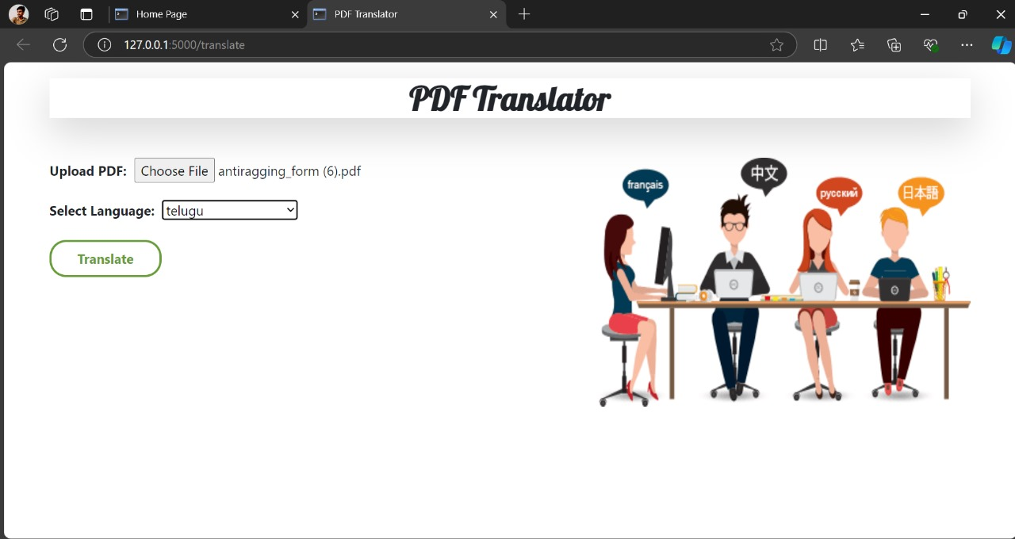
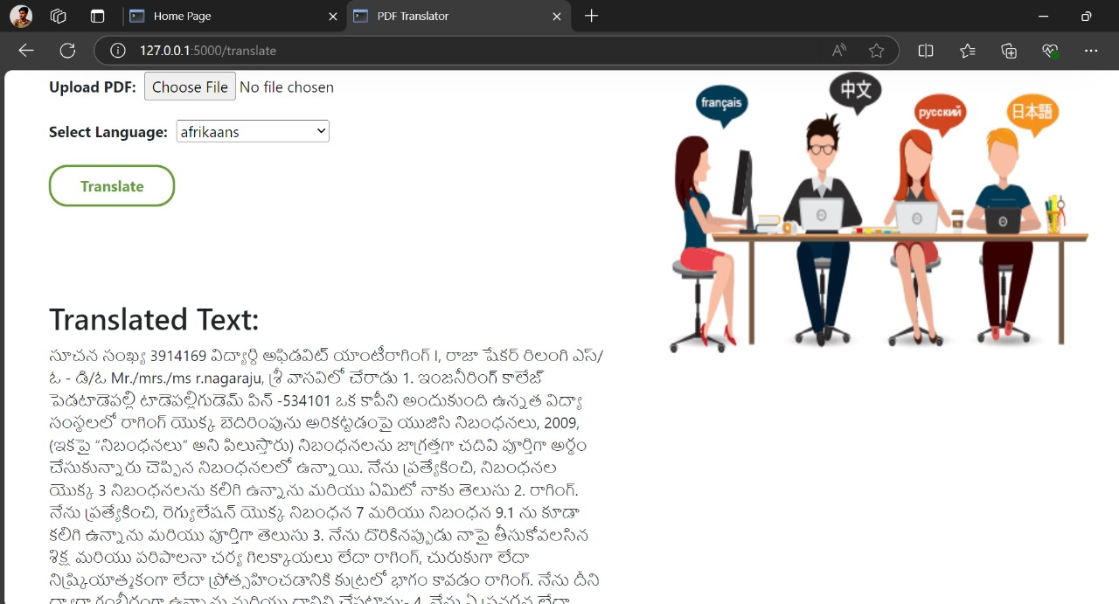
Application User Interface
.

Slide 12
Testing and Validation
UI Testing
File Compatibilty & Translation Accuracy
Outcomes
Functional Testing

Slide 13
Conclusion
Developed a Flask-based application for PDF text translation.
Integrated PyMuPDF for extraction and Googletrans for accurate language translation.
Successfully tested for functionality, usability, and edge cases.

Slide 14
Reference
[1] Narayan S. Adhikari et al. - A Benchmark and Evaluation for Text Extraction from PDF (IEEE Xplore)
[2] Jingchuan Luo et al. - PDFBoT: Extracting Body Text from Academic PDF Documents for Text Mining (dblp)
[3] PyMuPDF: https://pymupdf.readthedocs.io/
[4] Googletrans GitHub Repository: https://github.com/ssut/py-googletrans

Slide 15
THANK YOU

