Slide 1
ONLINE COURSE PORTAL FOR A UNIVERSITY
Rollno | Name
CB.EN.U4CSE18214 | R ASWATH SUNDAR
CB.EN.U4CSE18230 | KAILAASH B
CB.EN.U4CSE18202 | S AAKASH MUTHIAH
CB.EN.U4CSE18218 | DHARUN VENKATESH M
Section: CSE-C Faculty in Charge: K.BINDU

Slide 2
Overview
Introduction
Abstract
Logical Database Design ER Diagram
Entities
Attributes
Relationships
ER to Relational Schema Mapping
User Interface Screens
References

Slide 3
Introduction
With the humongous growth of computer technology, our lives are
becoming complex too. So exploiting the computer technology to
solve our day to day life problem has become the most efficient
solution. One of such scenarios is maintaining course portals in
educational institutions. Manually keeping track of every student’s
academic record in each course is far beyond human capability. Hence
developing and maintaining an online course portal prove to be
beneficial for students and faculties to review their works respectively,
allow faculties to grade their students and upload study materials
which can later be accessed by their students.

Slide 4
Abstract
This project aims at creating a course portal for a campus/institution.
This allows registered users of the system to join a course available on
the site and access the materials published for the course. Registration
to a course can be done either as a faculty or a student. When a user
registers himself as a faculty, an approval request will be sent to the
administrator, so that the administrator can verify the user as a faculty.
The details about the course and the study materials respective to the
course are uploaded by the faculties in their course portal which can
later be accessed by the students from their portals.

Slide 5
Abstract
Discussion Boards are made available for both the faculties and students for each course
where there can share their ideas and faculties can make
announcements. Tests can be created and conducted on the portal by
the faculties. There will be a grade-book section where students can
take up the tests and view their scores immediately as they complete
the tests. Students can express their opinion and provide feedback on
the course and faculties in the course feedback section.

Slide 6
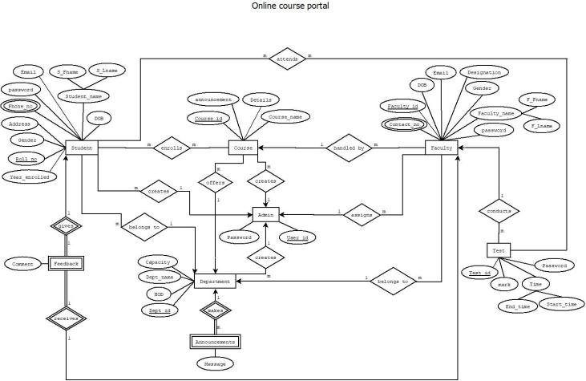
ER diagram

Slide 7
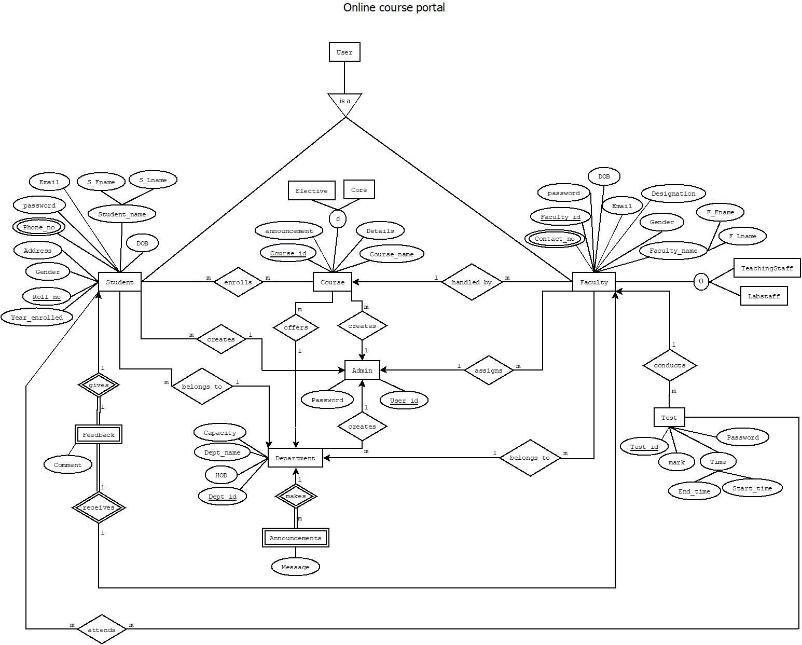
EER diagram

Slide 8
ER diagram -Entities
Student
Course
Faculty
Test
Announcements
Department
Feedback
Admin

Slide 9
ER diagram -Attributes-Student
Roll no
Year_enrolled
Gender
Address
Phone_no
Email
password
S_Fname
S_Lname
DOB

Slide 10
ER diagram -Attributes-Course
Course_id
Details
announcement
Course_name

Slide 11
ER diagram -Attributes-Faculty
Contact _no
Gender
F_Fname
F_Lname
password
DOB
Faculty_id
Designation
Email

Slide 12
ER diagram -Attributes-Test
Test-id
Password
Start_time
End_time
mark

Slide 13
ER diagram -Attributes-Announcements
Message

Slide 14
ER diagram -Attributes-Department
Department_id
Department_name
Capacity
HOD

Slide 15
ER diagram -Attributes-Feedback
Comment

Slide 16
ER diagram -Attributes-Admin
User_id
Password

Slide 17
ER diagram -Relationships
Students enroll courses
Student gives feedback
Students belong to department
Students attendt tests
Courses handles by faculty
Courses offered by department
Department makes announcements

Slide 18
ER diagram -Relationships
Faculty belongs to Department
Faculties receive feedback
Faculties conduct test
Admin Creates courses
Admin assigns faculty
Admin creates students
Admin creates Department

Slide 19
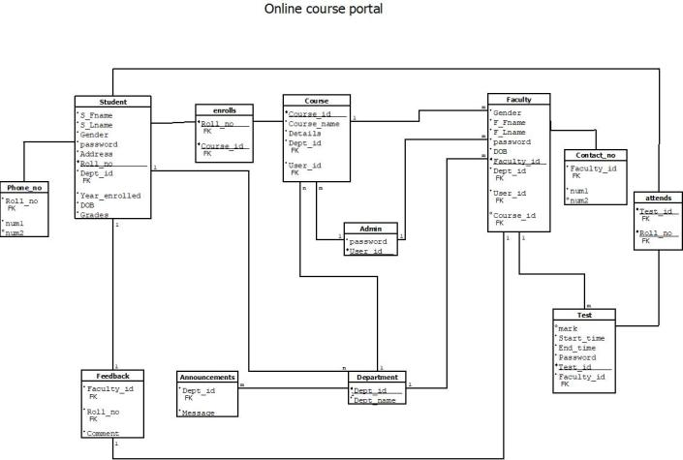
ER to Relational Schema Mapping

Slide 20
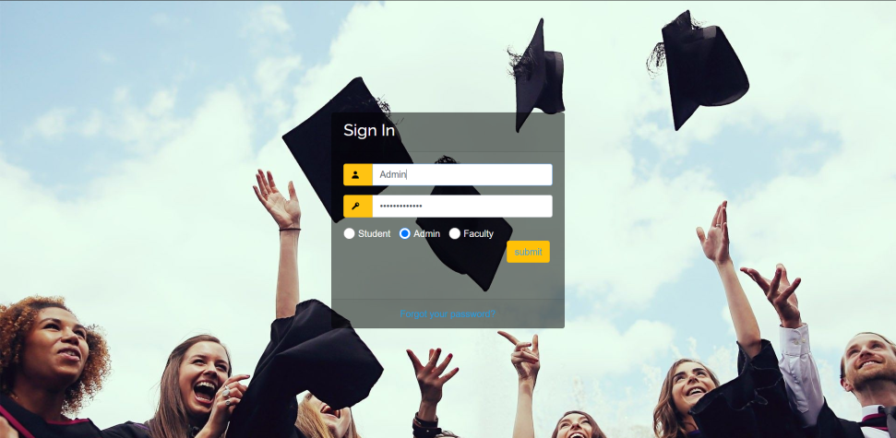
User Interface Screens

Slide 21
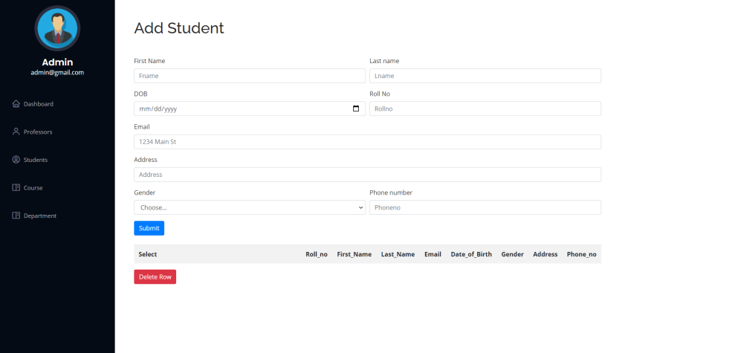
User Interface Screens

Slide 22
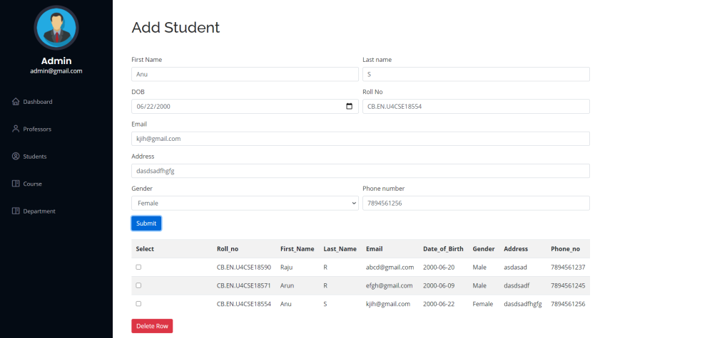
User Interface Screens

Slide 23
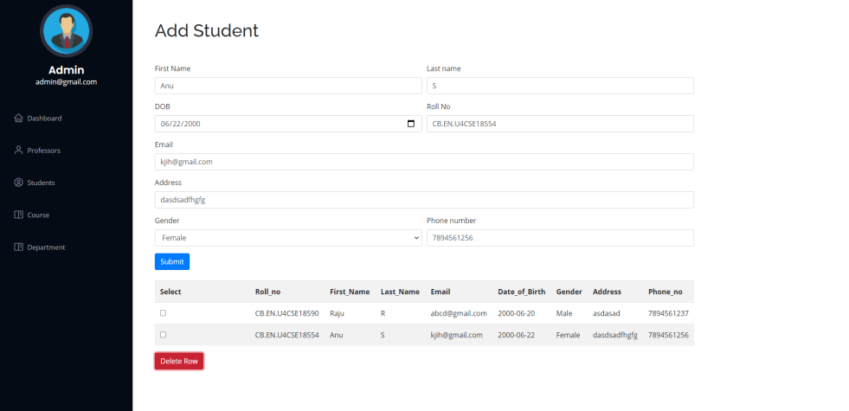
User Interface Screens

Slide 24
References
Books reference:
Abraham Silberschatz, Henry F. Korth and S. Sudarshan, Database Systems Concepts. 7th edition. New York, NY: McGraaw-Hill, [2020]
Websites reference:
https://getbootstrap.com/docs/4.5/getting-started/introduction/
https://www.w3schools.in/dbms/er-model/

Slide 25
Thankyou
Questions

