Slide 1
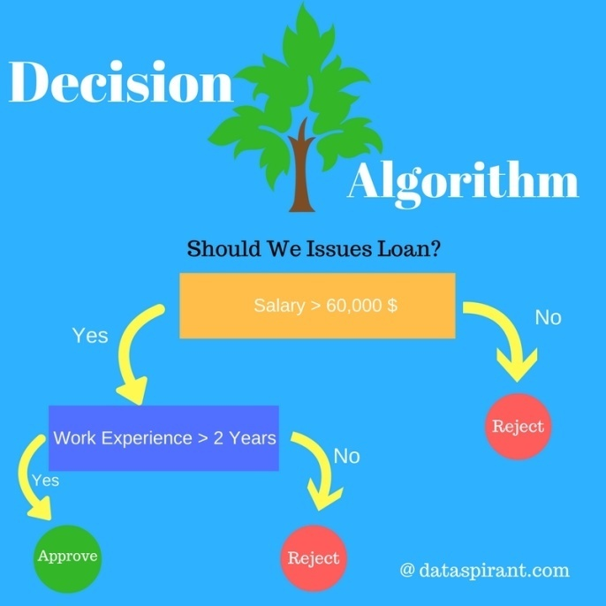
Decision Tree
Aswath Rao V S( 16PD05 )
Ridhanya M ( 16PD28 )

Slide 2
Introduction
It belongs to the family of supervised learning algorithms
Used for solving regression and classification problems
Overview of using Decision Tree is to create a training model which can use to predict class of target variables using learning decision rules ( If then rules )learned from training data.
It uses a tree like model to classify/predict the target values.
Internal node of the tree denotes to an attribute, and each leaf node corresponds to a class label.

Slide 3
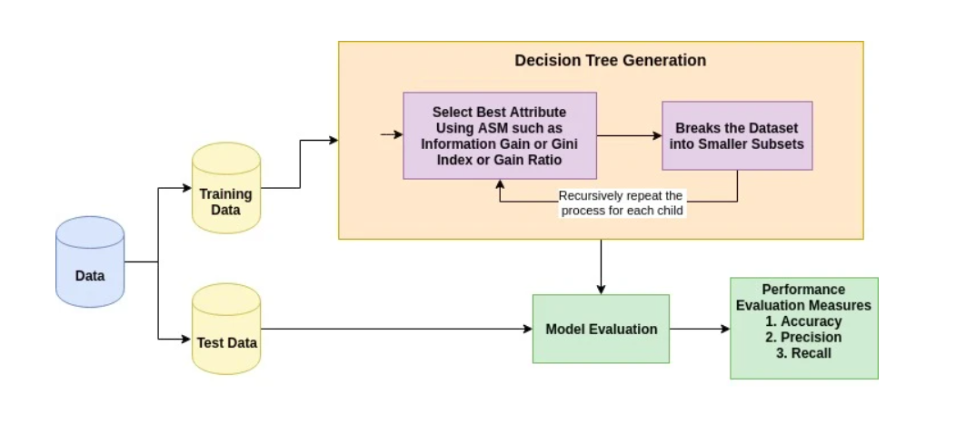

Slide 4
Model building
There are couple of algorithms there to build a decision tree , we only talk about a few which are
CART (Classification and Regression Trees) → uses Gini Index(Classification) as metric.
ID3 (Iterative Dichotomiser 3) → uses Entropy function and Information gain as metrics.

Slide 5
Assumptions while creating Decision Tree
At the beginning, the whole training set is considered as the root node.
Feature values are preferred to be categorical. If the values are continuous then they are discretized before to building the model.
Records are distributed recursively on the basis of attribute values.
Order to placing attributes as root or internal node of the tree is done by using some statistical approach.

Slide 6
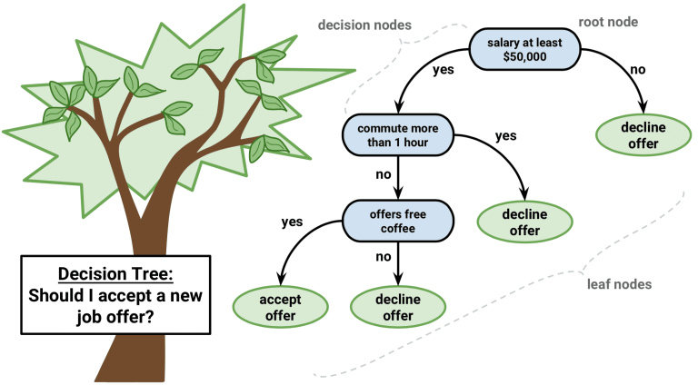
Pseudocode
Best attribute is placed at the root of the tree.
Split training set into subsets. Each subset should contain data with the same value for an attribute.
Repeat above steps on each subset until we get leaf nodes in all the branches of the tree.
For predicting, we start from the root . We compare the values of root attribute with record’s attribute and we follow the branch corresponding to that value and jump to the next node.

Slide 7
Attribute selection
The primary challenge in implementation is to identify which attributes do we need to consider as the root node and each level. Handling this is know the attributes selection.
The popular attribute selection measures:
Information gain and Gini index
These criterions will calculate values for every attribute. The values are sorted, and attributes are placed in the tree by following the order i.e, the attribute with a high value(in case of information gain) is placed at the root.
While using information Gain as a criterion, we assume attributes to be categorical, and for gini index, attributes are assumed to be continuous.

Slide 8

Information Gain
It quantifies by how much information does the attribute gives
Entropy – degree of randomness explained by attribute x
For example consider, binary classification problem with two classes positive and negative
If all target varaibles are positive or are negative then entropy will be zero
If half of the records are of positive class and half are of negative class then entropy is one i.e, high.
Using entropy we will calculate conditional entropy and then Information gain.

Slide 9
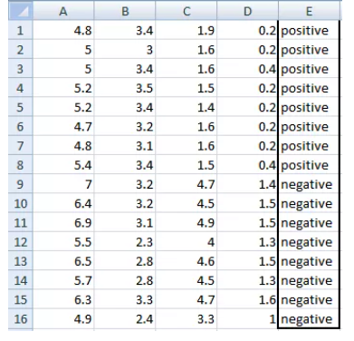
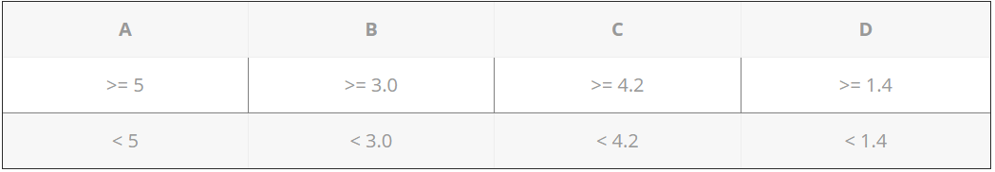
Example
Here in this example
we have 5 columns with last one as target
we have to convert continuous data
into categorical data to predict
There are two steps to calculate
Calculate entropy of Target.
Entropy for every attribute A, B, C, D needs to be calculated. Using information gain formula we will subtract this entropy from the entropy of target. The result is Information Gain.

Slide 10
Entropy of target
Number of positives = 8
Number of negatives = 8
As both are same, entropy is 1
Information gain for Variable A
A has value >=5 for 12 records out of 16 and 4 records with value <5 value.
For A >= 5 & class == positive: 5/12
For A >= 5 & class == negative: 7/12
gini(5,7) = 1- ( (5/12)2 + (7/12)2 ) = 0.4860
For A <5 & class == positive: 3/4
For A <5 & class == negative: 1/4
gini(3,1) = 1- ( (3/4)2 + (1/4)2 ) = 0.375

Slide 11
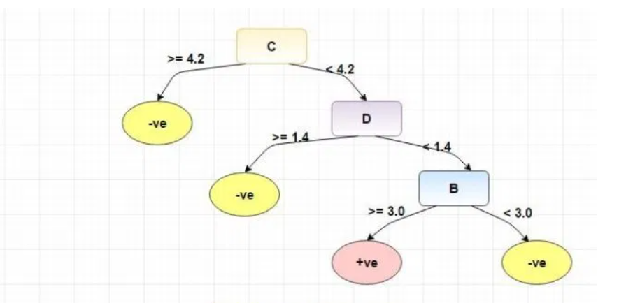
Similarly we calculate and get B = 0.3345, C = 0.2, D = 0.27
To avoid over fitting, we can use post or pre pruning techniques
Pruning is the process of reducing the size of the tree by turning some branch nodes into leaf nodes, and removing the leaf nodes under the original branch.

Slide 12
Disadvantages
There is a high probability of over fitting in Decision Tree.
Generally, it gives low prediction accuracy for a dataset as compared to other machine learning algorithms.
Information gain in a decision tree with categorical variables gives a biased response for attributes with greater no. of categories.
Calculations can become complex when there are many class labels.

