Slide 1
Infobasic -2
September 2011
Notes:
© 2006 Capgemini - All rights reserved
0

Slide 2
Objective
At the end of this session, participants will
Appreciate features of file operations in T24 routines
Appreciate features of sequential file access in T24 routines

Slide 3
Why File Operations?
Records of T24 application needs to be written/read
Programming made easier

Slide 4
Various File Operation
OPF
F.READ
F.WRITE
EB.READLIST
READ
WRITE

Slide 5
File Operations Usage Procedure
Write the code i.e. program/subroutine in jEditor
Compile the program/subroutine in jshell prompt, using EB.COMPILE <Filename> <Program/Subroutinename>
Make a PGM entry with M or S as type, and EB as product
Run the subroutine in T24 prompt
Notes:
PGM entry:
Type: M -> Mainline program
S -> Subroutine
Product: EB -> Specification of standard Globus alpha-numeric field

Slide 6
OPF
Used to open a file for reading/writing purpose
Has 2 parameters passed
Syntax:
CALL OPF(Filename,Filepointer)
Where,
Filename : Name of the file E.g. FBNK.CUSTOMER
Filepointer : Pointer/Path to the file
Notes:
NOTE:
File pointer is initialized with null value and at the time of execution it will be assigned to the path of the file.

Slide 7
OPF
Programming Flow
<Initialize variables FN.CUSTOMER,F.CUSTOMER,….>
<Open the file using OPF>
i.e. CALL OPF(FN.CUSTOMER,F.CUSTOMER)

Slide 8

T24 API
T24 APIs
API stands for Application Programming Interface
Wrappers around jBC commands
Subroutines
Executed from within T24 (Not from the jsh prompt)
Can make use of T24 APIs.
F.READ
OPF
T24 APIs
READ
OPEN
Jbc Commands

Slide 9

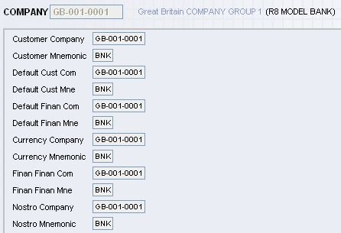
Internal working of OPF
What is the mnemonic of the current company?
BNK
Checks if file type and file open buckets have data
FIN
yes
NO
Reads the file type and file open from the bucket memory
Read FILE.CONTROL with ID :ACCOUNT
Obtain file classification
FIN
INT
File classification?
CUS
COMPANY-EB.COM.FINANCIAL.MNE
FN.ACC : FBNK.ACCOUNT
F.ACC = ‘’
COMPANY-EB.COM.CUSTOMER.MNEMONIC
FN.ACC : FBNK.ACCOUNT
F.ACC = ‘’
No prefix
FN.ACC : F.ACCOUNT
F.ACC = ‘’
Open the file using the jBASE OPEN command
Extract path of data file and place it in the file open bucket
F.ACC = ../bnk.data/ac/FBNK.ACCOUNT
Store file details in memory for future use
File requested : F.ACCOUNT
Actual File Name : FBNK.ACCOUNT
File Type Bucket: FIN
File Open Bucket : ../bnk.data/ac/FBNK.ACCOUNT
Notes:
The OPF routine checks for the file classification in FILE.TYPE bucket, if the FILE.TYPE bucket does not contains the file classification then if reads the FILE.CONTROL and obtains the file classification. The OPF executes jBASE OPEN command and extracts the data file path and loads FILE.OPEN bucket.
Thus the file classification and file path are available in FILE.TYPE and FILE.OPEN bucket.

Slide 10

Execute the same code again from the same session
Locate in memory - File F.ACCOUNT
Found
What is the file classification of the file?
File requested : F.ACCOUNT
Actual File Name : FBNK.ACCOUNT
File Classification Bucket : FIN
File Path Bucket : ../bnk.data/ac/FBNK.ACCOUNT
File Classification?
FIN
INT
CUS
COMPANY-EB.COM.FINANCIAL.MNE
FN.ACC : FBNK.ACCOUNT
F.ACC = ‘’
COMPANY-EB.COM.CUSTOMER.MNEMONIC
FN.ACC : FBNK.ACCOUNT
F.ACC = ‘’
No prefix
FN.ACC : F.ACCOUNT
F.ACC = ‘’
Check if FBNK.ACCOUNT is in OPF’s memory
Populate F.ACC with path of the file name
F.ACC = ../bnk.data/ac/FBNK.ACCOUNT
FN.ACC = FBNK.ACCOUNT
F.ACC = ../bnk.data/ac/FBNK.ACCOUNT
Note that the file has not been opened again using the jBC command OPEN
Notes:
In the same session when OPF is performed for again the File classification and File path are available in the FILE.TYPE and FILE.OPEN bucket. Thus OPF need not executes the jBASE OPEN command again as the file classification and file path are already available in respective buckets.

Slide 11
Login to another company (CO2) and execute the same code
What is the mnemonic of the current company?
BNK
Checks if file type and file open buckets have data
FIN
File Type Bucket already has the File classification
Next step is load the FILE OPEN bucket with CO2 data file path
Open the file using the jBASE OPEN command
Extract path of data file and place it in the file path variable
F.ACC = ../bnk.data/ac/FBNK.ACCOUNT
File requested : F.ACCOUNT
File Type Bucket: FIN
File Path : ../bnk.data/ac/FBNK.ACCOUNT
Actual File Name : FBNK.ACCOUNT,FCO2.ACCOUNT
Store file details in memory for future use
File Open Bucket : ../bnk.data/ac/FBNK.ACCOUNT,../bnk.data/ac/FCO2.ACCOUNT
Notes:
In the same session another company is logged and an OPF is performed, the File Classification is available in FILE TYPE bucket as OPF was already performed for another company. jBASE OPEN command is executed and the data file path is extracted and stored into FILE OPEN bucket.

Slide 12
Login to another company (CO2) and execute the same code
What is the mnemonic of the current company?
BNK
Checks if file type and file open buckets have data
FIN
File Type Bucket already has the File classification
Next step is load the FILE OPEN bucket with CO2 data file path
Open the file using the jBASE OPEN command
Extract path of data file and place it in the file path variable
F.ACC = ../bnk.data/ac/FBNK.ACCOUNT
File requested : F.ACCOUNT
File Type Bucket: FIN
File Path : ../bnk.data/ac/FBNK.ACCOUNT
Actual File Name : FBNK.ACCOUNT,FCO2.ACCOUNT
Store file details in memory for future use
File Open Bucket : ../bnk.data/ac/FBNK.ACCOUNT,../bnk.data/ac/FCO2.ACCOUNT
Notes:
In the same session another company is logged and an OPF is performed, the File Classification is available in FILE TYPE bucket as OPF was already performed for another company. jBASE OPEN command is executed and the data file path is extracted and stored into FILE OPEN bucket.

Slide 13
F.READ
Used to read record from file that is already opened using OPF
Has 5 parameters passed

Slide 14
F.READ
Syntax:
CALL F.READ(Filename,record.id,dynamic.array,File.var,Error.var)
Where,
Filename : File Name
Record.id : ID of the record to be read
Dynamic.array : Dynamic array that will hold read record
File.var : File Path
Error.var : Error Variable

Slide 15
F.READ
Programming Flow
<Initialize variables FN.CUSTOMER,F.CUSTOMER,….>
<Open the file using OPF>
<Read the record using F.READ>
i.e. CALL F.READ (FN.CUSTOMER,Y.CUSTOMER.ID,R.CUSTOMER,
F.CUSTOMER,Y.CUS.ERR)

Slide 16
Internal working of F.READ
Is the file pointed by FN.ACC open?
Perform OPF and open the file
File name : FBNK.ACCOUNT
Record Id : 11967
Record : xxxxxxxxx
No
Yes
Check if the record is in memory
Database
No
Read record from database using jBC command READ
R.ACCOUNT = Actual account record
FBNK.ACCOUNT
11967
10014
22117
Load record on to memory

Slide 17
F.WRITE
Used to write details onto a record of a file
Before writing, open a file and read the record
Has 3 parameters

Slide 18
F.WRITE
Syntax:
CALL F.WRITE(Filename, Record.id, Dynamic array)
Where,
Filename : File Name
Record.id : Record to be written
Dynamic array : Array holding the values to be written on record

Slide 19
F.WRITE
Programming Flow
<Initialize variables FN.CUSTOMER,F.CUSTOMER,….>
<Open the file using OPF>
<Read the record using F.READ>
<Assign the value to the dynamic array which we are going to write>
i.e. CALL F.WRITE (FN.CUSTOMER,Y.CUSTOMER.ID,R.CUSTOMER)

Slide 20
T24 API – F.WRITE
F.WRITE
WRITE
F.WRITE – Write a record to the database
Syntax
Example
CALL F.WRITE(Filename,Key,Record)

Slide 21
Example
Write a subroutine that will display the details
(Id, Mnemonic and Nationality) of a customer
whose id is 100037
Notes:
Algorithm
Step 1. Open the customer file
Step 2. Read the customer file and extract the record with
id 100037
Step 3. From the extracted record obtain the mnemonic
and nationality
Step 4. Display the customer id, mnemonic and
nationality

Slide 22
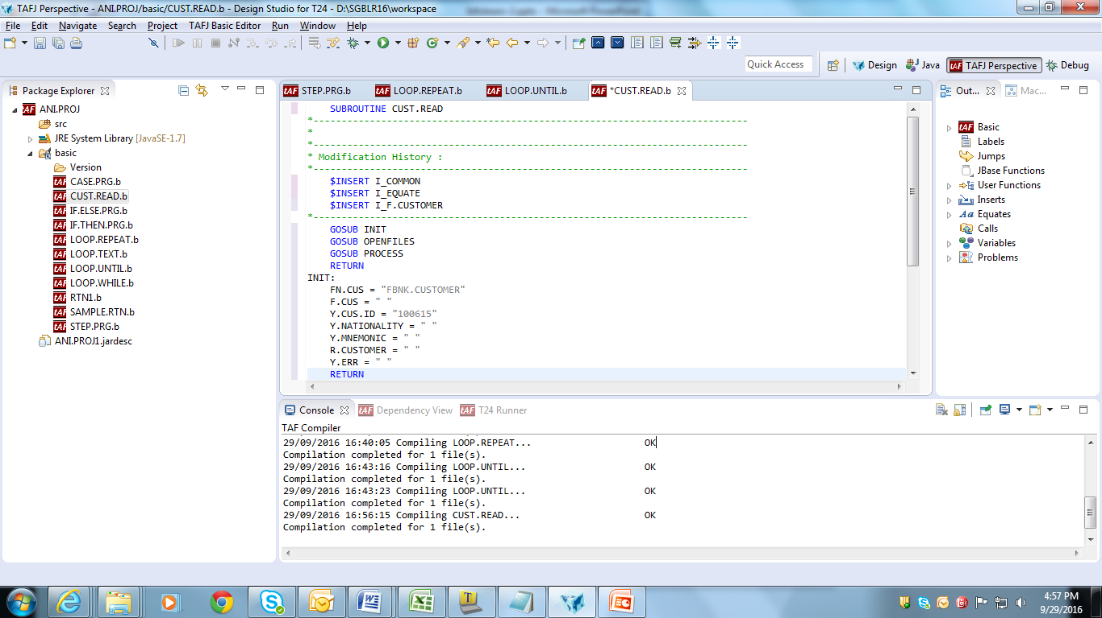
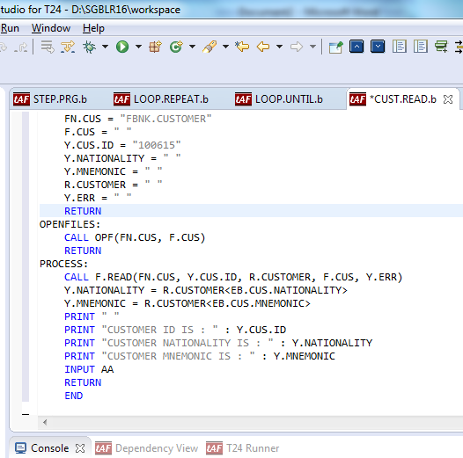
Solution
Write a subroutine as shown:
Insert file

Slide 23
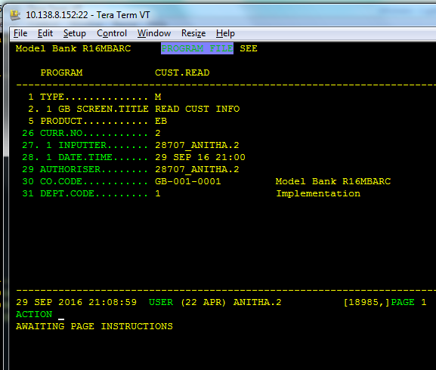
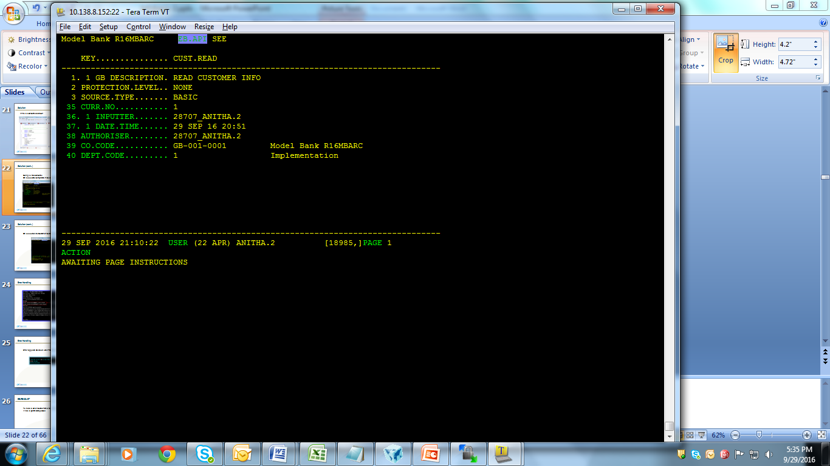
Solution (cont..)
Compile the subroutine
On successful compilation, make a PGM entry of the subroutine

Slide 24
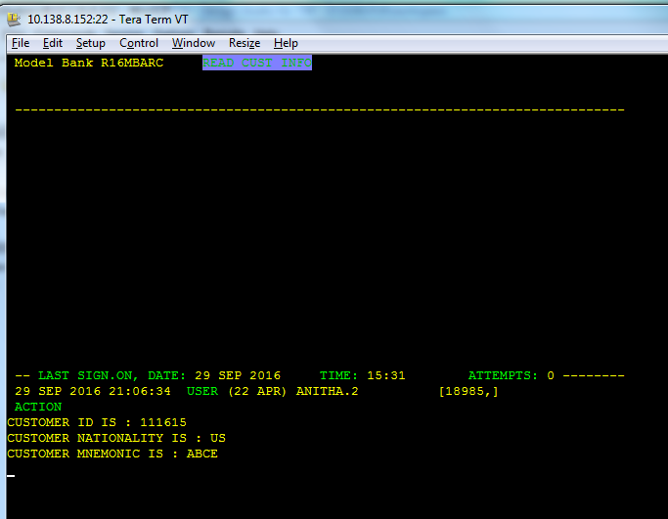
Solution (cont..)
On execution, the Customer record is opened, read and displayed

Slide 25
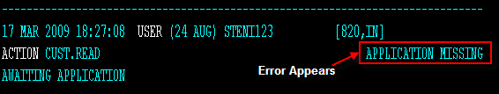
Error Handling
Error appears as shown, when PGM entry is not available for the subroutine

Slide 26
EB.READLIST
To read a set of records from a file we use this core routine
It has 5 parameters passed

Slide 27
EB.READLIST
Syntax:
CALL EB.READLIST(1,2,3,4,5 )
Where,
1 : Select Query
2 : List variable that contains only the ID of the selected records
3 : Id of the SAVEDLISTS file (Optional)
4 : No of Records selected (Total Count)
5 : Return code

Slide 28
EB.READLIST
Example
<Initialize File name FN.CUSTOMER>
SEL.CMD = “SELECT “:FN.CUSTOMER
CALL EB.READLIST(SEL.CMD,SEL.LIST,’’,NO.OF.RECORDS,RET.CODE)
Notes:
Conditions can also be given during file selection, e.g. SEL.CMD = “SELECT “:FN.CUSTOMER SECTOR =1001

Slide 29
REMOVE
Function that is used to extract a value from a dynamic array

Slide 30
REMOVE
SYNTAX:
REMOVE <var> FROM <array> SETTING <set var>
Var : variable which holds the extracted string
Array : Dynamic array from which the string is to be extracted.
Set var : Delimiter by which string is extracted from array.
(2 – FM, 3 – VM, 4 – SM, 0 – End of array)

Slide 31
Example
Write a subroutine that will changes the Account officer from 2 to 1 and display the details (Customer, Mnemonic, Old Acct officer and New Acct officer) for all customers

Slide 32
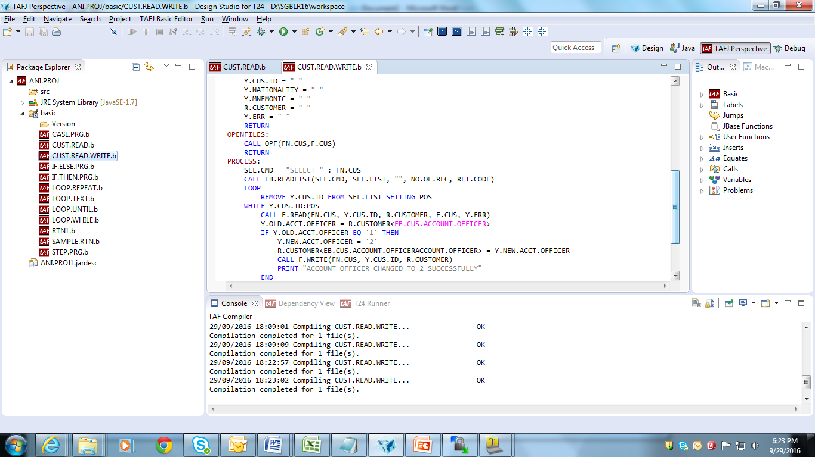
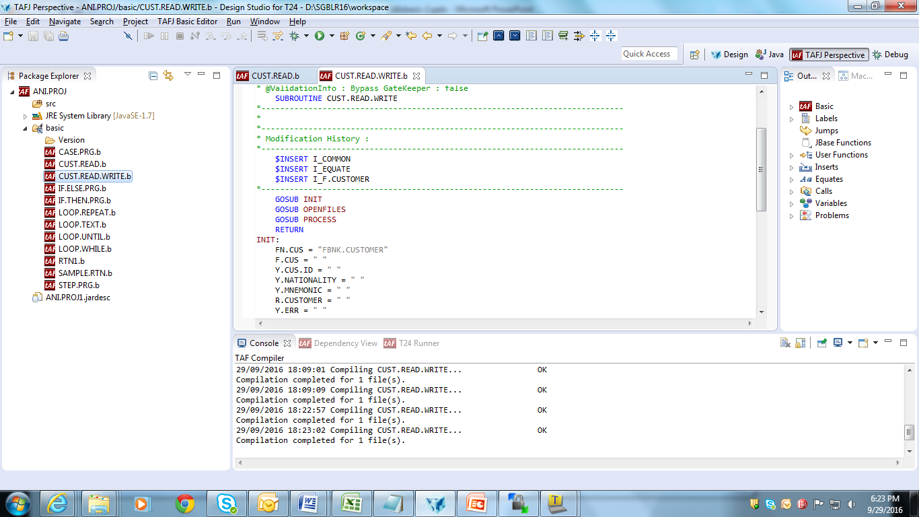
Solution (cont..)

Slide 33
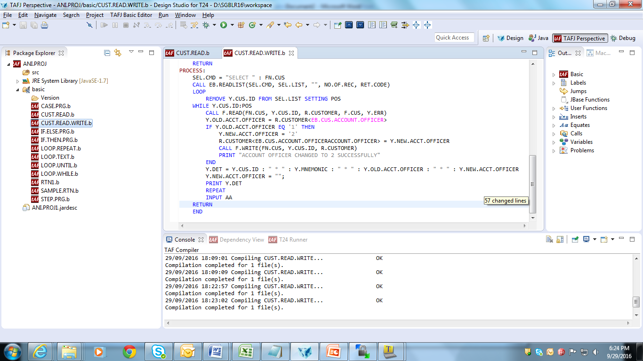
Solution (cont..)

Slide 34
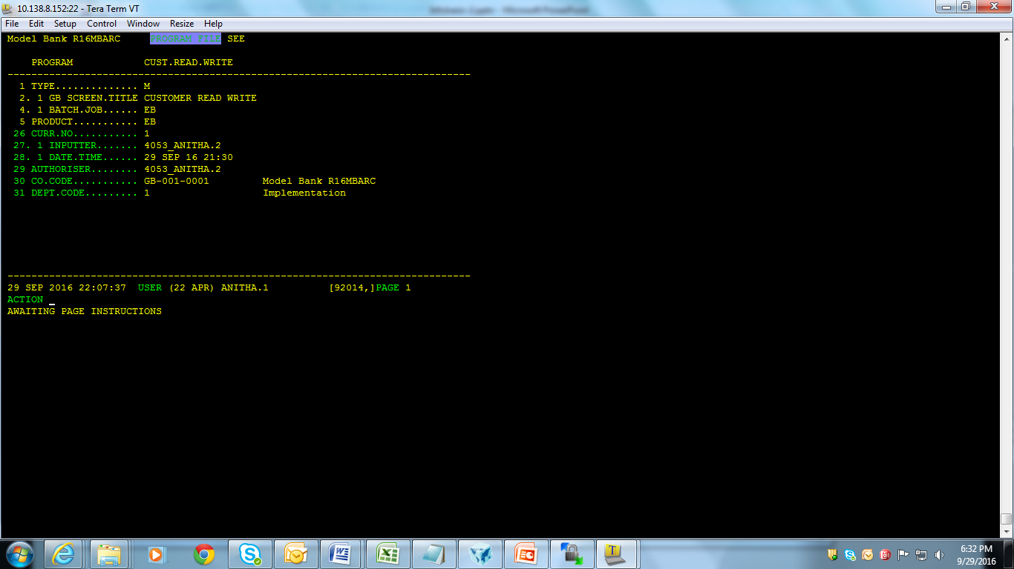
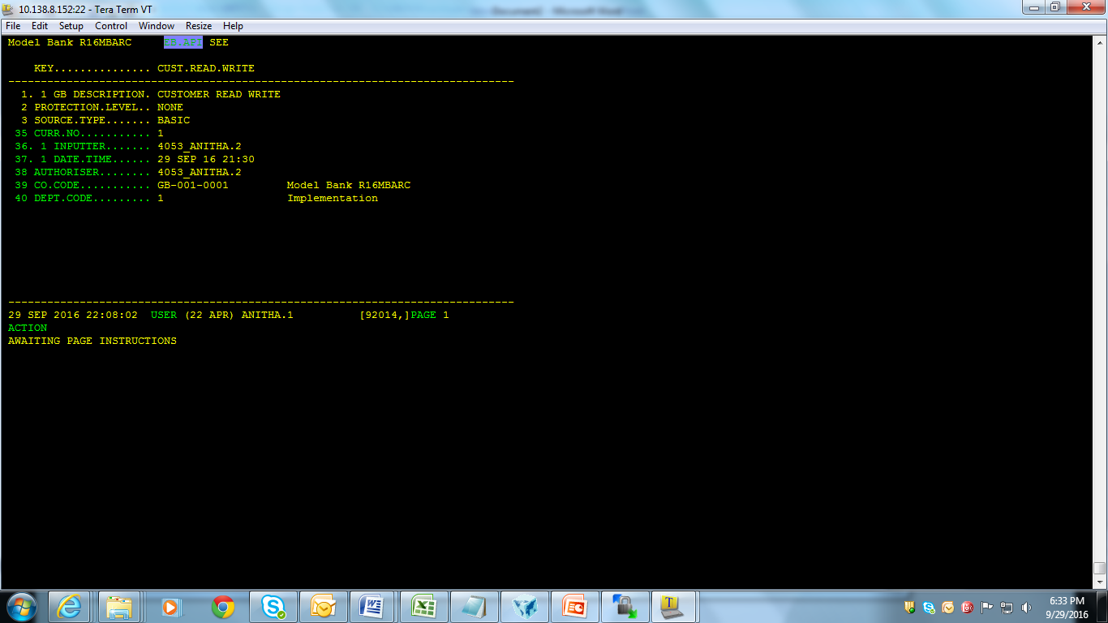
Solution (cont..)
Compile & catalog the subroutine
Make an entry in Program file for the subroutine

Slide 35
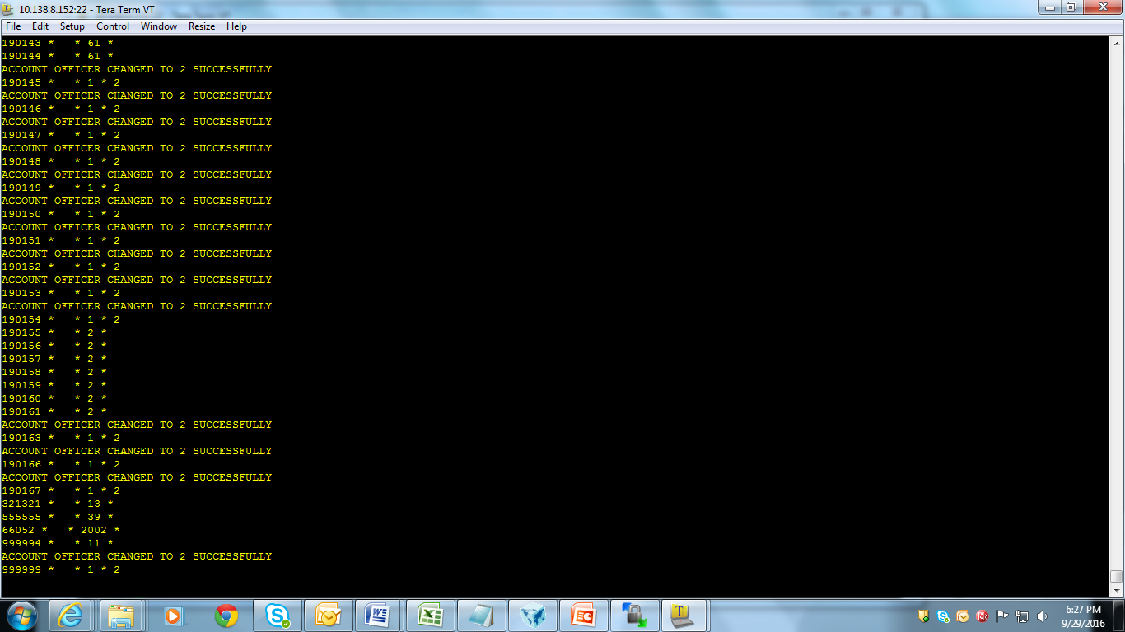
Solution (cont..)
Customer records are read from list, and Account Officer field value is changed and displayed

Slide 36
READ
Used to read a record from a file
Syntax:
READ variable1 FROM { variable2,} expression {SETTING setvar} {ON
ERROR statements} THEN|ELSE statements
Where,
Variable1 – Identifier into which record will be read
variable2 – jBC variable that is previously opened to a file using OPEN statement

Slide 37
Difference b/w FREAD and READ
FREAD | READ
Reads the buffer first and executes if the required data is in buffer, else checks for the required data in the server and executes | Directly checks for the required data in the server all the time, without checking buffer and executes

Slide 38
Example
Write a program to read a customer record based on input customer ID, and to print message “Record read successfully” or “Record not on file”

Slide 39
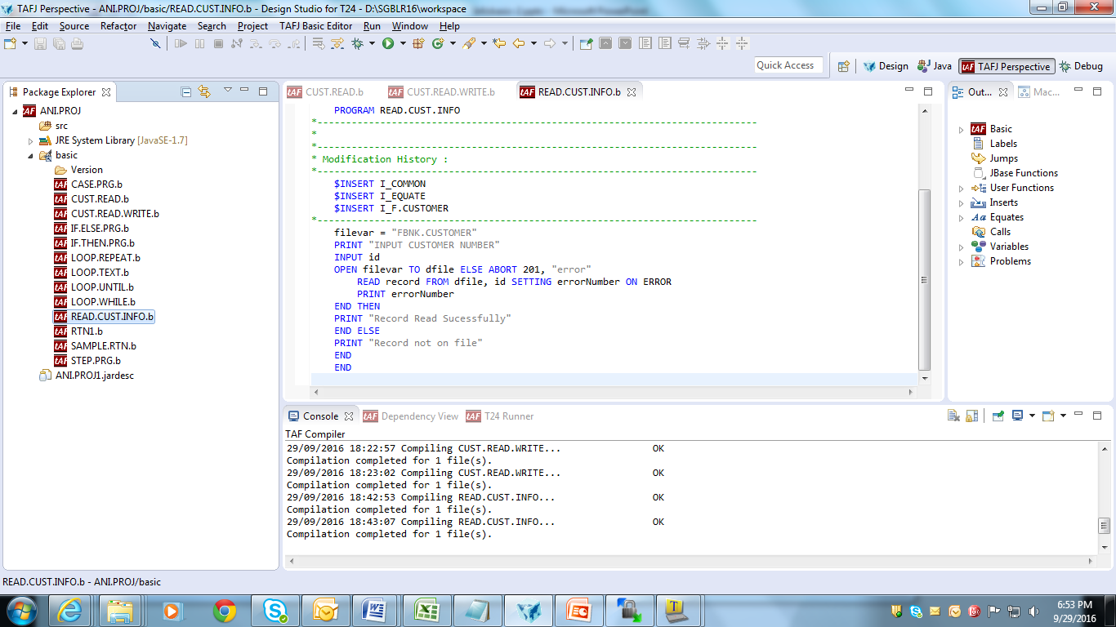
Solution

Slide 40


Solution (cont..)

Slide 41
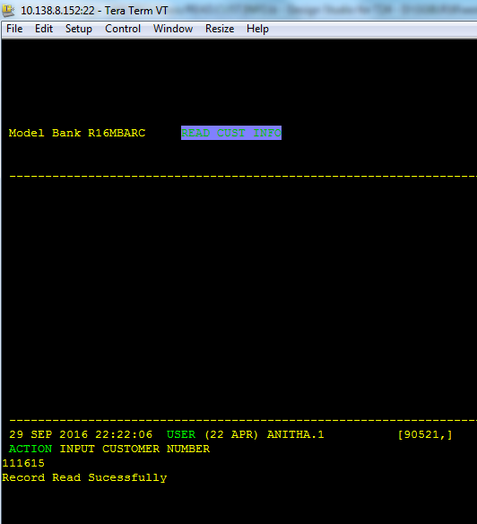
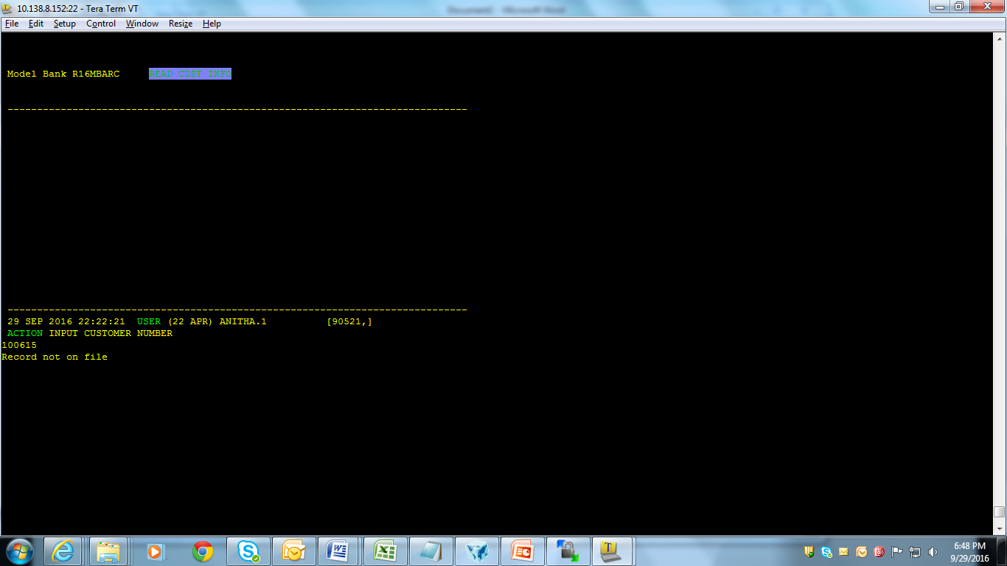
Solution (cont..)
Customer record is read and displayed

Slide 42
WRITE
Allows a program to write a record into a previously opened file
Syntax:
WRITE variable1 ON|TO { variable2,} expression {SETTING setvar} {ON ERROR statements}
Where,
variable1 – Identifier containing the record to write
variable2 – jBC variable previously opened to a file using the OPEN statement

Slide 43
Difference b/w FWRITE and WRITE
FWRITE | WRITE
Writes date into the buffer first, that's why sometimes we have to use JOURNAL.UPDATE | Writes data directly into the server

Slide 44
Example
Write a program
To check whether field ‘Town Country’ in Customer application has a value
If ‘Town Country’ has no value, then update it with ‘INDIA’

Slide 45
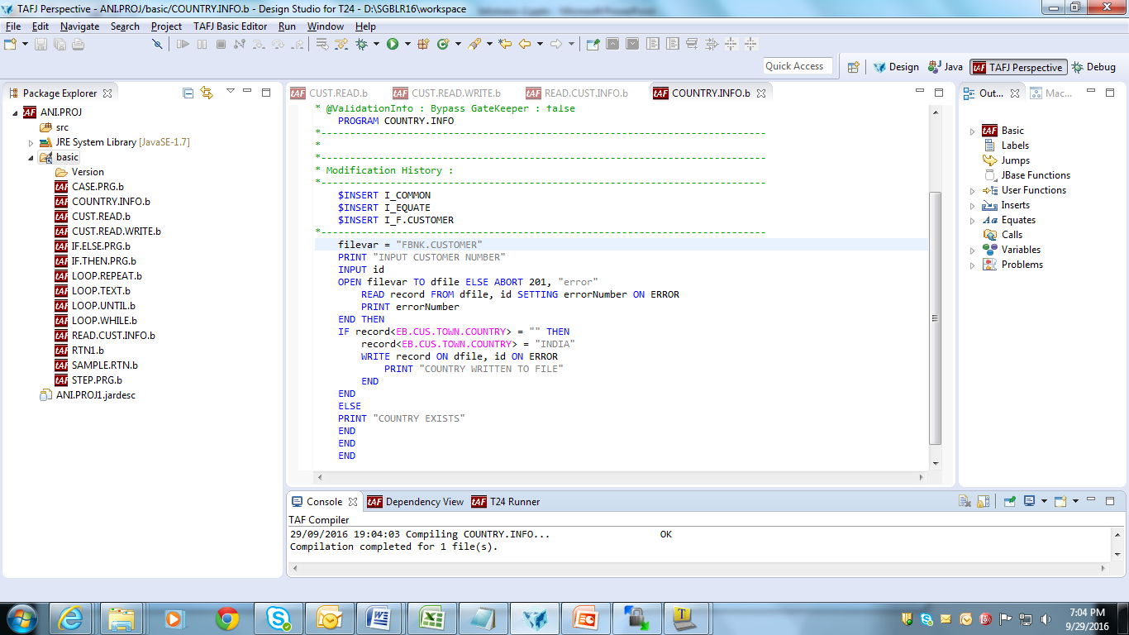
Solution

Slide 46
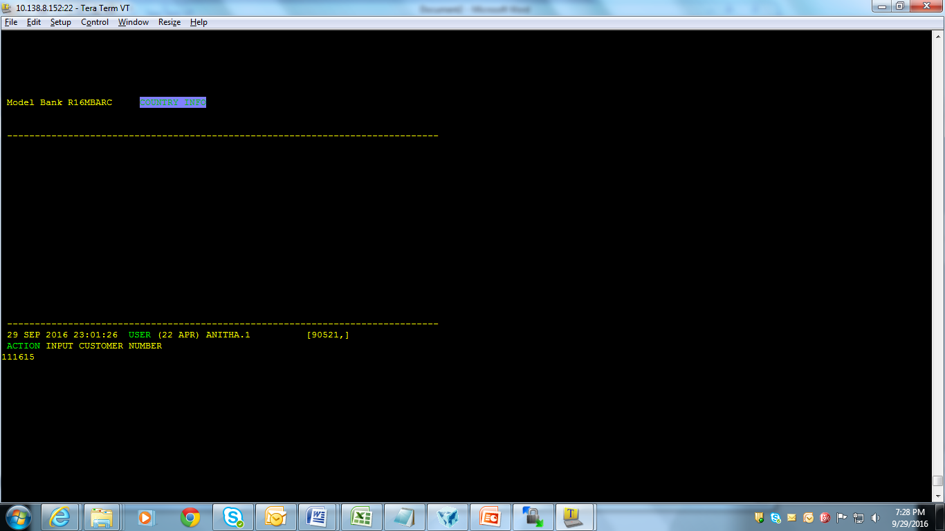
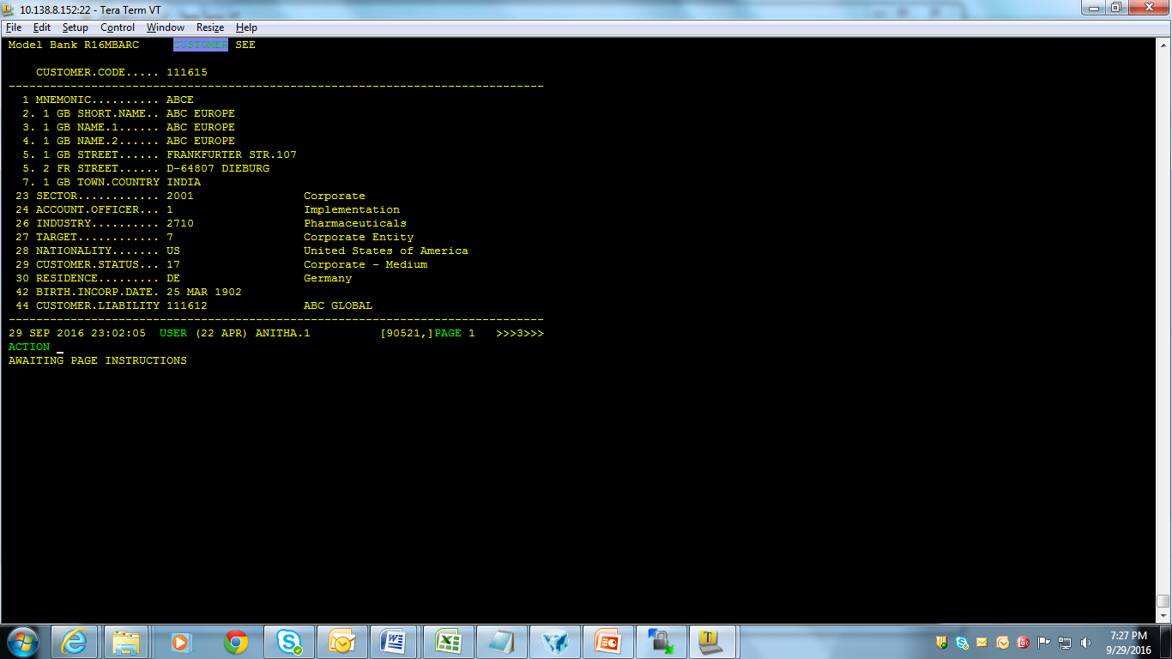
Solution (cont..)
Compile the program
Run the program & input customer number which is having NULL value in the field ‘Town country’

Slide 47
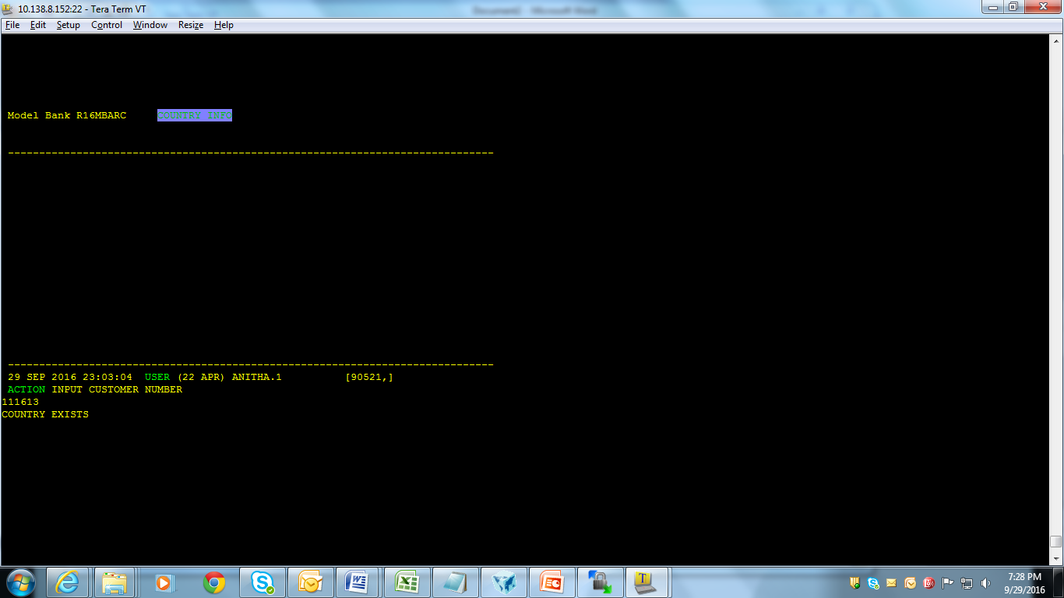
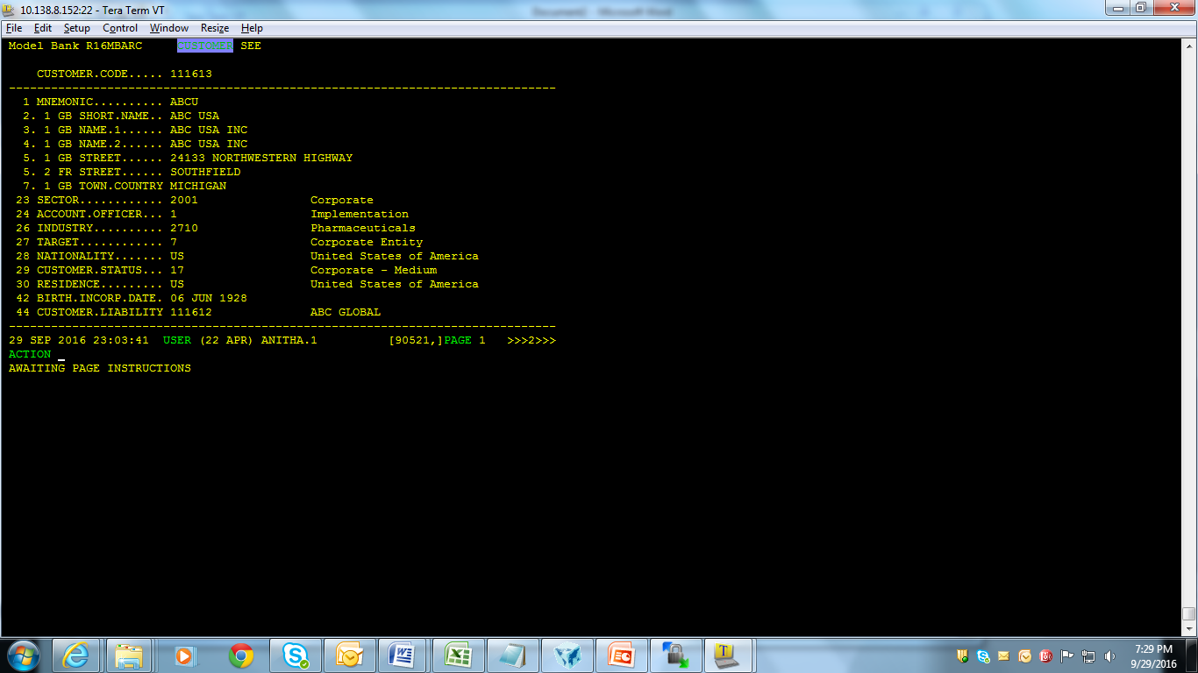
Solution (cont..)
Input Customer number having value in Town Country

Slide 48
Sequential File Access Commands
OPENSEQ – Opens a file for sequential writing or reading
READSEQ – Reads from file opened for sequential access
WRITESEQ – Writes data to file opened for sequential access

Slide 49
OPENSEQ
Syntax:
OPENSEQ Path{,File} {READONLY} TO FileVar { LOCKED statements } THEN | ELSE statements
Where,
Path: Specifies relative or absolute path of target file/directory
File: Specifies additional path information of target file
FileVar: Contains file descriptor of the file opened successfully
Statement: Conditional jBC statements

Slide 50
WRITESEQ
Syntax:
WRITESEQ Expression {APPEND} TO FileVar THEN | ELSE statements
(Or)
WRITESEQF Expression {APPEND} TO FileVar THEN | ELSE statements
Where,
Expression: Specifies the variable to contain next record from sequential file
Notes:
Before a file can be read, the file has to be created/written

Slide 51
Example:
Write a sequential processing to create a text file from a jBase non-hashed file

Slide 52
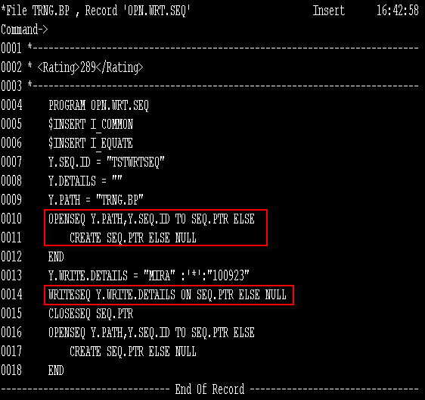
Solution
Notes:
Create a jBase non-hashed file called TRNG.BP
And write the program

Slide 53
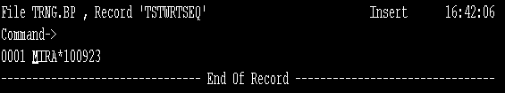
Solution (cont..)
Text file is created from jBase non-hashed file (TRNG.BP), using sequential processing

Slide 54
READSEQ
Syntax:
READSEQ Variable FROM FileVar THEN | ELSE statements
Where,
Variable: Specific variable to contain next record from sequential file
FileVar: Specific file descriptor of file opened successfully
Statement: Conditional jBC statement

Slide 55
Example
Write a program that uses sequential processing to a read an ASCII text file and write to a jBase non-hashed file

Slide 56
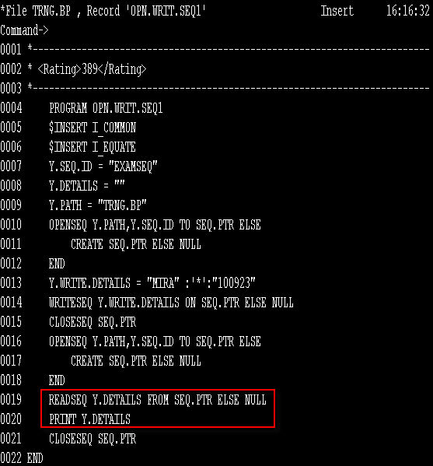
Solution

Slide 57

Solution (cont..)
An ASCII text file is read and written to a jBase non-hashed file

Slide 58
Workshop
Write a program using sequential processing to write a text file containing customer details and to read the text file from jBase non-hashed file

Slide 59
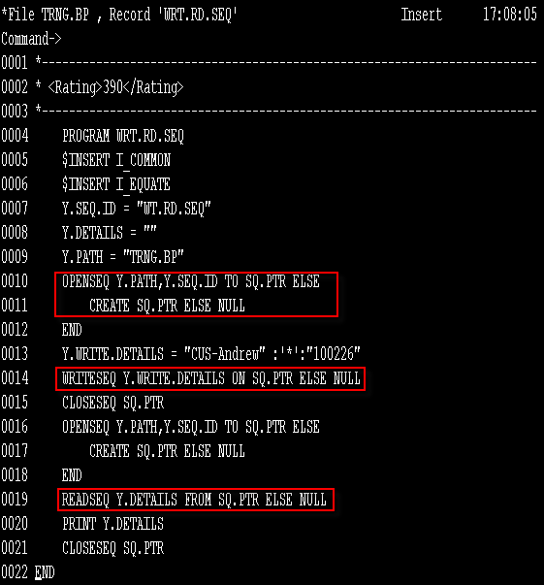
Solution

Slide 60
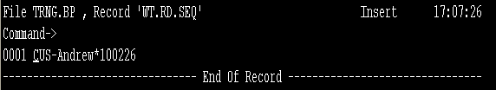
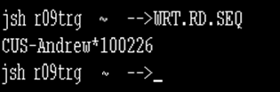
Solution (cont..)
Sequential file is created and data is written into the file and read from jBase non-hashed file

Slide 61
Summary
We have learnt the
Features of file operations in T24 routines through
OPF -> Opens a file for reading/writing purpose
F.READ & F.WRITE -> Used to read & write record from & to file that is already opened using OPF, respectively
EB.READLIST -> To read a set of records from a file we use this core routine
READ & WRITE -> Used to read & write a record from & to a file, respectively

Slide 62
Summary
Features of sequential file access in T24 routines through
OPENSEQ – Opens a file for sequential writing or reading
READSEQ – Reads from file opened for sequential access
WRITESEQ – Writes data to file opened for sequential access

Slide 63


www.capgemini.com/financialservices

