Slide 1
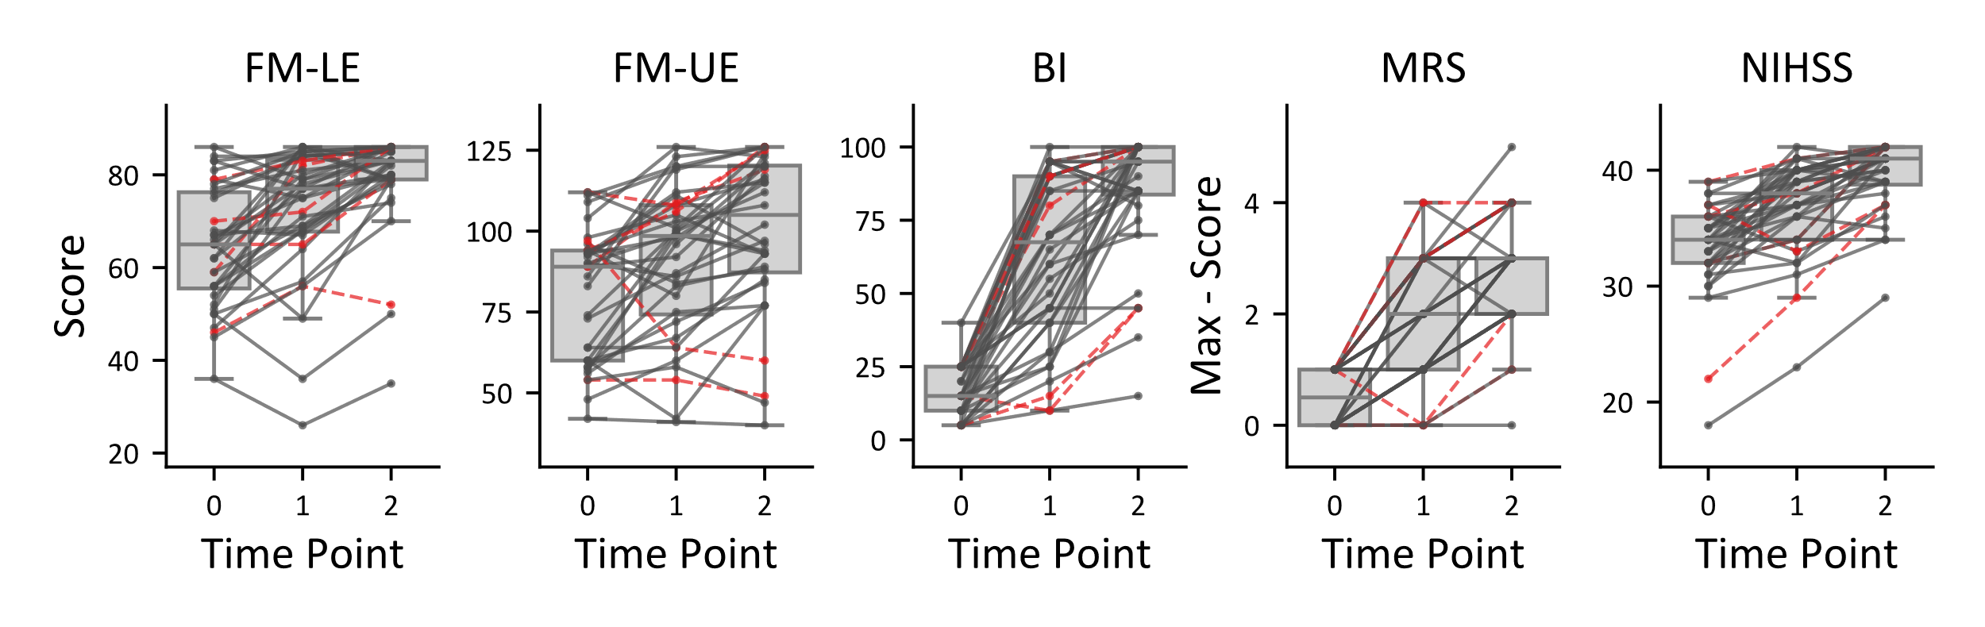
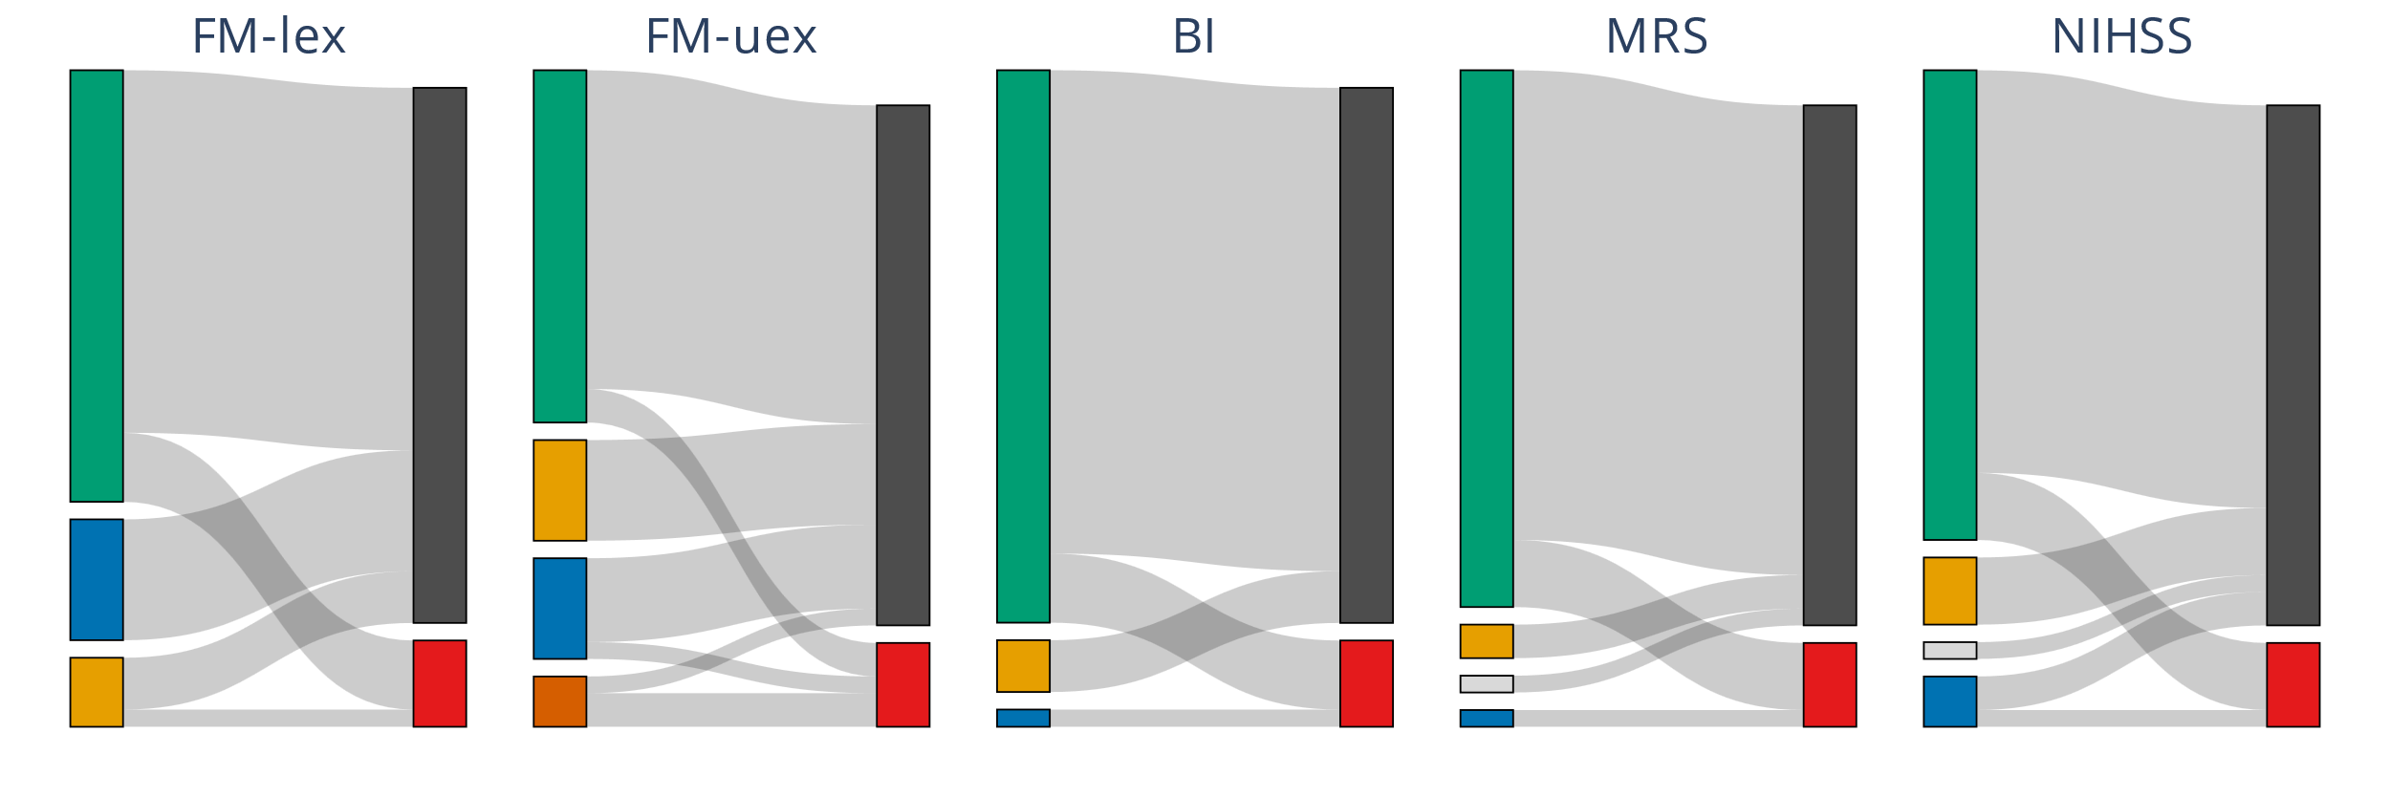
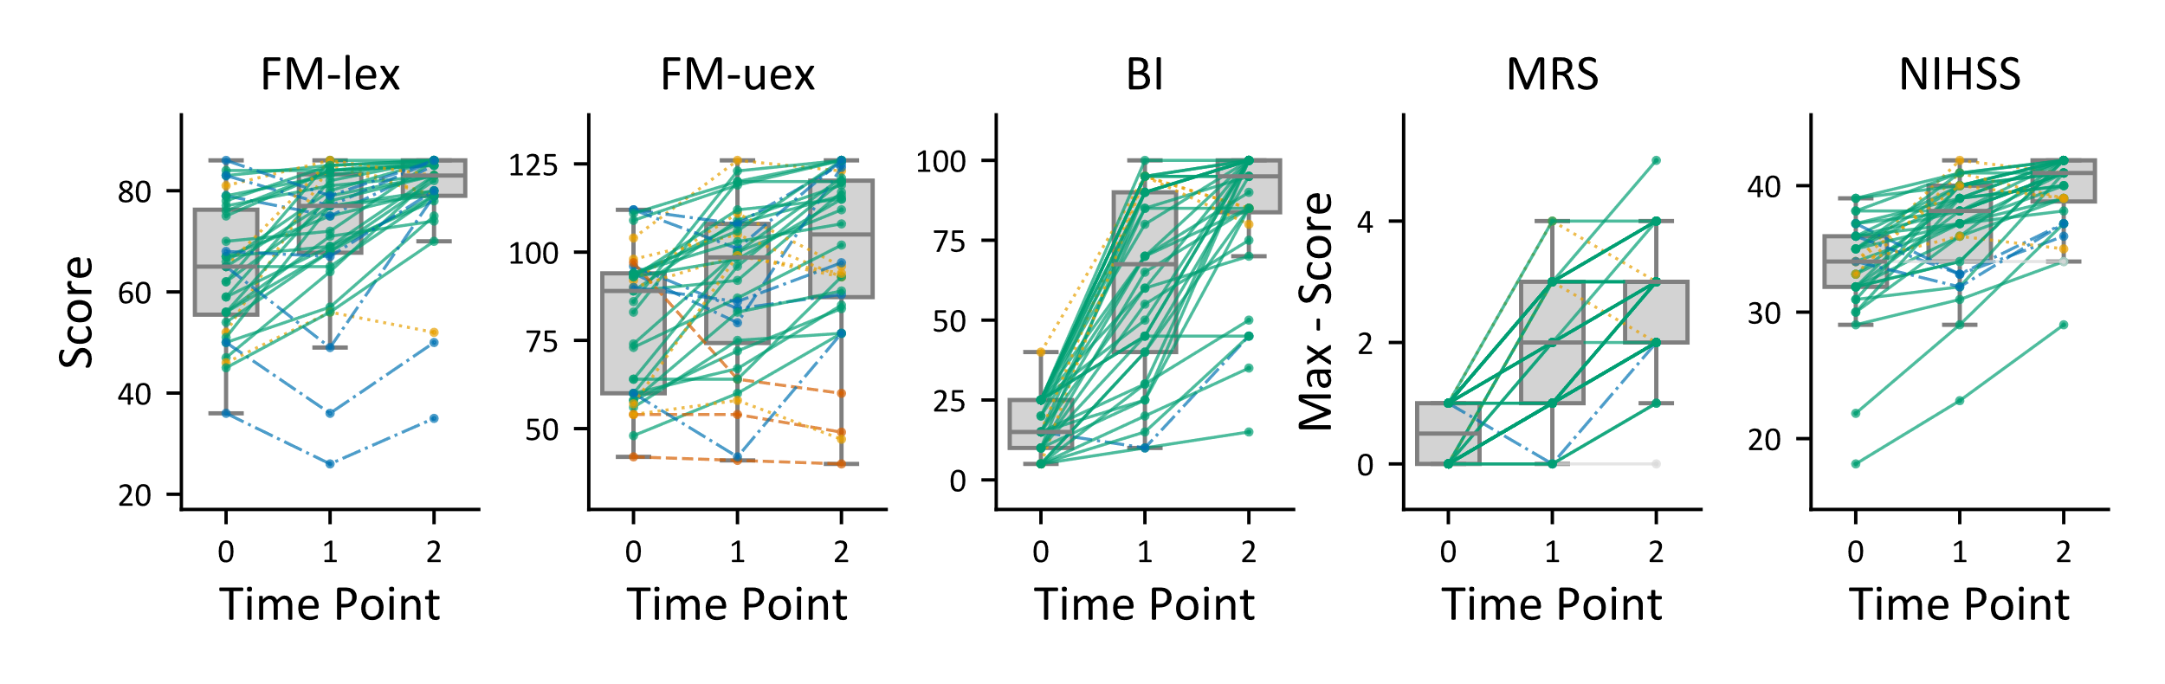
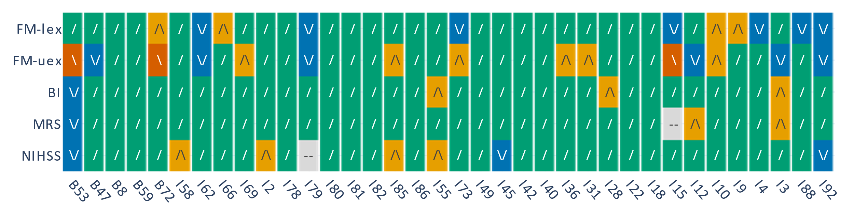
A
Figure X. Sankey diagram illustrating the relationship between recovery patterns and stroke type across different assessments. Panels (A–E) represent five different motor function assessments: (A) Fugl-Meyer Upper Extremity, (B) Fugl-Meyer Lower Extremity, (C) Barthel Index, (D) Modified Rankin Scale (mRS), and (E) National Institutes of Health Stroke Scale (NIHSS). On the left, recovery patterns are categorized into steady recovery, steady decline, early recovery with chronic decline, and late recovery with acute decline. These patterns are connected to stroke type on the right, distinguishing between infarct (ischemic stroke) and bleeding (hemorrhagic stroke). The width of the connections represents the number of patients following each trajectory, with exact patient counts indicated within the corresponding boxes. This visualization highlights how different recovery patterns are distributed between ischemic and hemorrhagic strokes across various assessment types. Figure X: Motor function recovery trajectories following stroke, distinguished by four recovery paterns. (A–E) Motor scores across three time points: 2 days (TP0), 14 days (TP1), and 60 days (TP2) post-stroke. (A) Fugl-Meyer Lower Extremity (FM-lex), (B) Fugl-Meyer Upper Extremity (FM-uex), (C) Barthel Index, (D) Modified Rankin Scale (mRS), and (E) National Institutes of Health Stroke Scale (NIHSS). The Y-axis represents motor performance, where higher values indicate better function. To ensure consistency across measures, mRS and NIHSS scores, which reflect deficits, were subtracted from their respective maximum values.
B
32
28
31
19
31
28
31
28
31
31
21
21
24
25
2
32
4
7
6
6
4
4
7
6
5
4
4
4
3
1
3
3
2
2
1
1
4
5
3
2
1
5
1
1
5
1
1
5
3
2
5
1
1
1
1
C
D
Patient ID
Steady recovery
Steady decline
Early recovery with chronic decline
Late recovery with acute decline
Not Classified
/
/\
Infarct/Ischemia
Bleeding
\
\/

Slide 2
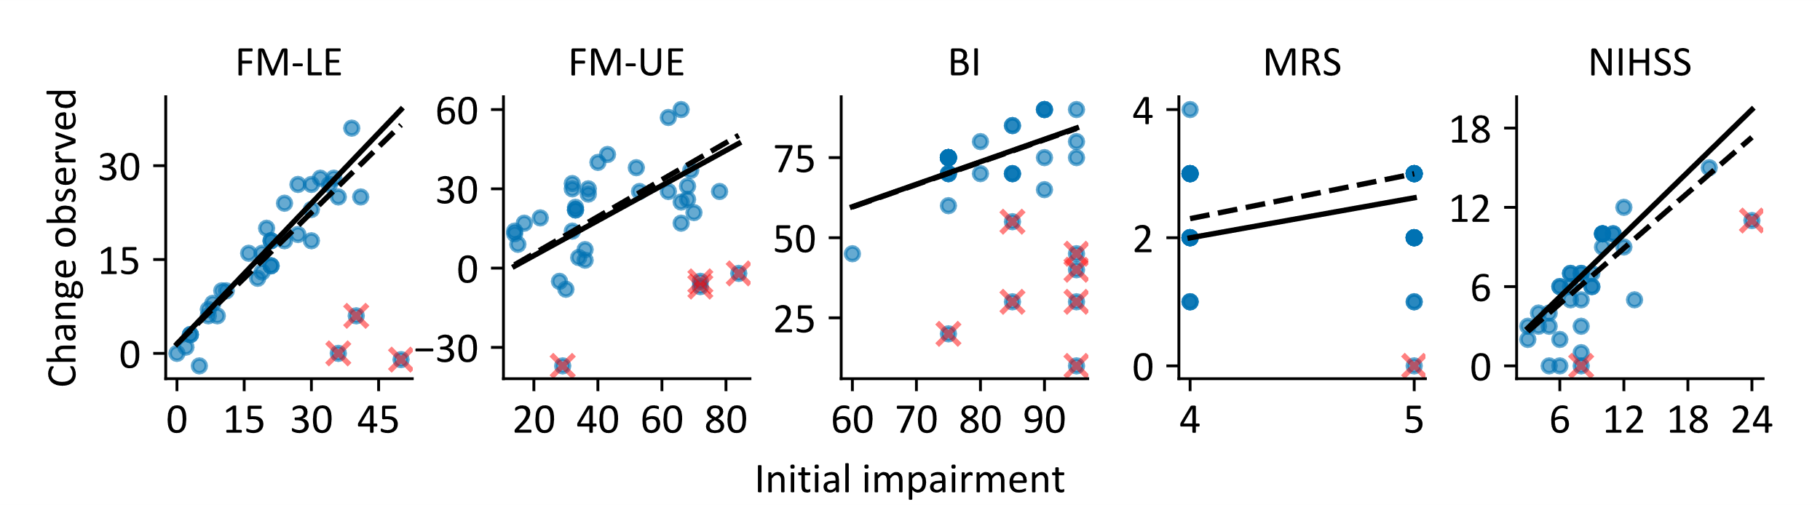
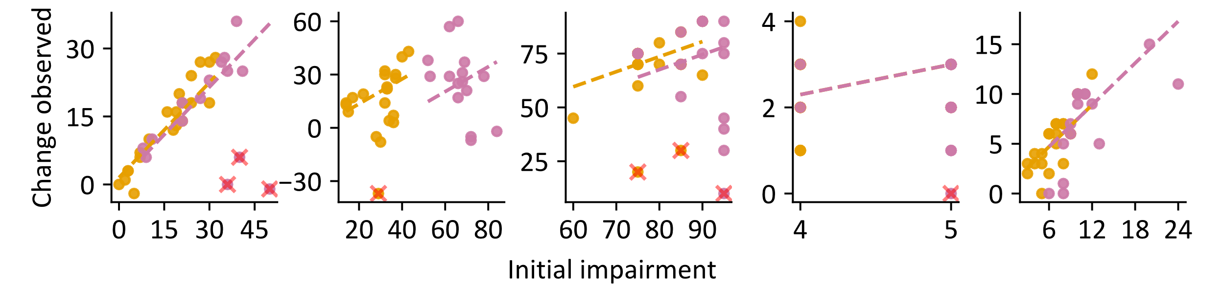
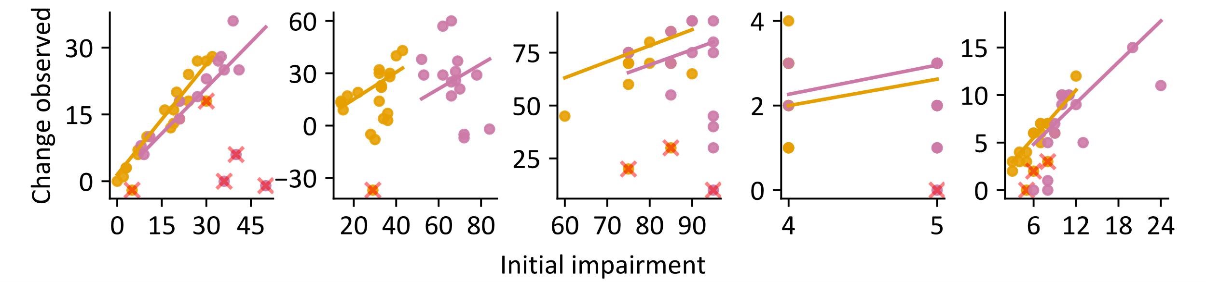
A
Best slope fit
PRR fit
Non-fitter (outlier)
x
C
B
C
D
E
PRR fit
General
Low initial deficit
High initial deficit
x
Best slope fit
Non-fitter (outlier)
Figure X. Comparison of proportional recovery rule (PRR) fit and best slope fit across different motor assessments. Panels (A–E) display the relationship between initial impairment (ii) and the change observed (co) for five different motor function assessments: (A) Fugl-Meyer Upper Extremity, (B) Fugl-Meyer Lower Extremity, (C) Barthel Index, (D) Modified Rankin Scale (mRS), and (E) National Institutes of Health Stroke Scale (NIHSS). Each panel includes two fitted lines: the PRR fit (dashed line), which represents the proportional recovery rule with a fixed 70% recovery slope, and the best slope fit (solid line), which is optimized for the given dataset. Outliers or non-fitters, identified based on the interquartile range (IQR) method using the best slope fit, are marked with a cross.

Slide 3
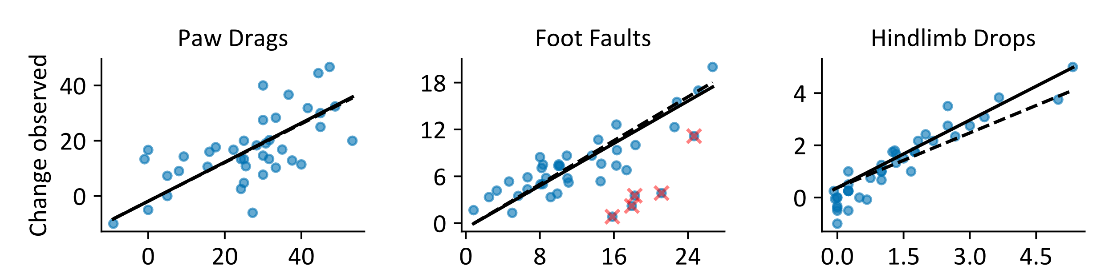
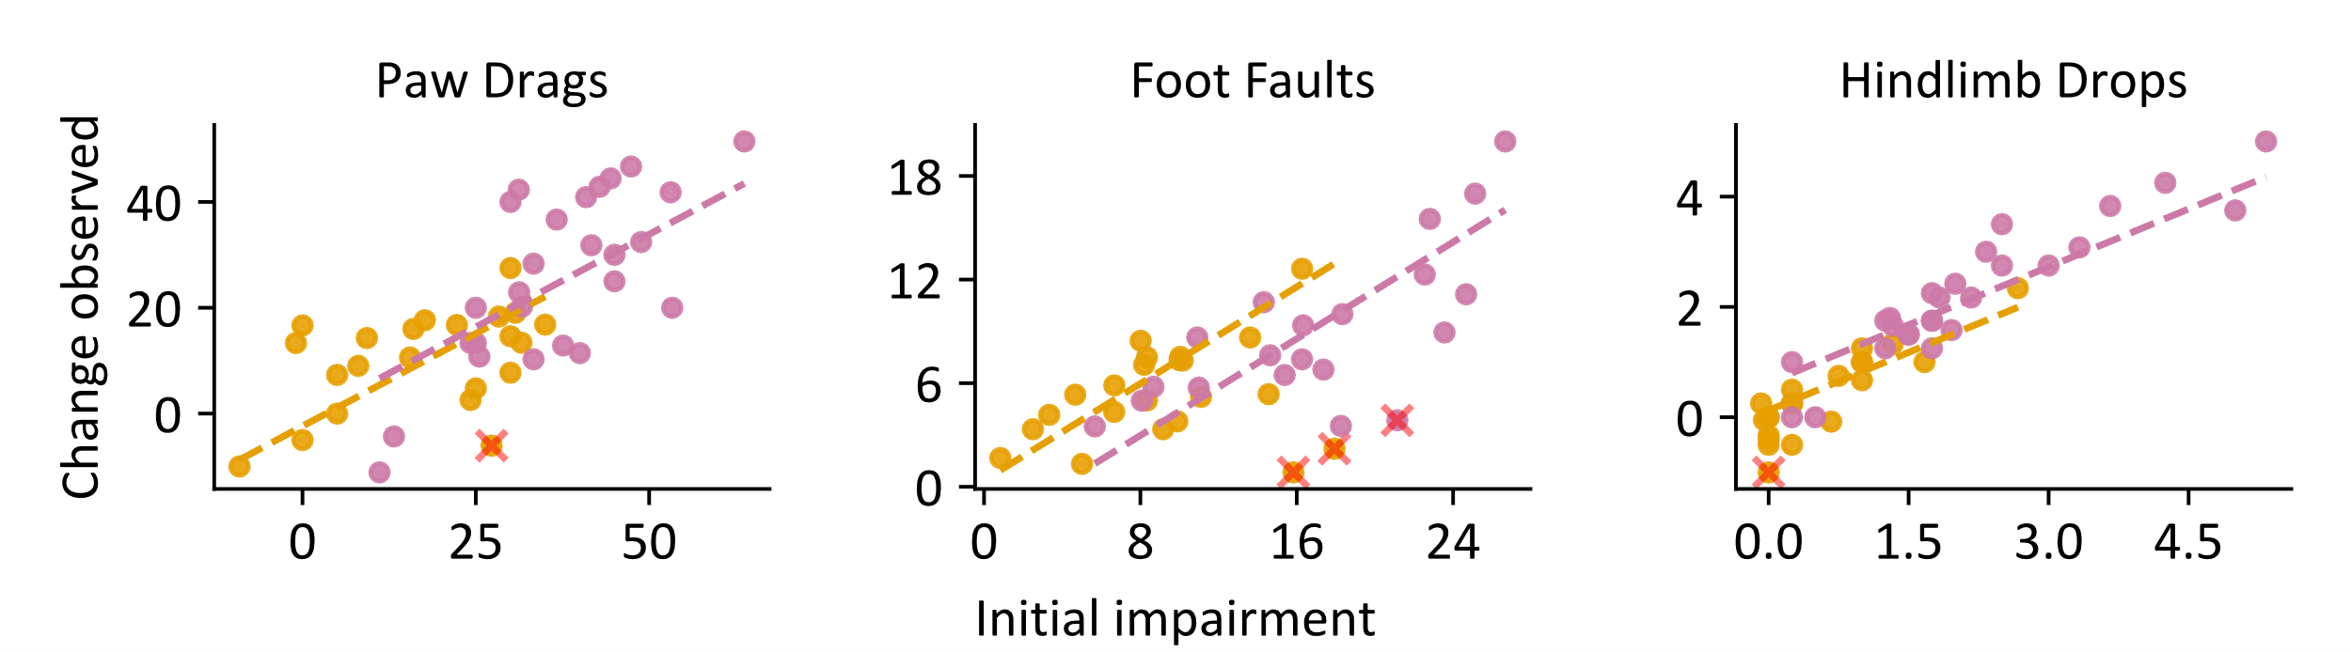
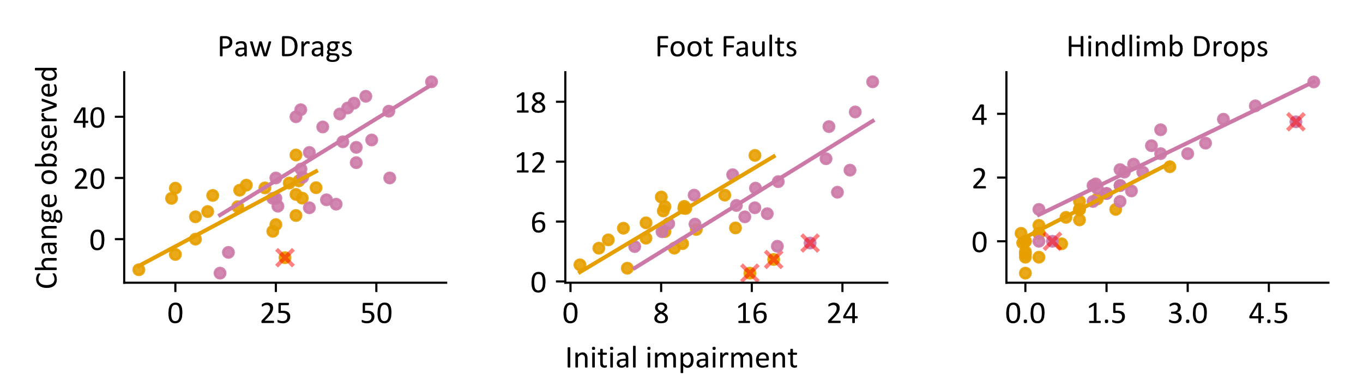
A
Best slope fit
PRR fit
Non-fitter (outlier)
x
C
B
C
D
E
PRR fit
General
Low initial deficit
High initial deficit
x
Best slope fit
Non-fitter (outlier)
Figure X. Comparison of proportional recovery rule (PRR) fit and best slope fit across different motor assessments. Panels (A–E) display the relationship between initial impairment (ii) and the change observed (co) for five different motor function assessments: (A) Fugl-Meyer Upper Extremity, (B) Fugl-Meyer Lower Extremity, (C) Barthel Index, (D) Modified Rankin Scale (mRS), and (E) National Institutes of Health Stroke Scale (NIHSS). Each panel includes two fitted lines: the PRR fit (dashed line), which represents the proportional recovery rule with a fixed 70% recovery slope, and the best slope fit (solid line), which is optimized for the given dataset. Outliers or non-fitters, identified based on the interquartile range (IQR) method using the best slope fit, are marked with a cross.

Slide 4
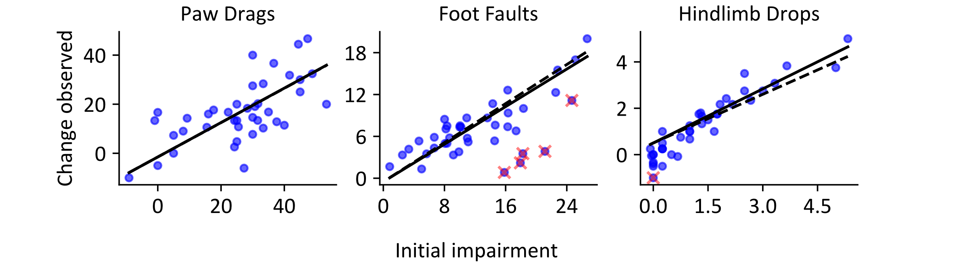

Slide 5
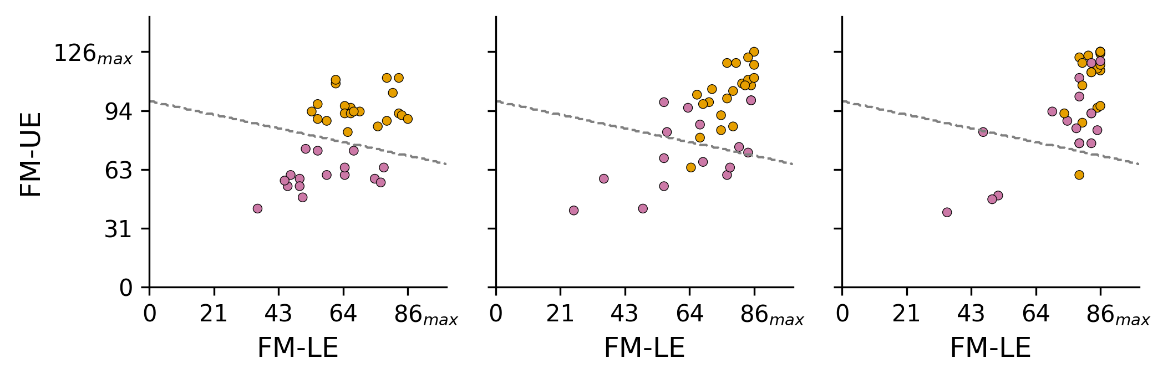
A
B
C
Good
Poor
2days
14days
90days
Figure X: Relationship between upper and lower extremity scores and their recovery over (A) the acute phase (2 days), (B) the subacute phase (14 days), and (C) 90 days. Two clusters were created by applying a k-means clustering algorithm with k=2 to dichotomize the data points into two groups—poor recovery and good recovery—based on Uex and Lex.

Slide 6
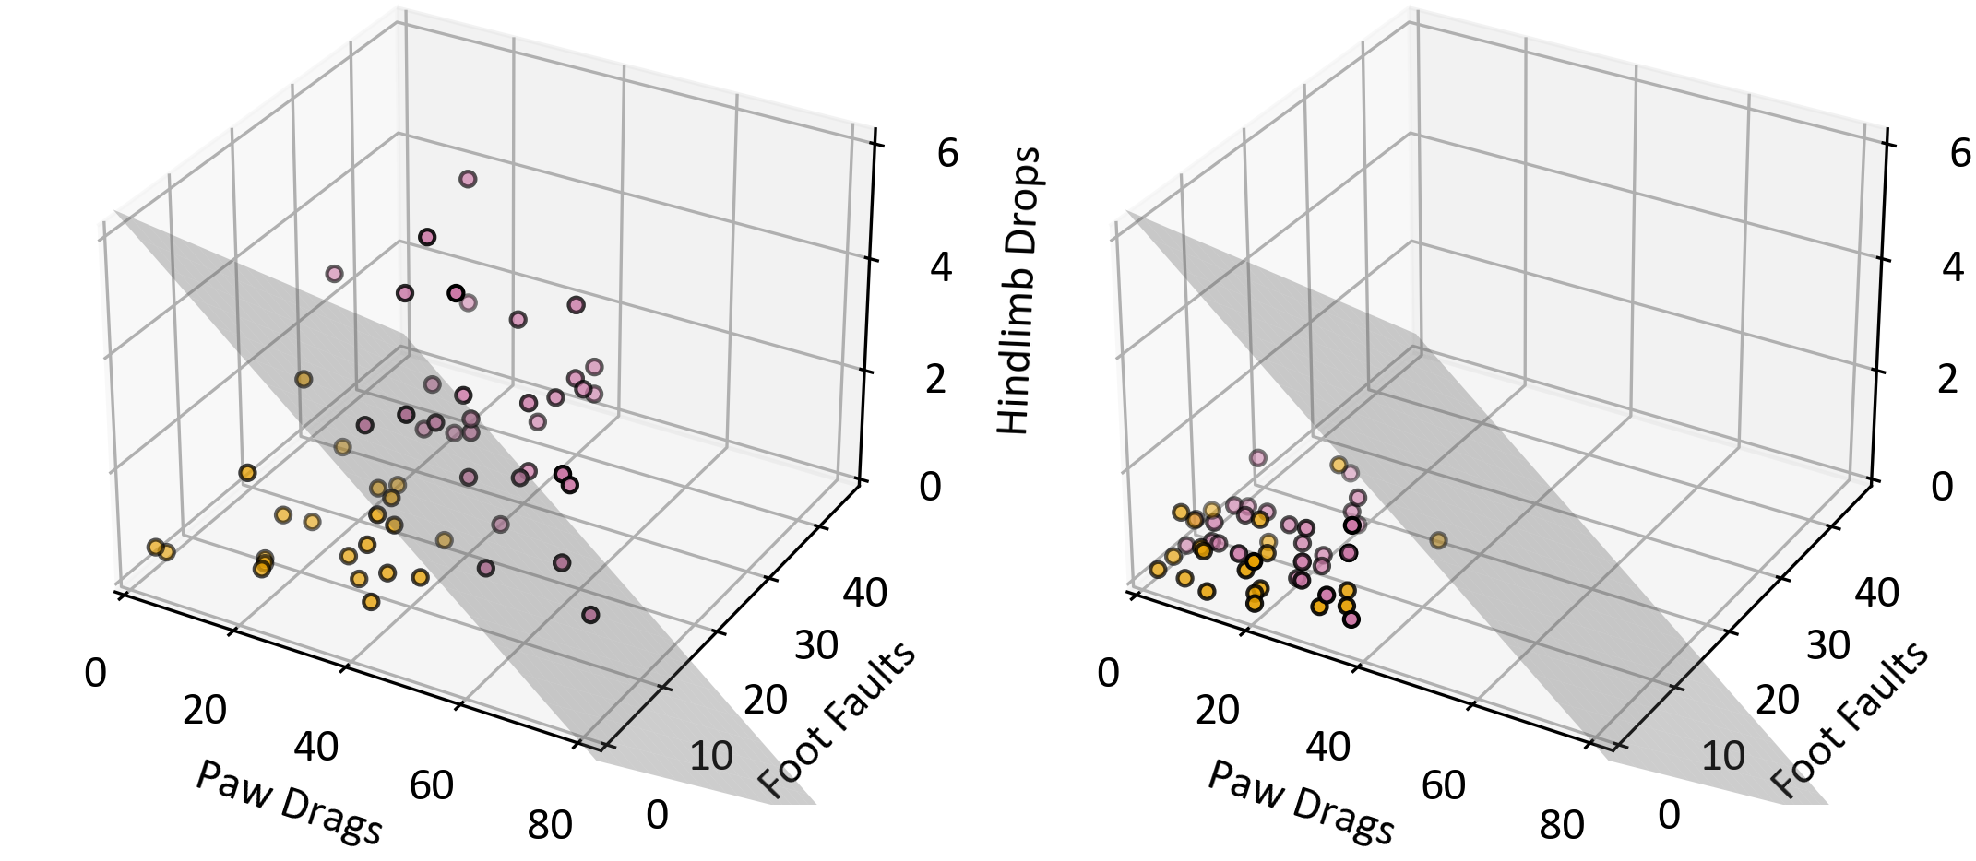
A
B

