Slide 1
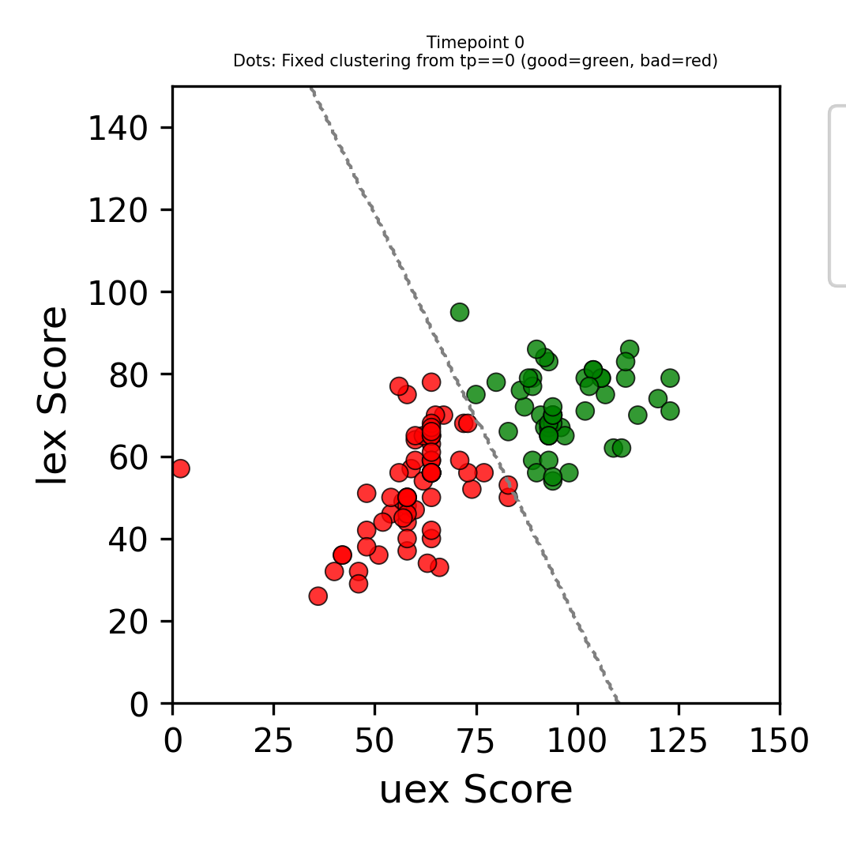
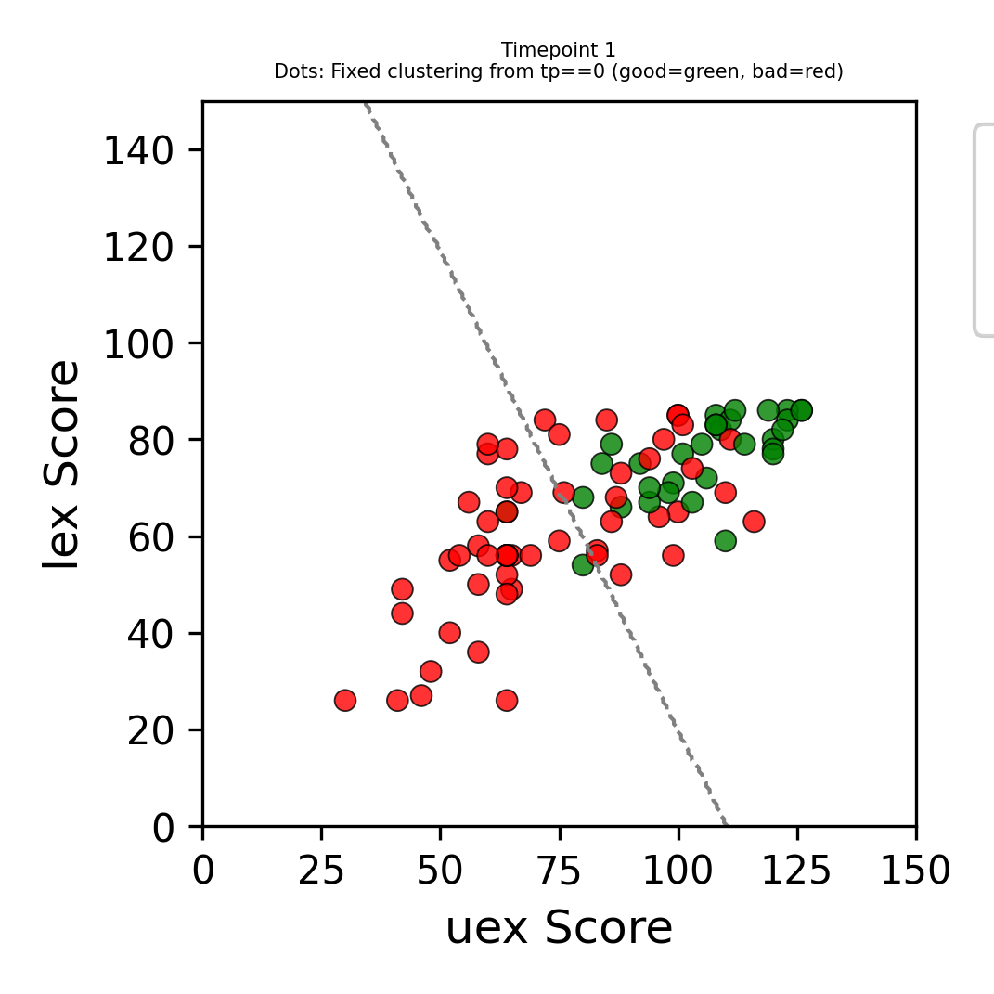
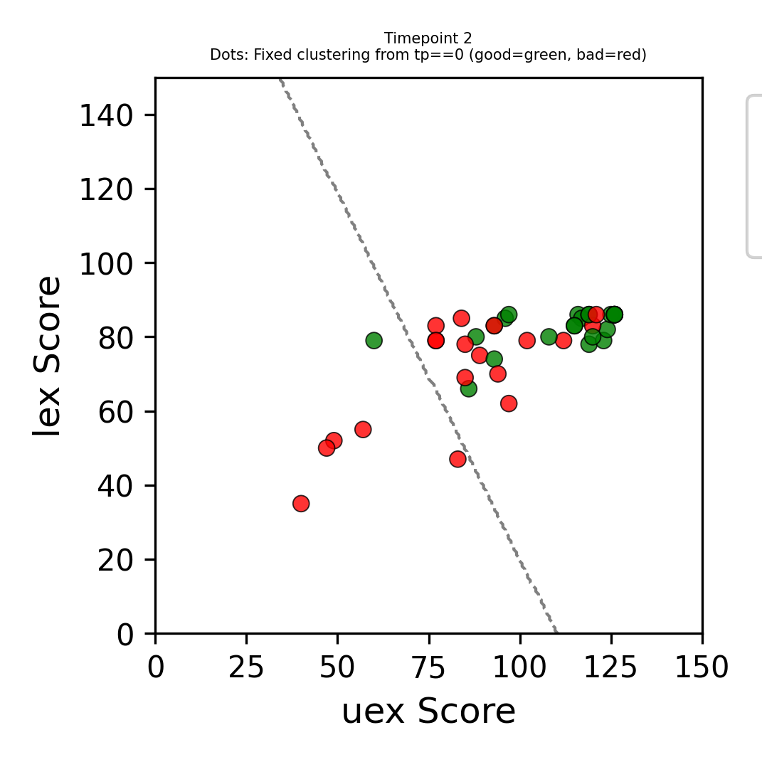
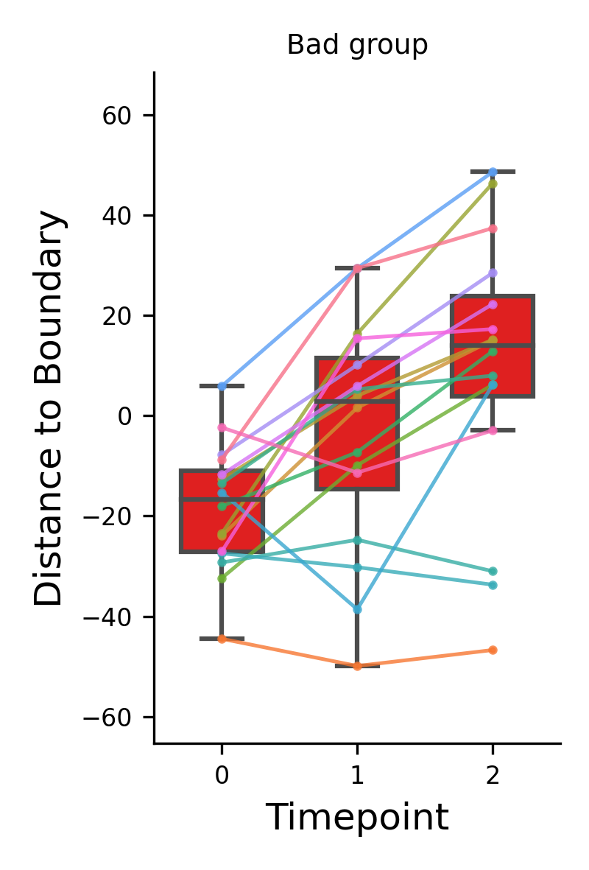
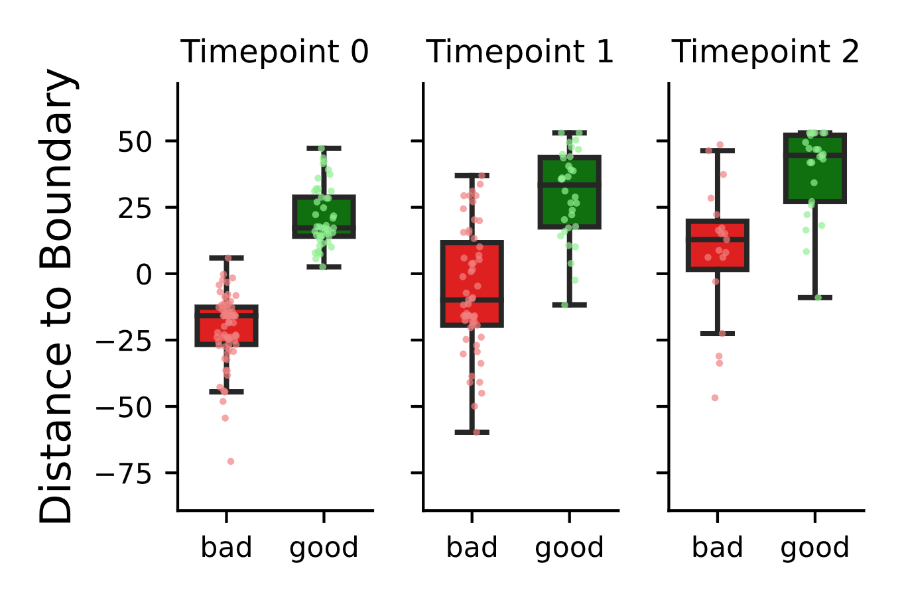
some patients have higher deficit but can catch up with patients with lower and usually better/faster recovery
TP0
TP1
TP2
Kmeans (K=2) based on TP=0 → creates two groups of high and low motor score patients
Spagetti Plot of the low motor score group
Distance to separation line
Distance to separation line
Low High
Low High
Low High
Negative values are beneath the line, positive values are above the line
Time Point

Slide 2
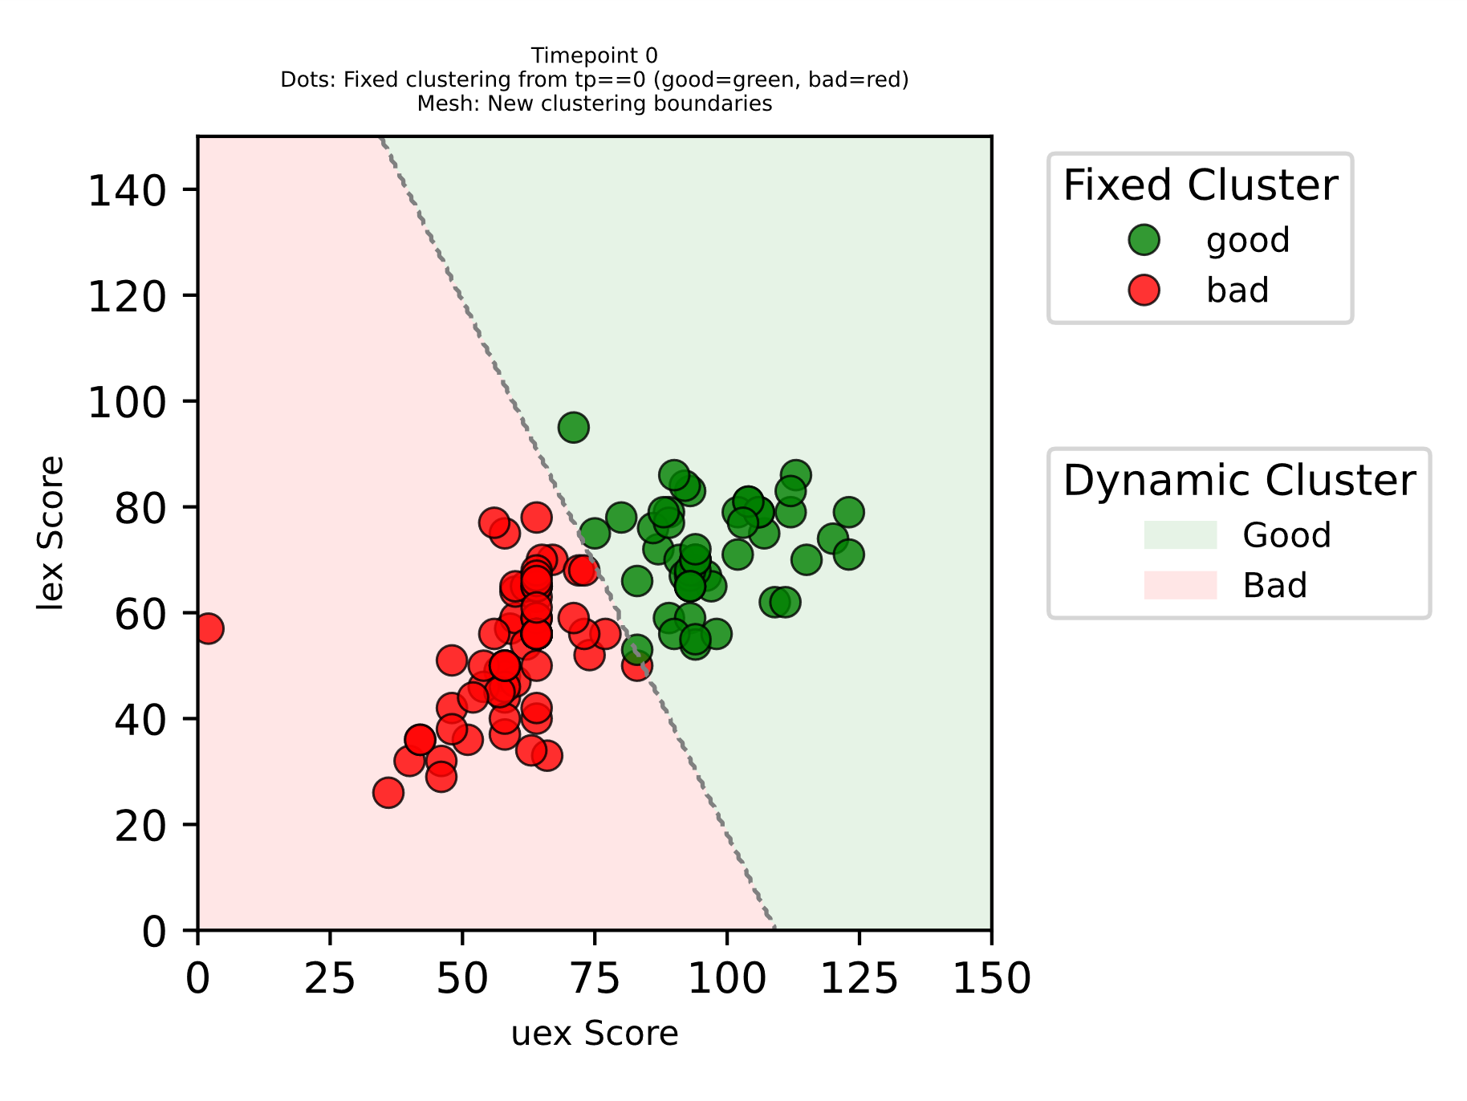
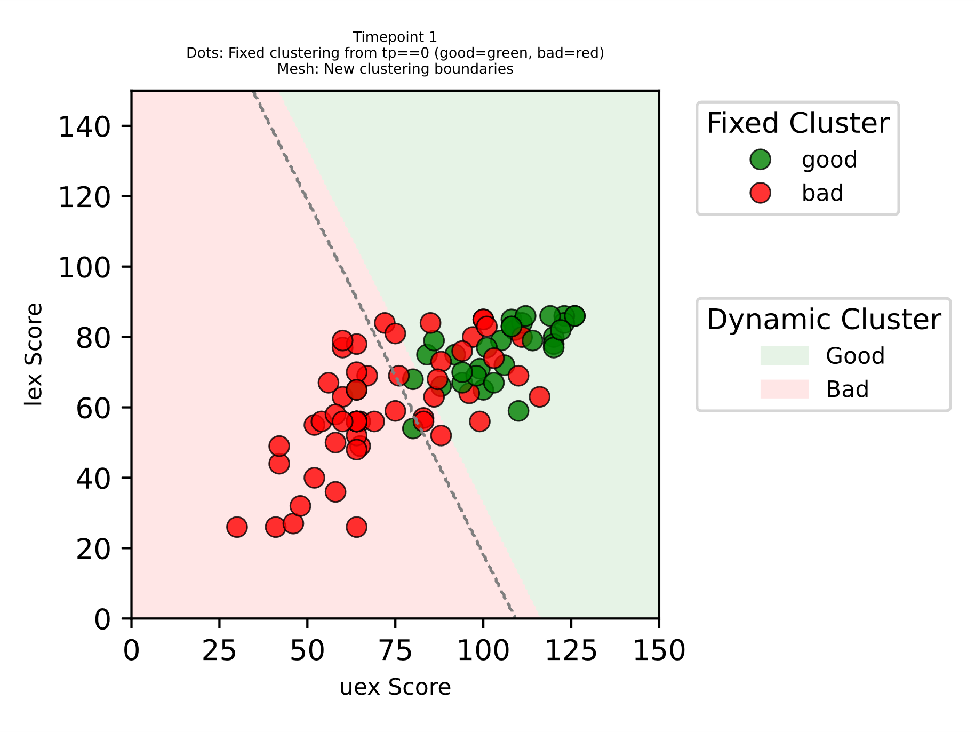
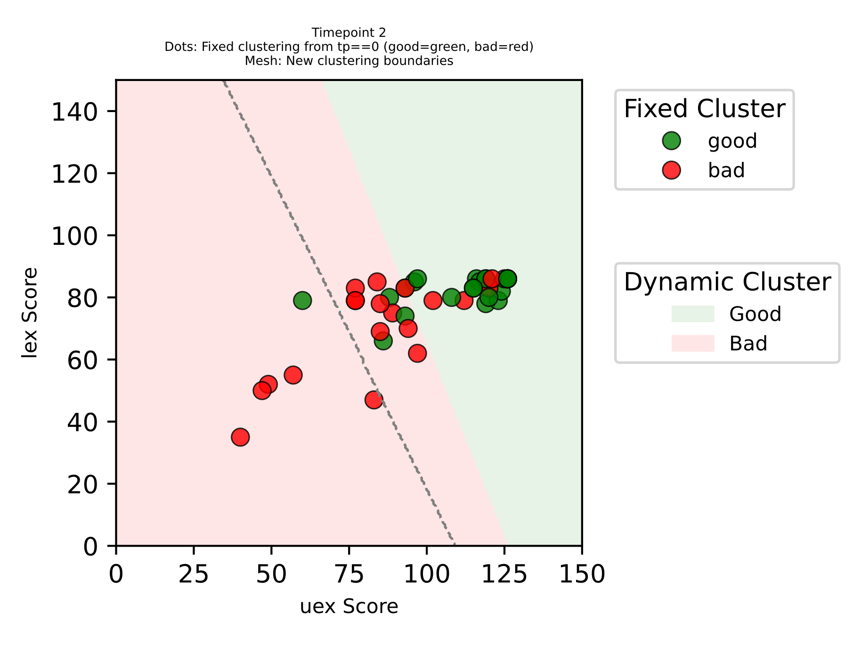
TP0
TP1
TP2
some patients have higher deficit but can catch up with patients with lower and usually better/faster recovery

