Slide 1
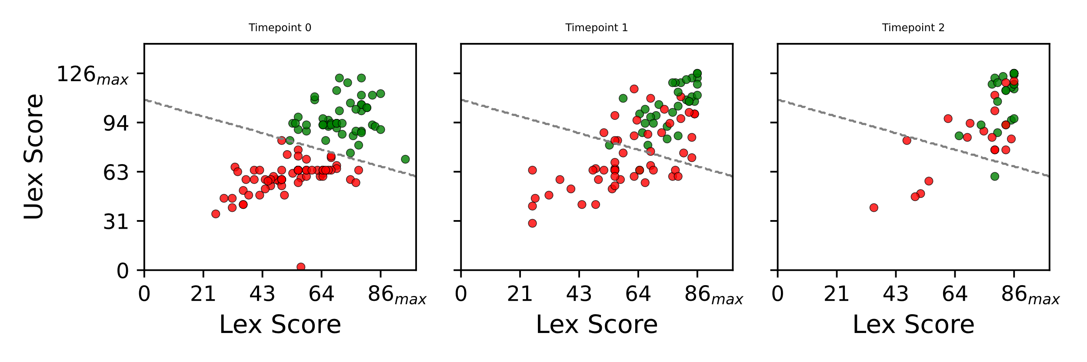
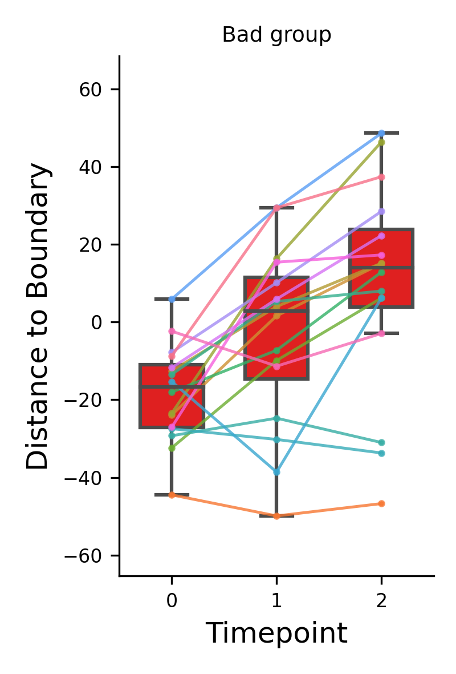
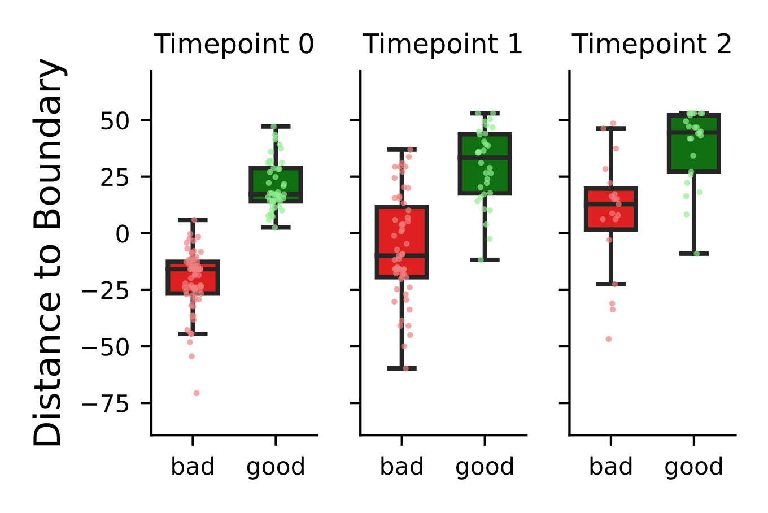
some patients have higher deficit but can catch up with patients with lower and usually better/faster recovery
Kmeans (K=2) based on TP=0 → creates two groups of high and low motor score patients
Spagetti Plot of the low motor score group
Distance to separation line
Distance to separation line
Low High
Low High
Low High
Negative values are beneath the line, positive values are above the line
Time Point

Slide 2
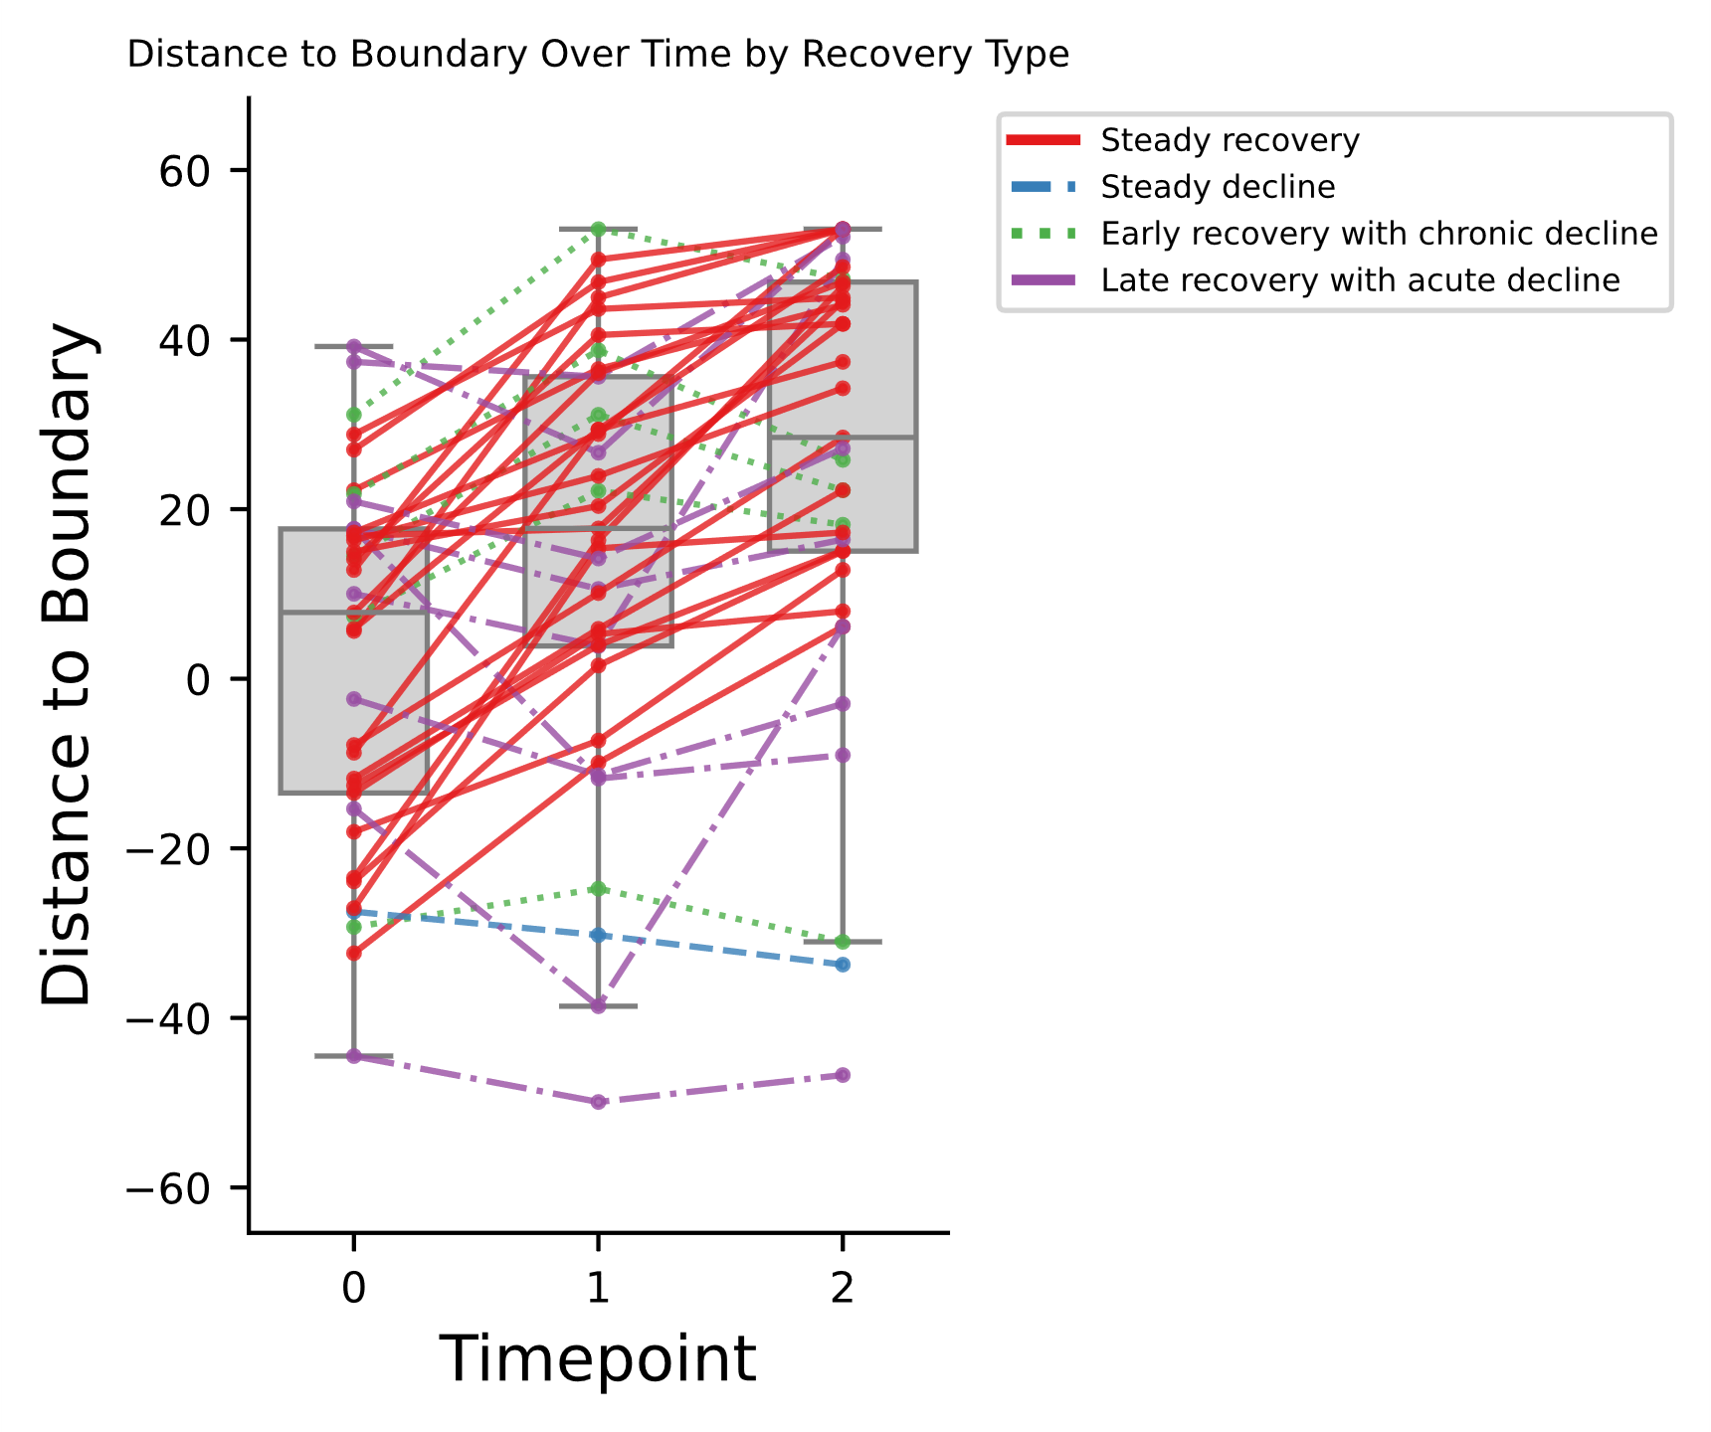
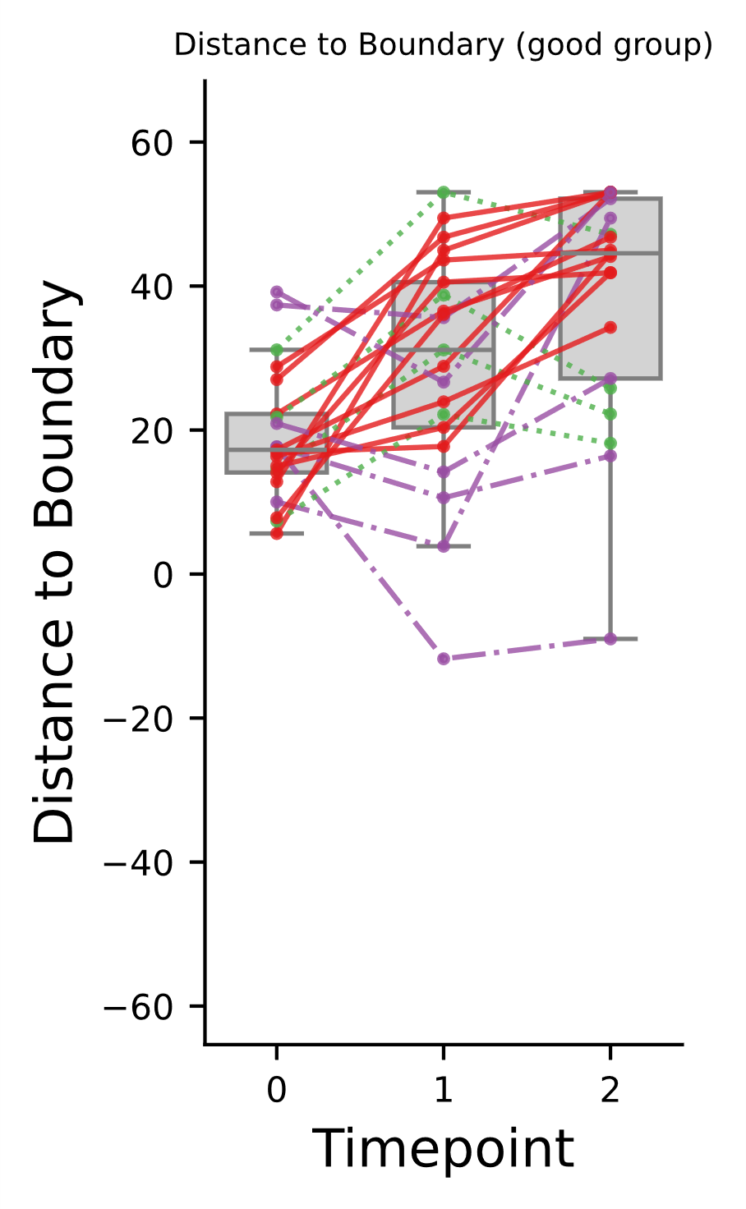
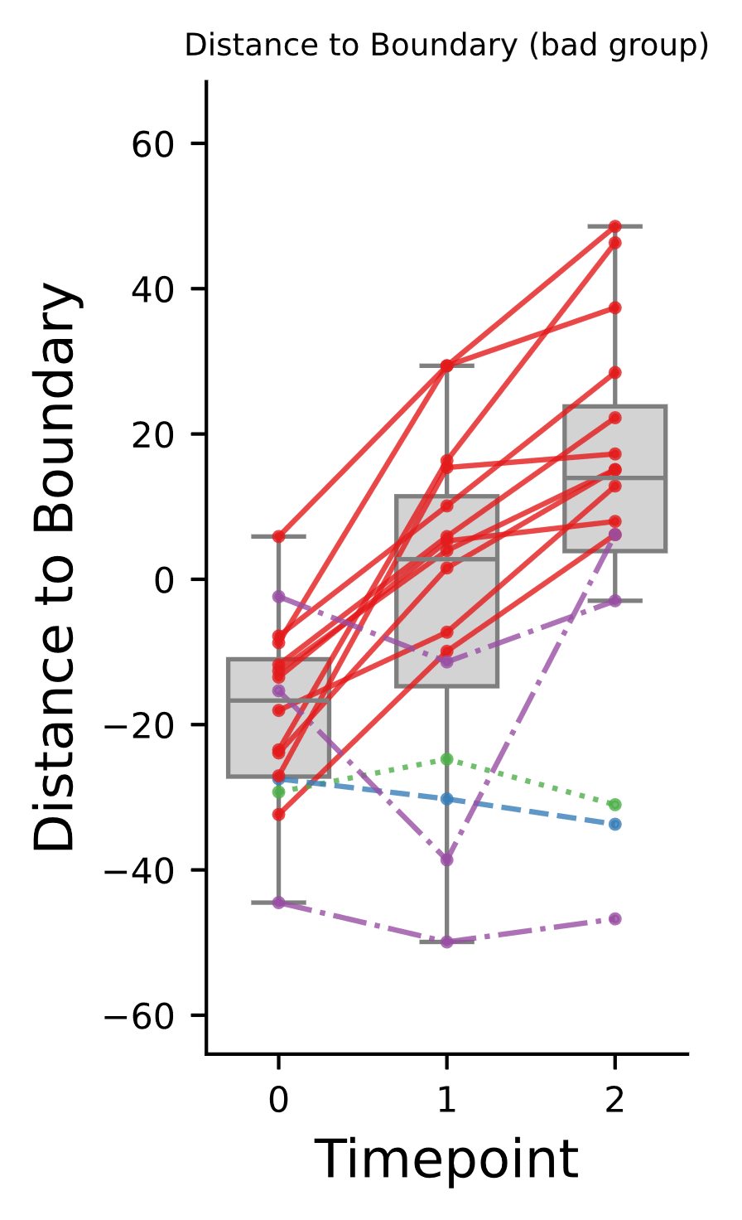
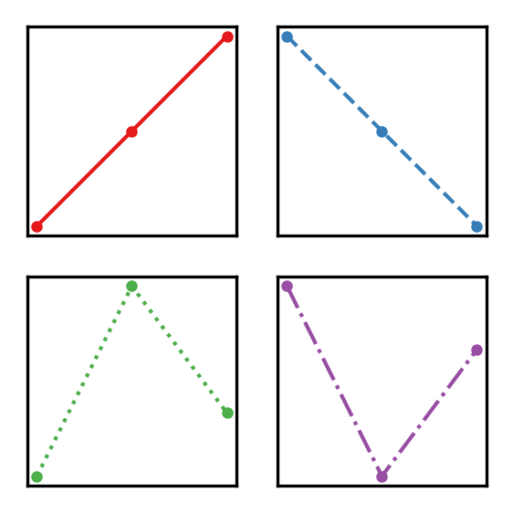
Overall Recovery Type Percentages:
Steady recovery: 59.46% (22 out of 37)
Steady decline: 2.70% (1 out of 37)
Early recovery with chronic decline: 13.51% (5 out of 37)
Late recovery with acute decline: 24.32% (9 out of 37)
Recovery Type Percentages by Fixed_Type:
Fixed_Type: bad
Steady recovery: 68.75% (11 out of 16)
Steady decline: 6.25% (1 out of 16)
Early recovery with chronic decline: 6.25% (1 out of 16)
Late recovery with acute decline: 18.75% (3 out of 16)
Fixed_Type: good
Steady recovery: 52.38% (11 out of 21)
Steady decline: 0.00% (0 out of 21)
Early recovery with chronic decline: 19.05% (4 out of 21)
Late recovery with acute decline: 28.57% (6 out of 21)

Slide 3
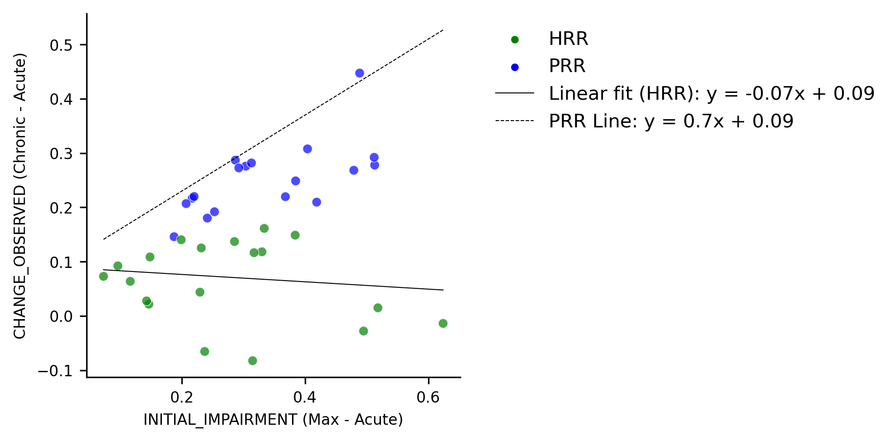
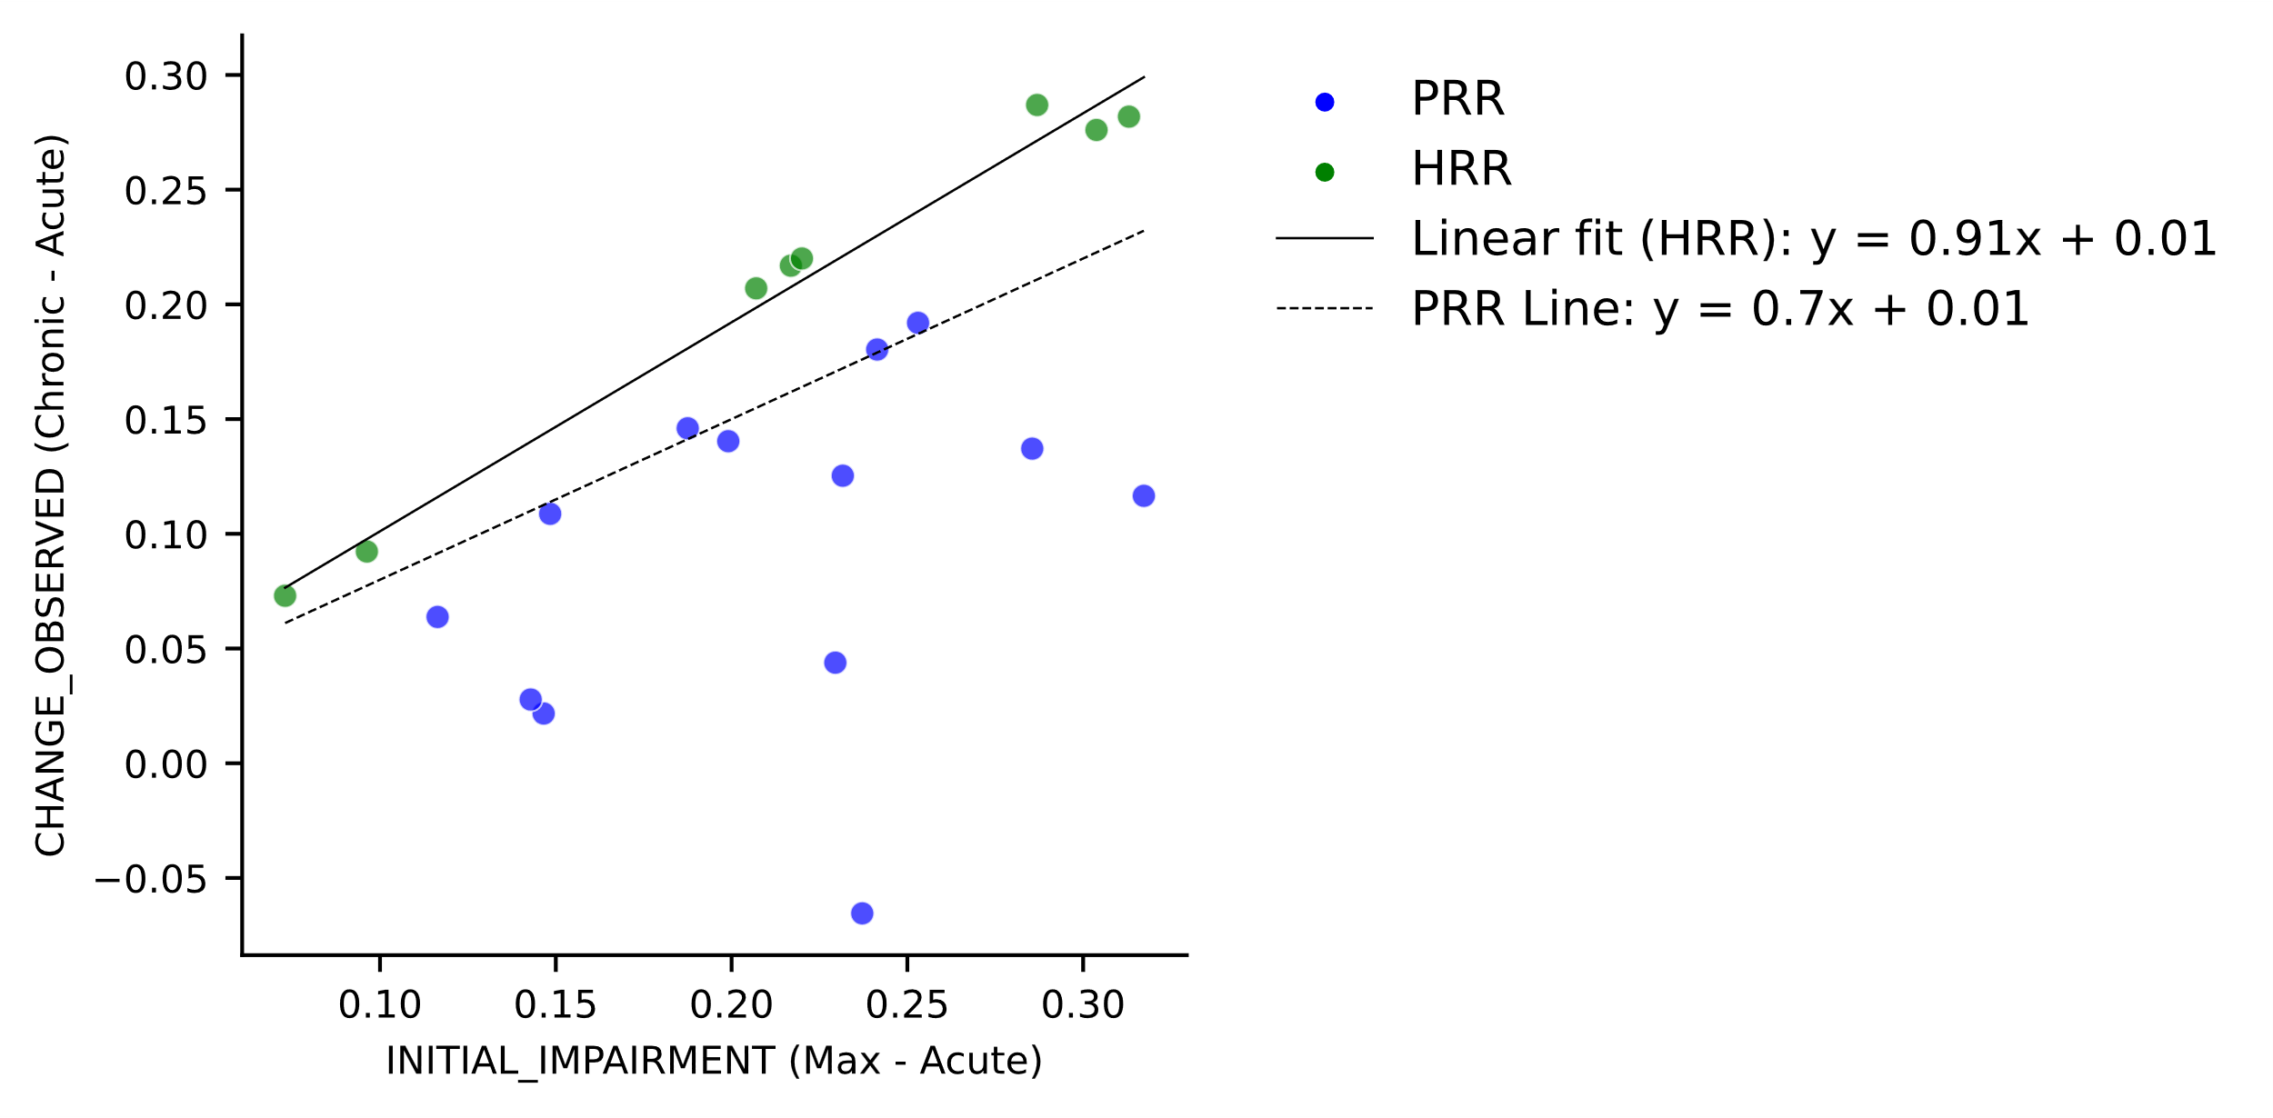
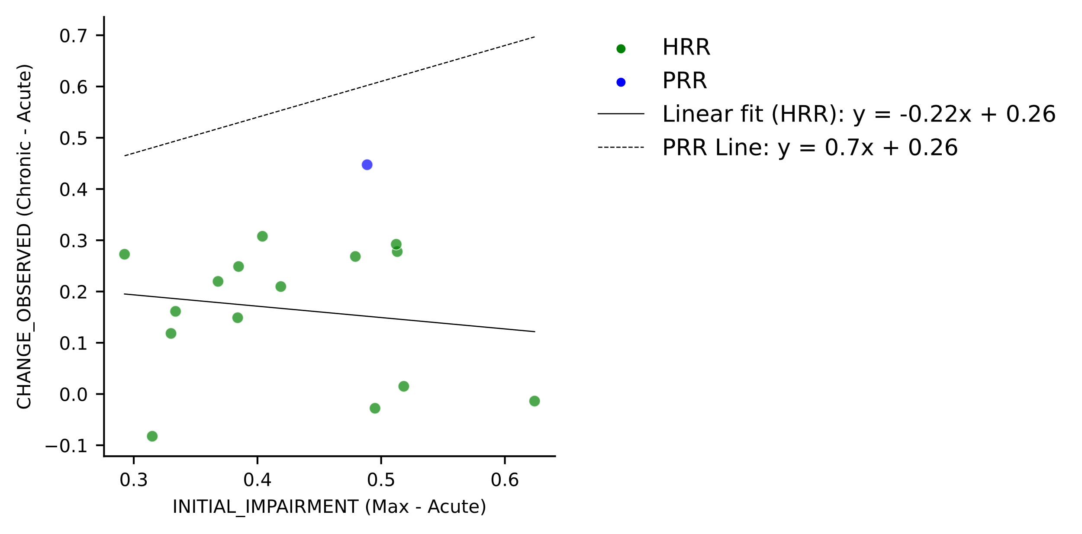
All data
Good only
a) The PRR works good for those patients that:
the proportional recovery rule (PRR) was a manifestation of a spontaneous mechanism that is present in all patients with mild-to-moderate paresis but only in some with severe paresis
quote from: Kundert et al. https://pmc.ncbi.nlm.nih.gov/articles/PMC6854610/#:~:text=In%202008%2C%20it%20was%20proposed,(%E2%80%9Cproportional%20recovery%E2%80%9D.
b) In my mice data, as most of them recover well, two distinct recovery trajectories could be identified, those that are similar to the PRR, and those that recover better e.g. MRR.
c) This is not the case in the human dataset. We have much more decliners, and if I use the same approach from our mice paper it leads to the sepration of fitters and non fitters, rather then a new recovery trajectory (higher then 70% for example). See figure in the pp.
Good only

Slide 4
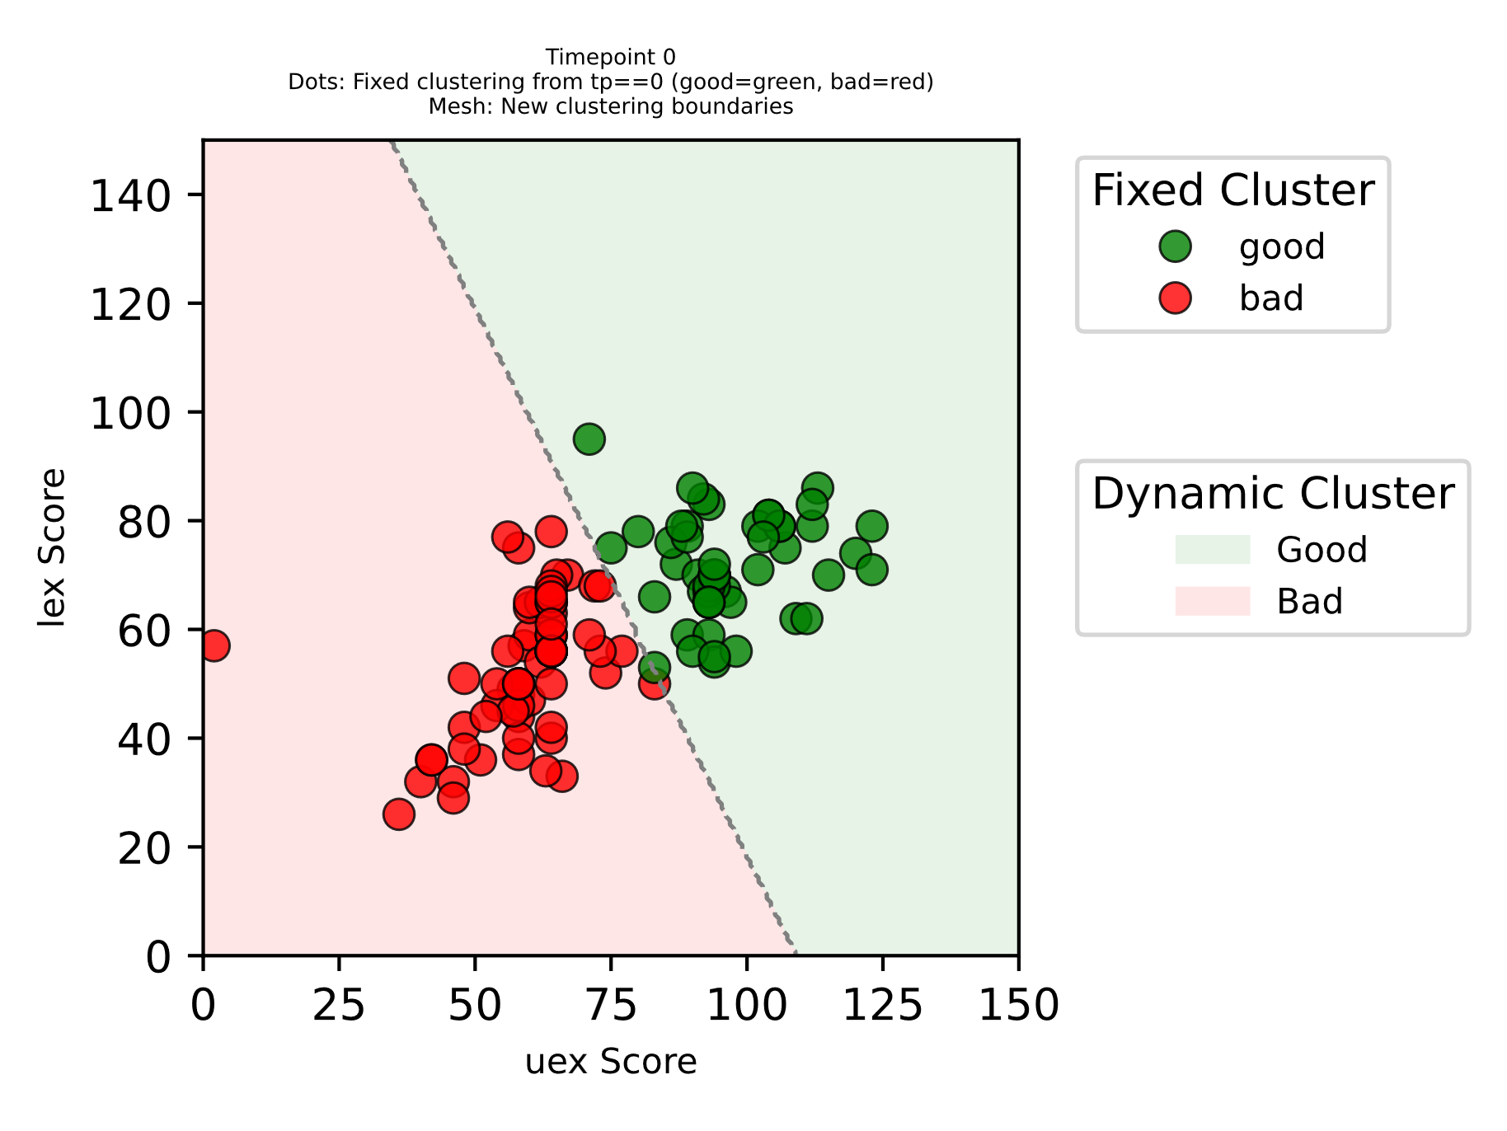
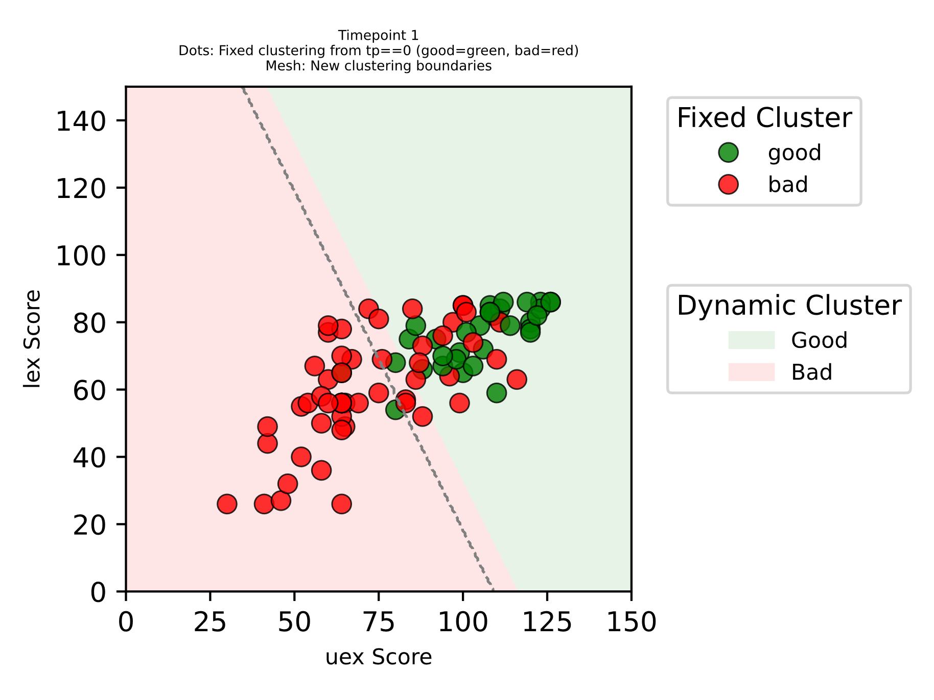
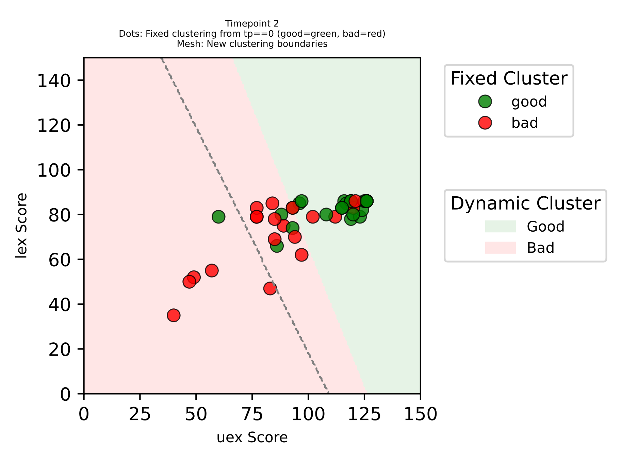
TP0
TP1
TP2
some patients have higher deficit but can catch up with patients with lower and usually better/faster recovery

