Slide 1
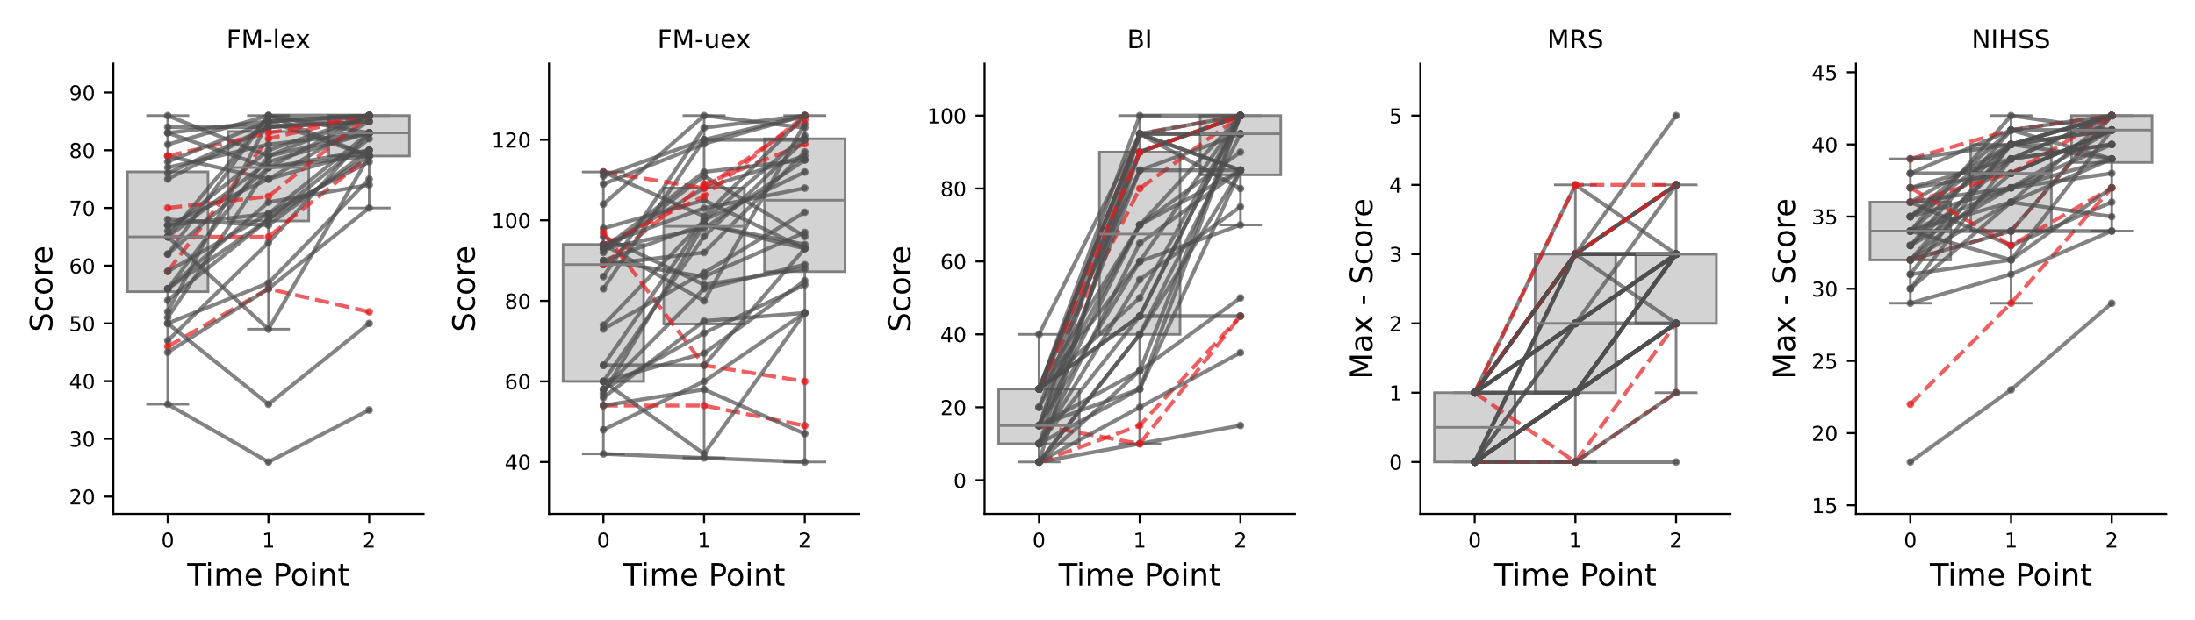
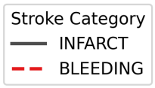
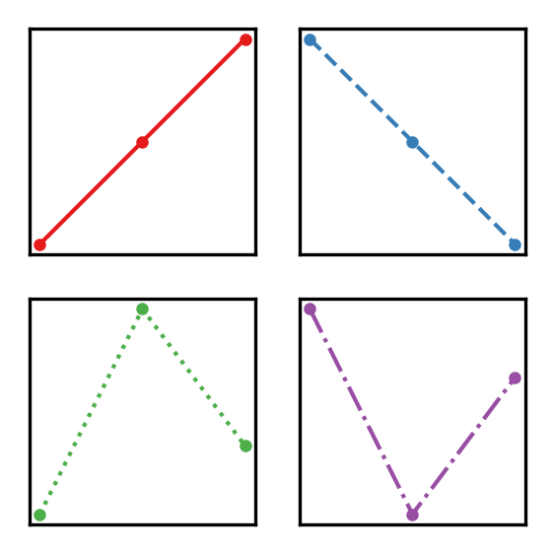
A
B
C
D
E
Figure X: Motor function recovery trajectories following stroke, distinguished by two stroke types: Bleeding (dark red) and Infarct/Ischemia (gray). Motor scores are presented across three time points: 2 days (TP0), 14 days (TP1), and 60 days (TP2) post-stroke. (A) Fugl-Meyer Lower Extremity (FM-lex), (B) Fugl-Meyer Upper Extremity (FM-uex), (C) Barthel Index, (D) Modified Rankin Scale (mRS), and (E) National Institutes of Health Stroke Scale (NIHSS). The Y-axis represents motor performance, where higher values indicate better function. To ensure consistency across measures, mRS and NIHSS scores, which reflect deficits, were subtracted from their respective maximum values.

Slide 2
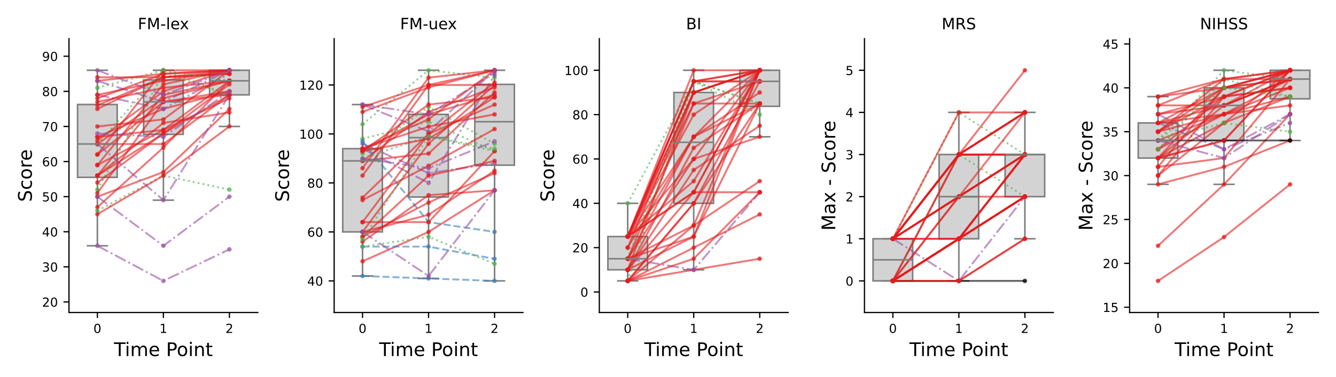
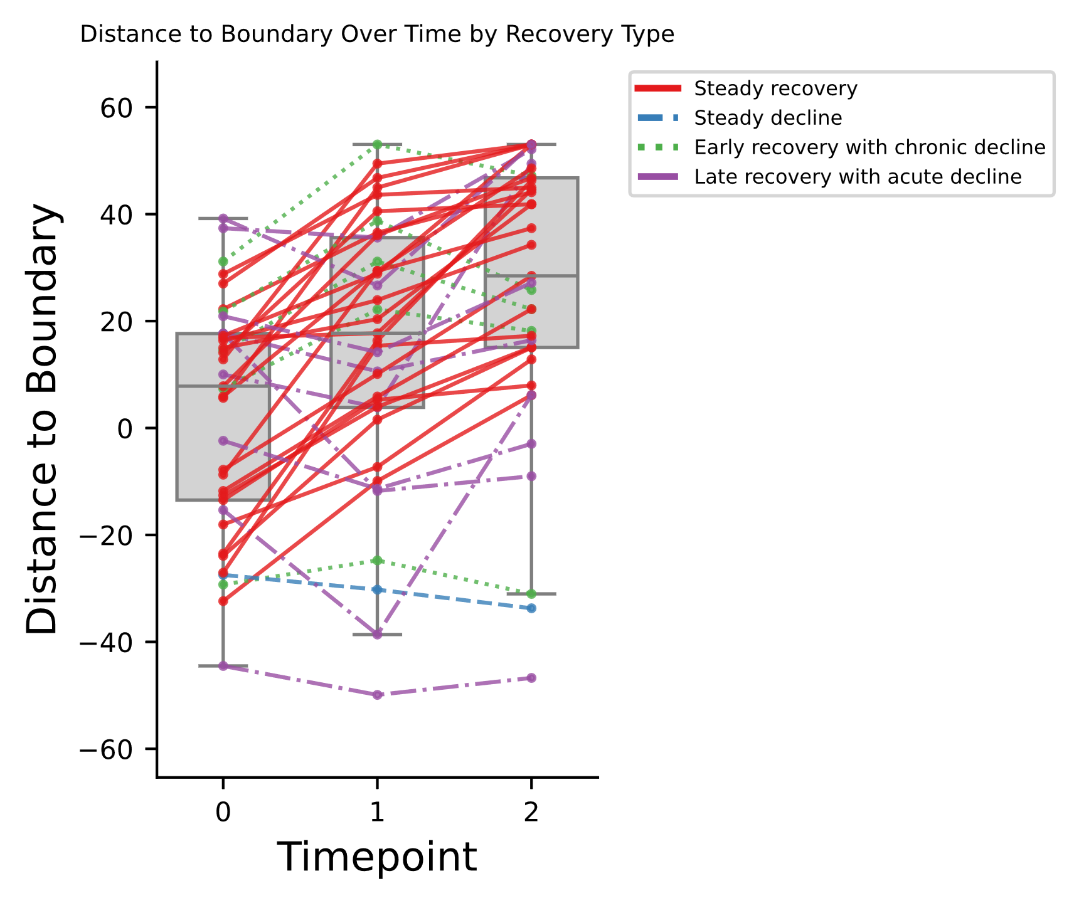
A
B
C
D
E
Figure X: Motor function recovery trajectories following stroke, distinguished by four recovery paterns. (A–E) Motor scores across three time points: 2 days (TP0), 14 days (TP1), and 60 days (TP2) post-stroke. (A) Fugl-Meyer Lower Extremity (FM-lex), (B) Fugl-Meyer Upper Extremity (FM-uex), (C) Barthel Index, (D) Modified Rankin Scale (mRS), and (E) National Institutes of Health Stroke Scale (NIHSS). The Y-axis represents motor performance, where higher values indicate better function. To ensure consistency across measures, mRS and NIHSS scores, which reflect deficits, were subtracted from their respective maximum values.

Slide 3
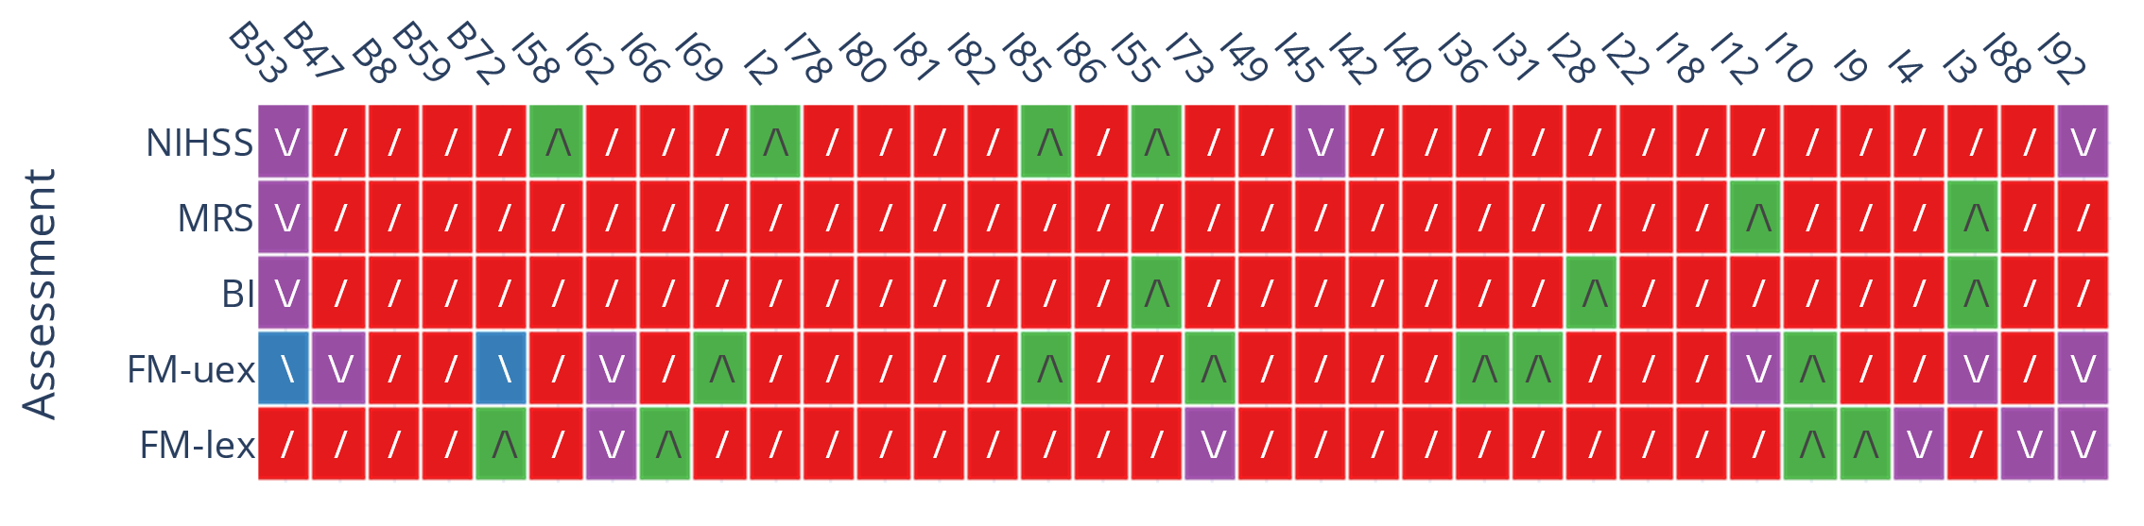
Patient-ID
/
Steady recovery
Steady decline
/\
Early recovery with chronic decline
Late recovery with acute decline
\
\/
Figure X: Classification of subjects into recovery patterns across different assessments. The heatmap displays how each subject is categorized into one of four recovery patterns: steady recovery, steady decline, early recovery with chronic decline, and late recovery with acute decline based on the different assessment types. The heatmap allows for comparison of recovery pattern classifications across assessments, highlighting potential variations in classification depending on the measure used. Subjects labeled with "I" indicate infarct cases, while those labeled with "B" indicate bleeding cases.

Slide 4
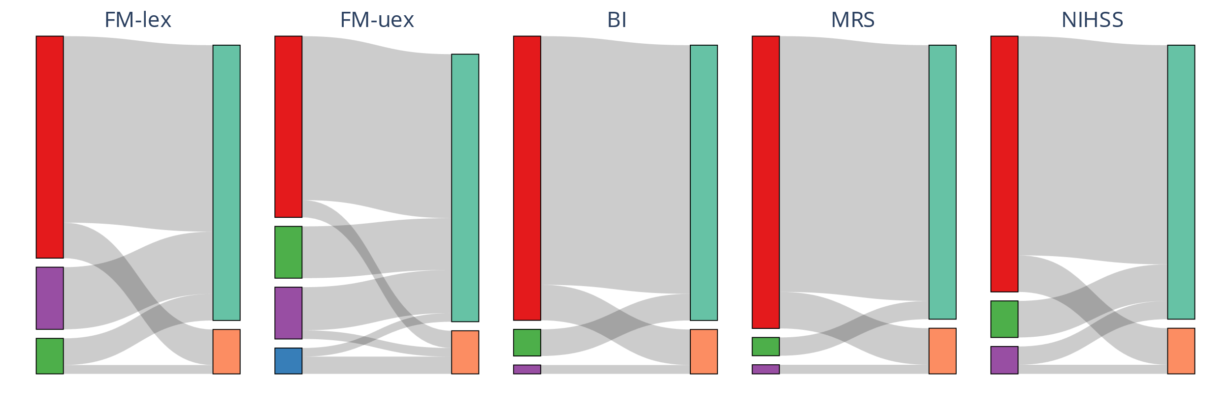
A
B
C
D
E
32
28
31
31
31
31
31
21
25
32
6
7
6
4
4
5
3
5
5
5
2
5
3
5
1
1
Steady recovery
Steady decline
Early recovery with chronic decline
Late recovery with acute decline
Infarct/Ischemia
Bleeding
Figure [X]. Sankey diagram illustrating the relationship between recovery patterns and stroke type across different assessments. Panels (A–E) represent five different motor function assessments: (A) Fugl-Meyer Upper Extremity, (B) Fugl-Meyer Lower Extremity, (C) Barthel Index, (D) Modified Rankin Scale (mRS), and (E) National Institutes of Health Stroke Scale (NIHSS). On the left, recovery patterns are categorized into steady recovery, steady decline, early recovery with chronic decline, and late recovery with acute decline. These patterns are connected to stroke type on the right, distinguishing between infarct (ischemic stroke) and bleeding (hemorrhagic stroke). The width of the connections represents the number of patients following each trajectory, with exact patient counts indicated within the corresponding boxes. This visualization highlights how different recovery patterns are distributed between ischemic and hemorrhagic strokes across various assessment types.

Slide 5
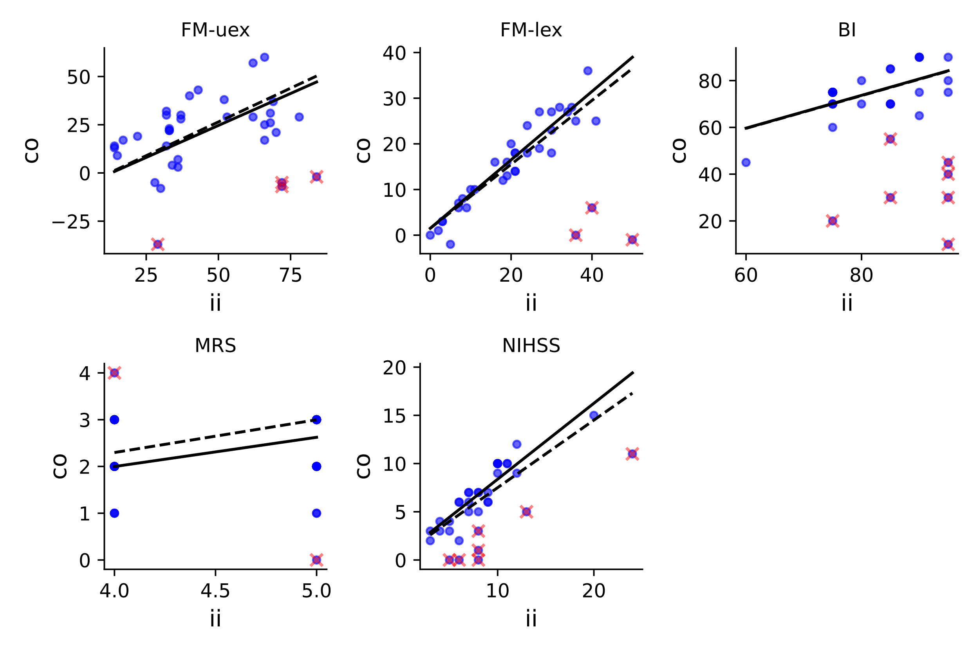
A
B
C
y = 0.75x + 1.51
y = 0.70x + 1.51
y = 0.70x + 17.59
y = 0.70x + 17.59
y = 0.66x - 8.54
y = 0.70x - 8.54
D
E
Best slope fit
PRR fit
Non-fitter (outlier)
y = 0.79x + 0.5
y = 0.70x + 0.5
x
y = 0.63x - 0.5
y = 0.70x - 0.5
Figure X. Comparison of proportional recovery rule (PRR) fit and best slope fit across different motor assessments. Panels (A–E) display the relationship between initial impairment (ii) and the change observed (co) for five different motor function assessments: (A) Fugl-Meyer Upper Extremity, (B) Fugl-Meyer Lower Extremity, (C) Barthel Index, (D) Modified Rankin Scale (mRS), and (E) National Institutes of Health Stroke Scale (NIHSS). Each panel includes two fitted lines: the PRR fit (dashed line), which represents the proportional recovery rule with a fixed 70% recovery slope, and the best slope fit (solid line), which is optimized for the given dataset. Outliers or non-fitters, identified based on the interquartile range (IQR) method using the best slope fit, are marked with a cross.

Slide 6
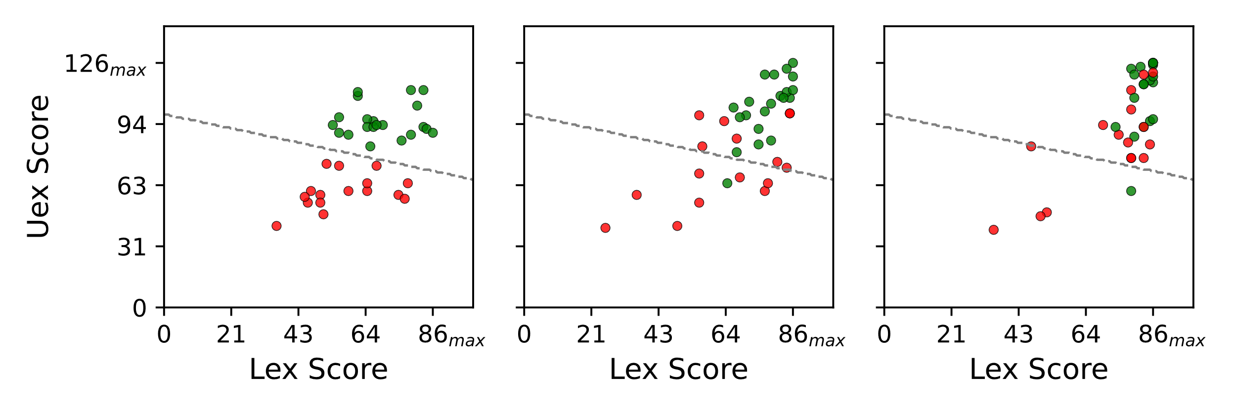
A
B
C
Good
Poor
2days
14days
90days
Supplement Figure X: Relationship between upper and lower extremity scores and their recovery over (A) the acute phase (2 days), (B) the subacute phase (14 days), and (C) 90 days. Two clusters were created by applying a k-means clustering algorithm with k=2 to dichotomize the data points into two groups—poor recovery and good recovery—based on Uex and Lex.

