Slide 1
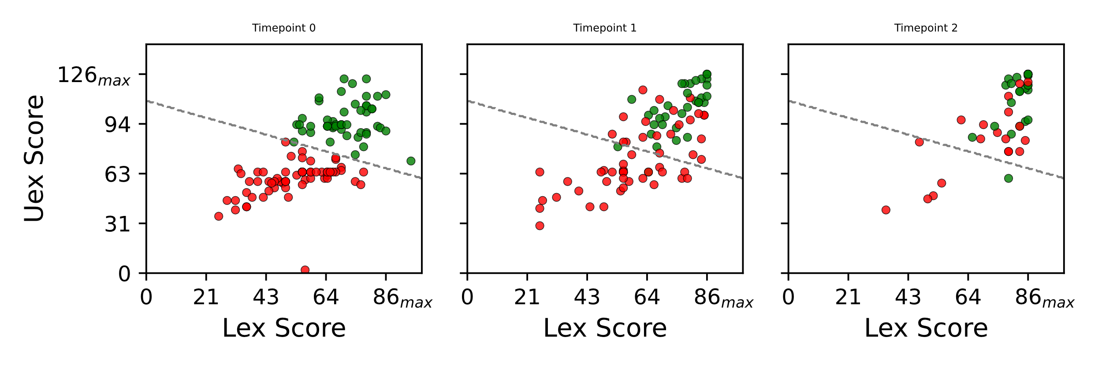
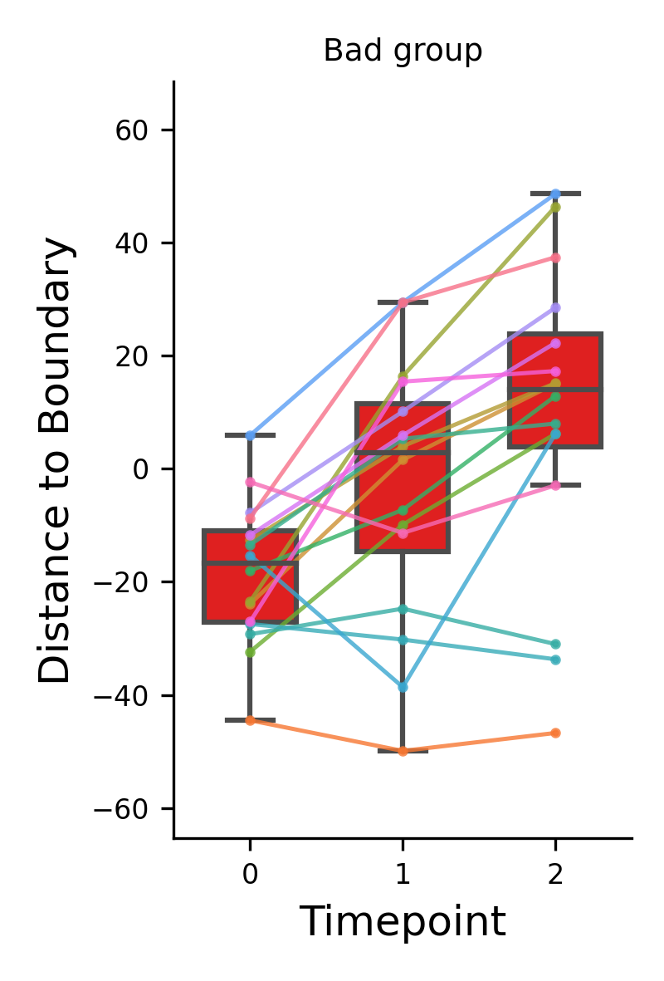
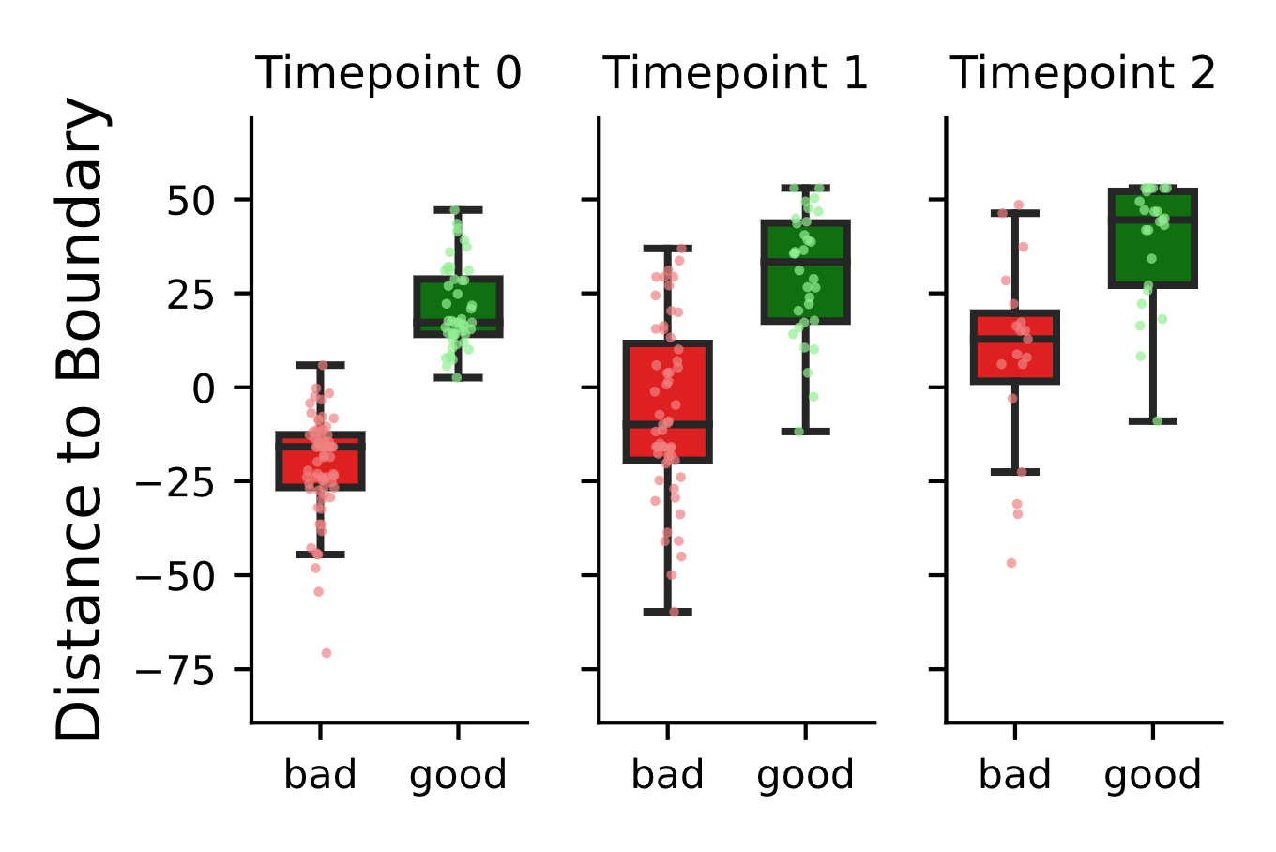
some patients have higher deficit but can catch up with patients with lower and usually better/faster recovery
Kmeans (K=2) based on TP=0 → creates two groups of high and low motor score patients
Spagetti Plot of the low motor score group
Distance to separation line
Distance to separation line
Low High
Low High
Low High
Negative values are beneath the line, positive values are above the line
Time Point

Slide 2
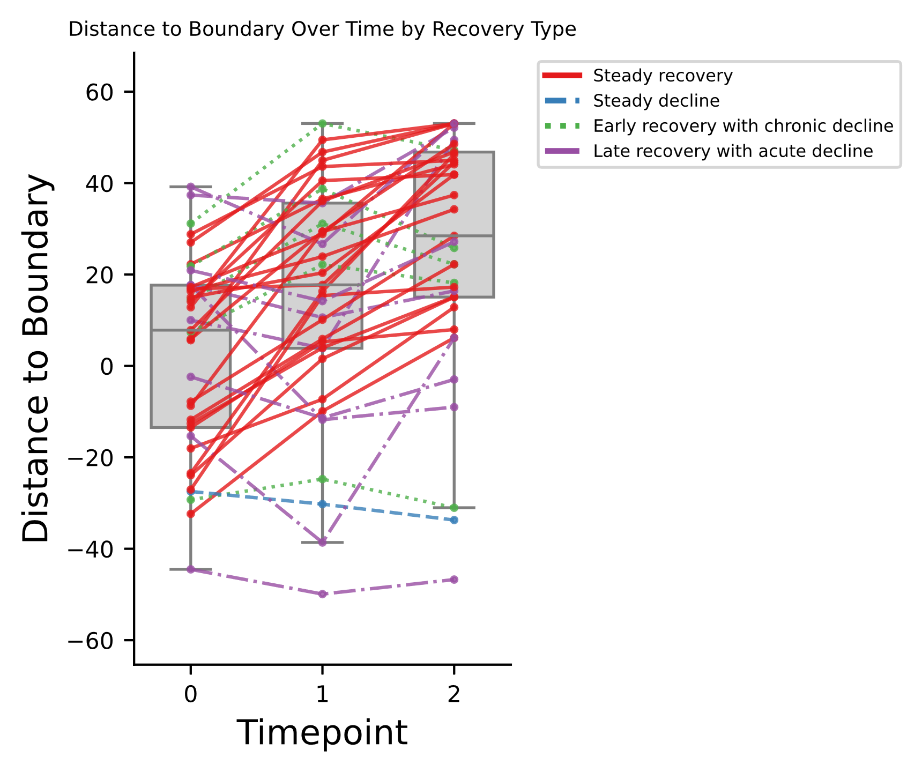
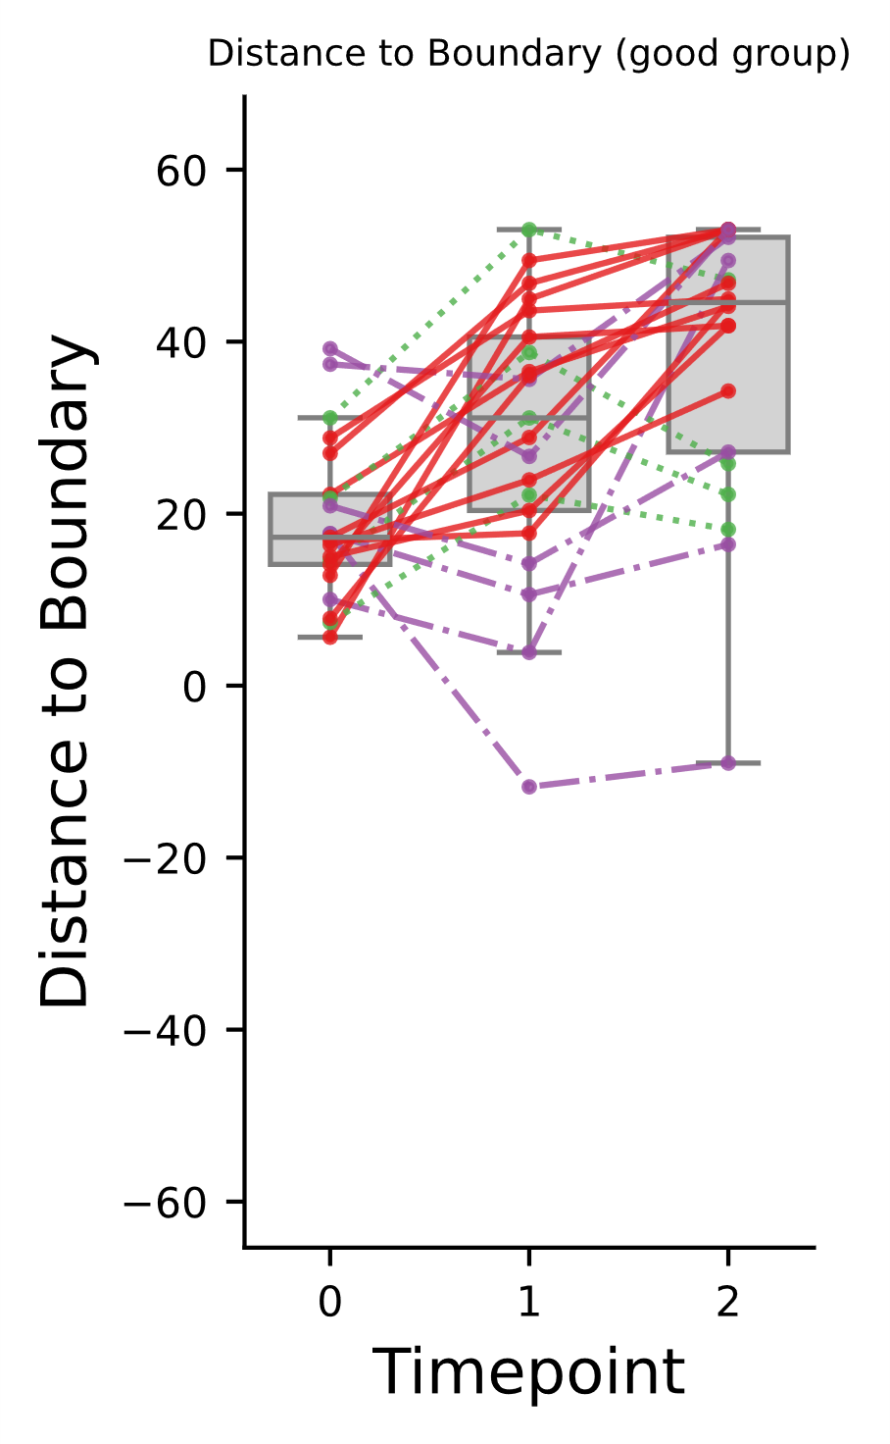
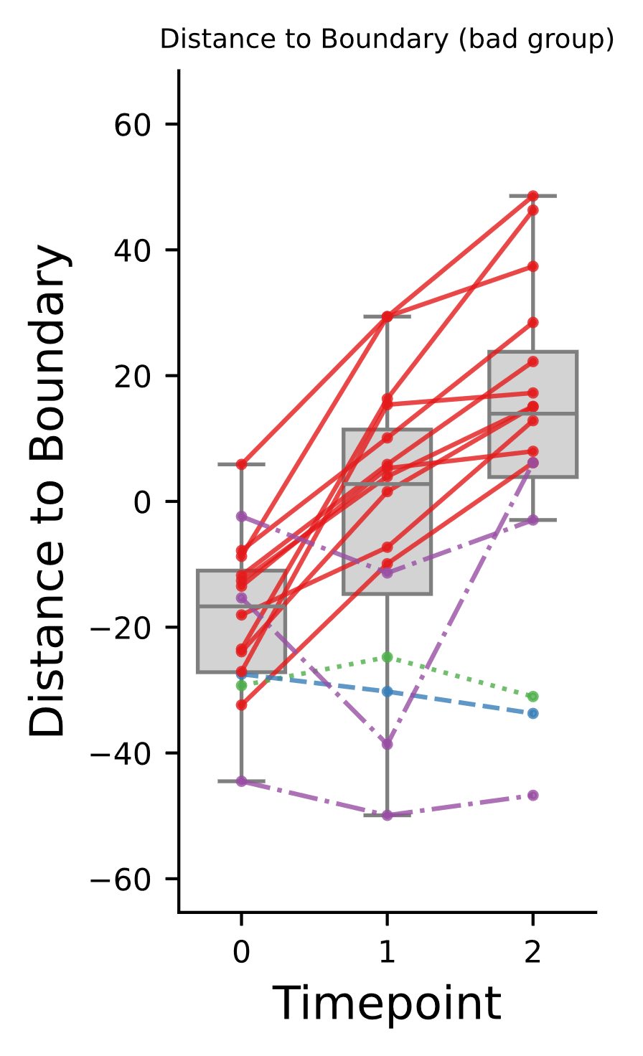
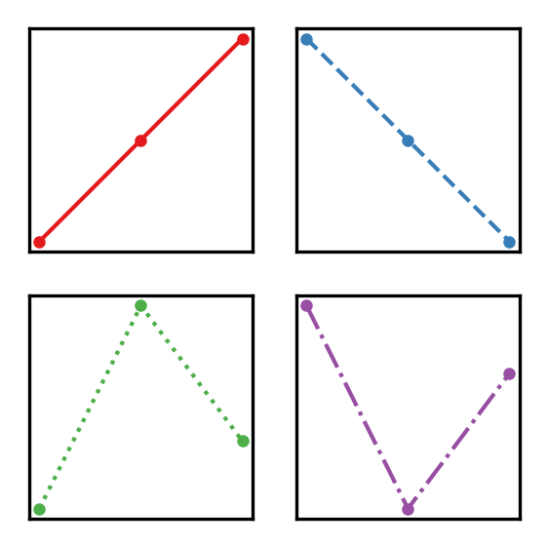
Overall Recovery Type Percentages:
Steady recovery: 59.46% (22 out of 37)
Steady decline: 2.70% (1 out of 37)
Early recovery with chronic decline: 13.51% (5 out of 37)
Late recovery with acute decline: 24.32% (9 out of 37)
Recovery Type Percentages by Fixed_Type:
Fixed_Type: bad
Steady recovery: 68.75% (11 out of 16)
Steady decline: 6.25% (1 out of 16)
Early recovery with chronic decline: 6.25% (1 out of 16)
Late recovery with acute decline: 18.75% (3 out of 16)
Fixed_Type: good
Steady recovery: 52.38% (11 out of 21)
Steady decline: 0.00% (0 out of 21)
Early recovery with chronic decline: 19.05% (4 out of 21)
Late recovery with acute decline: 28.57% (6 out of 21)

Slide 3
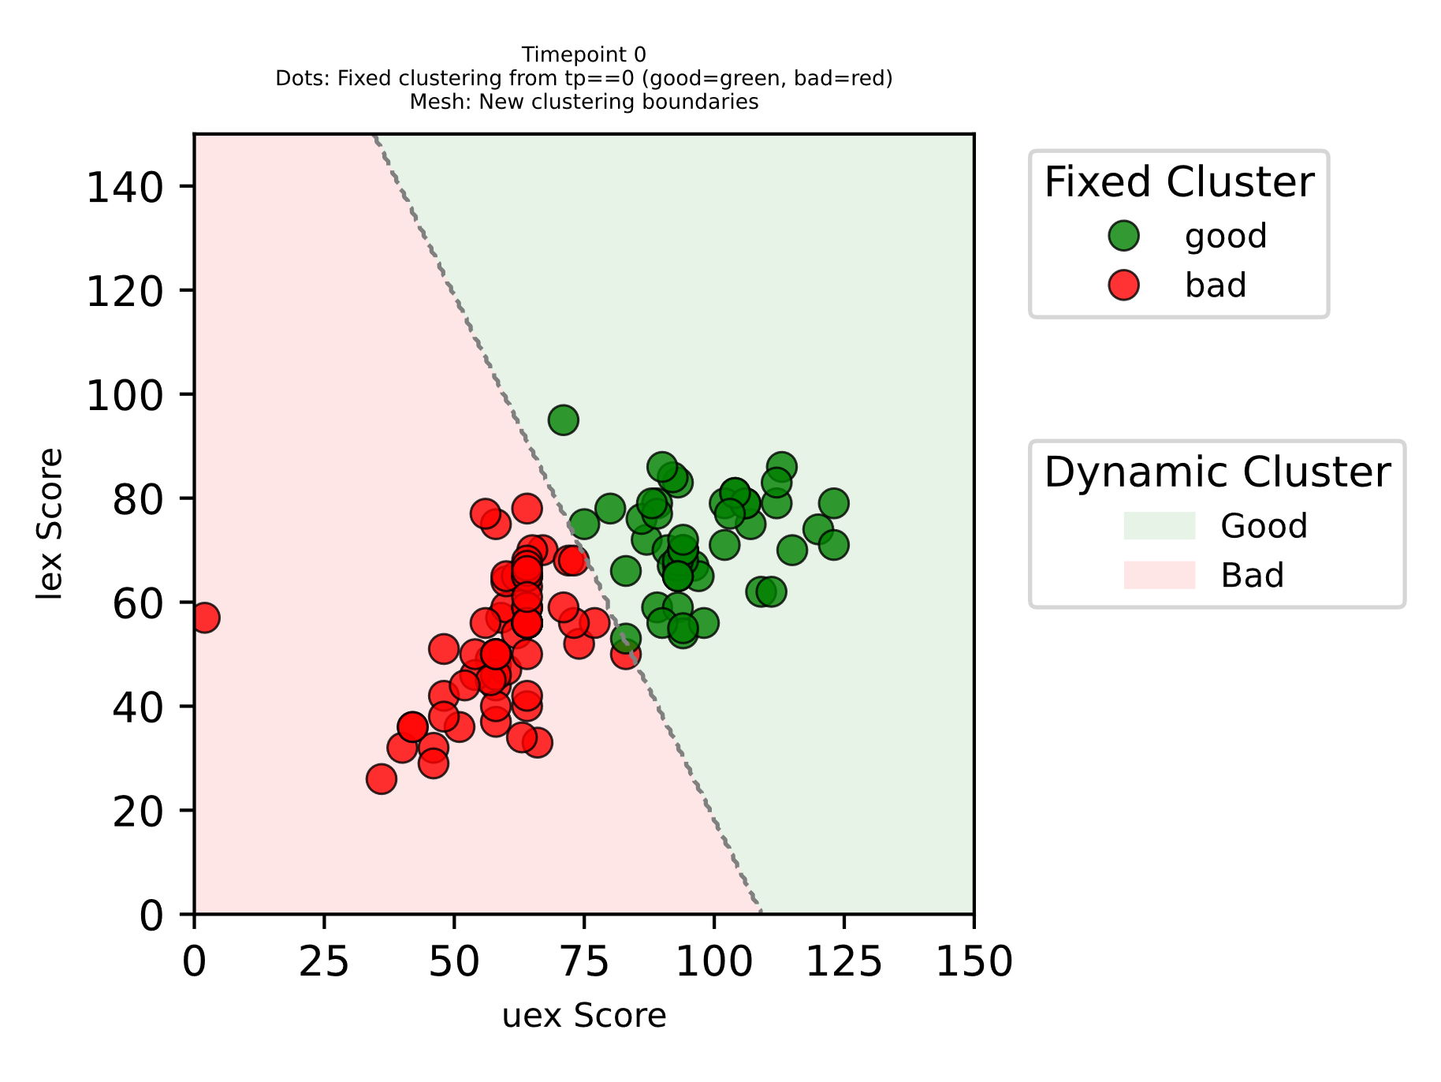
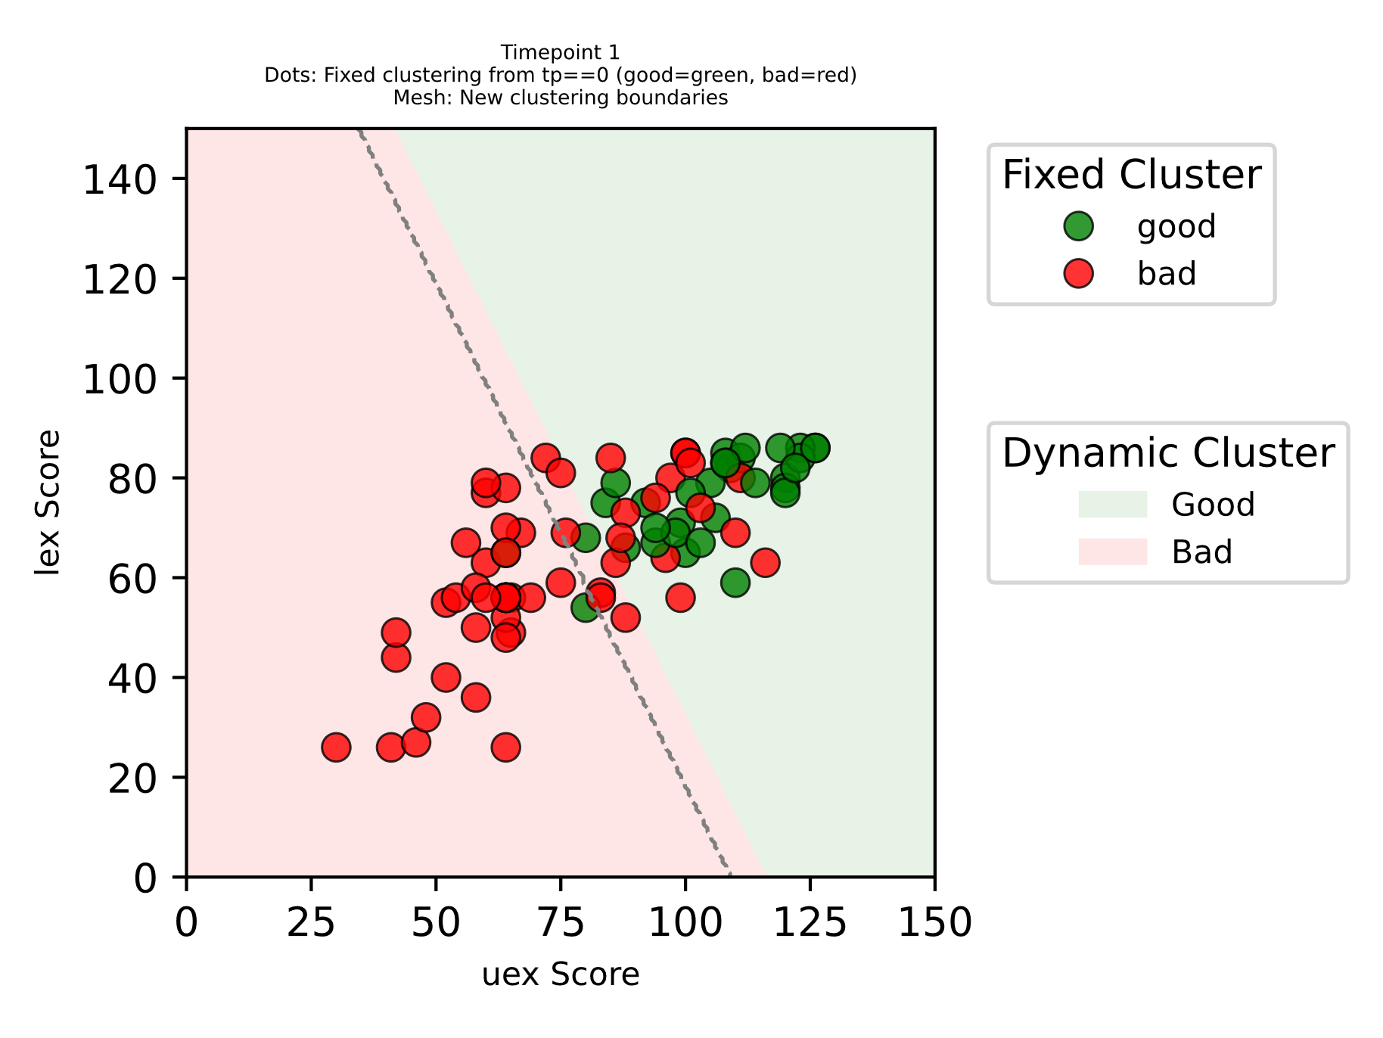
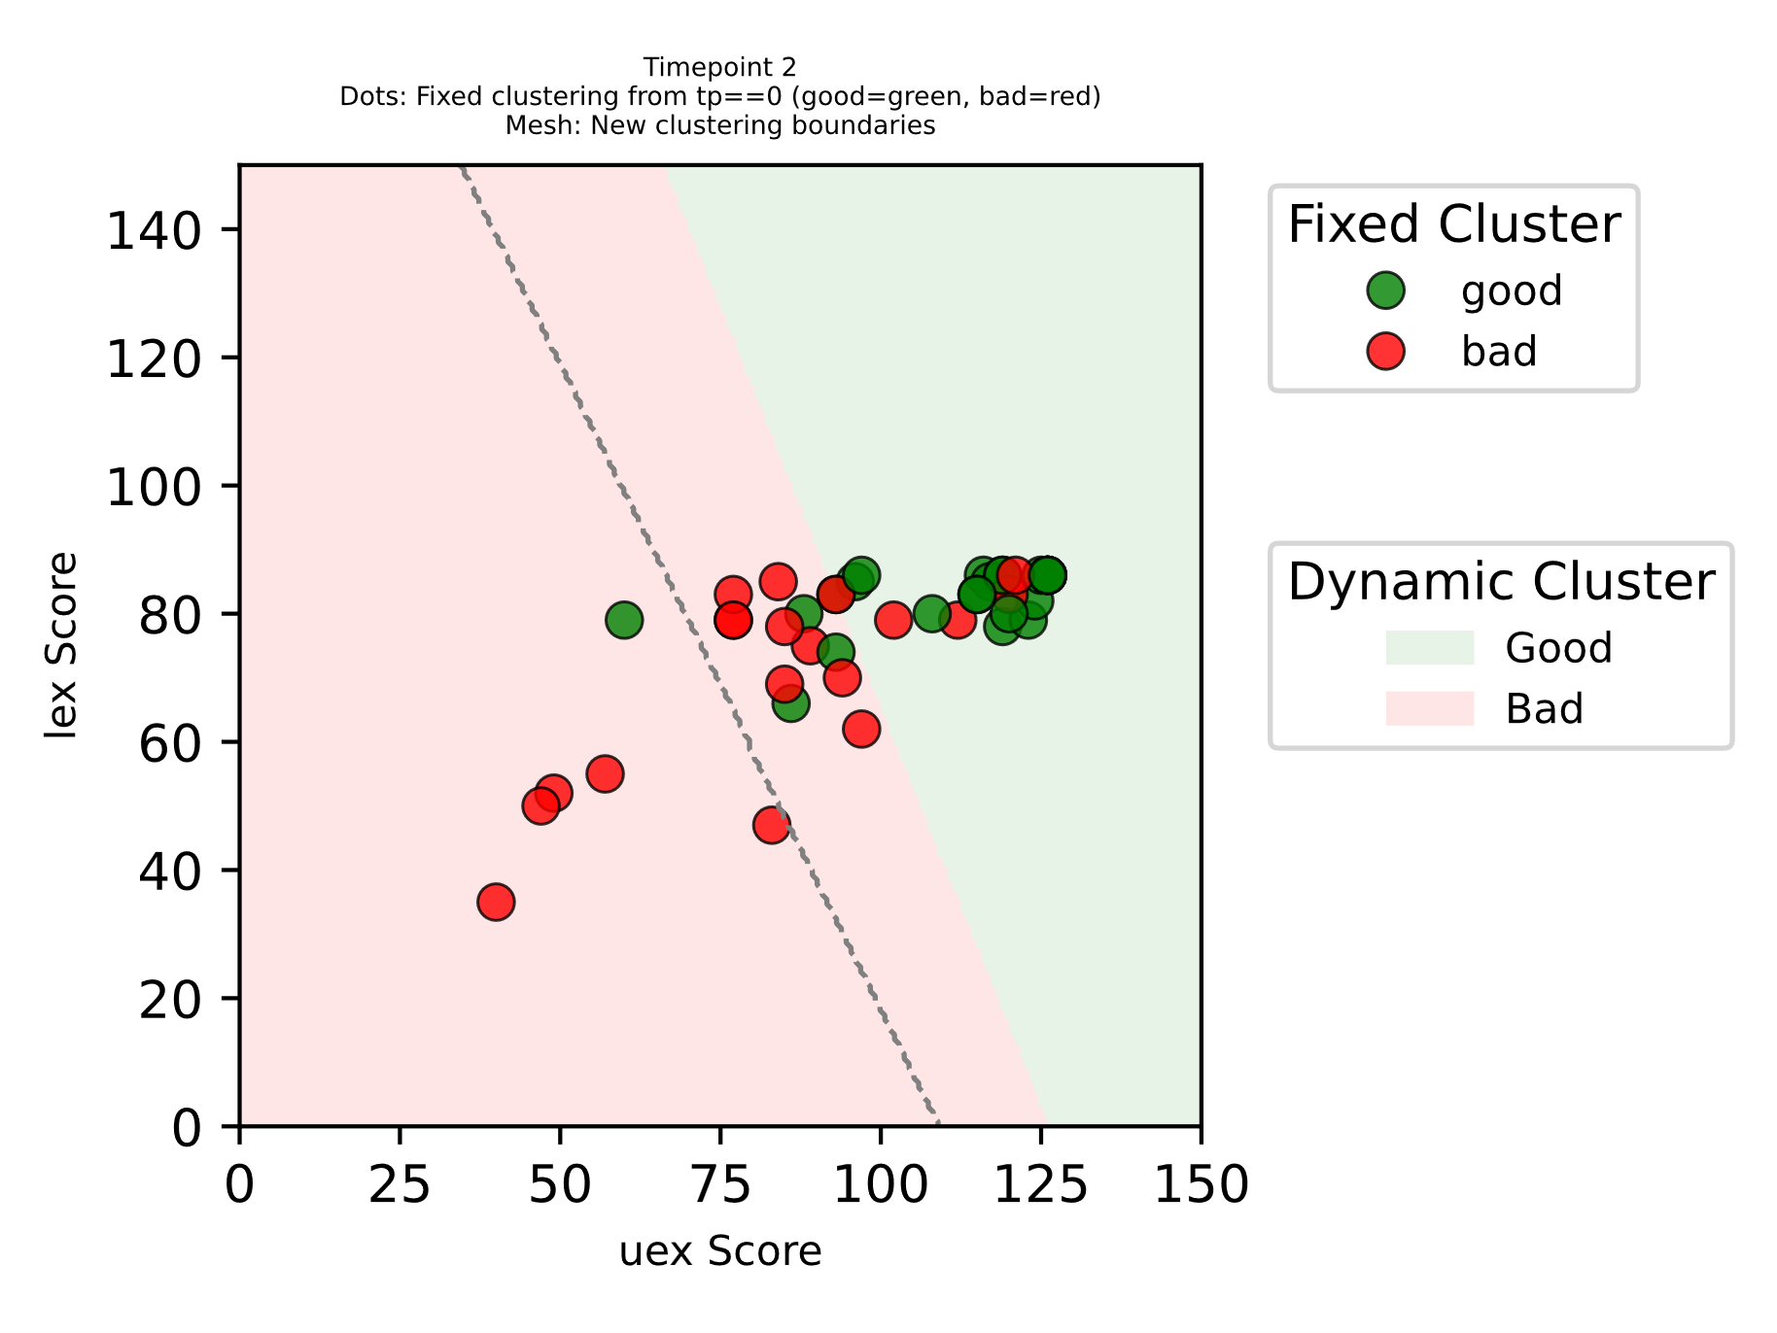
TP0
TP1
TP2
some patients have higher deficit but can catch up with patients with lower and usually better/faster recovery

