Slide 1
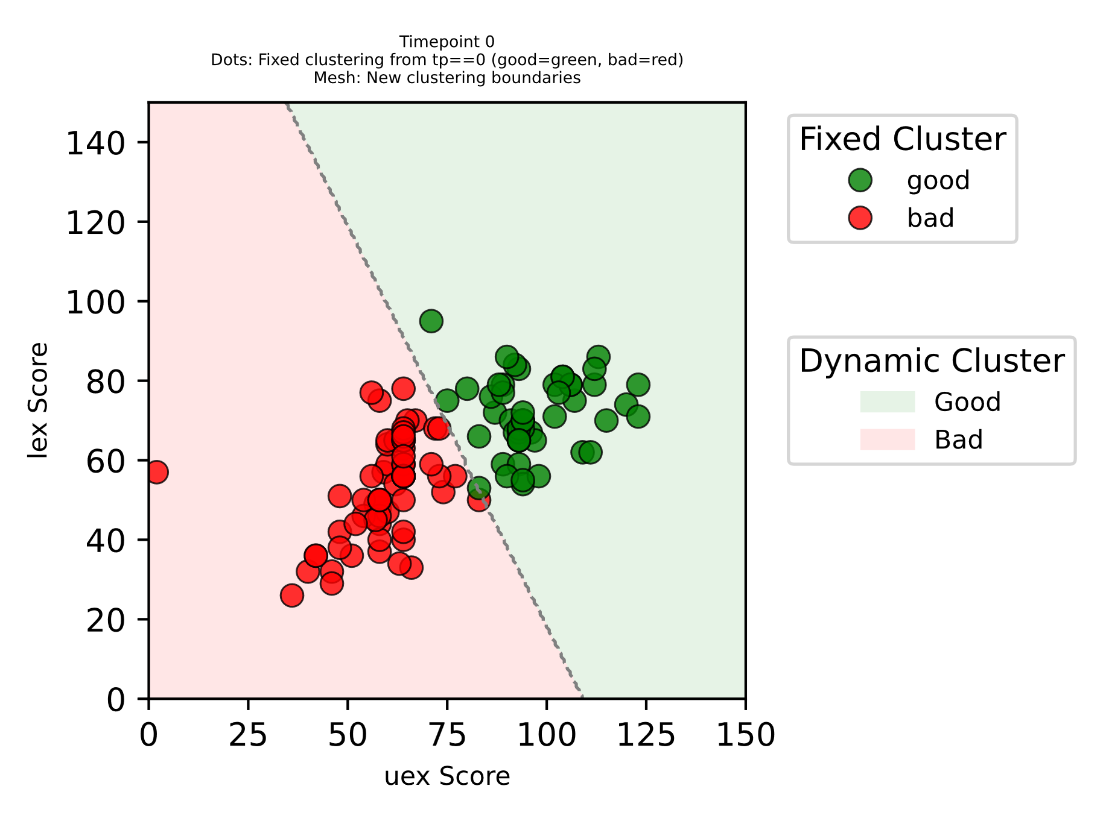
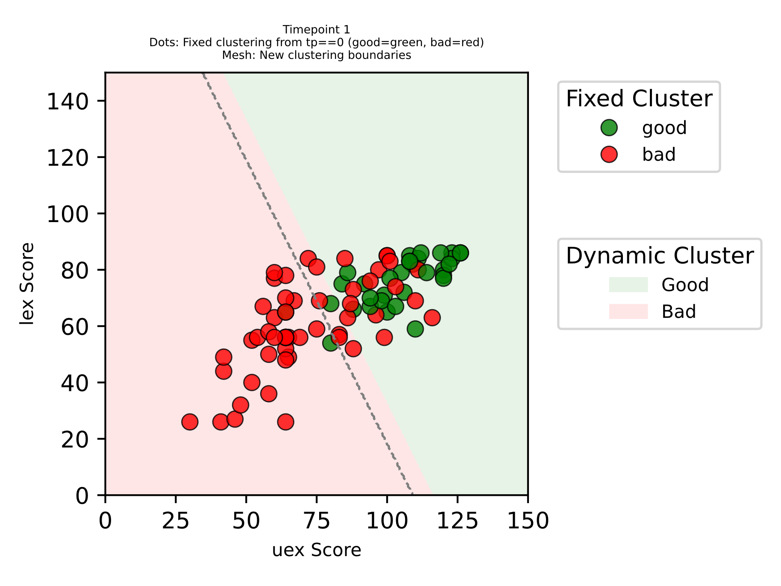
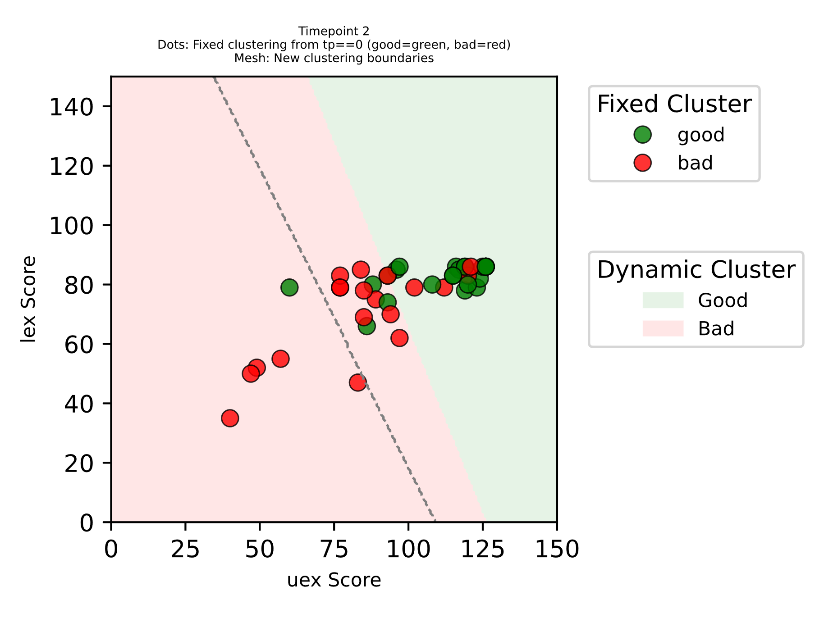
TP0
TP1
TP2
some patients have higher deficit but can catch up with patients with lower and usually better/faster recovery

