Slide 1
MINIGDRIVE
A Full-Stack Cloud Storage Platform
Built By: Aswin Raj A & Mohamed Suhail S
Secure • Scalable • Smart

Slide 2
Abstract

Slide 3
What is MiniGDrive?
A lightweight, responsive cloud-based file storage and management application.
It enables users to securely register, login, upload, download, and manage their files.

Slide 4
Key Features

Slide 5
Secure Authentication
User registration and login
Password hashing and session management

Slide 6
File Management
Upload, download, trash/restore, bulk actions
Responsive dashboard for both desktop and mobile

Slide 7
Voice & Language Support
Voice Command Support: Perform actions hands-free using the Web Speech API.
Multilingual Support: Supports English, Tamil, and Hindi.

Slide 8
Tech Stack
Frontend: HTML, CSS, JavaScript
Backend: Flask (Python), SQLite
DevOps: Docker, GitHub Actions, AWS EC2
Security: HTTPS via CloudFront, Secure File Handling

Slide 9
DevOps & Deployment
CI/CD Pipeline: Automated deployments with GitHub Actions.
Hosting: Deployed on AWS EC2.
Security: Served securely via CloudFront CDN with HTTPS encryption.

Slide 10
Application
Screenshots

Slide 11
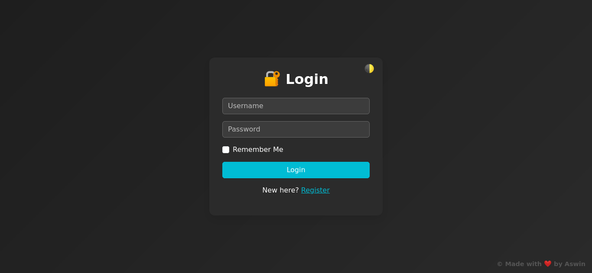
Login Page

Slide 12
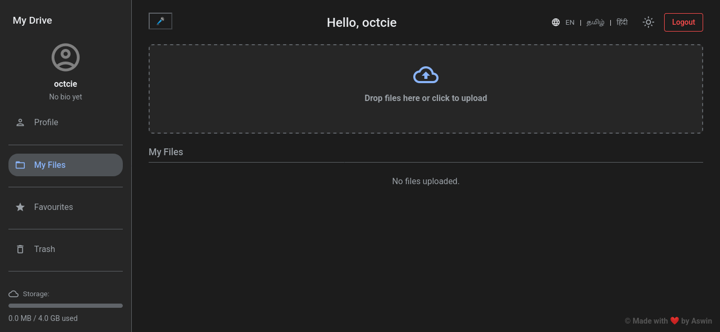
Dashboard Interface

Slide 13
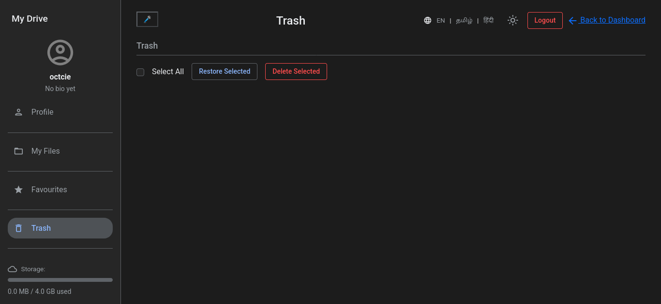
Trash and Restore Interface

Slide 14
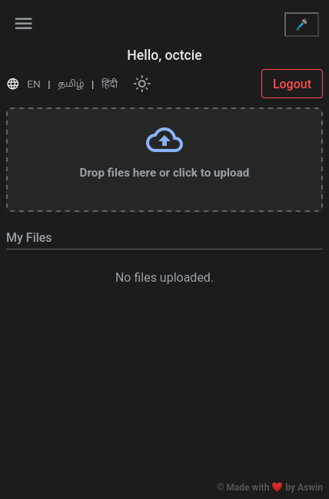
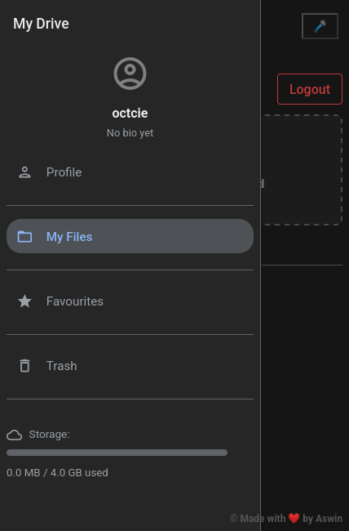
Mobile View & Storage Visualization

Slide 15
What makes it Special?
Combines core web development with DevOps practices
Emphasizes accessibility with voice and language support
Real-world hosting on AWS, not just a local project

Slide 16
Learning Outcomes
Flask + SQLite Integration
Secure web development practices
Cloud deployment and CI/CD pipelines
Real-world problem solving in file hosting

Slide 17
Closing Slide
Thank You!
Any Questions?

