Slide 1
LIBRARY MANAGEMENT SYSTEM
PROJECT COORDINATORS
DR HARIKRISHNAN D
ASSOCIATE PROFESSOR
VINEETH M V
ASSISTANT PROFESSOR
SREELEKSHMI H
ASSISTANT PROFESSOR
GROUP MEMBERS
ASWIN KUMAR P V [16]
AKASH DEEP [07]
DAKSHINA D [19]
ATHIRA K V [17]

Slide 2
INDEX
SL NO | CONTENT
1 | INTRODUCTION
2 | OVERALL DESCRIPTION
3 | SYSTEM FEATURES
4 | EXTERNAL INTERFACE REQUIREMENTS
5 | OTHER NON FUNCTIONAL REQUIREMENTS
6 | USE CASE DIAGRAM
7 | CLASS DIAGRAM
8 | CURRENT STATUS
9 | CONCLUSION
10 | REFERENCES

Slide 3
INTRODUCTION
PURPOSE
The main objective of this document is to illustrate the requirements of the project library management system.It gives a detailed description of both the functional and nonfunctional requirements of the project.
The purpose of this project is to provide a user-friendly environment to maintain the details of books and students who are accessing the library
The main purpose of this project is to regulate and simplify the circulation of books in and out of the library and provide various reports.
INTENDED AUDIENCE AND READING SUGGESTION
This project is intended to be used by Librarians of educational institutions like a college or a school.
PROJECT SCOPE
The system is basically updating the old conventional manual library system into an web application which can be used by users to get details of their account , availability of books and other details.
The project is specifically designed for librarians and library users of educational institutions
The system can be further developed to be used by any existing or new library to manage its books and books borrowing, insertion and monitoring

Slide 4
OVERALL DESCRIPTION
PRODUCT PERSPECTIVE
Library Management system is a replacement for the old conventional method of management which depends on paperwork for recording books and its details
It will take care of current book detail at any point of time. The book issue, book return will update the current book details automatically so that the user gets the updated current book details accurately.
PRODUCT FEATURES
The system provides real time information about the books available in the library, main purpose of the system is to reduce manual work and implement automation.
The system is able to manage book details, addition and deletion of books, book issue/return , and generate various reports for record keeping according to the end user requirement.
The librarian will act as the administrator to control the users and manage the book.
The student's status of borrowal/return of a book is maintained in the database.A new student can be registered by the librarian and his account can also be managed.

Slide 5
USER CLASSES AND INTERFACES
The system provides various types of services based on the user.
There are mainly two actors in the scene , the librarian who acts as the administrator and the user who can be a student using the system.
The features that are available to these users are:-
Librarian
● Insert, modify and delete books.
● Add a new user into the database.
● Get the information of any member who has borrowed the book.
● Add and edit book categories and arrange books by these categories.
● Update book details.
● Can issue and return books.
● Approval book renewal request.
● Calculate fine for late return.

Slide 6
Student
● Check account information.
● Browse through different categories of books in the library.
● Check the availability of a book to borrow
● Request to renew the book borrow period.
● See any impending fine to be paid.
OPERATING ENVIRONMENT
The Library Management System is a web application and shall operate in all famous browsers,for a model we are taking Microsoft internet explorer ,Google chrome ,Mozilla firefox etc.
DESIGN IMPLEMENTATION CONSTRAINTS
Any details regarding the books from the library are to be recorded to have updated and correct values
The borrowing/return of books must be updated properly, users must be notified to renew their book once the borrowing period limit is over.

Slide 7
ASSUMPTIONS AND DEPENDENCIES
The assumptions are:
The system graphical user interface should be user friendly so that the users can use it easily.
All the information of users, books and their details must be stored and updated accurately and should be accessible by the system.
The system should have sufficient storage capacity and provide fast access to the database.
The system should provide searching and filtering facilities
The dependencies are:
Specific hardware and software required by the software to run.
On the basis of the requirements and specifications the project will be developed and run.
The end users must have a proper understanding of the project.
The information of all the users must be stored in the database and is accessible by the system.
Any update regarding the books from the library must be properly recorded to the database and the data entered must be correct.

Slide 8
SYSTEM FEATURES
LOGIN AND REGISTRATION
Description:The user is provided with an interface to login to the system by providing his username and password. The librarian is provided with an interface to register a new user.
Login:
Input:The user enters the username and password.
Output: The user is redirected to the home page .
Processing: The username and password is validated
Register a user :
Input: Librarian enters name, username , password and role.
Output: User gets registered into the system
MANIPULATE BOOK DETAILS
Description: The librarian is allowed to add a new book delete a book and update the details of a book in the database
Add Book:
Input: Details of book including book name, author, publication, publication year.
Output: Book gets added in the database.
Processing: The system checks if a similar book already exists in the database

Slide 9
Delete book:
Input: Librarian selects which book to be deleted from the available books:
Output: The selected book gets deleted from the database.
Edit book:
Input:The user selects a book to edit and changes the details as required.
Output: The details of the book are updated
CATEGORIZING
Description: The librarian is given the functionality to categorize the books into various section
based on the genre or speciality
Add Category:
Input: A new category
Output: A new category gets added.
Processing: The system checks whether the category already exists in the system
Change Category:
Input : The librarian selects or changes a category of a book.
Output: Category gets changed.

Slide 10
SEARCH
Description: The system allows the user to search for a book available in the library
Input: The user enters the keyword and an optional category
Output: A book matching the provided keyword and category is listed.
Processing: The database is searched for the entered keyword
VIEW
Description: The system allows the librarian to View all users and books details
View book:
Input:The librarian selects a book.
Output : All details like name, autor, publication, publication date ,availability status is displayed.
View user:
Input: The librarian selects a user.
Output: All details regarding a particular user including books currently borrowed by him are displayed
ISSUE/RETURN BOOK
Description: The system allows the librarian to issue and return books to different users.

Slide 11
Issue Book:
Input: The librarian selects a user and marks the book which is to be issued to that particular user.
Output: The book is issued to the user and is reflected in the user profile.
Return Book:
Input: The librarian selects the user who wants to return a book and marks the book as returned.
Output: The book return status is reflected in the user profile
Calculate fine:
Input:Command to calculate fine.
Output:Fine for the particular user is calculated.
Processing:The fine is calculated based on the number of days past the return date.
Return book with fine:
Input:Selects the user who wants to return the book. Calculate fine with the command.
Output: The fine is calculated and marked paid in order to return the book by the user.
RENEW BOOK
Description: The user requests the librarian to renew a book which has passed its return date and
the librarian approves or declines the request.

Slide 12
Request Renew Book:
Input: User selects a book for its renewal and submits his request.
Output: The request gets forwarded to the librarian.
Confirm Renew Book;
Input: The librarian gets the request from a user to renew the book and selects approve or decline.
Output: As per the librarian's choice the renewal is processed.

Slide 13
EXTERNAL INTERFACES AND REQUIREMENTS
User Interfaces
The system provides a good graphical user interface for the user and administrator which allows them to operate easily on the system performing required tasks such as create, update and viewing details.
● Login and registration interface: This interface provides the user the facility to login or
register into the system.
● Home page:
Librarian: This interface allows the librarian to perform functionalities like:
Add,delete, update book details.
Can see user and book details like the books borrowed and availability status.
Categorize books based on its genre and specialization.
Issue /return books to the user.
Calculate the fine for different users based on the number of days past the borrowal period.
Common:
This interface allows both the librarian and student to search for books based on different inputs like keyword, category etc.
Student:
The interface allows the student to search for books and see information about a particular book.
Functionalities like request renewal for books past allotted time,seeing impending fine,viewing account information is also made available

Slide 14
Hardware Interfaces
● 1GHz or High processor
● 512 MB RAM
● 500 MB Hard Disk
Software Interfaces
● Windows
● Internet Explorer, Chrome, Firefox
Communications Interfaces
Communication interfaces are the interfaces that belong to any communication function that are
required and used in our software.
● Web browser :internet explorer, chrome firefox
● Communication standards :HTTP ,HTTPS

Slide 15
Other Nonfunctional Requirements
Performance Requirements
● The performance of the system must be fast and accurate.
● The system should accommodate a high number of users and books without any fault.
● The system should handle expected and unexpected errors in ways that prevent loss in information and long delay in acquiring information.
Safety Requirements
● The database may get crashed at any point in time due to virus or OS errors. Therefore it is required to take a backup of the database so that all information is not lost
Security Requirements
● System will use a secured database.
● Session handling methods must be implemented properly to prevent login anomaly and unauthorized access into the system.
● System has different types of users and each user has constraints unique to him/her.
Software Quality Attributes
● The project should be an open source.
● The quality of the system is maintained in such a way that the system and the database usage is very user friendly.
● The user will be able to easily download and install the system

Slide 16
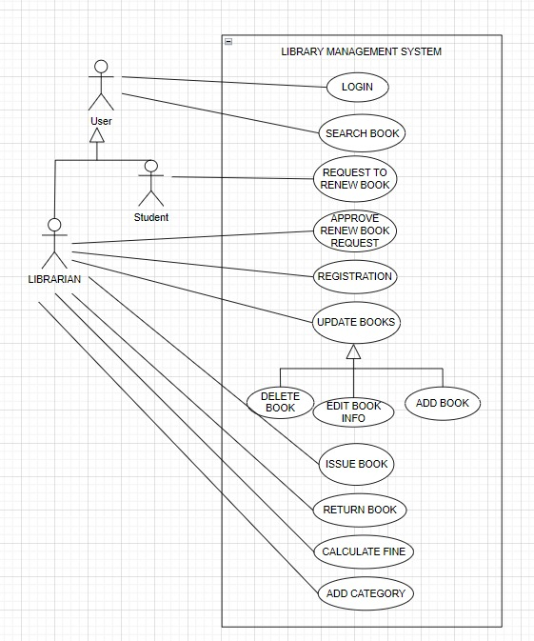
USE CASE DIAGRAM

Slide 17
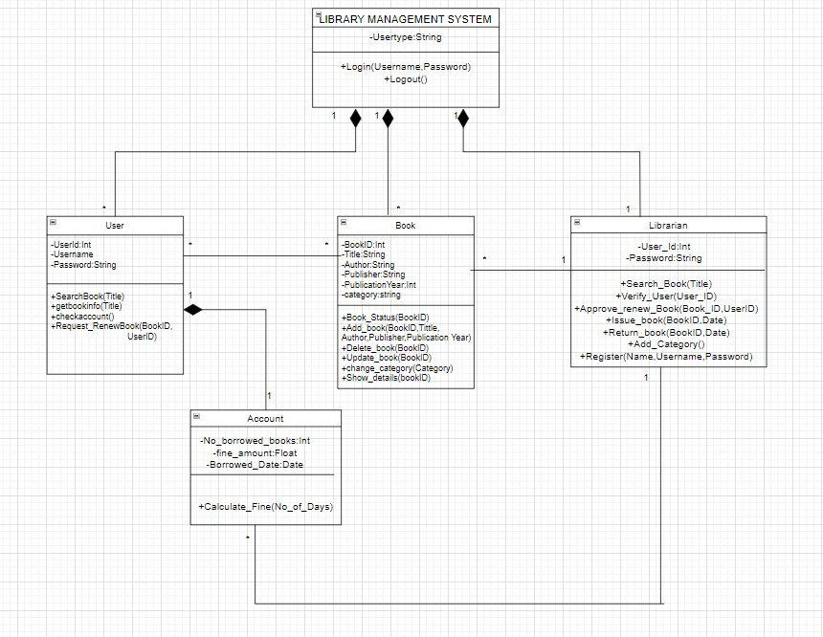
CLASS DIAGRAM

Slide 18
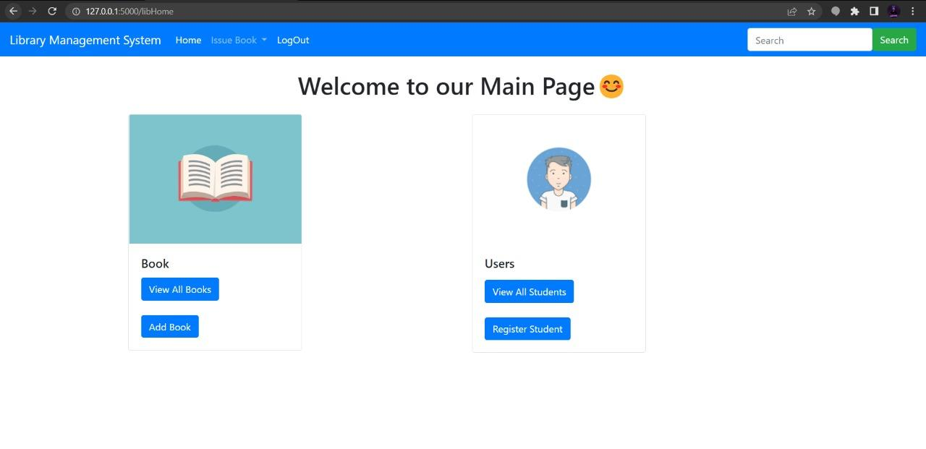
CURRENT STATUS

Slide 19
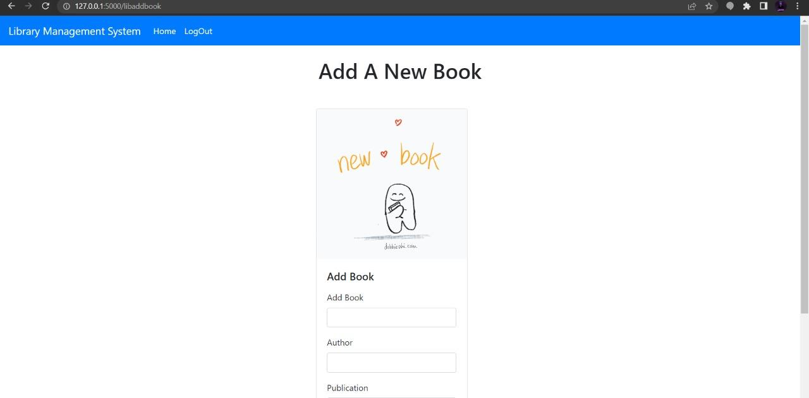
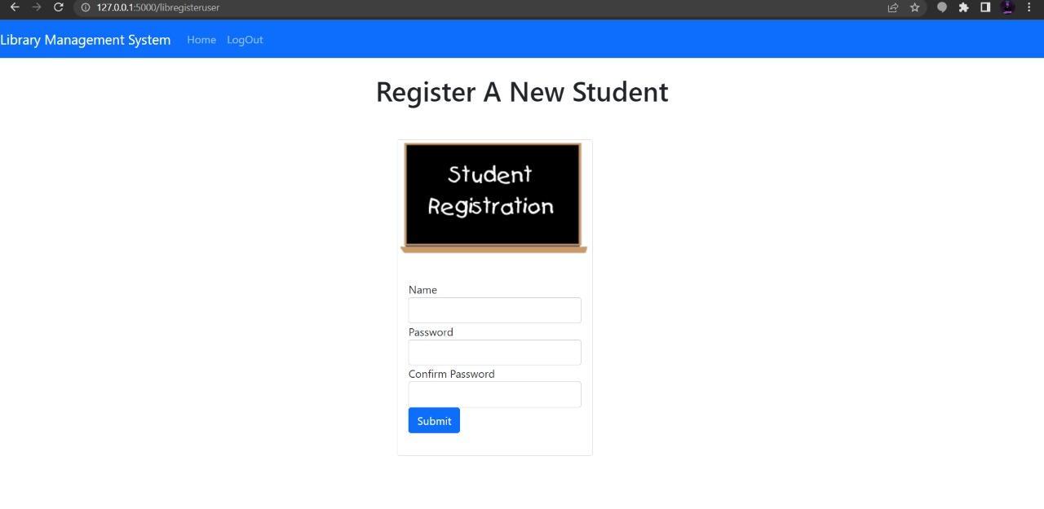

Slide 20
CONCLUSION
The proposed system is able to efficiently manage , categorize , keep a track of books stored in a library.
The system is able to help the admin to keep track on the users and their activities in the library.
The implementation of the system will reduce data entry time,and can replace old conventional pen and paper system.
The software allows storing the details of the data related with the books and users.

Slide 21
REFERENCE
https://www.youtube.com/watch?v= al 2 bECumKg&t= 1270 s
https://codewithharry.com/videos/php mysql login system in one video
https://www.slideshare.net/ToseefHasan2/srs-for-library-management-system
https://github.com/vinitshahdeo/Library-Management-System

Slide 22

THANK YOU

