Slide 1
MVP Presentation – Team Cipher
Idea Title : SupplySense – Retail Supply chain resilience
Team Captain Name : Aswin Kumar B S
Team members Names : Naveen D , Smriti T M , Malar S
College Name : Kumaraguru College of Technology

Slide 2
SupplySense
Problem Statement
Solution Description
SupplySense — AI Procurement Intelligence for Indian FMCG
Problem
₹12,000 Cr annual loss due to supply chain disruptions
78% procurement teams rely on spreadsheets & intuition
No visibility beyond Tier-1 suppliers
Impact
Stockouts detected after failure (not before)
Tier-2 risks invisible → cascade failures
Alerts scattered across emails
₹ exposure calculated too late
Core Gap Procurement is reactive, not predictive
SupplySense = Real-time AI Procurement Command Center
Flow
Signal → AI Agents → Risk Score → ₹ Impact → Action
How it works
Detects disruptions (weather, strikes, supply issues)
Scores supplier risk (0–1 across 6 factors)
Calculates ₹ TFE (financial exposure)
Recommends actions (switch / reorder / expedite)
Key Features
Risk Engine (6 factors)
India Map (risk visualization)
What-if AI Chat (scenario simulation)
Alternate Supplier Suggestions
Board Brief (exec summary)
Custom Risk Weights (real-time UI recalculation)

Slide 3
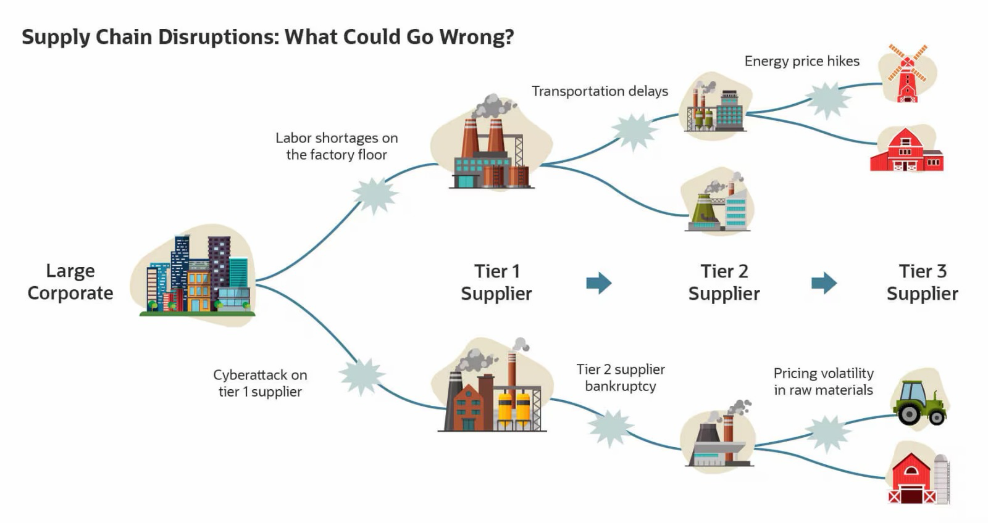

Slide 4
SupplySense
Uniqueness / Innovativeness
Business Impact
Novelty
Multi-agent AI system (not single LLM)
AI reasoning + deterministic math
Focus on 7–14 day early warning
Key Differentiators
Deterministic risk engine (auditable)
Explainable AI (score breakdown)
Client-side weight customization
Tier-2 cascade risk propagation
India-First Design
Festival-aware demand
₹-based financial impact
India map risk clustering
Vs Existing Tools
ERP → backward-looking
Planning tools → slow
SupplySense → real-time, predictive, actionable
Quantitative
Detection: 48 hrs → < 2 min
Stockout prevention: 20% → ~70%
Alternate sourcing: 3–5 days → < 1 hr
Analyst time saved: ~12 hrs/week
ROI (₹500 Cr company)
1 stockout = ₹18–25L
Prevents ~8/year = ₹1.5–2 Cr saved
Cost = ₹15–20L/year
ROI = 8–10x
Qualitative
Faster decisions
Full visibility
Reduced panic ordering
Better supplier control

Slide 5
SupplySense
Technical Design and architecture
Backend
Python, FastAPI
AWS RDS PostgreSQL
Frontend
React + TypeScript
AI Layer
Multi-agent pipeline
Signal → Risk → Action → Advisor
AWS Bedrock (Claude)
Core Engines
Risk Engine
Financial Engine
Cascade Engine
AWS Stack
Amazon RDS → database
Amazon Bedrock → LLM (Claude / Nova)

Slide 6
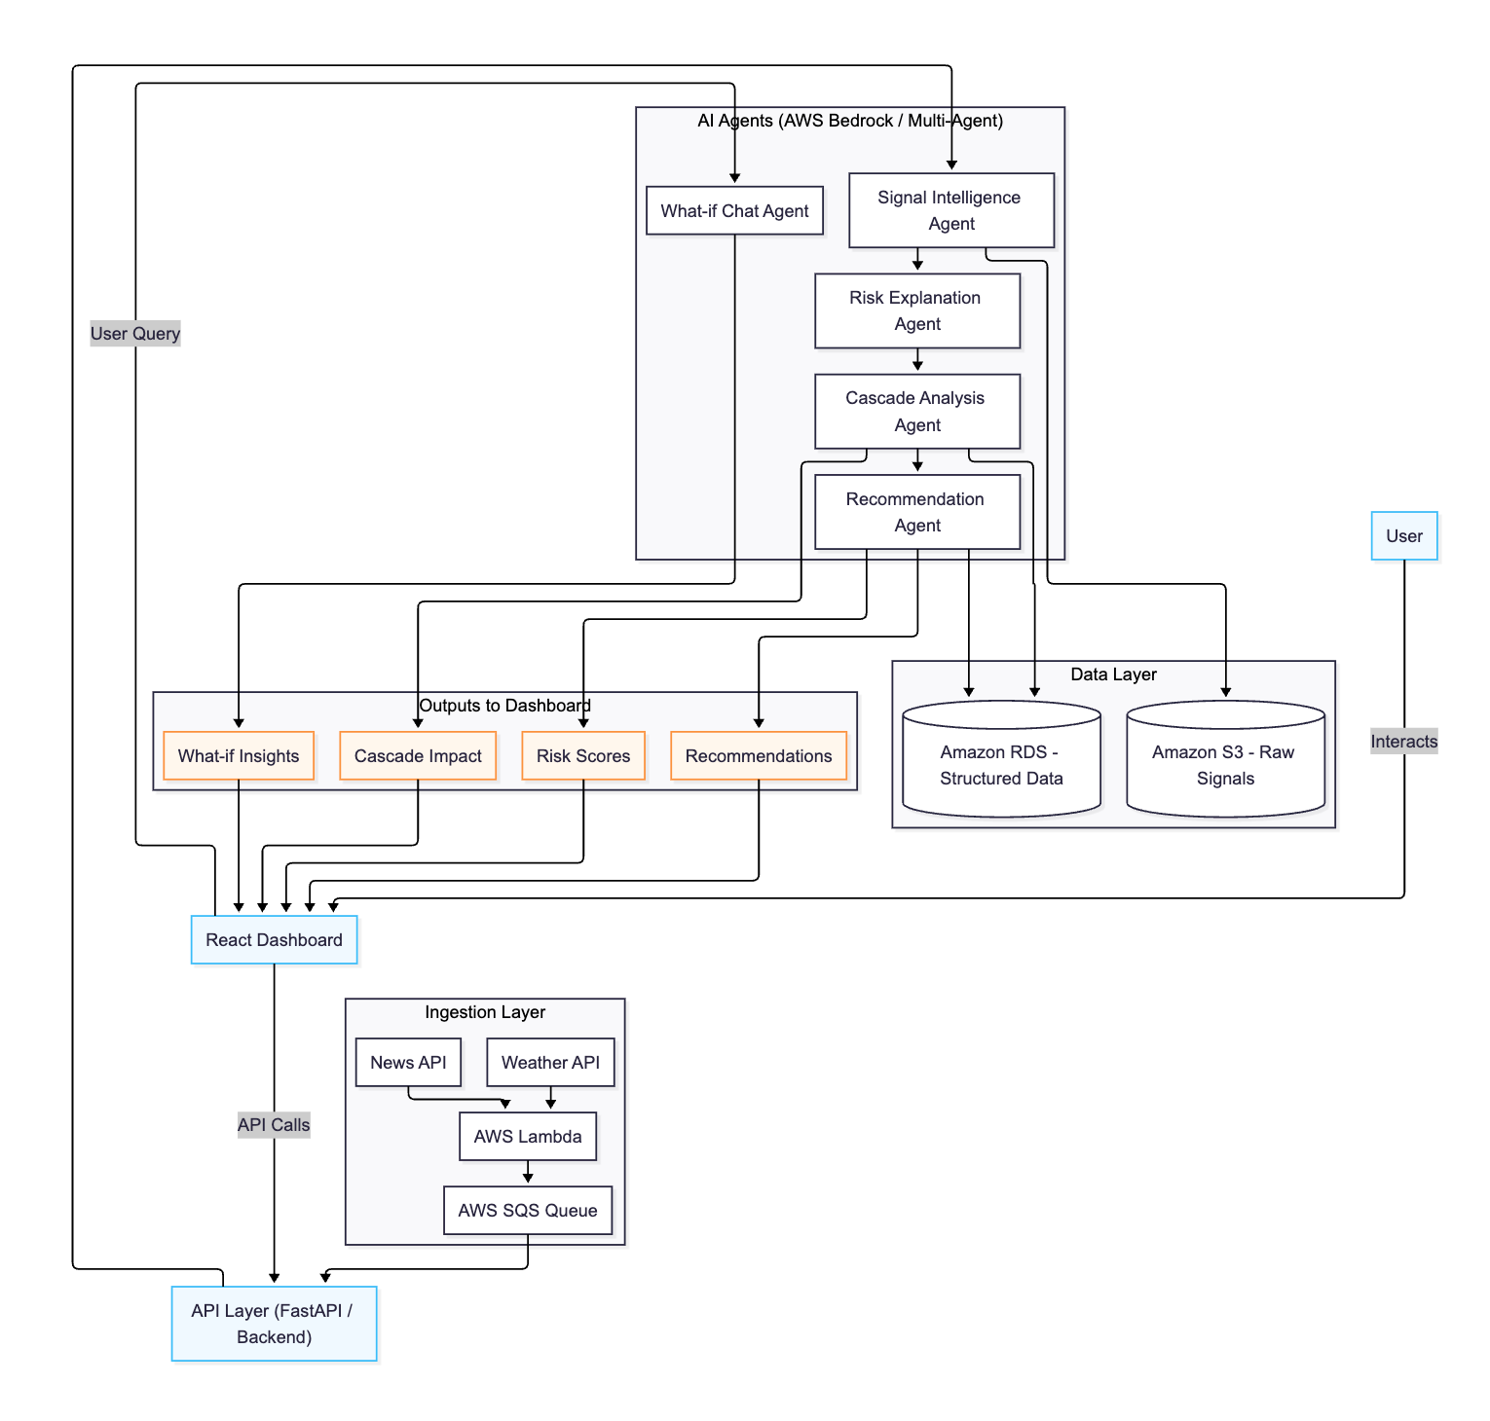

Slide 7
SupplySense
Scalable / Reusable
Roadmap
Live ERP integration (SAP, Oracle)
Real GSTN E-Way Bill API integration
ML-based demand forecasting
Supplier financial risk scoring
Multi-country expansion
Autonomous ordering (AI executes purchase)
Technical
FastAPI + PostgreSQL → scalable backend
Multi-agent architecture → modular
AWS Bedrock → model flexible
Real-time event pipeline
Business Reusable across:
FMCG
Pharma
Automotive
Retail
Key Point One platform → multiple industries (configurable)

Slide 8
Thank you

