Slide 1
BELUS
A small idea to wake people

Slide 2
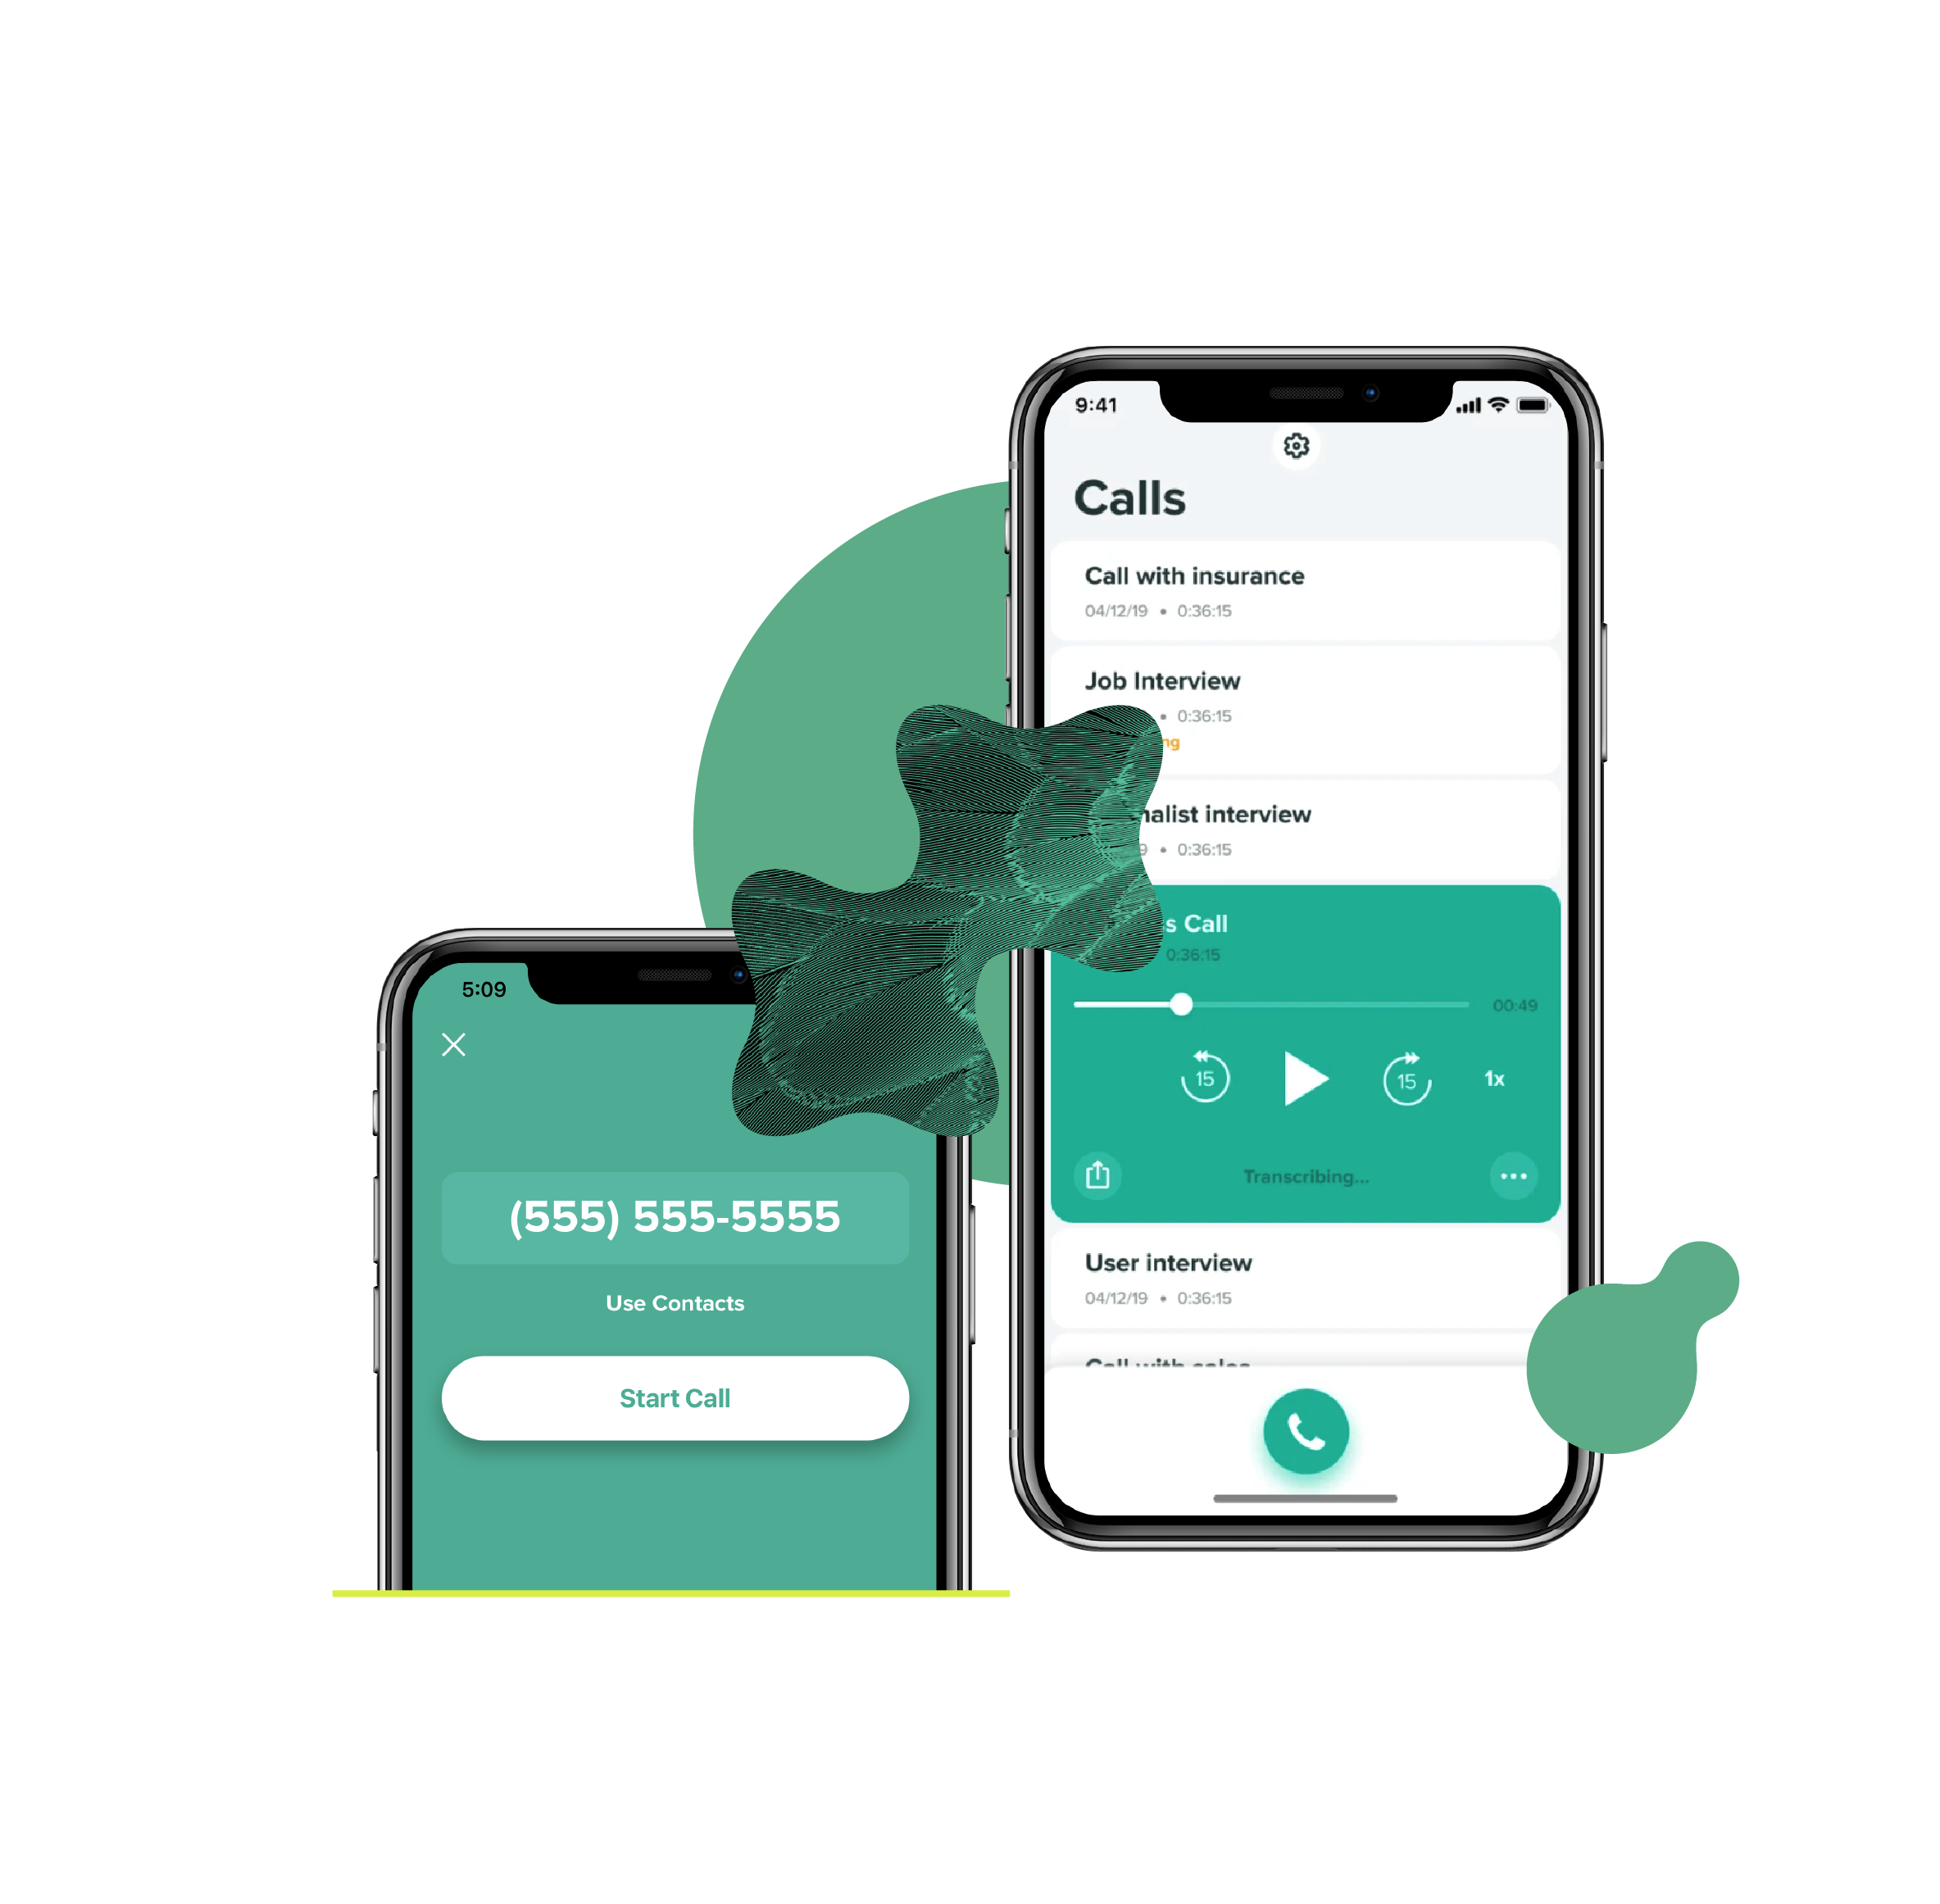
Call
What is calls?
Calls are nothing but it is a way of communication with each others
Using devices.This call made a big industrial change in the world
Based on generation call system are drastically change from hard to smart system.
Whatever the change occour we face most spam call are continue from old system of calling function to advance calling function.

Slide 3
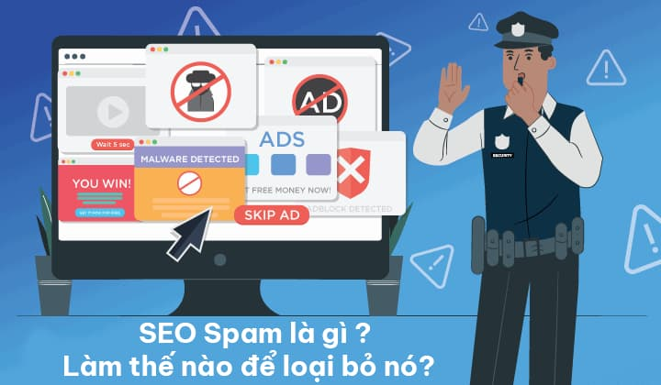
spam
Spam:
Spam define as a fraud activities occur in our daily life in simple way but with a lot of profitable support.
Now a days spam not occur physically but occur in digital form this is a easy way to fraud people in a easy manner most of spam has no record or any proof.

Slide 4
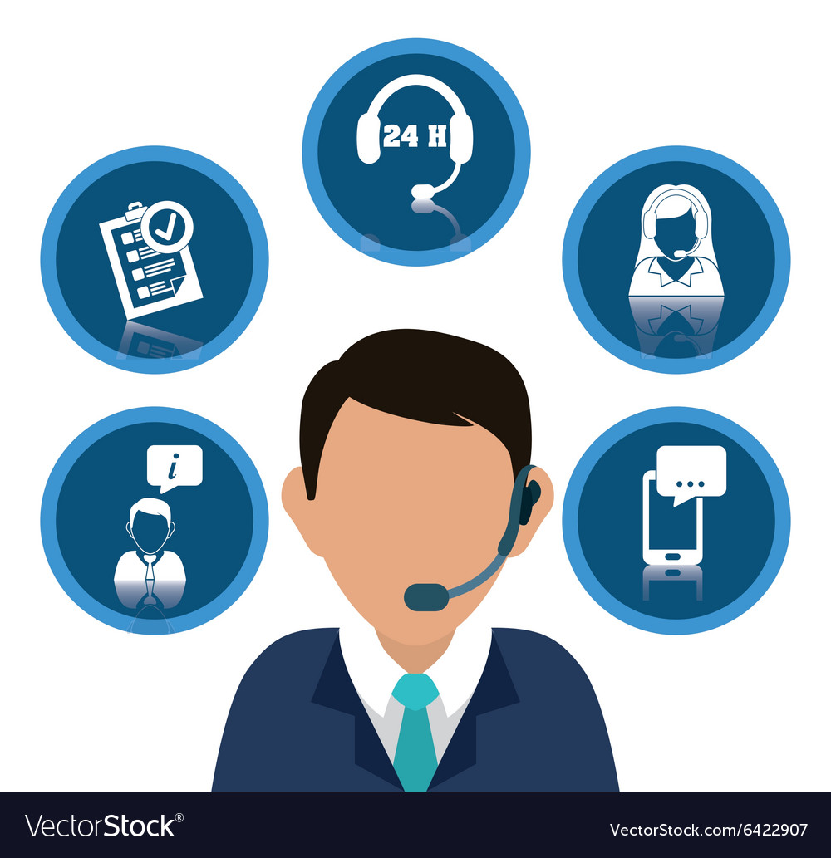
service call
Service calls are nothing but it is a computer call which was provide by the product seller to the customer for the purpose to provide a upgrade service for their use.
Service calls are classified into :
Customer service .
Upgradation service .
Alert service.

Slide 5
Difference between spam call & service call
Spam call
Service call
Simply put, spam is a type of unwanted call that occurs when a person or company calls an extremely large number of people at once. Often, these calls are identified and labeled with a spam risk label.
Most people have suffered through the experience of being irritated with dozens of annoying and unwanted spam calls that interrupt their day. And lest you think we're just talking about that persistent ex or your local gym asking if you want to cancel your monthly membership--we’re not. Based on Hiya's 2020 data, it’s estimated that North America and Western Europe alone received around 157 billion spam calls in the last year. Consumers in those regions were hit by an average of 144 spam calls in the past year. 38% of all spam calls resulted in monetary loss, with an average of $182.00 per call!
Service call are nothing but this a customers oriented call often use to call and ask about their product or if they launch any new plan the call and inform us.

Slide 6
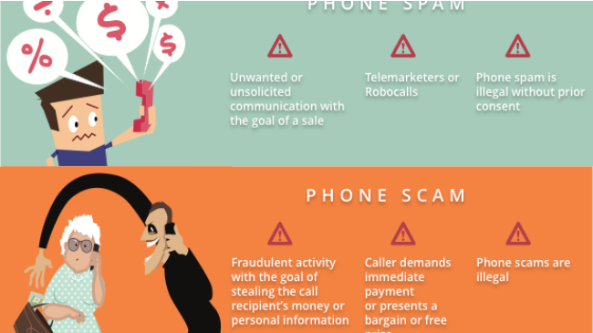
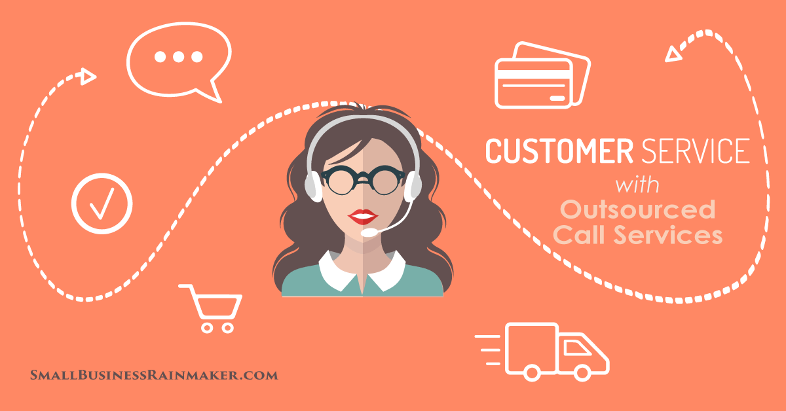
Picture form:

Slide 7
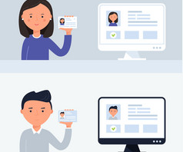
PHONE NUMBER VERFICATION:
it – phone verification has been used for years. However, the fact that it’s as common as it is, combined with people’s concern about the use of their personal data for marketing purposes, has led to the birth of many different methods to trick the system. Although understandable, it’s quite a problem for companies relying on their clients’ phone numbers to deliver crucial information, including newsletters, and yes, marketing new products. If the number is not valid, the information never reaches the customer, which is a waste of valuable time and resources of the organization.
Additionally, verifying the phone number of the customer is Chances are, you’re already quite familiar with it. Phone verification is used in many industries to confirm that the number provided by the client is valid and available. It can also serve as an additional way to verify the client’s identity (for example, Google’s two-step verification method when signing into the account using a different device than usual).
There’s hardly anything novel about vital when fighting fraud. It shouldn’t come as a surprise to anyone that fraudsters rarely use their real contact information. And even if the phone number is valid and available, certain factors can help determine the risk associated with it. iDenfy’s solution was designed to take these and other issues into account.

Slide 8
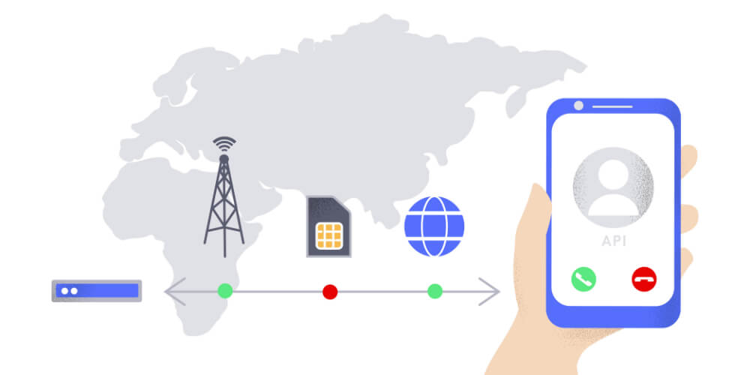
HOW IT WORK?
The procedure itself is relatively simple. Whenever the company needs to verify the client’s phone number, it will send them a one-time password (OTP) via short message or “text to speech” message if SMS is not possible. The person will then need to type out the password in the required field.
The process can be adapted for a variety of goals. A company may use it as an additional fraud prevention tool after a failed deep phone check or integrate the solution as part of the secure onboarding process. iDenfy’s product includes:
Global coverage
Mobile & Landline support
Unique OTP in a matter of seconds
Automated onboarding
Two-factor authentication regulatory security
In addition to phone number verification, the solution is also risk score adapted. The so-called deep phone number check & validation will scan multiple data points of the phone number and calculate a reliable risk score associated with the number, which will help decide what further actions to take. It’s a helpful tool to recognize fraud patterns at an early stage. Here’s how it works.
THESE SOURCE TAKEN FROM: IDEFY WEB PAGE.

Slide 9
ABOUT DIGITAL NUMBER SYSTEM
A digital system can understand positional number system only where there are a few symbols called digits and these symbols represent different values depending on the position they occupy in the number.
A value of each digit in a number can be determined using
The digit
The position of the digit in the number
The base of the number system (where base is defined as the total number of digits available in the number system).
This is just a idea to use in the software.

Slide 10
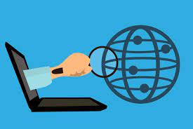
Reason for using ip address to track mobile number:
There are several reasons why you would want to find the phone number of another user through their IP address.
Many eCommerce websites and other platforms track the phone numbers of people that visit their websites from their IP addresses to send adverts and provide better product recommendations.
Some other people who receive inappropriate or spam calls and messages from unknown phone numbers may also want to track the location of the caller or sender.
If you are not familiar with how IP addresses work, you may not know that it’s possible to trace someone’s phone number using their IP address; however, this is possible.
In fact, just as your IP address can also be gotten from your phone number, your phone number can be obtained from your IP address.

Slide 11
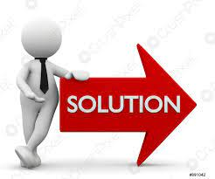
Our Solution to avoid spam:
Our team just create a phone security app . We try to give a refine solution for identify which is spam and service clls .
We just try to identify the spam call and give a alert and a notify to customer and help them to avoid such call .
This is a refine process and we try to give a premium feel at free of cost.
We just create this app and web page for social service.

Slide 12
Solution:
We just try to resolve the drawbacks of other similar apps and make fine user friendly application to the user.
we just not only use ip address but we going to discover the geographical position of spam user.

Slide 13

Process:
To identify number we are going to use internet protocol ,which is easy to identify the caller ID (DNS).
This way make easy to track the phone number by a tower signals.
These make easy to identify the call ID because it able to track only spam call and help to block the call.
0.00

Slide 14
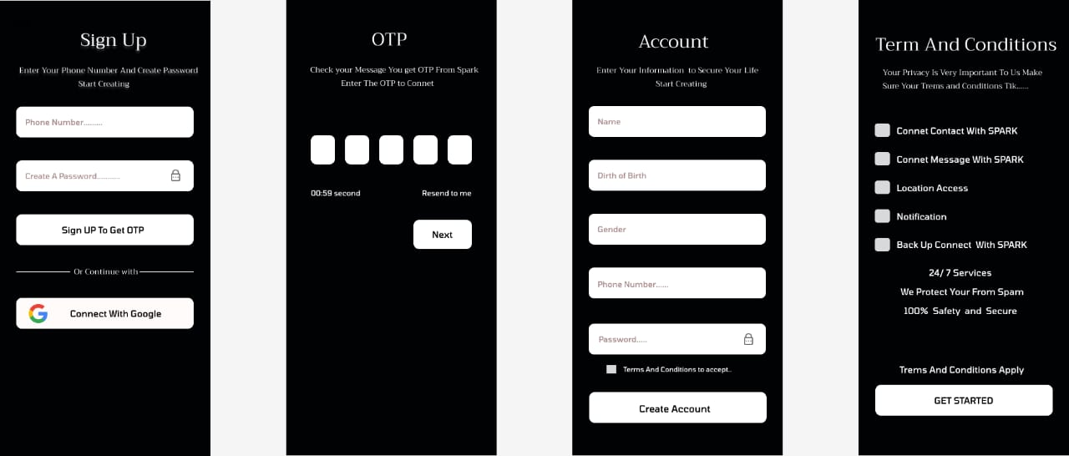
Our creation:
This is our app inter face.
We will give a unique id to customer and we will go in a unique way.
to enhance user exprience in a unique way.

Slide 15
THE PROCESS of display the call:
Using voice and color pattern to identify the spam and service call.
For example:
For fraud (black and red).
For service(cyan).
For normal(custom).
For friends (custom).

Slide 16
upgrade for future:
We give continuous upgrade for more feature.
After some reach we use add to activate premium.
We ensure security to our customers.
After the success of our app we will update app customize interface for better usage.
this app ensure the women security.
This also contain SOS feature and can use this feature by voice command.
We also come with a complain box and a suggestion box for customer service.
And we has more update also.
We will give update and restore the bug.

Slide 17
Thank you
Credit:
Vishnu from(Bca).
Rooban jayakumar from(Bca).
Hari Krishnan from(Bca).
Aswin from (Bsc, cs with da).
Arawind from(Bsc, cs with da).
Sanjith from (Bsc, cs with da).

