Slide 1
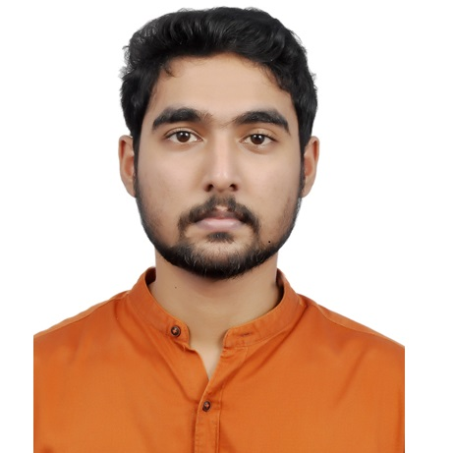

Aswin K Unnikrishnan
Senior Analyst/Software Engineer
Bachelor of Technology
Mechanical Engineerig : 2018 - 2022
I Transform Premier Talent batch
Skills
Hyderabad
C# | Basics, OOPS, Exception Handling ,Arrays ,Collection and Generics, Delegates and Events, File Io and Serialization.
.NET Framework | ADO.NET,ASP.NET with MVC5 and WEB API, Entity Framework
Database | My SQL
Angular | Components, Services, Modules, Routing, Forms & Validation
UI Tech | HTML 5 & CSS 3,JavaScript, ES6 & TypeScript
Add On skills | Communication Skill , Team management
ASWIN.K-UNNIKRISHNAN@CAPGEMINI.COM
+91 8129635194
A5
Full Stack Developer
• Understanding of RDBMS concepts using SQL Server.
• Practical understanding of C# and SQL concepts using
Visual Studio and SQL Server
• Hands on experience in developing applications using .NET Framework, ADO.NET Core
• Understanding of HTML5 , CSS and Angular CLI.
• Understanding of Version control tools like git and github
Completed case study on Crop Deal which is a Web-based System where farmers can sell their crops to dealers.The farmer can register with all the details and can post his crops for sale here. The dealers can buy the crops that he/she is interested from the list of crops published by farmers and also make the payment throught the portal.
Crop Deal is implemented to make farmers’ life easier by advertising their crops and selling them directly to the dealer, as it neglects all The commissions farmers pay to sell their crops.
Technologies used:
• ANGULAR
• ASP.NET CORE
• Microsoft SQL Server
Tools | GIT , POSTMAN
Check out my work on GitHub

