Slide 1
CHAT BOT USING GENERATIVE AI
CREATED BY;
G.Loga Aswin Raj
REG.NO:912321104018
3RD YEAR CSE
SACS MAVMM ENGINEERING COLLEGE,MADURAI

Slide 2
PROJECT OUTLINE
Problem statement
Proposed system/solution
System development approach
Algorithm and deployment
Result
conclusion

Slide 3
PROBLEM STATEMENT
Rule-based approach:
This approach instructs a chatbot to answer questions based on a set of pre-determined rules that it was initially trained on. These set rules can be extremely simple or highly complex. While rule-based chatbots are capable of handling simple queries, they frequently fail to handle more complex queries/requests
Self-learning approach:
As the name implies, they are chatbots that can learn on their own. These use advanced technologies such as Artificial Intelligence and Machine Learning to train themselves based on instances and behaviors. Naturally, these chatbots are far more intelligent than rule-based bots. Let’s take a look at the two types of Self-learning bots: retrieval-based bots and generative bots

Slide 4
PROPOSED SYSTEM/SOLUTION
Our project is based on Artificial Intelligence- powered Chatbot. A python is software that provides a user- friendly interface to make the connection easier and convenient with the internet providing valid and reliable web services. We've created a sample chatbot using the same with a twitch as an online platform that provides a chatbot platform to the online clients. The web-based platform provides a vast intelligent base that can help simulate problem-solving for humans.
We can help if the user wants to have any query or he wants to enquire about something. Our methodology includes API of Chatbot that will be developed with Cascading style sheet which covers all the styling part and the Javascript is used for functioning the chatbot Back end part will be done with Python programming language. It also contains various machine learning algorithms to learn the Chatbot by experiencing various user's responses and requests. The following diagram shows the complete System Architecture:

Slide 5
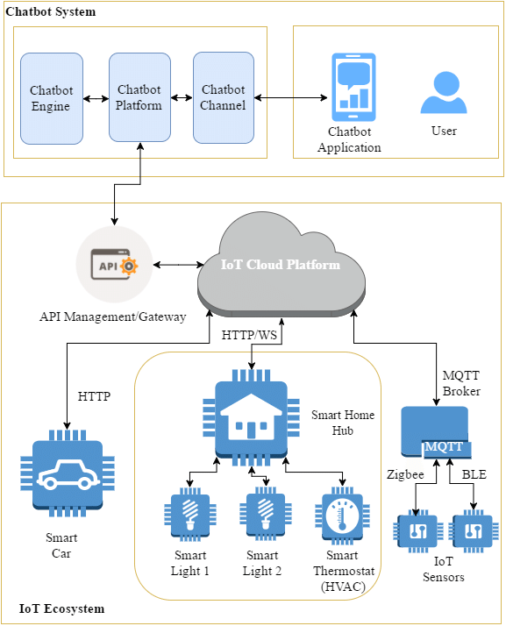
.

Slide 6
SYSTEM DEVELOPMENT APPROACH
Chatbots have emerged as a quintessential part of present-day virtual interactions, revolutionizing the way groups interact with customers and customers interact with the era. At the core of chatbot development lies a rich theoretical framework that draws upon diverse disciplines along with artificial intelligence, natural language processing, human-computer interaction, and software program engineering.
A chatbot is a software program for simulating intelligent conversations with humans using rules or artificial intelligence. A computer program that can comprehend human language and communicate with a user via a website or messaging app is known as a chatbot (conversational interface, AI agent).
Chatbots are conversational technologies that effectively carry out repetitive activities. They are well-liked by people because they facilitate the speedy completion of those tasks, freeing them up to concentrate on more complex, strategic, and interesting duties that call for human qualities that are unmatched by computers.

Slide 7
ALGORITHM AND DEPLOYMENT
Designing an algorithm for a chatbot involves several steps, including understanding the requirements, defining the chatbot's functionalities, choosing an appropriate architecture, implementing natural language processing (NLP) capabilities, and deploying the chatbot on a suitable platform. Here's a basic algorithm outline for building a chatbot:
Define Purpose and Scope:
Clearly define the purpose of the chatbot (e.g., customer support, information retrieval, entertainment).
Determine the scope of the chatbot's capabilities and limitations.
Choose Platform and Framework:
Select a platform for building and deploying the chatbot (e.g., web-based, messaging platforms like Facebook Messenger or Slack).
Choose a suitable framework or programming language for development (e.g., Python with libraries like NLTK, TensorFlow, or frameworks like Rasa or Dialogflow).

Slide 8
.
Collect and Organize Data:
Gather relevant data sources such as FAQs, product information, or any other data required to fulfill the chatbot's purpose.
Organize the data in a structured format for easy retrieval and processing.
Design Conversational Flow:
Create a flowchart or outline representing the conversation flow between the user and the chatbot.
Define various intents (user goals) and corresponding responses.
Implement Natural Language Processing (NLP):
Integrate NLP capabilities to understand user inputs and generate appropriate responses.
Implement techniques like tokenization, part-of-speech tagging, named entity recognition, and sentiment analysis.
Train NLP models on labeled data for intent classification and entity extraction.

Slide 9
CONCLUSION
A chatbot is an exemplary example of human-computer interaction. In recent years, there has been a significant advancement in the development of chatbots, and they have evolved into one of the most powerful and widely adopted applications. However, this is only the beginning of chatbots, and to meet their full potential, it requires our attention and effort to understand how they work and how they are developed.

Slide 10
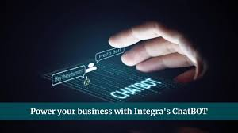
Result
Embrace the transformative potential of chat box technology to elevate customer and drive business growth.unlock the power of personalized interactions and real-time suppport.

Slide 11
REFERENCE
https://www.researchgate.net/figure/Proposed-System-Design-of-IoT-Chatbot-System_fig2_310122692
https://www.kaggle.com/datasets/niraliivaghani/chatbot-dataset

Slide 12

.

