Slide 1
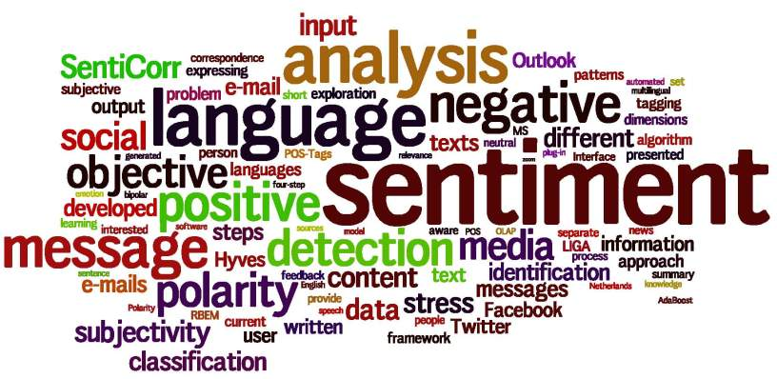

EMO-SENSING

Slide 2
INTRODUCTION
To classify the Polarity of a given text and decide whether the expressed opinion in the text is positive or negative .
A major benefit of social media analysis is that we can see the good and bad things people say about the particular brand .
The bigger your company gets difficult it becomes to keep a handle on how everyone feels about your brand .For large companies with thousands of daily mentions on social media,news,sites and blogs,it is extremely difficult to do this manually.
To combat this problem,Sentiment analysis software are necessary .These softwares can be used to evaluate the people’s sentiment about particular brand .

Slide 3

PROBLEM STATEMENT
In order to predict sentiments of reviews, we label each review with a reviewer’s score indicating the sentiment of the reviewer. Our task is to predict a reviewer’s score on a scale of 1 to 5, where 1 indicates the reviewer extremely dislikes the food he or she mentions in the review and 5 indicates the user likes the food a lot.
Given a review , we have to determine whether the review is positive (4 or 5) or negative(1 or 2).We can apply different models of machine learning and can see the best result out of different classification models to classify the reviews.

Slide 4
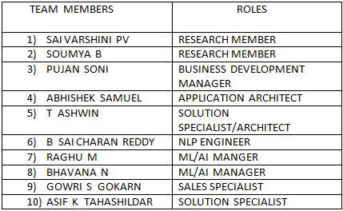
TEAM STRUCTURE AND ROLES

Slide 5
PROBLEMS FACED BY THE CLIENT
USE OF SLANGS: These words are different from English words and it can make an approach outdated because of the evolutionary use of slangs.
MULTI-LINGUAL :Users can express their opinions in different languages, while others using repeated words or symbols to convey an emotion.

Slide 6
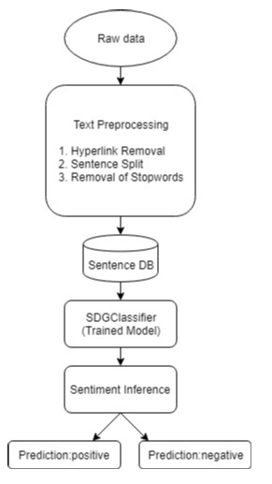
ARCHITECTURE

Slide 7
Step 1- Gathering data: Amazon Food Reviews was used as a source of text in this project, we gathered reviews for sentiment analysis to analyse if it’s a positive or a negative review.
Step2-Text Preparation: Text preparation is nothing but filtering the extracted data before analysis. It includes identifying and eliminating non-textual content, stopwords removal, punctuation removal and stemming.
Step 3- Sentiment Detection: We use SDGClassifier to classify the food reviews. SGDClassifier: SGD stands for Stochastic Gradient Descent: the gradient of the loss is estimated each sample at a time and the model is updated along the way with a decreasing strength schedule.
Step 4- Sentiment Classification: Sentiments can be broadly classified into two groups, positive and negative.

Slide 8
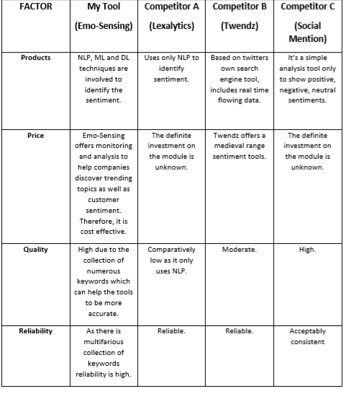
COMPETITOR BENCHMARKING DATA

Slide 9
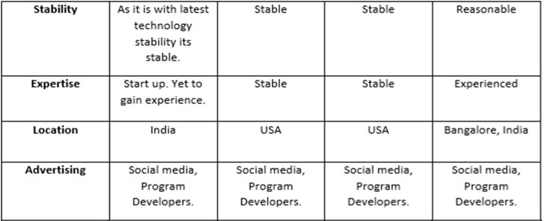

Slide 10
TECHNOLOGY OPTIONS CONSIDERED
PANDAS: BSD-licensed Python library providing high-performance, easy-to- use data structures.
NUMPY: Dealing with numerical data.
MATPLOTLIB: graphical Representation.
SKLEARN: Data Splitting
FLASK: This is used Instead of the Django. Due to its light weight less dependencies which makes the web deployment faster.
SQLITE: provides an SQL interface compliant with the DB-API 2.0 specification described by PEP 249.
BS4: Beautiful Soup 4 is a Python library for pulling data out of HTML and XML files.

Slide 11
CONCEPT VALIDATION
It is easy to use.
Free from failures
It gives accurate output

Slide 12
SOLUTION TO PROBLEM
A Dataset is created using Amazon reviews on Food Products. Food reviews are short messages with full of slang words and misspellings.
So we perform a sentence level sentiment analysis. This is done in two phases. In first phase preprocessing is done.
Finally using different classifiers, food reviews are classified into positive and negative classes. Based on the number of food reviews in each class, the final sentiment is derived.

Slide 13
IMPROVING SCALABILITY
Improvements in software to get high performance.
Improvements in computational complexities by using time and space complexity algorithms.
Improvement in abstraction by making use of powerful programming languages.

Slide 14
ESTIMATED TIME
Feasibility study/early initiations:-1-2 weeks
Requirement gathering:-2 weeks
Coding and Implementation:-2 weeks
Testing and analysis:-1 week
Deployment of the product:-1 week

Slide 15
IMPROVING ACCURACY
To prepare a better model which asks the user for all the input attributes as our model asks only for the review text.
Improvement in the Database model
Conduct many test cases to improve the accuracy.

Slide 16
SWOT ANALYSIS
STRENGTHS Amazon has a strong control of the market share. Offers competitive pricing for it’s consumers. Easy to make repeat purchases. | WEAKNESSES Perfect competition Market. Constant competition. Too many similar products.
OPPORTUNITIES New products are constantly being made available. Market share is essentially endless due to the digital era Cannibalism of smaller companies can boister market share and Products/Services. | THREATS Competition pricing due to fierce competition. Ease of entry into market poses a threat to market share.

Slide 17
ESTIMATED COST OF PROPOSED PRODUCT
Project Management = 25K
i) Project manager = 8K
ii) project team members = 17K
Software development = 45K
Testing cost = 16K
Training and support = 20K
Reserves = 17K
Total cost of product = 148K

Slide 18
MARKETING CONCEPTS
We can promote through social medias like facebook,instagram etc.
Most important of Amazon’s marketing channels is email.
Directly contact the software developers for their latest updation.

Slide 19
THANK YOU ☺

