Slide 1
SOLAR POWER TRACKING & PREDICTION SYSTEM USING IOT
Name: Aswin Raj B.V
June 2023 – July 2023

Slide 2

ABSTRACT
This abstract explores solar power tracking & prediction in IoT, which optimizes solar panel positioning using real-time data, and predicting the power generated for next day using machine learning algorithms. By integrating IoT sensors and advanced analytics, solar tracking systems can dynamically adjust panel orientation for maximum energy generation. Machine learning algorithms enhance prediction accuracy, while IoT enables remote monitoring and proactive maintenance. This approach improves efficiency, reduces shading effects, and extends panel lifespan, contributing to a sustainable energy future.

Slide 3

WHAT IS INTERNET OF THINGS (IOT) ?
INTRODUCTION
IoT stands for the Internet of Things. It refers to a network of physical objects or "things" that are embedded with sensors, software, and connectivity capabilities, allowing them to collect and exchange data over the internet.

Slide 4
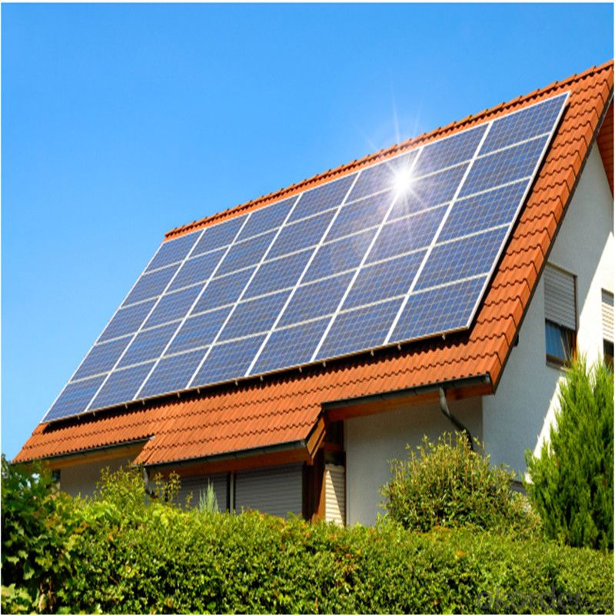
SOLAR ENERGY SYSTEM
A solar energy system, also known as a solar power system or photovoltaic (PV) system, is a technology that harnesses the energy from sunlight and converts it into electricity.
Solar power systems typically consist of several components, including solar panels, inverters, mounting structures, and electrical wiring.

Slide 5
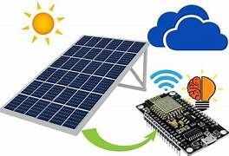
APPLICATION OF IOT IN SOLAR TRACKING SYSTEM
Remote Monitoring and Control
Data Analytics and Predictive Maintenance
Integration with Weather Data
Energy Management and Optimization
Integration with Smart Grids
Energy Monitoring and Reporting

Slide 6

PROBLEM STATEMENT
The problem is that existing solar panel systems lack the ability to autonomously track the sun's movement, resulting in suboptimal energy generation. Additionally, without accurate solar irradiance predictions, it is challenging to optimize the position of the solar panels in real-time.
By developing a solar tracking system that can autonomously adjust the position of the solar panels, and integrating it with machine learning algorithms for solar irradiance prediction, the project aims to optimize energy generation and increase the efficiency of solar panel systems.

Slide 7

LITERATURE REVIEW
Introduction:
Solar tracking systems are designed to maximize the efficiency and energy generation capabilities of solar photovoltaic systems by dynamically adjusting the orientation of solar panels to align with the sun’s position. This Literature review examines solar tracking systems and evaluates their advantages, disadvantages, and performance characteristics.

Slide 8
AUTHOR NAME | TITLE | COMPONENTS USED | RESULT
Adel Mohamed Taha El-monem Salama Published : 2018 | Practical Implementation of Dual Axis Solar Power Tracking System | Uno Arduino LDR sensors Relay module WS-MPPT30 Solar panel | MPPT dual axis technique is an efficient and it would be advanced in future work to utilize the maximum power based on the type of solar panel material, its size and tracking speed.
Zolkapli, M AI-Junid S Othman Z Manut, A Mohd Zulkifli M Published : 2013 | High-Efficiency Dual-Axis Solar Tracking Developement using Arduino | Uno Arduino LDR sensors Servo motor Solar panel | System has been proven to work to absorb maximum sunlight source for high efficiency solar harvesting applications. The economically and environmentally solar tracking system development will be a technique to use in renewable-energy more widely and wisely.
Falah I. Mustafa A.Salam Al-Ammri Farouk F. Ahmad Published : 2017 | Direct and Indirect Sensing two-axis Solar Tracking System | Uno Arduino LDR sensors DC motor Solar panel Bluetooth module | Standalone working and wireless communication is achieved with computer which makes the system reliable and observable. The use of LDR sensors and high precision angle sensors guarantees a more accurate and efficient tracking system.

Slide 9
OUTCOME
Solar tracking prediction optimizes solar panel positioning using real-time data, and machine learning. By accurately forecasting solar irradiance, it enables dynamic adjustments for maximum energy generation efficiency.
This approach reduces shading effects, lowers maintenance costs, and extends panel lifespan. Integration of IoT enables remote monitoring and control, facilitating real-time adjustments and proactive maintenance.
Solar tracking prediction enhances performance and contributes to a sustainable energy future.

Slide 10
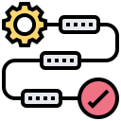
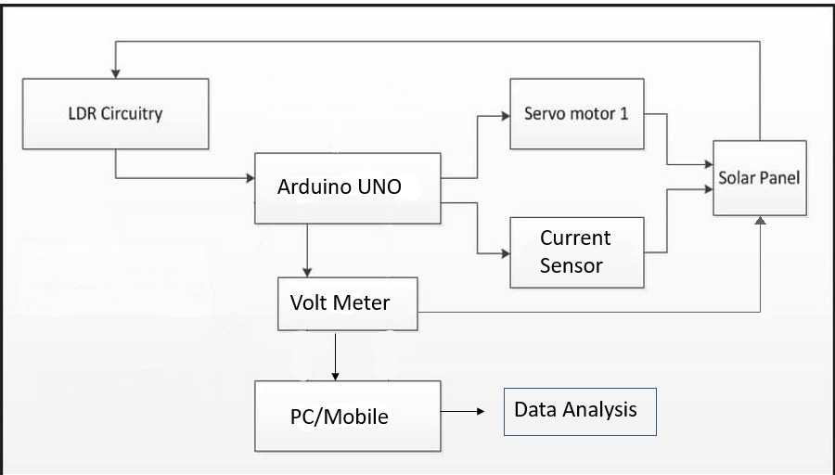

PROPOSED METHODOLOGY
Sensor

Slide 11
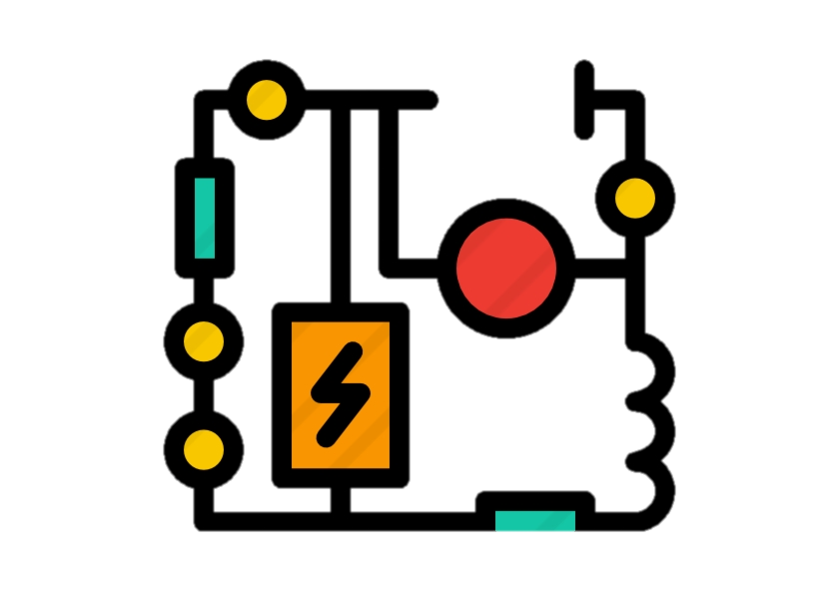
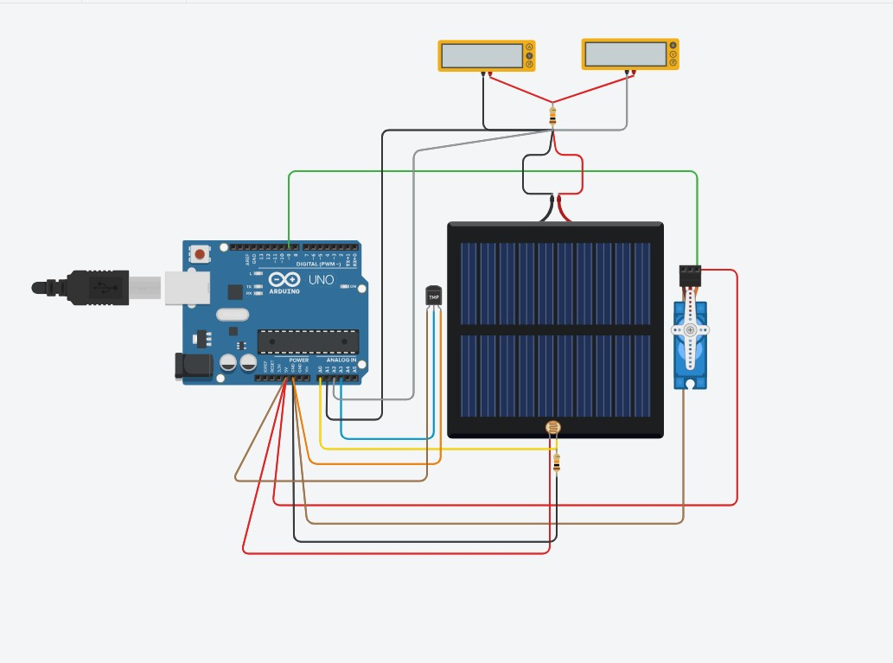
Components Used:
Model Requirements & Connection
Circuit Diagram
Arduino UNO
LDR Sensor
Servo Motor
Voltage Sensor
Current Sensor
Solar Panel
Current Sensor
Voltage Sensor
Temperature Sensor
Servo Motor
Solar Panel
LDR Sensor

Slide 12

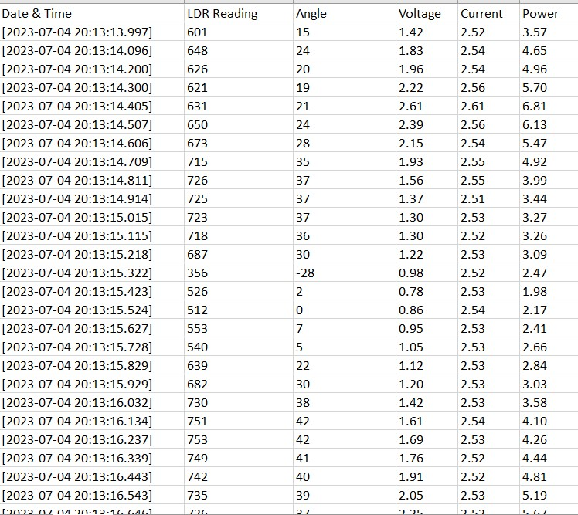
Extracting Raw Data
The data of LDR reading, Angle of Servo motor, Voltage sensor reading, Current Sensor Reading, Power generated in Kilowatts(Kwh) were captured using Arduino serial monitor and Imported to Excel Using Tera Term software, for further analysis.

Slide 13

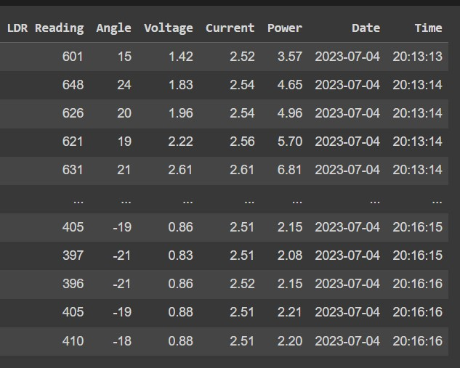
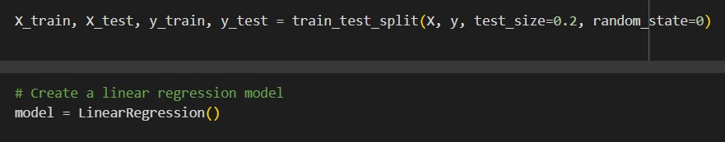
Data Analysis
Data Preprocessing :
Separating Date & Time into different columns & converting into Datetime format.
Model Building:
80% of the data is taken for training and the remaining 20% is for testing.
Linear Regression algorithm is used for model fitting.

Slide 14

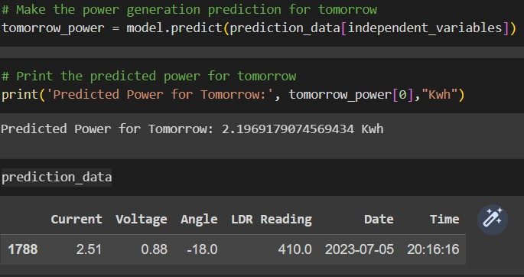
Data Analysis
Model Evaluation
An R-squared (R2) value of 0.98 can be considered a very good performance and R2 value of 0.98 suggests a strong fit of the regression model to the data, indicating that the model is able to explain a large portion of the variance in the power generation data.
Prediction :
The predicted power to be generated for the next day is 2 Kwh.

Slide 15
REFERENCES
Divya, V & Sashanka, P. -Renewable Energy. Retrieved June 5, 2012, from http://www.yuvaengineers.coml?p=495 47
H. Fayaza, N.A. Rahimb, R. Saidura, K. H. Solangi, H. Niaz & M.S. Hossaina, "Solar energy policy: Malaysia vs developed countries," 2011 IEEE First Conference on Clean Energy and Technology (CET), pp.374-378,27-29
Musse Mohamud Ahmed & Marizan Sulaiman, -Design and Proper Sizing of Solar Energy Schemes for Electricity Production in Malaysia Power Engineering Conference, 2003. PECon 2003. Proceedings National , pp. 268- 271,15-16 Dec. 2003
O.C.Vilela, N.Fraidenraich & C.Tiba, (2003) -Photovoltaic pumping systems driven by tracking collectors. Experiments and simulation (2003) Solar Energy, 74 (I), pp. 45-52
AK. Saxena & V. Dutta, -A versatile microprocessor- based controller for solar tracking, IEEE Proc., 1990, pp. 1105 - 1109

Slide 16
Thank You

