Slide 1


SUPER ENCRYPTION OF AFFINE CIPHER WITH FIBBONACI MATRIX
S ASWIN-17BCE1201
MEGHANA J-17BCE1113

Slide 2
INTRODUCTION
Super-encryption is a process of encrypting the information that is already encrypted. Multiple encryptions are the process of employing multiple ciphers. The generation of the key for each cipher plays a pivotal role.
Designing an algorithm for each layer of encryption requires independency. If the algorithm for the first encryption depends on the other then security levels are very low.
Designing of mathematical models for multiple encryptions mostly based on time and space complexity.

Slide 3
AFFINE CIPHER
Affine cipher uses simple mathematical functions is of the form y≡(ax+b)mod m for encryption.
Each letter in plain text is substituted by a number using the mathematical function and convert back to the letter using x=a-1(y-b) mod m

Slide 4
LIMITATION OF AFFINE CIPHER
To encrypt a message in the English language, taking m=26 in the equation y≡(ax+b)mod m, x is the integer equivalent of plaintext
letter, chosen a and b are randomly integers, a is multiplicative parameter, a should have inverse with respect to modulo 26. The possible values of a are 12 since there are 12 numbers that are relatively prime with 26 and less than 26. The possible value of b,the additional parameter is 26.
Thus, the number of possible keys is 12×26=312

Slide 5
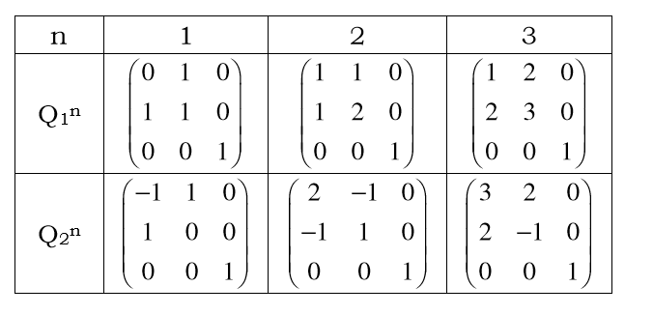
USE OF FIBBONACI MATRIX

Slide 6
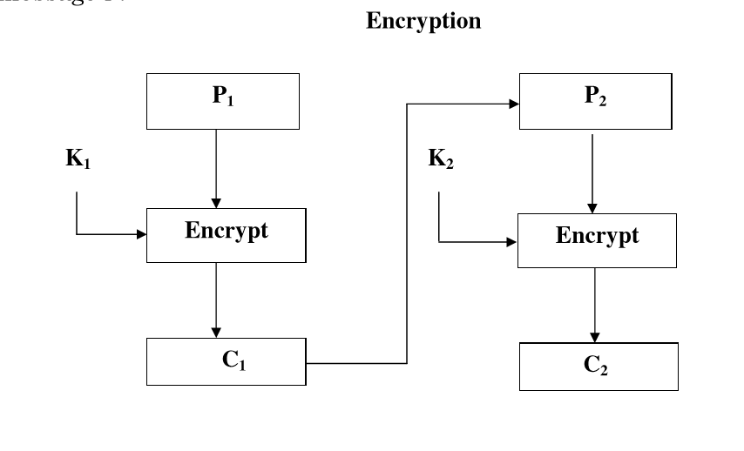
ENCRYPTION

Slide 7
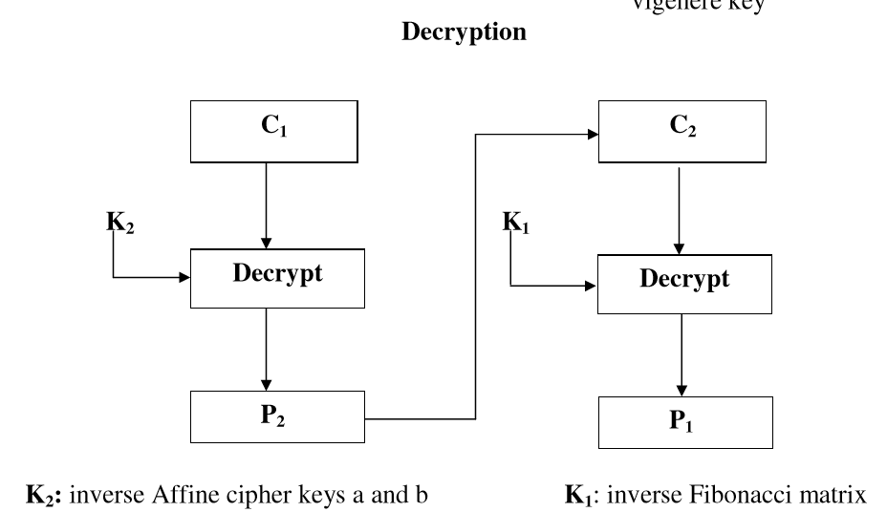
DECRYPTION

Slide 8

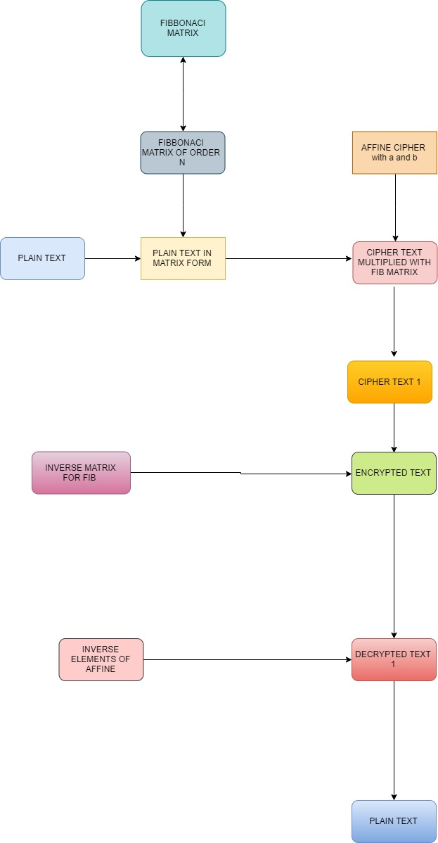
BLOCK DIAGRAM

Slide 9
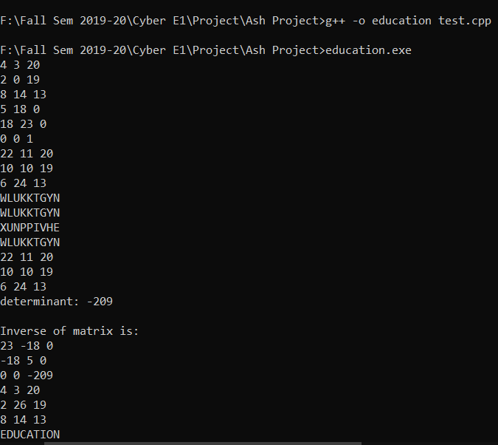
EDUCATION

Slide 10
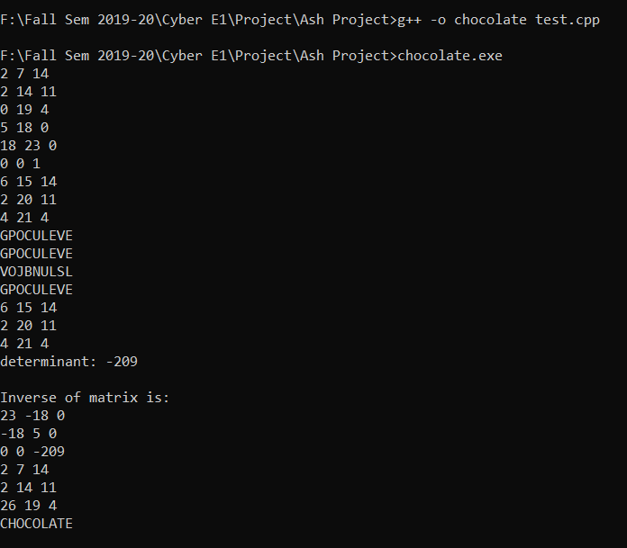
CHOCOLATE

Slide 11
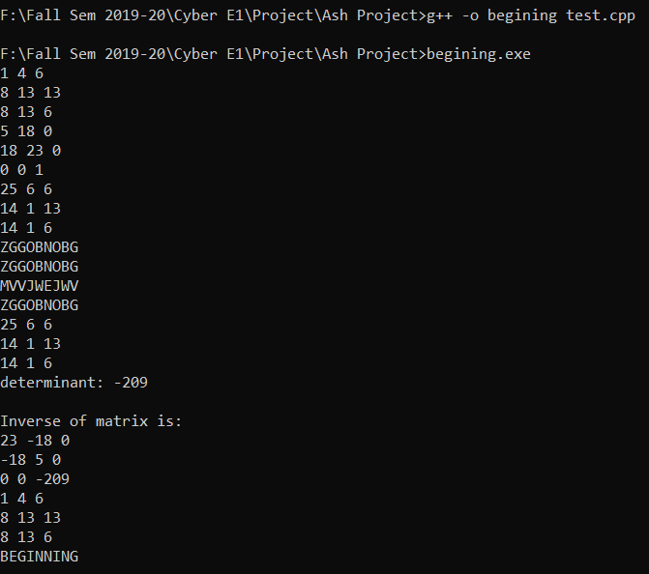
BEGINNING

Slide 12
EDUCATION

Slide 13
EDUCATION

Slide 14
EDUCATION

Slide 15
EDUCATION

Slide 16
EDUCATION

Slide 17
ADVANTAGES
Time taken to calculate the inverse of matrix is large.
Secure in terms of time and security
Long range of key to choose

Slide 18
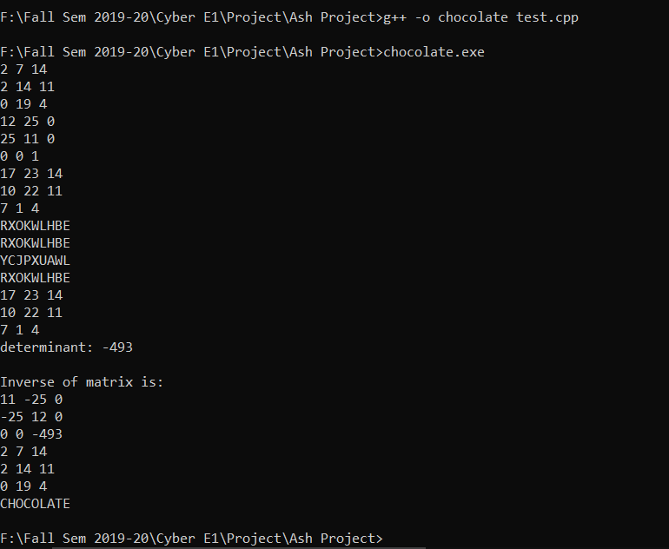
PRIVATE KEY = 100000000

