Slide 1
MINOR
PROJECT

Slide 2
GETMYTIME

Slide 3
GetMyTime

Slide 4
Team Presentation
(Group - 6)
ASWIN S HARI
MEGHA LEKSHMI
DEVADATH V
JEWEL S PRAKASH

Slide 5
DESCRIPTION

Slide 6
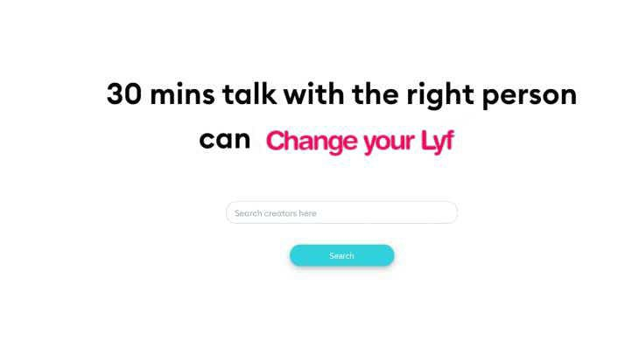
If you want to connect anybody and take their advice you can search their name or field.
You have to select them by taking free time slot through registration.

Slide 7
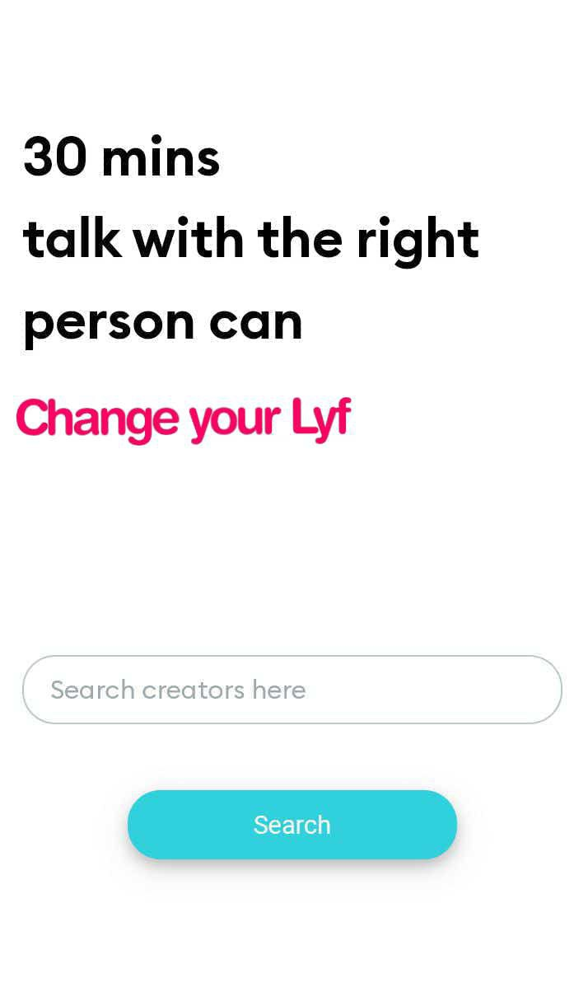
30 minutes is allowed per head.
Number of calls are unlimited per head.
While booking you have to enter your name and purpose.

Slide 8
EXISTING SYSTEM

Slide 9
The procedure consists of different steps so the immediate communication is not possible.
The searching process for the existing system is not possible.
Communication and file handling is not easy.

Slide 10
Drawbacks of existing system
Need large number of different registers.
Chance of losing information.

Slide 11
PROPOSED SYSTEM

Slide 12
The Details about each member are kept in the database of the online system.
The system provides various types of reports are generated through the system according to the need.

Slide 13
Advantages
Reduces time consumption.
Providing accurate information.
Interactive and user friendly environment.

Slide 14
MODULES

Slide 15
Admin :
• Add category like Celebrities, Doctors, Engineers etc
• View Experts
• View Public Users
• Approve celebrity
• View Appointment Details

Slide 16
Expert :
• Register with category
• Login
• Upload Free Time
• View Appointment details
• Make Confirmation

Slide 17
Public User :
• Register
• Login
• View Free time
• Book slot
• View Confirmation

Slide 18
DATA FLOW DIAGRAM

Slide 19
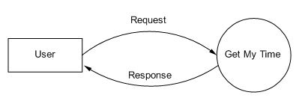
LEVEL 0

Slide 20
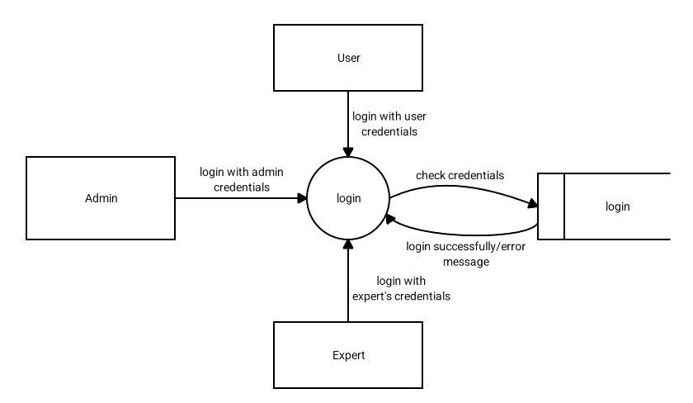
Level 1

Slide 21
Level 2 : ADMIN

Slide 22
EXPERT

Slide 23
USER

Slide 24
SCREENSHOTS

Slide 25
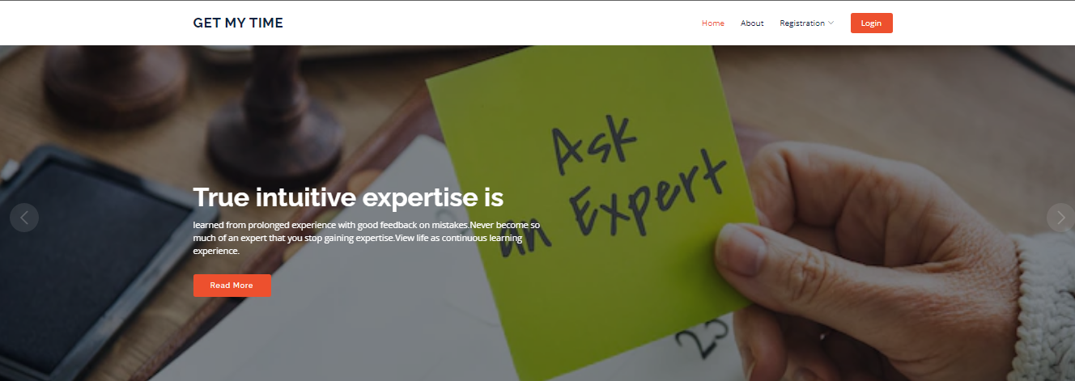
HOME PAGE

Slide 26
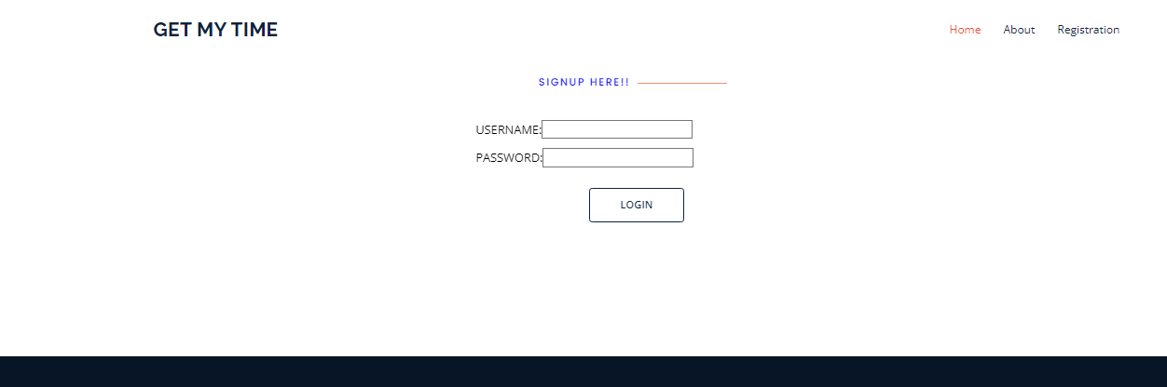
LOGIN PAGE

Slide 27
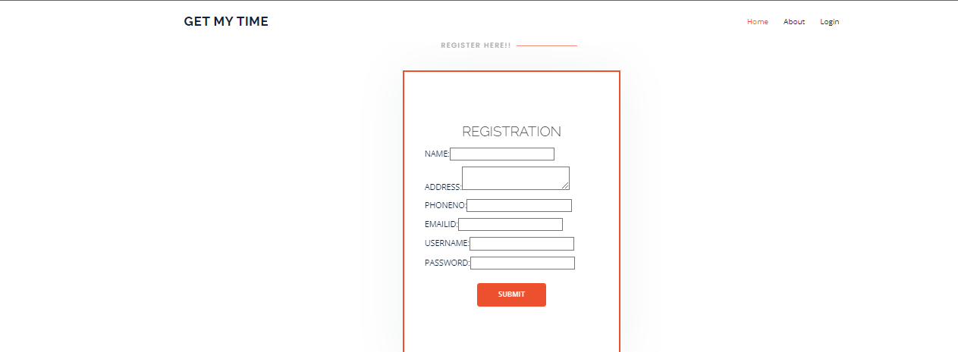
REGISTRATION PAGE

Slide 28
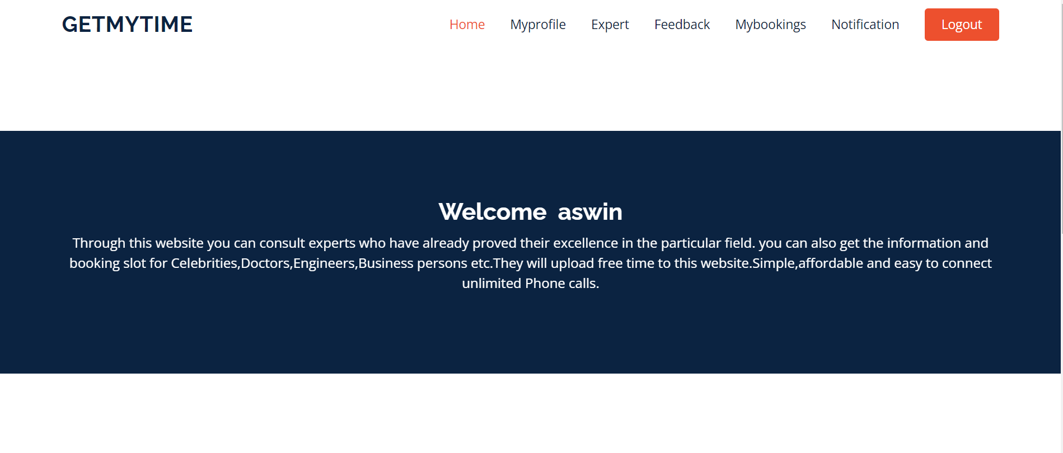
USER HOME PAGE

Slide 29
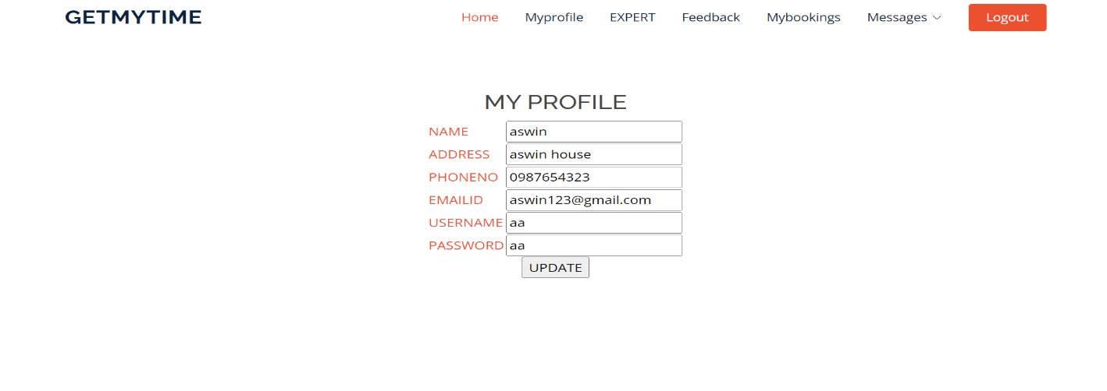
USER PROFILE

Slide 30
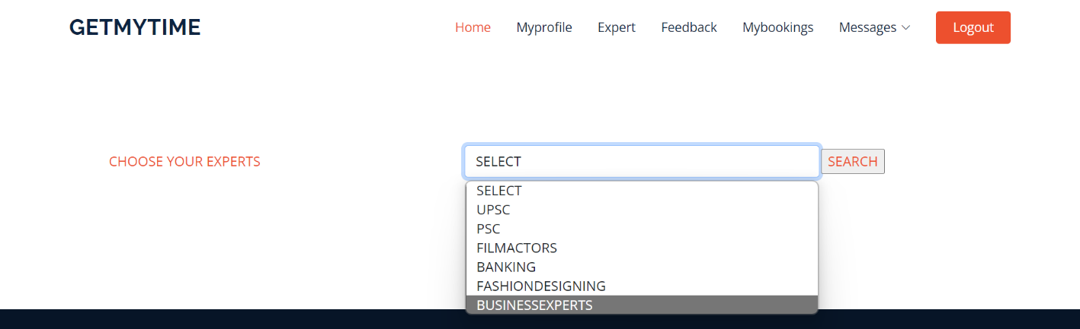
SEARCH EXPERT

Slide 31
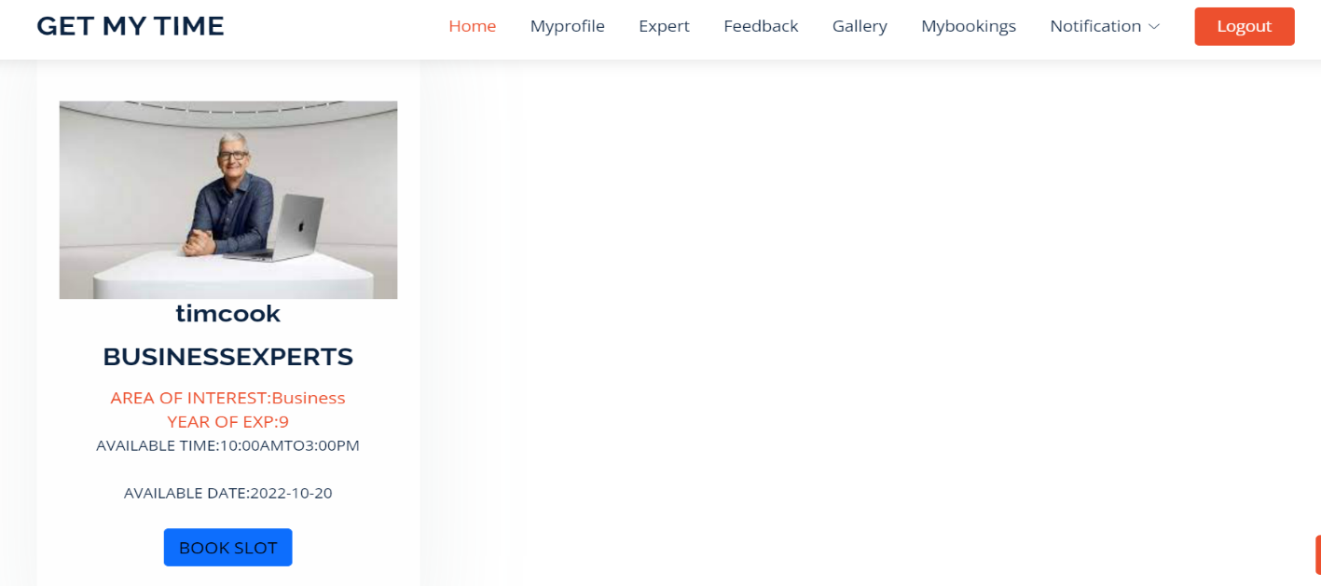
VIEW EXPERT

Slide 32
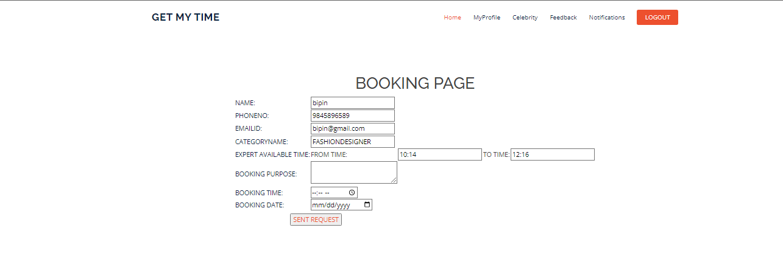
BOOK A SLOT

Slide 33
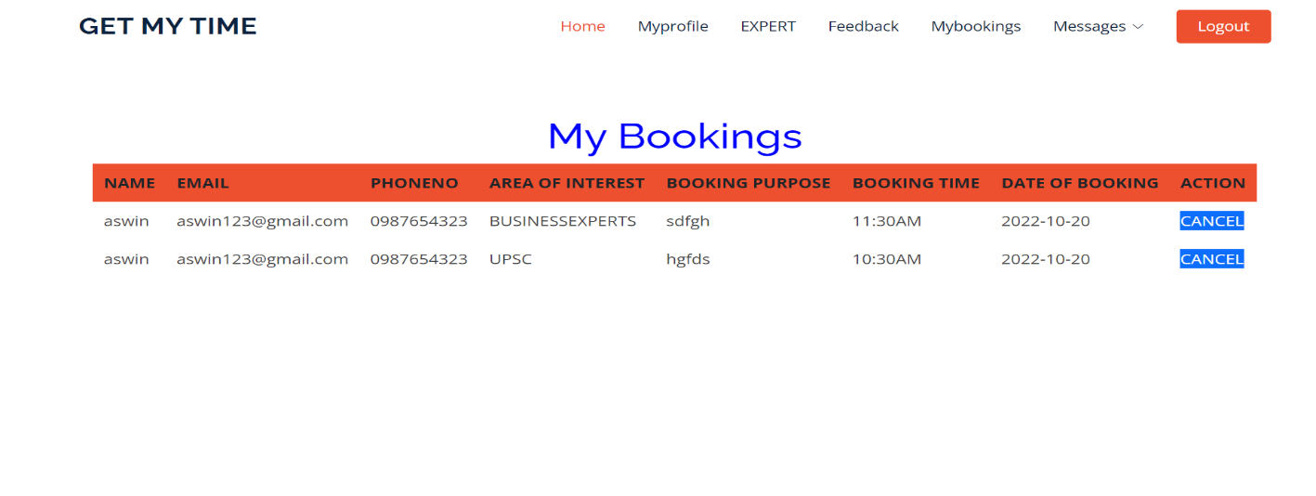
MY BOOKING HISTORY

Slide 34
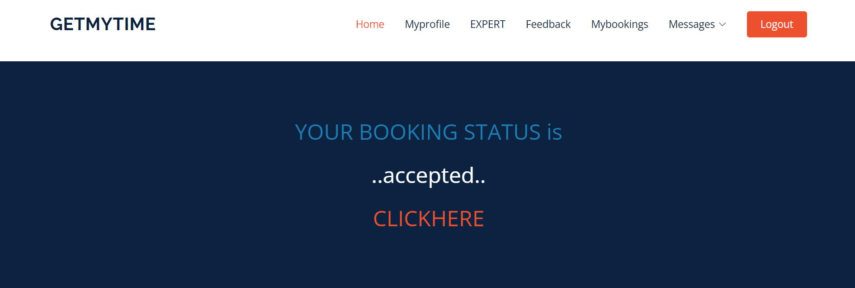
BOOKING STATUS

Slide 35
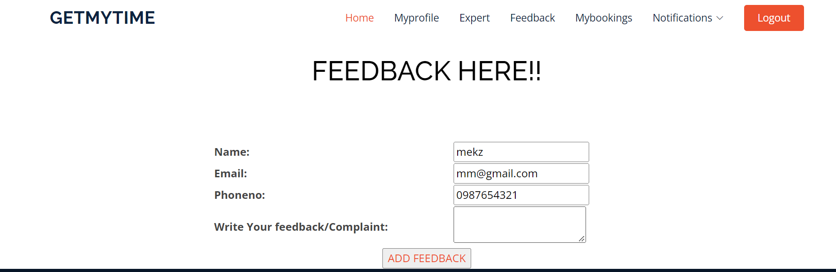
ADD FEEDBACK

Slide 36
Conclusion
To conclude, this project would help a lot of people to find the right people to ask advices , and clear their doubts.
The contribution of this project would make is that it would eliminate the need of travel time also reduce the cost.
This project aims to help the users to reduce their time and cost

Slide 37
THANKS!
Any questions?

