Slide 1
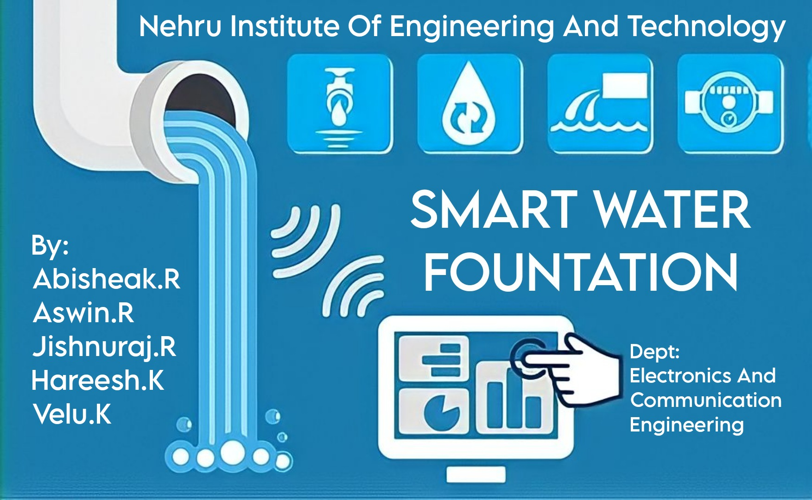

Slide 2
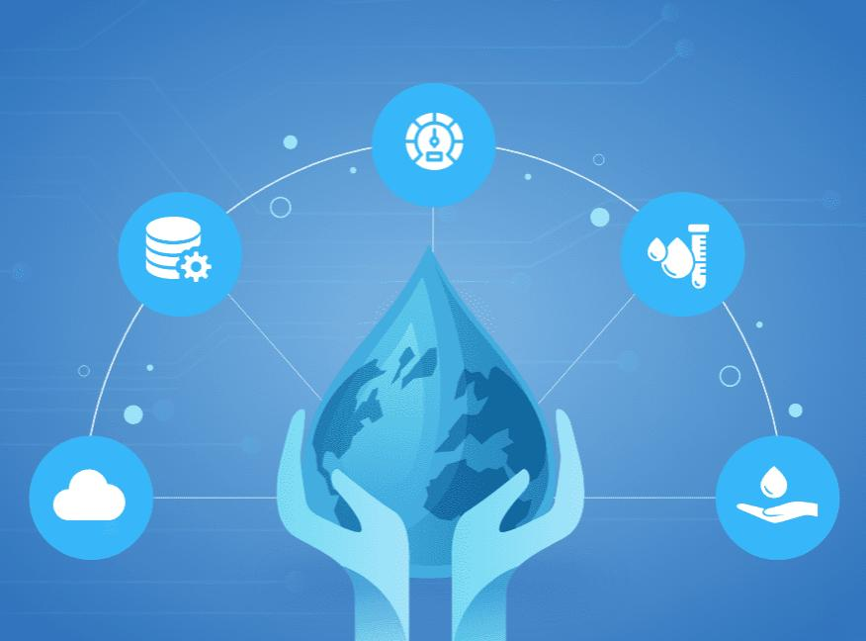
objective
Nowadays, the internet of things has been improved greatly with the progress of the sensor, big data, mobile Internet and other relative technologies. One water fountain with intelligent monitoring system based on the internet of things is discussed in this paper. The key parameters of the water fountain were derived from the sensors and transmitted the encrypted data by GPRS or WIFI net to central server automatically. The Access database was established according to the real time running data of each water fountain fixed everywhere.

Slide 3
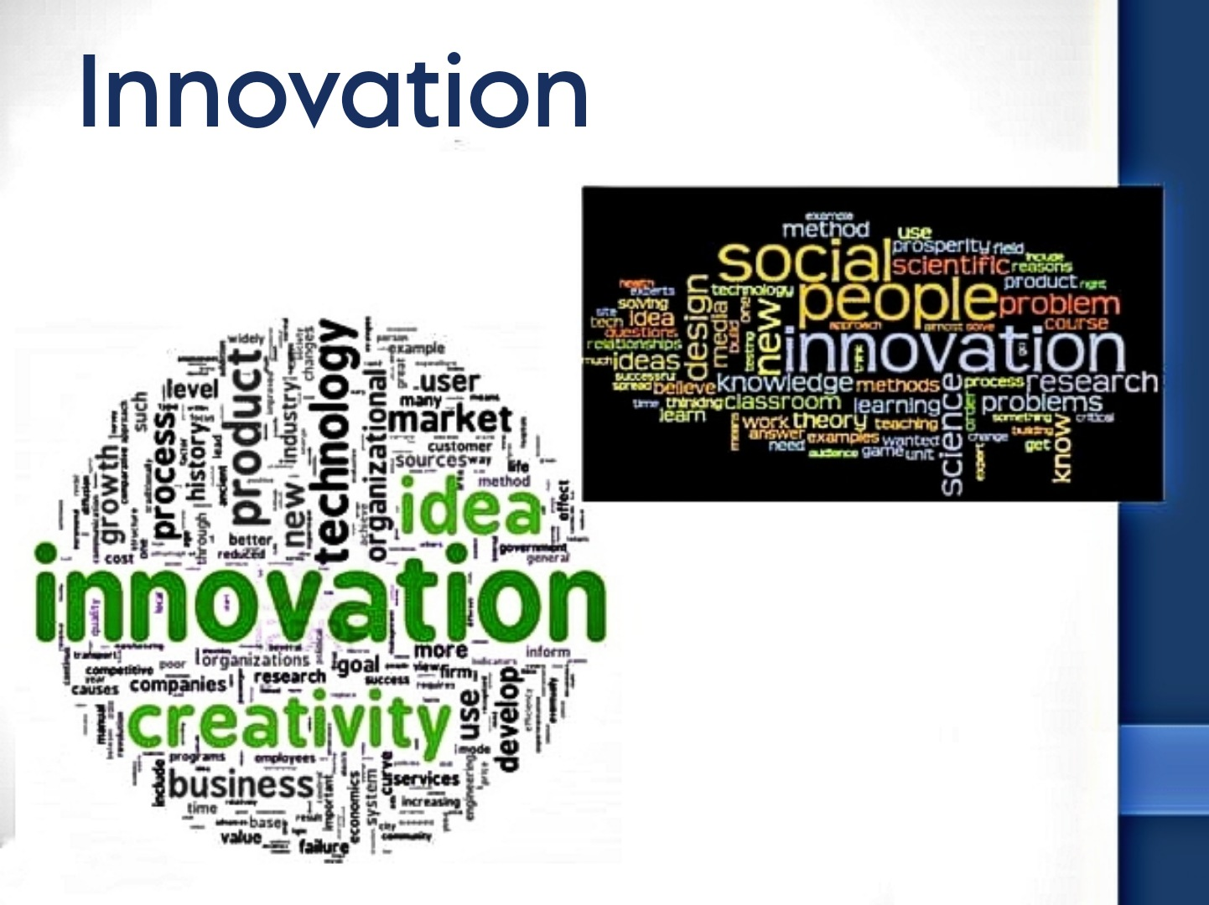

Slide 4
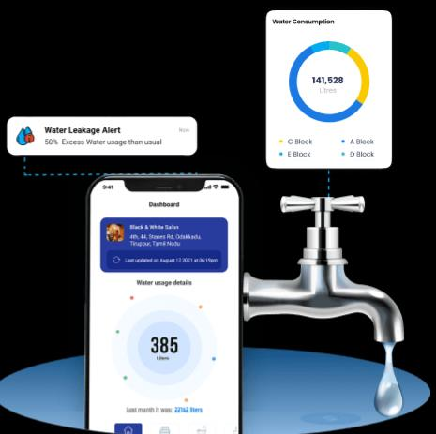
Innovations and ideas of Smart Water Fountation
Hydration Tracking: Implement sensors that can measure water intake and sync with health apps to provide users with personalized hydration recommendations.
Real-Time Water Quality Monitoring: Integrate sensors to monitor water quality in real-time, providing users with information about impurities and contaminants in the water.
Solar-Powered Fountains: Create water fountains powered by solar energy, making them energy-efficient and environmentally friendly.
Smart Bottle Refill Stations: Develop smart refill stations that detect and refill reusable water bottles automatically, promoting the use of eco-friendly containers.

Slide 5
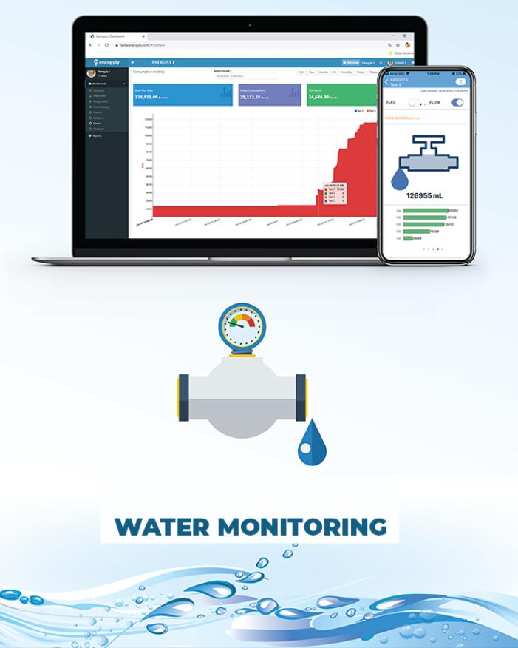
Gesture-Controlled Fountains: Design fountains that respond to gestures, allowing users to control the water flow and temperature with simple hand movements.
Water Saving Modes: Include intelligent water-saving modes that adjust water flow based on the demand, optimizing water usage in different scenarios.
Educational Displays: Incorporate interactive screens that display information about the importance of hydration, local water sources, and environmental impact, raising awareness among users.
Mobile App Integration: Create dedicated mobile apps that allow users to locate nearby smart water fountains, check water quality reports, and receive notifications when they need to hydrate.

Slide 6
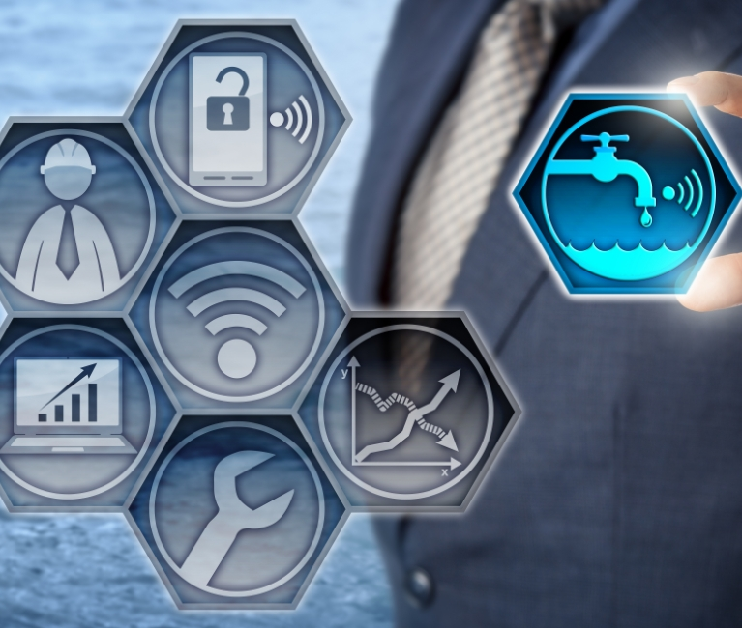
Voice Command Integration: Enable voice-activated controls, allowing users to operate the fountain and access information through voice commands, enhancing accessibility.
Aromatherapy Infusion: Introduce aromatherapy features that allow users to infuse water with natural scents, providing a refreshing and pleasant drinking experience.
Emergency Response System: Include a panic button or sensor that, when activated, dispenses clean drinking water, aiding in emergency situations and natural disasters.
Smart Payment Integration: Implement contactless payment systems for paid water dispensing, enabling users to pay through mobile wallets or contactless cards.
Interactive Art Installations: Combine water fountains with interactive art installations, creating visually appealing and engaging public spaces that also serve a functional purpose.
Weather-Responsive Controls: Integrate weather sensors to adjust water temperature and flow rate based on the ambient temperature, ensuring users receive comfortable and refreshing hydration.
Customizable Designs: Offer customizable designs for smart water fountains, allowing cities and businesses to incorporate their branding, fostering a sense of community ownership.These ideas leverage technology and creativity to enhance user experience, promote hydration, and contribute to sustainable practices.

Slide 7


