Slide 1
facial RECOGNITION
facial RECOGNITION
SUBMITTED BY : ASWIN EDAKKODE
SUBMITTED BY : ASWIN EDAKKODE

Slide 2
Problem statement
Problem statement
Facial recognition is one of the challenging concepts to implement in computer vision.
The Objective of this project is to make a Convolutional Neural Network that accurately predicts the faces across a wide range of scenarios such as dim lighting, facing from a non-frontal angle, etc.

Slide 3
How is this helpful?
How is this helpful?
This technology has a wide range of potential applications
in business :
Access Control : Facial recognition can be used for identity verification and authorization for accessing buildings, rooms, devices, machines or other secured areas.
Time & Attendance : Facial Recognition can be used for tracking employee attendance, productivity, overtime and breaks.
Personalized Customer Experiences: Used for analyzing customer demographics, preference, emotions and behaviors as well as providing personalized recommendations, offers according to each customer.
Security & Surveillance : Used for detecting and preventing crimes, identifying suspects or missing persons, monitoring public places or events.

Slide 4
methodology
methodology
Data Collection: A dataset of facial images of 40 different persons that includes different lighting conditions, poses, expressions are collected and saved in 2 folders train and test appropriately.
Data Preprocessing: Techniques such as normalization, resizing, cropping, and augmentation are applied to the images.
Model Design : Design a Convolutional Neural Network (CNN) for a base model first while considering factors such as the number of layers, neurons, epochs, activation functions and regularization techniques.
Model Compiling : Compile the CNN model on the dataset using appropriate hyper- parameters.
Model Evaluation: Performance of the model is evaluated by plotting accuracy and loss.
The base model is improved by adjusting the number of layers, neurons and epochs.

Slide 5
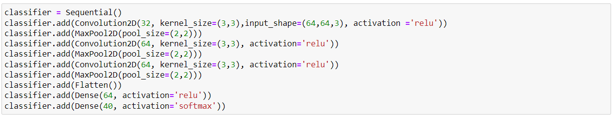
Base model
Base model
No Data augmentation was used in Base Model.
3 Convolutional Layers and 3 Max-pooling layers were used.
20 epochs were used for the base model.

Slide 6
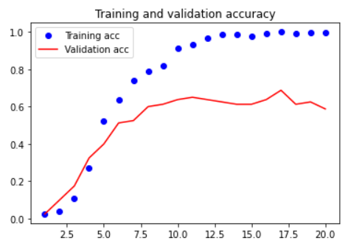
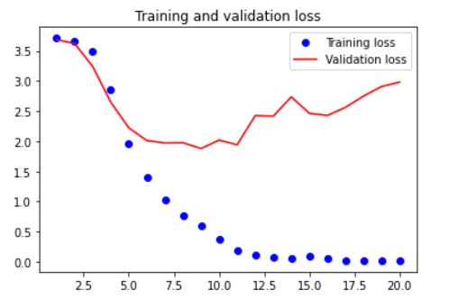
evaluation of the base model
evaluation of the base model
The model is not that great.
Let’s improve…

Slide 7
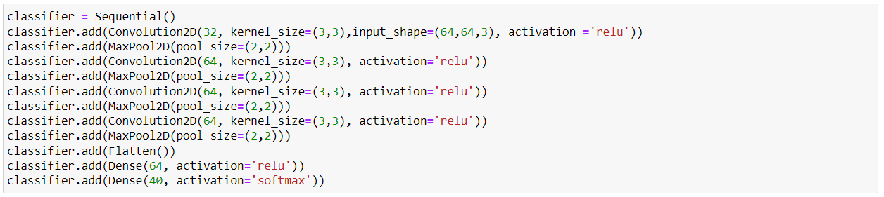
Model 2
Model 2
Data augmentation is used here.
Added one more convolutional and max-pool layer.
150 epochs were used.

Slide 8
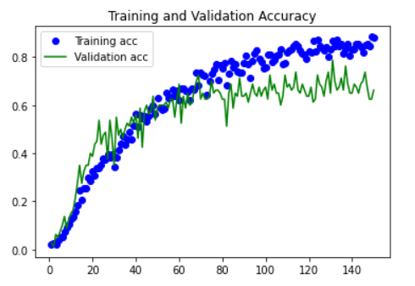
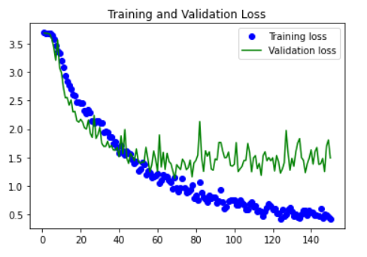
evaluation of the 2nd model
evaluation of the 2nd model
This model has better results.

Slide 9
conclusion
conclusion
The 2nd model does better.
The main contributions of this project are:
We have demonstrated the effectiveness of CNN for face recognition tasks, as it can learn the features and patterns from the images automatically.
We have shown that factors like data augmentation, epochs and number of layers can improve the performance of the model.
Although this has good accuracy, there is always room for improvement.
~THE END~
~THE END~

