Slide 1
Fetal health
Fetal health
Fetal health
Presented by : ASWIN EDAKKODE
LAST UPDATED : 23 – 02 – 2023

Slide 2
Problem statement
Problem statement
Child Mortality remains as one of the critical global health issue.
This not only devastates families and communities but also undermines progress towards achieving sustainable development goals.
Final Goal : Reduce under‑5 mortality to at least as low as 25 per 1,000 live births.

Slide 3
Objective of this project
Objective of this project
Parallel to notion of child mortality is Maternal Mortality.
The vast majority of the deaths that occur during and following pregnancy is due to low resource.
OBJECTIVES: Help healthcare professionals identify high-risk pregnancies accurately and assist in allocating limited resources.
Build an accurate machine learning model that categorizes fetal health into three levels: normal, suspicious, and pathological.

Slide 4
methodology
methodology
The data set I am working with contains various features, such as baseline value, accelerations, fetal movement, uterine contractions, and many more, all of which are extracted from Cardiotocograms (CTGs). Analyzing these features effectively is crucial for identifying fetal health issues and improving the outcomes of mothers and babies.
DATA PROCESSING: Check and handle missing values and outliers.
EDA : Visualize columns using histogram, boxplot and barplot.
FEATURE SELECTION : Using statistical tests features are selected.
MODELS :
Models like Logistic Regression, Decision Tree, Random Forest etc . . are trained, tested and tuned using different hyperparameters.
The Models are evaluated on the basis of accuracy score, classification report, confusion matrix etc.
The models are compared and the best one is selected.

Slide 5
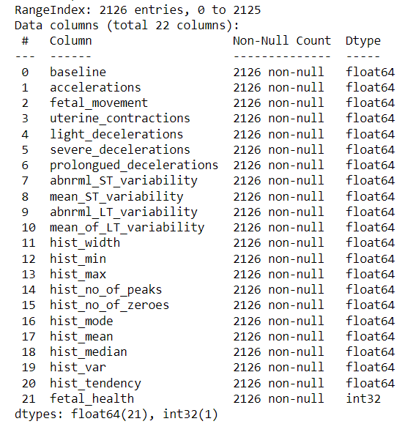
Information of the dataset
Information of the dataset

Slide 6
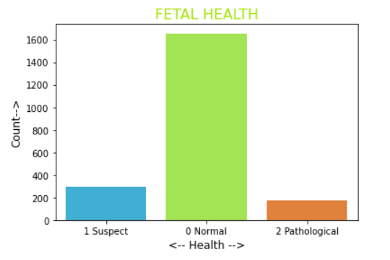
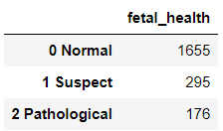
Target variable – fetal health
Target variable – fetal health
The data for normal is far more than that of suspect and pathological.

Slide 7
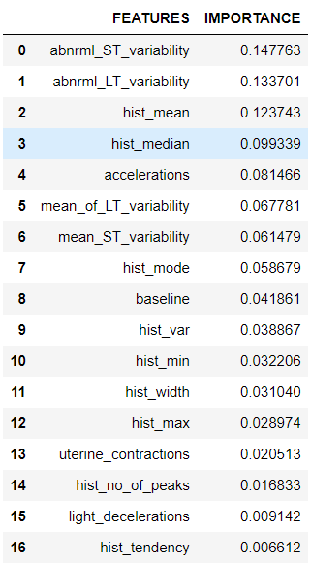
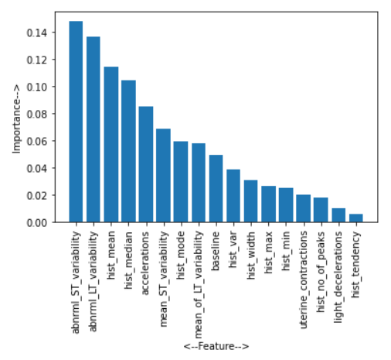
Feature importance
Feature importance
Abnormal short-term variability, Abnormal long-term variability and histogram mean are the most important features to classify the fetal health.

Slide 8
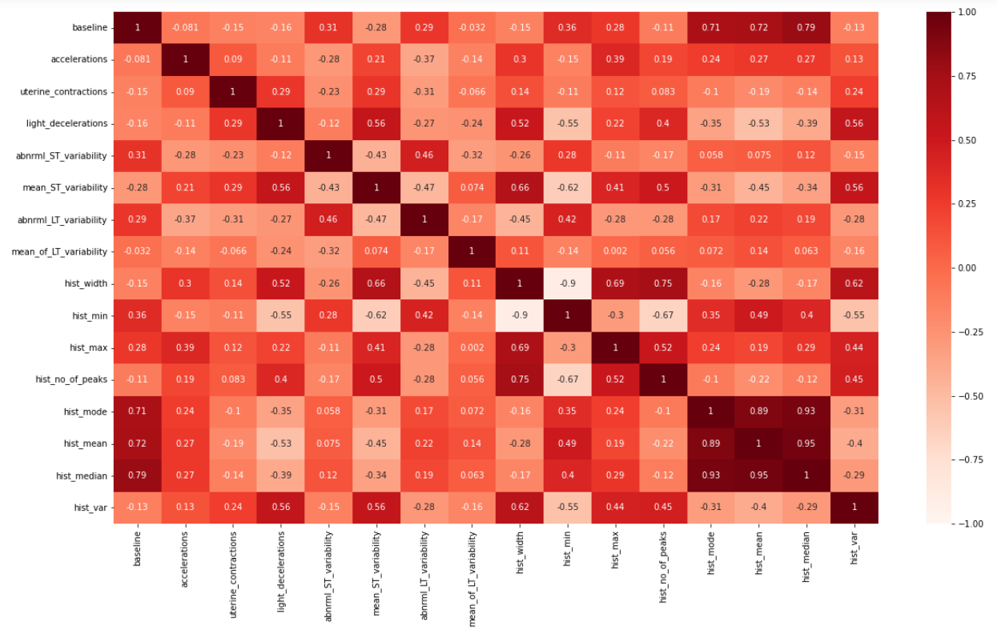
multicollinearity
multicollinearity

Slide 9
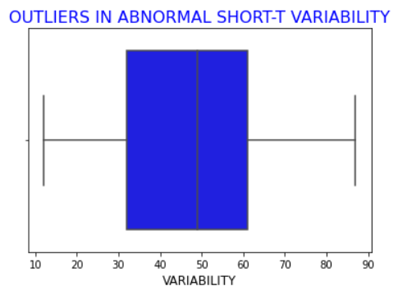
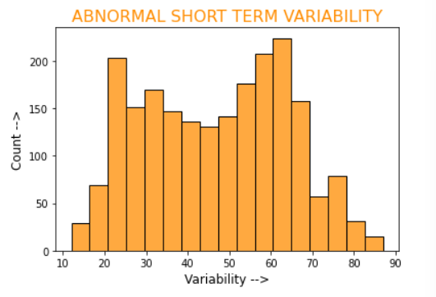
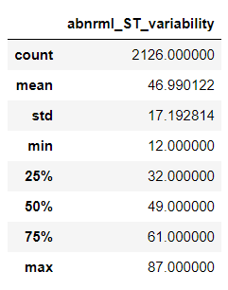
Abnormal short term variability
Abnormal short term variability
Percentage of time with abnormal short term variability

Slide 10
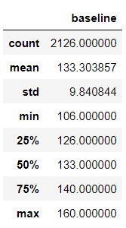
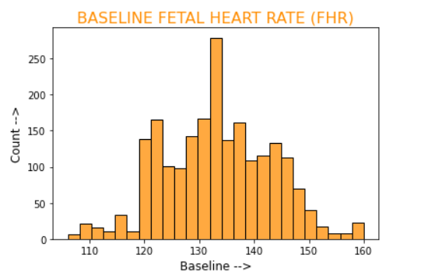
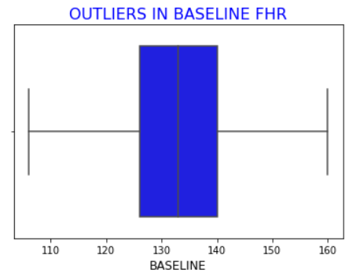
Baseline
Baseline
Fetal Heart Rate Baseline (beats per minute)

Slide 11
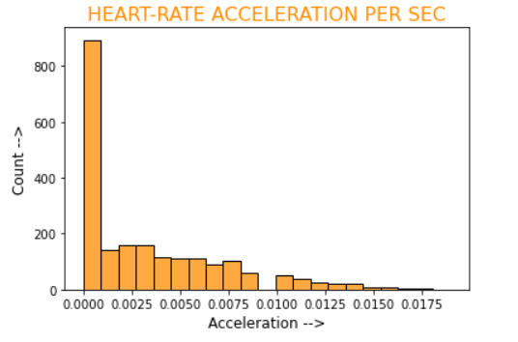
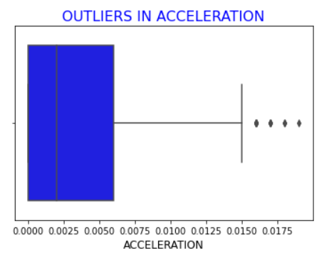
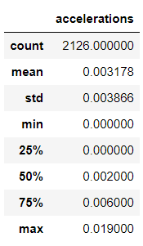
Accelerations
Accelerations
Number of accelerations per second

Slide 12
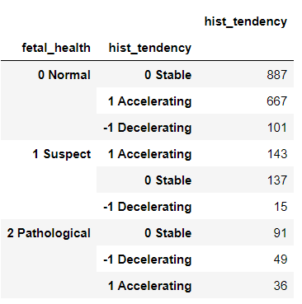
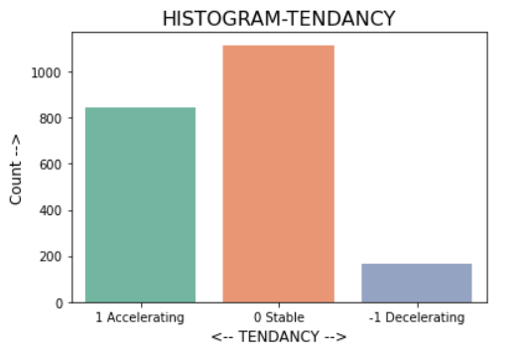
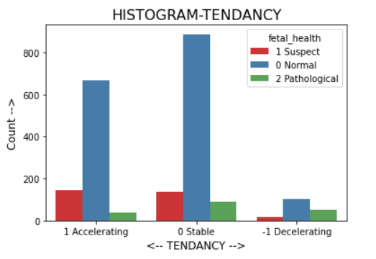
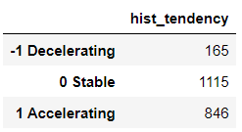
Histogram tendency
Histogram tendency

Slide 13
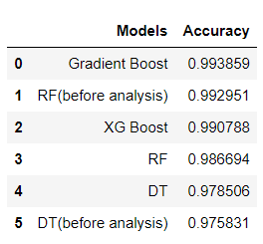
Models AND EVALUATIONS
Models AND EVALUATIONS
LOGISTIC REGRESSION
DECISION TREE
RANDOM FOREST
ADA BOOST CLASSIFICATION
GRAD BOOST CLASSIFICATION
SUPPORT VECTOR MACHINES
NAÏVE BAYES
K NEAREST NEIGHBORS
XG BOOST CLASSIFICATION
All Models were build on both balanced and unbalanced data.
After all evaluation, models gave better results on balanced data.
Gradient Boost gives the best accuracy with 99.3%
Random forest, before dropping features using statistical tests, gives the next best accuracy – 99.2%
XG Boost – 99%
Random Forest, after statistical tests – 98.6%

Slide 14

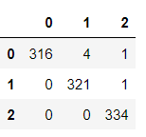
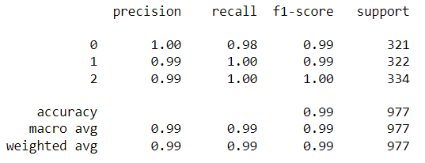
1)GRADIENT BOOST
ACCURACY
This is the best model with least misclassification.
All Actual Pathological cases were predicted correctly.
F1 – score of Pathological class is 1.
CONFUSION MATRIX
CLASSIFICATION REPORT

Slide 15

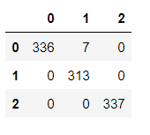
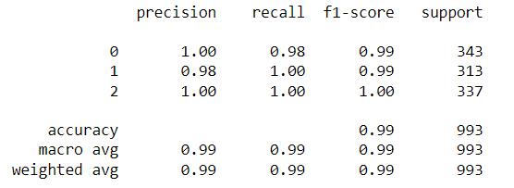
2)Random forest
Random Forest Before dropping features using statistical tests.
ACCURACY
All Actual Pathological and Suspicious cases were predicted correctly.
Precision, Recall, F1 – score of Pathological class is 1.
Since there is no misclassification cases as Pathological this could be considered as the best model to allocate resources efficiently.
CONFUSION MATRIX
CLASSIFICATION REPORT

Slide 16

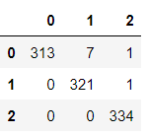
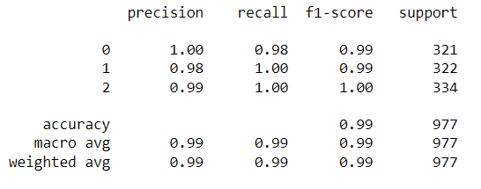
3)XG BOOST
ACCURACY
All Actual Pathological and Suspicious cases were predicted correctly.
F1 – score of Pathological class is 1.
CONFUSION MATRIX
CLASSIFICATION REPORT

Slide 17

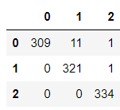
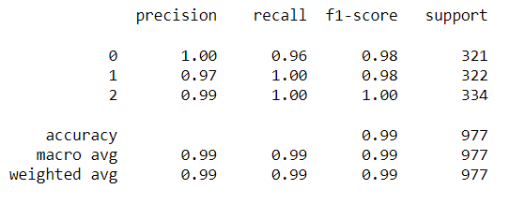
4)Random forest
Random Forest After dropping features using statistical tests.
ACCURACY
All Actual Pathological and Suspicious cases were predicted correctly.
F1 – score of Pathological class is 1.
CONFUSION MATRIX
CLASSIFICATION REPORT

Slide 18
conclusion
conclusion
Gradient Boost Algorithm and Random Forest Algorithm gives the best model.
It depends upon whether resources are being allocated/how much resource are being allocated to the Suspicious class and the scale to which the algorithm will be used.
~ THE END ~
~ THE END ~

