Slide 1
Breast Cancer Analysis
Group - 3
By,
Ashwini Nelagondanahalli Virupakshappa
Aswini Sivakumar
Divya Ramesh
Prachi Dalvi

Slide 2
Agenda
Introduction
Objective
Data
Exploratory Data Analysis
Model Analysis
Model Comparison and Conclusion
Improvements & Enhancements

Slide 3
Introduction
Breast cancer is a disease in which cells in the breast grow out of control
It is the second-leading cause of cancer deaths in women
As per studies, 80% of breast cancer occurs in women older than age 50
Notes:
Breast cancer is a disease in which the healthy cells of the tissue in the breast are invaded(spread) and mutated(change, evolve), which further grow in large numbers to form a malignant(infectious, uncontrollable, harmful) tumor.
It is one of the most common types of cancer in women, and it can also occur in men, although it is much less common
It can most likely occur at any age.
80% of the patients who have breast cancer are above 50 years of age

Slide 4
Objective
Understand the relation between the variables and the target variable
Analyze and find best model to predict the status of the new patient
Analyze and find the important variables for the target variable
Notes:
our goal is to understand the relation between the variables and target variables
to analyze and find the best model that will help to predict the status (Alive or Dead) of the new patient.
We will also be analyzing which variables are important for target variable that is status and how they affect the results in different models.

Slide 5
Data
Dataset:
https://www.kaggle.com/datasets/reihanenamdari/breast-cancer
4024 records and 16 variables
Age, Race, Marital Status, T-stage, N-stage, 6th Stage, Differentiate, Grade, Astage, Tumorsize, EstrogenStatus, ProgesteroneStatus, Regional Node Examined, Regional Node Positive, Survival Months, Status.
Data cleaning/validation
Notes:
We got the data from kaggle
T-stage → size of main tumor
N-stage → number of lymph node that contain cancer
6th stage → 1st and 2nd letter says stage of the cancer and last alphabet describes how badly it has spread
Differentiate → arrangement of cells. well, poor and moderately differentiated
Grade→ severeness of the cancer
A-stage→ regional- not spread to other parts, distant-spread to distant parts like lungs, liver
Estrogen status →If breast cancer cells have estrogen receptors, the cancer is called ER-positive breast cancer
Progesterone Status - If breast cancer cells have Progesterone receptors, the cancer is called PR-positive breast cancer.
Regional Node examined → how many regional nodes examined around the tumor
Regional node positive→ how many regional nodes are affected
Survival months → after detection for how many months patient has survived
status → whether the patient is dead or alive
the data from kaggle was pretty consistent without null or missing fields.
But we did make the required changes like
the variable names was having spaces, we used validvarname=v7 to make them as valid SAS names. validvarname=v7 that will remove spaces and replace it with underscores
In Grade variable, grade 4 was alphabetic while others were numeric so we changed it to numeric

Slide 6
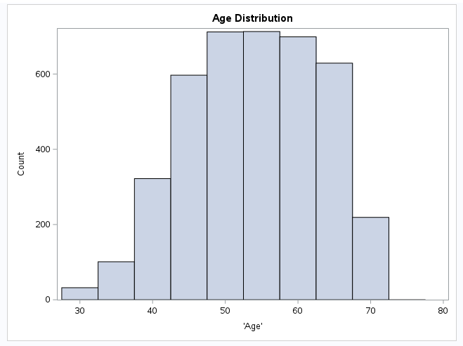
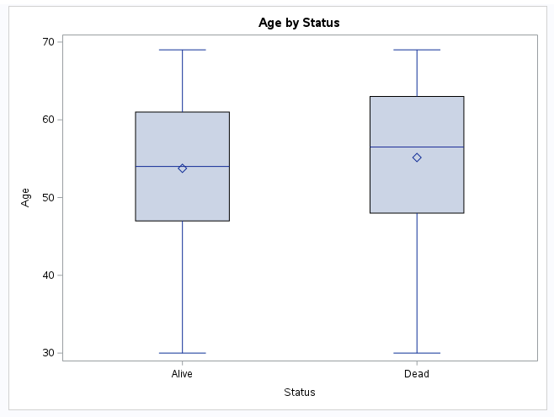
EDA
Notes:
1.The range of patient’s age is from 30-69. Most of the patient’s age lies between 45 to 65 age which we found in our research as well that 80% of women whose age is more than 50 have breast cancer
2. the mean and median age of alive patients is slightly lower than the dead patients. This indicates that chances of older patients surviving are less

Slide 7
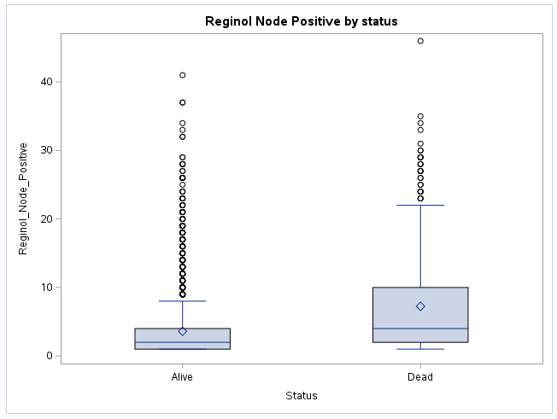
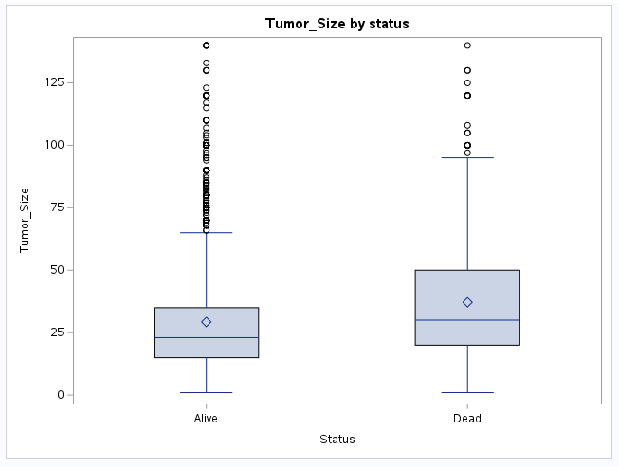
EDA Cont. (Status)
Notes:
Average and median is lower in alive which means less number of regional nodes affected compared to dead patients. Both are right skewed.
Alive is having more outliers compared to dead
Average and median is slightly lower in alive. Both are right skewed.
Alive is having more outliers compared to dead

Slide 8
Status Analysis
Logistic Regression
CART Model
Neural Networks
Discriminant Analysis
Notes:
Our target variable, 'status', is categorical with two classes, representing the patient's status as either 'alive' or 'dead'. Therefore, we approach this as a classification problem. We applied four models on our dataset to determine the best approach.
We noticed that two variables in our dataset, t-stage and tumor size, were correlated. To investigate their impact, we ran our models using each variable separately while holding the other variable.
We divided our dataset into a 70% training set and a 30% validation set for all the four models.We have an imbalance dataset with 85% of the data showed a status of 'alive', while 15% showed a status of 'dead'. After splitting the data, we still maintained the same proportions of 'alive' and 'dead' in both the training and validation sets. We first applied our models to the complete data, and then compared those results to the results obtained from an undersampled dataset.

Slide 9
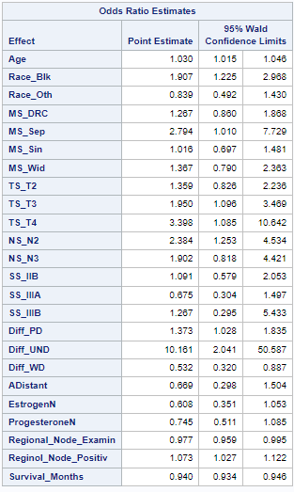
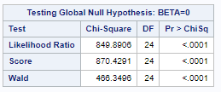
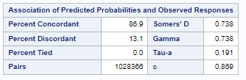
Status Analysis Cont. Logistic Regression
With all Variables:
Notes:
We began with logistic regression and found that when tumor size was included with other variables, the model was statistically significant. However, the p-value for tumor size and most variables were greater than alpha, and 1 was a possible value in the confidence intervals for tumor size.
We then added T-stage to the model along with the other variables. The resulting model was statistically significant, with two out of three dummy variables for T-stage showing significance. Only the TS_T2 variable was not significant. The area under the curve (AUC) was 86.9%, which is considered good.
When interpreting the odds ratio estimate for the age variable, we could see that for every year the patient gets older, the odds of their status being dead increase by 3%

Slide 10
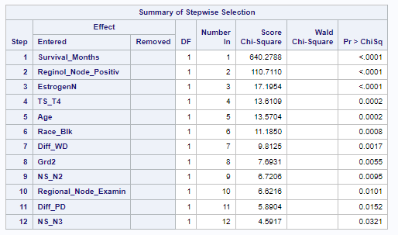
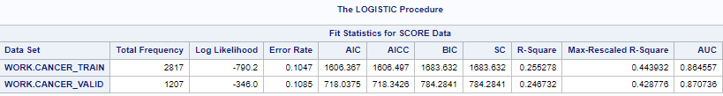
Status Analysis Cont. Logistic Regression
Important variables from stepwise selection method.
Model fit and model performance
Notes:
After applying stepwise selection to the model with T-stage, we found the following important variables:
On the training set, the area under the curve (AUC) was 86.4%, which is considered good. On the validation set, the AUC improved to 87%, which is also considered good. Additionally, the AIC and BIC were lower on the validation set than on the training set, indicating no signs of overfitting.

Slide 11
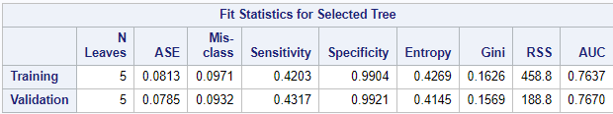
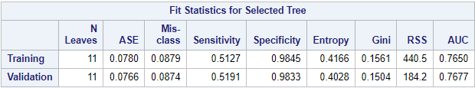
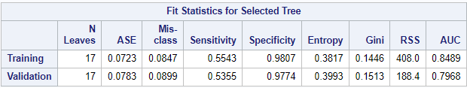
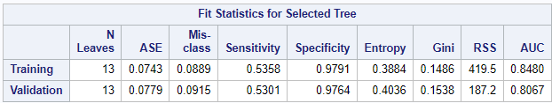
Status Analysis Cont. CART Model
Entropy with T-stage
Entropy with Tumor Size
Gini with T stage
Gini with Tumor size
Notes:
Our second model was CART, and we applied both GINI and ENTROPY measures for models with T-stage and tumor size. We found that GINI with tumor size performed better, resulting in 13 leaves after pruning, with a better AUC and specificity and a moderate sensitivity.
On the other hand, although ENTROPY with T-stage had the lowest number of leaves after pruning among the four models applied, its sensitivity and AUC were considerably lower compared to GINI with tumor size.

Slide 12
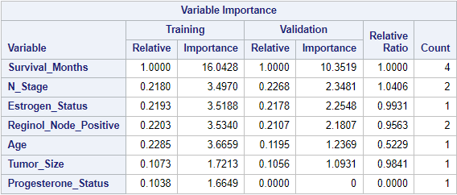

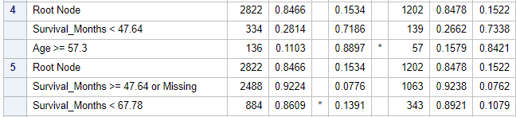
Status Analysis Cont. CART Model
Gini with Tumor Size (Final Model - Important variables)
Notes:
These are the important variables from the model Gini with Tumor Size
While interpreting the node criteria for Node 5, we can see that for patients with a survival months ranging between 47.64 and 67.78 months, there is an 86.09% chance that their status is alive.

Slide 13
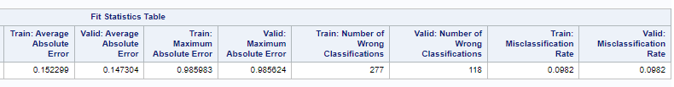



Status Analysis Cont. Neural Network Model
With Tumor_Size:
With T_stage:

Slide 14
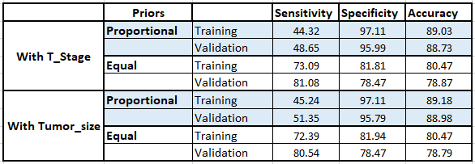
Status Analysis Cont. Discriminant Analysis

Slide 15
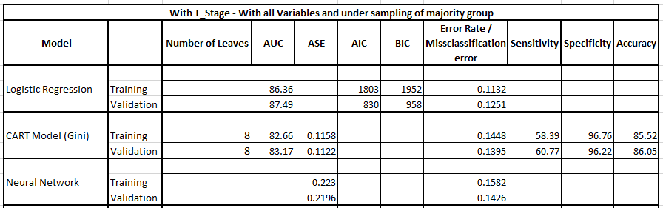
Under Sampling using Majority Group

Slide 16
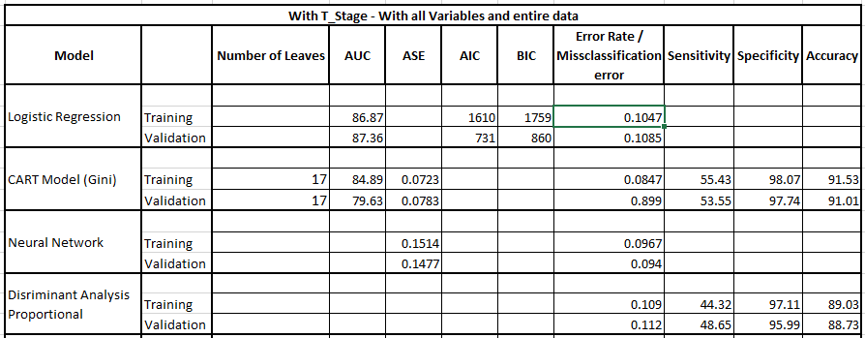
Model Comparison & Conclusion:

Slide 17
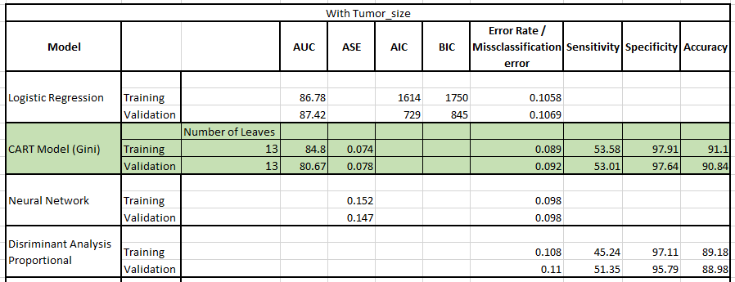
Model Comparison & Conclusion:

Slide 18
Improvements / Enhancements
Patients pre-existing health conditions data
Treatment path followed

Slide 19
Questions?

Slide 20
Thank You!

