Slide 1
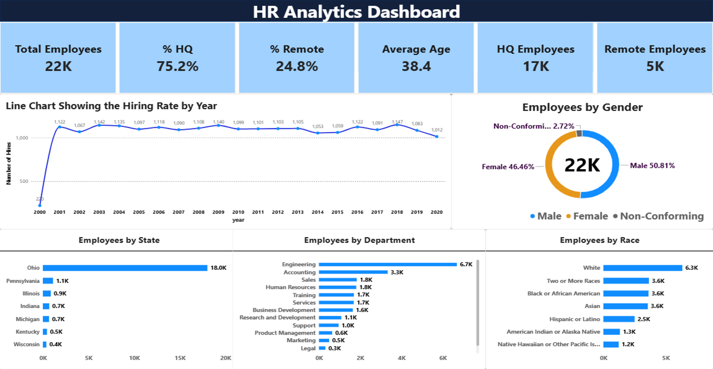
PRDA – 03
HR Analytics
Power BI Dashboard Presentation
Name
Nettem Aswini Naidu
Team ID
PTID-CDA-OCT-26-11122
Course
CDA
Members
Individual project
Notes:
Good morning. I am Nettem Aswini Naidu. This is my individual Power BI project, PRDA-03 HR Analytics.

Slide 2
Project objective
Analyse HR employee data to understand the workforce.
Build a Power BI dashboard with KPIs and charts.
Derive insights and give suggestions to the company.
3
5
KPIs
charts
12
4
insights
suggestions
Notes:
The objective is to analyse the HR employee data to understand the workforce, build a Power BI dashboard with KPIs and charts, and then derive insights and suggestions for the company. In total: 3 KPIs, 5 charts, 12 insights and 4 suggestions.

Slide 3
Getting the data
Data loaded into Power BI Desktop using Get Data.
Fields used: gender, department, race, state, location (HQ or Remote), age, hire year and termination.
DAX measures built for the KPIs and charts.
22,214
employee records
17
data fields
2000–2020
hire years
Notes:
The first step was to get the data into Power BI Desktop. The dataset has 22,214 employee records and 17 fields, with hire years from 2000 to 2020. I then built DAX measures for the KPIs and charts.

Slide 4
Power BI dashboard
Notes:
This is the complete dashboard. It has the KPI cards, a line chart for hiring by year, a donut chart for gender, and three bar charts for state, department and race.

Slide 5
KPIs
22,214
75.2% HQ
24.8% Remote
38.4
Number of employees
Average age (years)
Percent of workers at HQ and working remotely
Notes:
These are the three KPIs. There are 22,214 employees. 75.2 percent work at headquarters and 24.8 percent work remotely. The average age is 38.4 years.

Slide 6
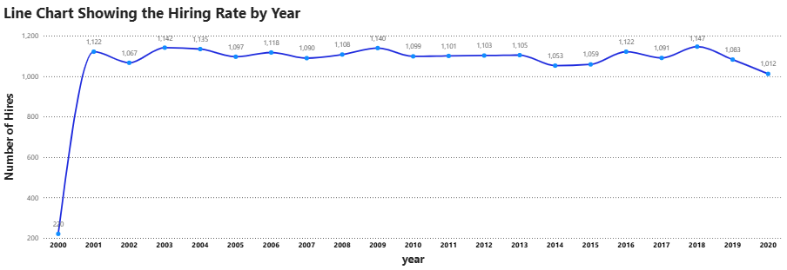
Hiring rate by year
1,000–1,150 hires a year
1,147 peak hires, in 2018
1,012 lowest full year, 2020
Notes:
X axis is the hire year and Y axis is the number of hires. After the partial year 2000, hiring stays between about 1,000 and 1,150 every year. The peak is 2018 with 1,147 hires, and 2020 is the lowest full year with 1,012.

Slide 7
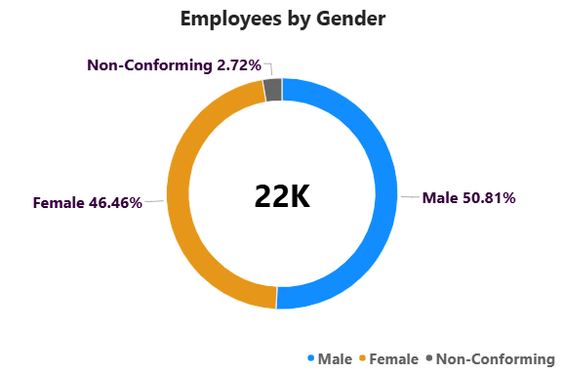
Employees by gender
50.81%
Male: 11,288 employees
46.46%
Female: 10,321 employees
2.72%
Non-Conforming: 605 employees
Notes:
Male employees are 50.81 percent and female employees are 46.46 percent, so the workforce is well balanced. Non-conforming employees are 2.72 percent, which is 605 people.

Slide 8
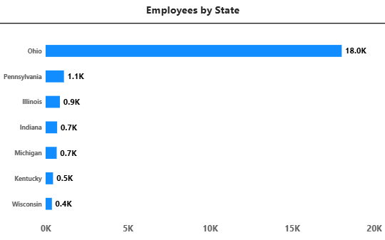
Employees by state
81%
of employees are in Ohio (18,025)
1,115
in Pennsylvania, the next largest
382
in Wisconsin, the smallest
Notes:
Ohio is by far the largest location with 18,025 employees, which is 81 percent of the workforce. Pennsylvania is next with 1,115 and Wisconsin is the smallest with 382.

Slide 9
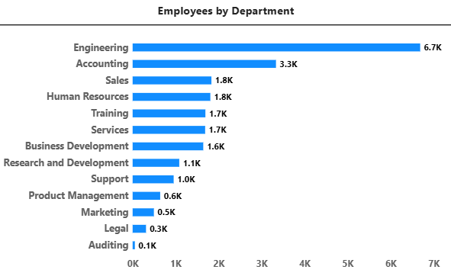
Employees by department
30%
work in Engineering (6,686)
3,333
in Accounting, the second largest
52
in Auditing, the smallest team
Notes:
Engineering is the largest department with 6,686 employees, about 30 percent. Accounting is second with 3,333. Auditing is the smallest team with only 52 employees.

Slide 10
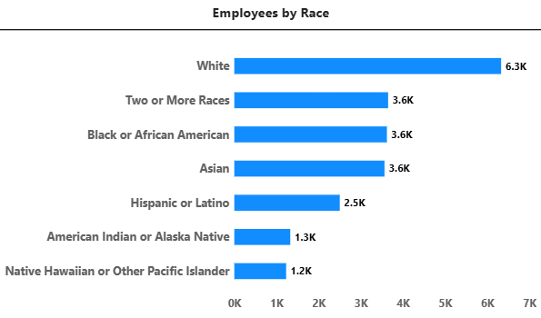
Employees by race
28.5%
White, the largest group (6,328)
~16%
each: Two or More Races, Black, Asian
1,229
Native Hawaiian or Other Pacific Islander, smallest
Notes:
White employees are the largest group with 6,328, which is 28.5 percent. Two or More Races, Black or African American and Asian are each about 3,600, around 16 percent. No group is above 30 percent.

Slide 11
Insights: the workforce
Location
State
Department
75.2% work at HQ and 24.8% work remotely.
Ohio has 81% of employees (18,025).
Engineering is 30% of staff. Auditing has only 52 employees.
Gender
Race
Age
Male 50.8%, Female 46.5%, Non-Conforming 2.7%.
White is the largest group (28.5%). No group is above 30%.
Average age is 38.4. About 54% are 25 to 44; only 6% are 55 or older.
Notes:
These insights describe who works in the company: most people work at headquarters, Ohio holds 81 percent of staff, Engineering is the largest department, gender is balanced, no race is above 30 percent, and the average age is 38.4.

Slide 12
Insights: hiring and attrition
Hiring
Peak and low
Attrition
About 1,000–1,150 hires a year after 2000.
Peak 1,147 in 2018. Lowest full year 1,012 in 2020.
17.7% of employees have left (3,929).
By department
Remote vs HQ
By age
Highest in Auditing (23.1%), Legal (20.3%) and R&D (19.6%). Lowest in Marketing (14.6%).
Remote staff leave less often (16.8%) than HQ staff (18.0%).
Under 25 leave most (18.7%). Age 55 and above leave least (16.5%).
Notes:
Hiring has been steady and peaked in 2018. Overall 17.7 percent of employees have left. Attrition is highest in Auditing, Legal and R and D, remote employees leave less often than HQ employees, and employees under 25 leave most often.

Slide 13
Suggestions for the company
Reduce dependence on Ohio
Retain high-attrition teams
81% of staff are in one state. Grow hiring in other states to spread risk.
Auditing, Legal, R&D and Support lose 19–23% of staff. Review pay, workload and growth paths.
Support early-career staff
Keep remote options
Employees under 25 leave most (18.7%). Add onboarding and mentoring.
Remote staff leave less (16.8% vs 18.0% at HQ). Offer flexible work where roles allow.
Notes:
My suggestions to the company: first, reduce dependence on one state by growing hiring elsewhere. Second, focus retention on Auditing, Legal, R&D and Support, where attrition is highest. Third, support employees under 25 with onboarding and mentoring. Fourth, keep remote options, because remote employees leave less often.

Slide 14
Conclusion
Dashboard: Power BI turns raw HR data into a clear view. The KPIs, line chart, donut chart and bar charts show the whole workforce at a glance.
Workforce: The company has 22,214 employees. Most work at headquarters (75.2%) and the average age is 38.4 years.
Concentration: Employees are concentrated in Ohio (81%) and in Engineering (30%). Gender is balanced and no race is above 30%.
Hiring and attrition: Hiring has been steady at about 1,000–1,150 a year, but 17.7% of employees have left, mostly in small teams such as Auditing and Legal.
What I learned: How to load data, write DAX measures, design charts, and turn numbers into insights and suggestions.
Notes:
In conclusion: Power BI helped me turn raw HR data into a clear dashboard. The company has 22,214 employees, most work at headquarters, and the average age is 38.4. Staff are concentrated in Ohio and Engineering, gender is balanced, and no race is above 30 percent. Hiring is steady, but 17.7 percent of employees have left, mostly in small teams like Auditing and Legal. Through this project I learned to load data, write DAX measures, design charts, and turn numbers into insights and suggestions.

