Slide 1
PRDA – 03 HR Analytics
Power BI Dashboard PPT
Name
Nettem Aswini Naidu
Team ID
PTID-CDA-OCT-26-11122
Course
CDA
Members
Individual project
Notes:
Introduce the project: PRDA-03 HR Analytics, an individual Power BI dashboard project.

Slide 2
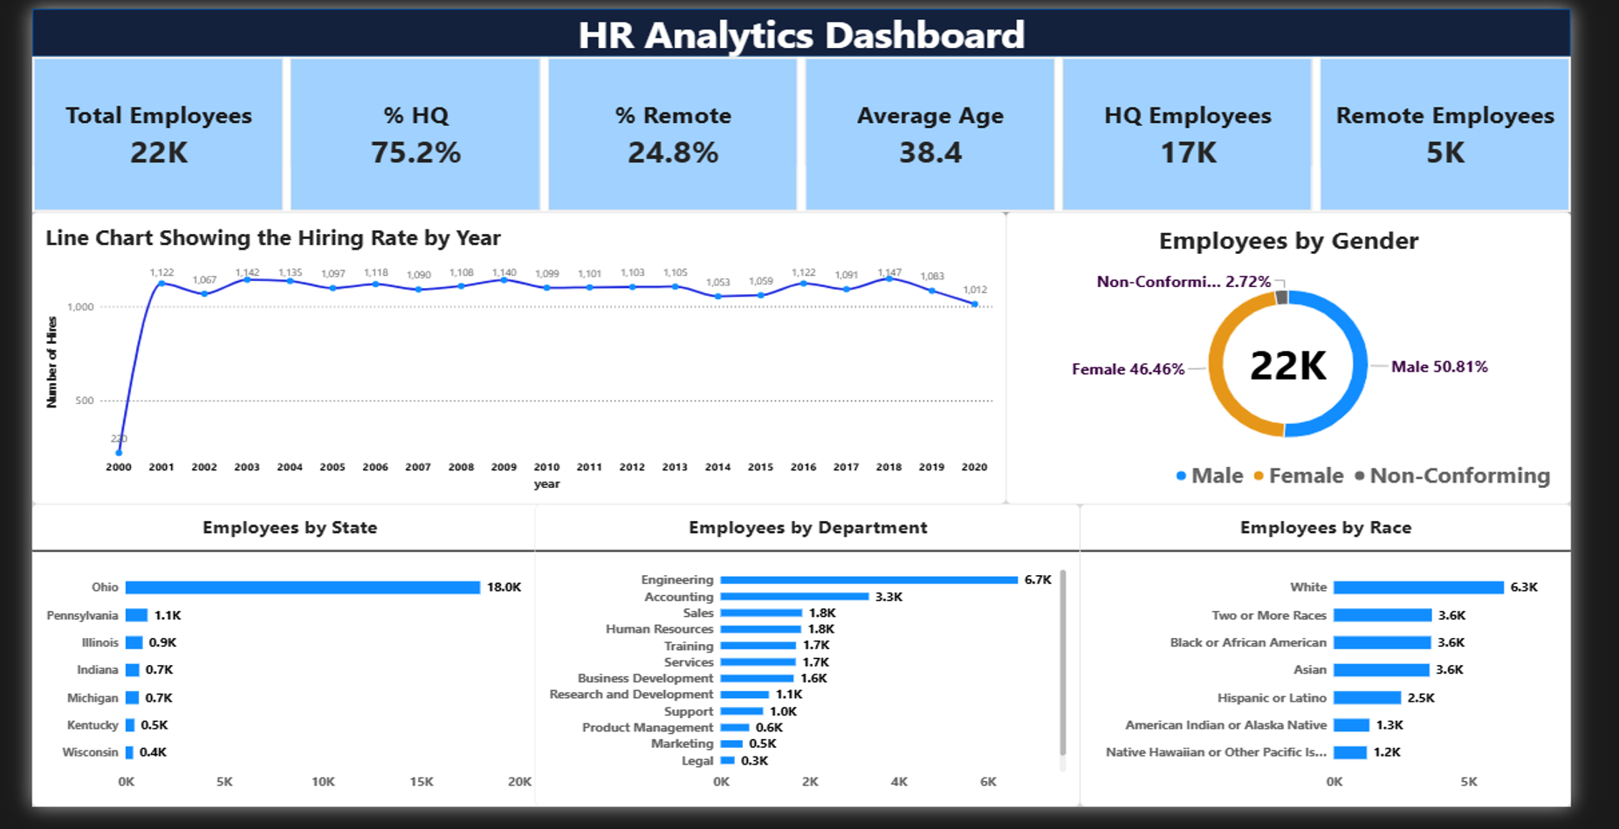
HR Analytics dashboard

Slide 3
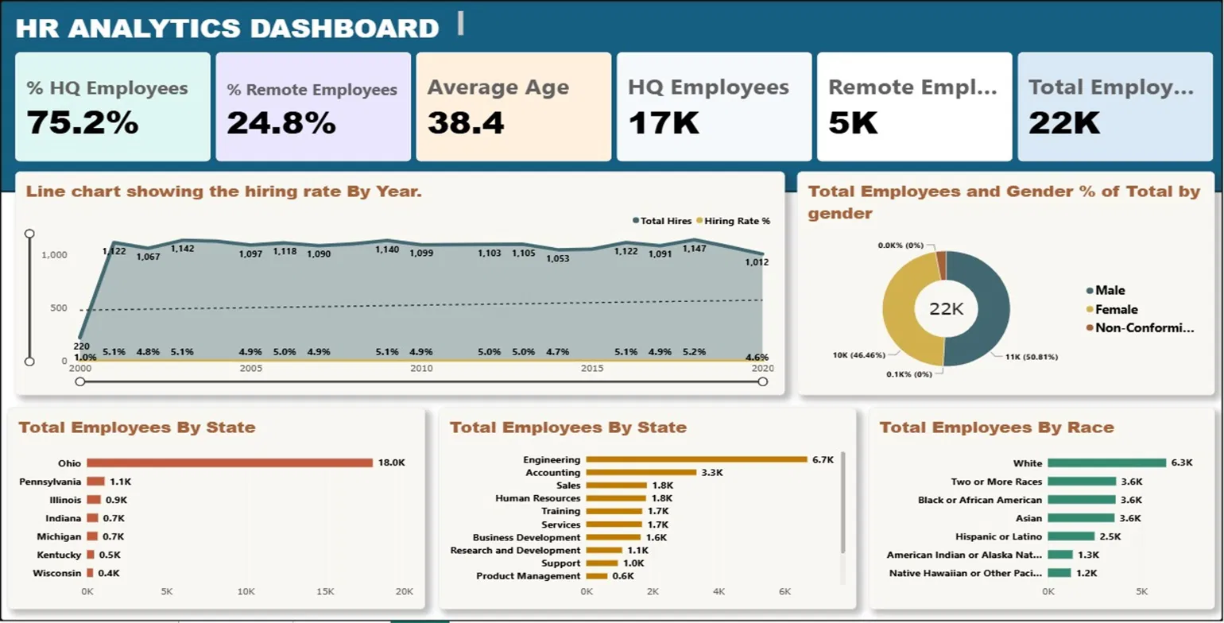
HR Analytics dashboard (alternate design)
Notes:
Alternate dashboard design.

Slide 4






KPI Cards
Notes:
Alternate dashboard design.

Slide 5
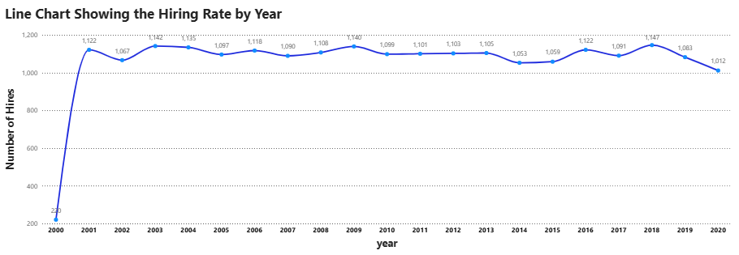
Hiring trend by year
Notes:
Hiring rate by year.

Slide 6
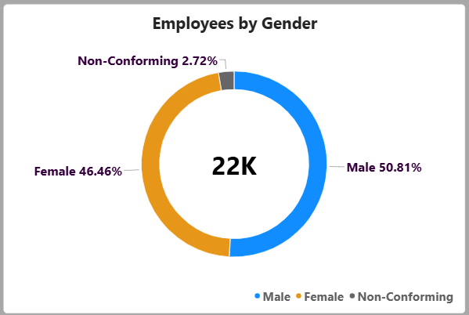
Employees by gender
Notes:
Gender split.

Slide 7
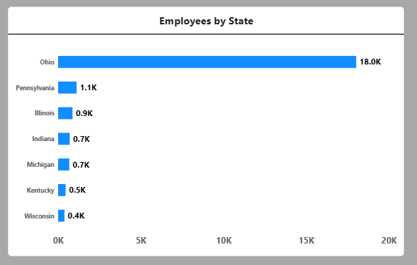
Employees by state
Notes:
Employees by state.

Slide 8
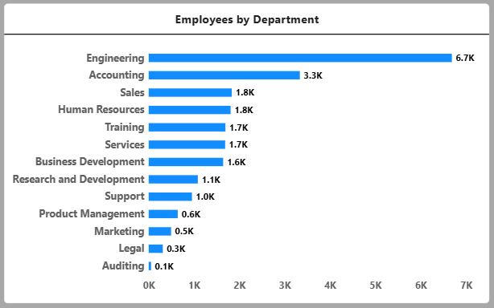
Employees by department
Notes:
Employees by department.

Slide 9
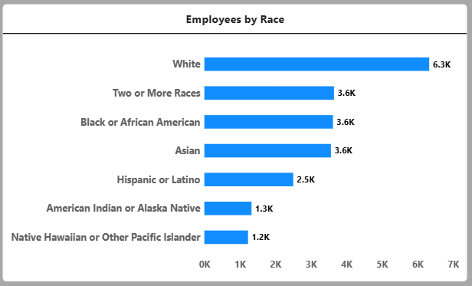
Employees by race
Notes:
Employees by race.

