Slide 1

Road Accident Analysis In USA
By: Aswini Pusuluri
015310269

Slide 2
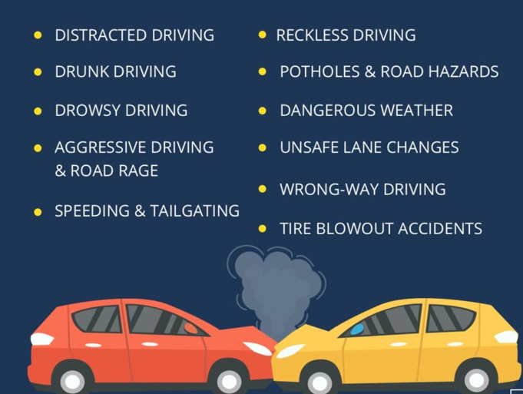
Project Background
Road accidents have become a major unnatural global problem claiming staggering numbers of fatalities every year
Improvement in living standards has introduced new trends in the motor vehicle sector, thus resulting in an increased number of vehicles on the road each year
Despite the remote work options and reduced traffic trends in major cities in the last couple of years, the traffic mortality rate is still on the rise

Slide 3
Project Motivation
As per WHO statistics 1.35 million succumb to road accidents every year globally of which 38,000 deaths occur in the United States
The death estimates from motor vehicle crashes in the first half of 2021 have risen by 18.4% over the preceding year with an estimate of 20160 deaths.
Visualizing and analyzing accident data can help us better understand what causes accidents and how we can take safety measures.

Slide 4
Project Objective
Top Accident –Prone States and Cities
Distribution of accident severity across US time zones
Accidents at different times of the day
Most Accident-prone day of the week
Road accidents in different weather conditions
Accidents based on density of population
Severity of road accidents by temperature

Slide 5
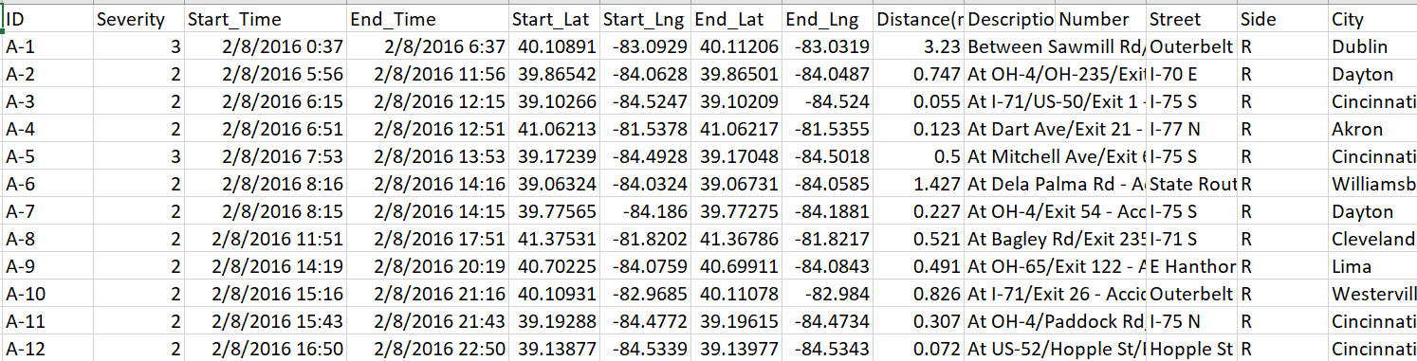
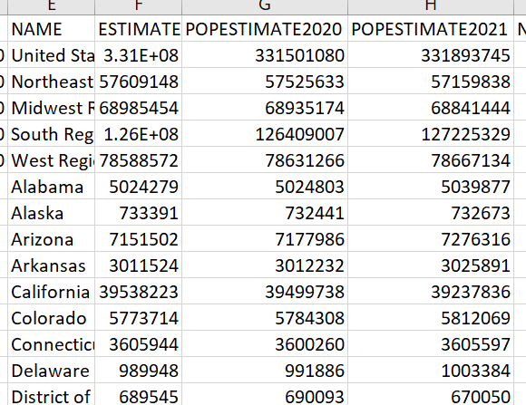
Data Collection
Us Accidents Dataset from Kaggle
Population data from US Census Bureau

Slide 6
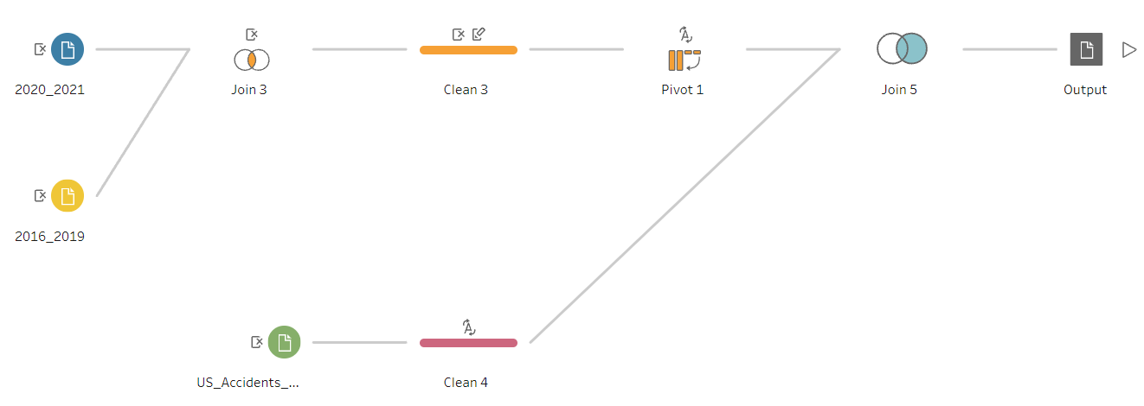
Data Processing

Slide 7
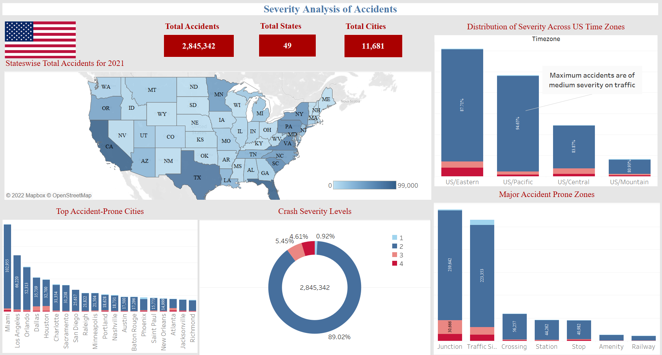
Data Visualizations

Slide 8
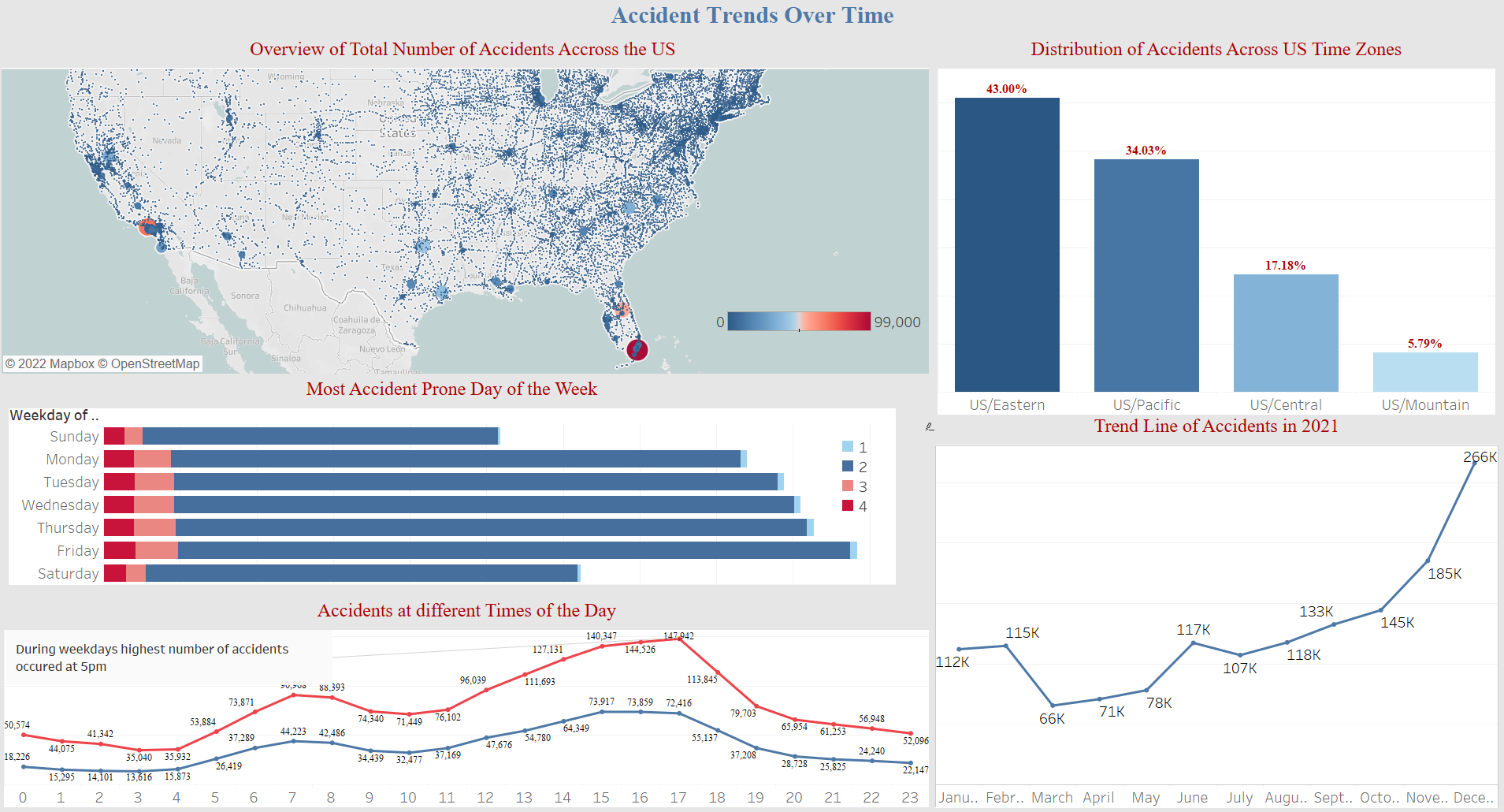
Visualizations Cont..

Slide 9
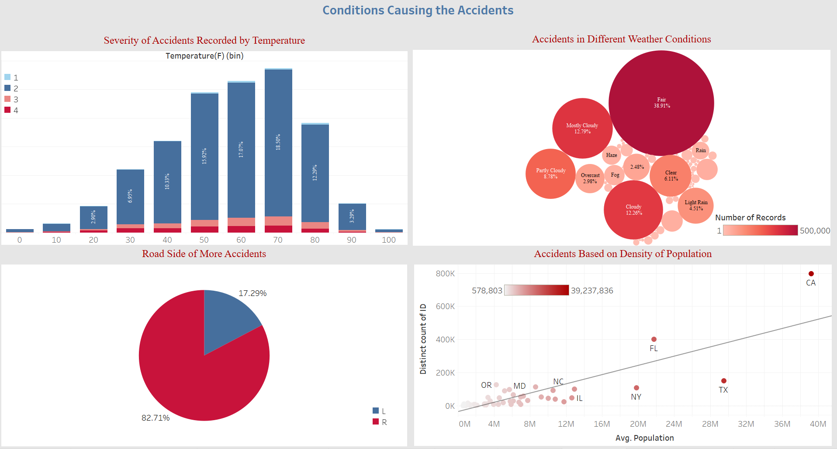
Visualizations Cont..

Slide 10
Recommendations
Measures should be taken to reduce the accidents during peak times recognized during the day, especially on weekdays.
Alerts should be provided to drivers when the weather is cloudy or overcast.
Strict speed limits should be implemented in the recognized hotspot zones
Congested roads should be avoided

Slide 11
Future Work
Collect and analyze accident data from all over the world in addition to the United States.

Slide 12


