Slide 1
Cybersecurity in Autonomous Vehicles
MODULE 5.2

Slide 2
Agenda
How Autonomous systems work?
Why Autonomous Vehicles (AV) security matters
Threat Landscape
CAN Bus & IDS
Sensor Spoofing
Putting It All Together

Slide 3
How Autonomous Systems Work?
Perception: Sensors (Camera, LiDAR, RADAR, GPS) observe the environment. The vehicle builds a real-time picture of the world around it.
Prediction: ML models interpret sensor data to classify objects, detect pedestrians, read traffic signs, and anticipate what other vehicles will do.
Planning: The system decides the safest path, speed, and maneuver based on predicted states of the environment.
Action: Commands are sent over the CAN bus to actuators — brakes, throttle, steering — to execute the plan.
Notes:
Add figures

Slide 4
Why Autonomous Vehicles (AV) security matters?
Software directly controls steering, braking and acceleration
Large attack surface: sensors, ECUs, V2X, cloud
Cyberattacks can cause real-world physical harm
Breaches damage regulatory compliance and public trust

Slide 5
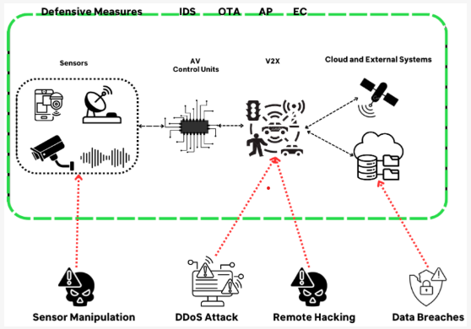
The AV attack surface
Attackers can target every layer of an AV
Physical / Sensor Layer: GPS Spoofing, LiDAR laser injection, camera blinding, ultrasound jamming
In-Vehicle Network (CAN Bus): DoS Flooding, message spoofing, replay attacks, fuzzy frame injection
Perception: Adversarial patches on traffic sign boards, FGSM image perturbations, model poisoning
Communication layer: V2X replay attacks, man-in-the-middle on OTA updates
Notes:
Picture source : https://www.mdpi.com/2079-9292/13/13/2654

Slide 6
The CAN Bus: Vehicle’s Internal Nervous System
CAN Frame Structure
Why CAN is Insecure by design?
No authentication: any ECU can send any message; no way to verify the sender
No encryption: all data is transmitted as plain text, visible to every node
Broadcast by design: every message seen by all ECUs simultaneously
Priority arbitration: low CAN ID = higher priority; attackers flood with high-priority frames
Timestamp
CAN_ID
DLC
DATA0-DATA7
Flag – 0,1,2

Slide 7
Common CAN Attack Types
Denial of Service (DoS) : Flood bus to block legitimate ECUs
Fuzzy: sends random frames to destabilize ECUs
Spoofing: Inject fake messages as trusted ECU
Replay: capture and retransmit real packets at wrong time

Slide 8
Intrusion Detection System (IDS)
Machine Learning based IDS in This Workshop
Model: Any classification model can be applied on labeled CAN data
Approach: Using machine learning models from scikit-learn
Load, clean and pre-process Raw CAN data files
Perform feature engineering
Model Training and Evaluation
Key Metrics for IDS Evaluation:
Precision: to identify false alarms
Recall: to identify missed attacks
ROC-AUC: to obtain ranking between different attack types

Slide 9
Sensor Spoofing

Slide 10
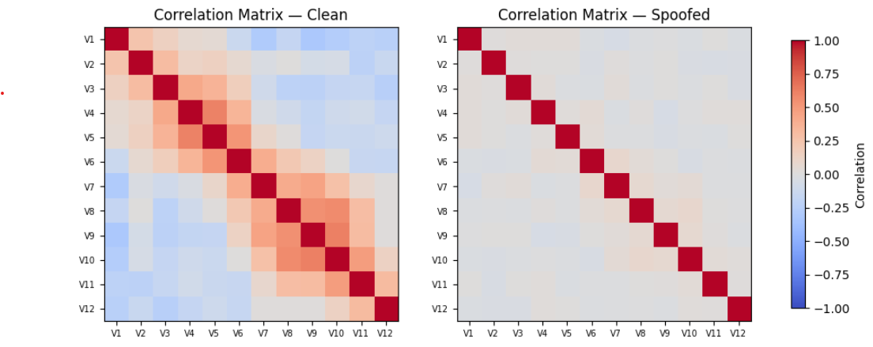
Sensor Spoofing — Attacking the Physical Layer
Spoofing attacks inject false data into sensor feed before they reach the model
Formula: x_spoofed = x_clean + N(0, σ²)
Notes:
Show data before and after spoofing

Slide 11
Spoofing Types and Risks
Type | Attack Strategy | Risk
LiDAR Spoofing | Laser pulses → phantom obstacles or blind spots | Fake objects; missing real obstacles
Camera Spoofing | Glare / IR blinding / adversarial projection | Object misclassification; lane loss
GPS/GNSS Spoofing | Broadcast fake signals → shift position | Vehicle navigates wrong route
RADAR Spoofing | Jam or replay signals → false velocity | Wrong speed estimates
Notes:
Show data before and after spoofing

Slide 12
Sensor Spoofing
Sensor Spoofing in This Workshop
Model: Any classification model can be applied on single-sensor or fused multi-sensor data
Approach:
Load, clean and pre-process sensors dataset
Apply gaussian noise spoofing to any one sensor at inference time
Model Training and Evaluation
Key Metrics for IDS Evaluation:
Attack Strength (σ): controls how much noise is injected
Clean accuracy: Baseline model performance when sensors are normal
Spoofed accuracy: To measure the resilience of the model when input is corrupted

Slide 13
Putting It All Together
Next Steps & Q&A
Questions on any of the attack techniques?
Workflow:
Start with Notebook 1 → 2 → 3
Encourage:
Experimenting with hyperparameters
Trying combinations of techniques
Thinking about your own deployment scenarios

