Slide 1

GLOBAL ELECTRONICS
DATASPARK – Illuminating Insights for Global Electronics
Content :
Customer Analysis
Sales Analysis
Store Analysis
Product Analysis
Exchange Rates Analysis
Presented By
Aswini S

Slide 2
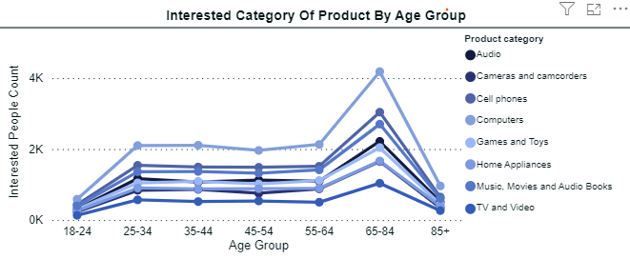
CUSTOMER ANALYSIS
Insight Statement 1:
Compared to other product categories computer is the highest preferrable product, TV and Video is the lowest preferrable product among all age group.
Problem Statement:
Compared to other age groups , the age group between 18-24 shows less interest in buying products in all categories.
Solution Statement:
Most individuals in the 18-24 age group are likely college students. To engage them effectively, leverage platforms like Instagram, TikTok, and Snapchat, where they're most active. Develop interactive content such as polls, challenges, and giveaways that promote participation and sharing. This approach will help spark their interest in purchasing products.

Slide 3
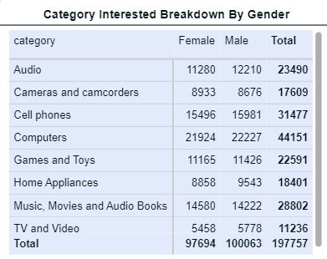
CUSTOMER ANALYSIS
Insight Statement 2:
Categories like "Computers" and "Cell phones" have high interest from both males and females, while categories such as "Home Appliances" and "TV and Video" show lower overall interest, particularly among females.
Problem Statement:
There is a noticeable gender disparity in interest across various product categories, with some categories like "Audio" and "Computers" having a balanced interest from both genders, while others, like "TV and Video," show much lower engagement, especially among females. This imbalance could impact sales and product marketing strategies.
Solution Statement:
To address the gender disparity in interest, launch targeted campaigns that emphasize the benefits of products specifically for female customers. Additionally, offer discounts and promotions to raise awareness and attract more female customers.

Slide 4
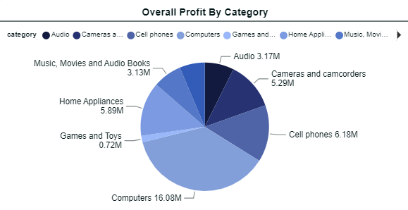
SALES ANALYSIS
Insight Statement 1:
The highest profits are generated by the "Computers" category, contributing $16.08M, followed by "Cell phones" with $6.18M, and "Home Appliances" with $5.89M. The "Games and Toys" category generates the least profit at $0.72M.
Problem Statement:
The profit distribution is heavily skewed towards a few categories, with the "Games and Toys" category significantly underperforming compared to others.
Solution Statement:
To enhance profitability in underperforming categories like "Games and Toys," consider targeted marketing campaigns, product bundling, and promotional offers

Slide 5
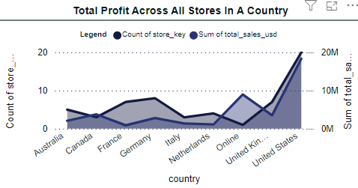
SALES ANALYSIS
Insight Statement 2:
The United States has the highest total sales, exceeding $20M, with a significant number of stores contributing to this total. In contrast, countries like Australia and Canada have fewer stores and generate lower total sales. The online segment shows moderate sales but has fewer stores compared to the United States.
Problem Statement:
There is a substantial disparity in total sales. While the United States is performing exceptionally well, other countries like Australia, Canada, and the Netherlands have lower sales figures, indicating underperformance or untapped market potential.
Solution Statement:
To address the sales disparity, consider expanding the number of stores and enhancing marketing efforts in underperforming countries. For the online segment, improving the online shopping experience and offering exclusive deals could drive higher sales

Slide 6
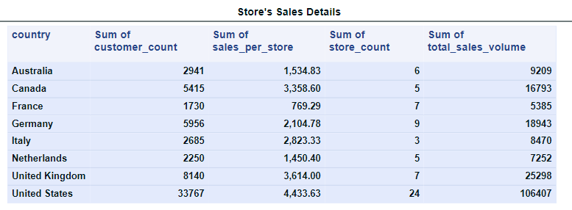
STORE ANALYSIS
Insight Statement 1:
The United States leads in all metrics, with significantly higher customer count , sales per store , total sales volume , indicating a strong market presence
Problem Statement:
Countries like France and Italy have lower sales and customer counts, indicating potential underperformance. The disparity in sales volume , customer count across these region suggest that there may be underlying issues such as low market penetration or fewer stores.
Solution Statement:
To address this issue, we can implement strategies similar to those used in the United States and the United Kingdom. Lower customer engagement often correlates with fewer stores and reduced product awareness. By increasing the number of stores and enhancing product knowledge, we can boost customer awareness and, ultimately, increase profits.

Slide 7
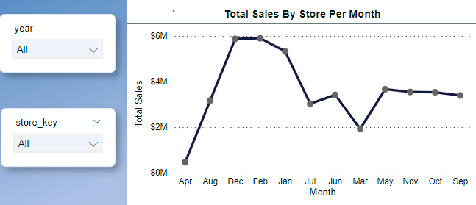
STORE ANALYSIS
Insight Statement 2:
Sales peak sharply in December, reaching around $6M, followed by a gradual decline through February.
Problem Statement:
The consistent low sales during the middle of the year could indicate an off-peak season where customer demand is low. This fluctuation can create challenges in maintaining a stable cash flow and might impact profitability during off-peak months
Solution Statement:
To tackle this issue, we can focus on promoting products, launching new product lines, and offering mid-month discounts, coupons, and special promotions. Additionally, stores could diversify their product range to include items that are in demand year-round. By planning inventory and staffing levels in line with seasonal trends, operational efficiency can be optimized, and costs can be reduced during periods of lower sales.

Slide 8
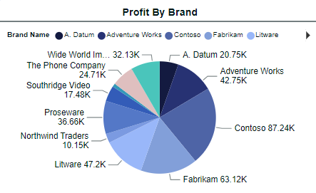
PRODUCT ANALYSIS
Insight Statement 1:
Contoso is the most profitable brand followed by Fabrikam and Litware. Smaller brands like Northwind traders and Southridge video contribute much less to the overall profit
Problem Statement:
The Lower profitability of other brands like Northwind traders and Southridge video may indicate that these brands are struggling to compete or are not as effectively positioned in the market. This imbalance could pose a risk to overall business.
Solution Statement:
To tackle this issue, analyzing the strategies of top-performing brands like contoso and fabrikam and applying similar tactics to the weaker brands could help boost their profitability. Diversifying the brand portfolio by investing in underperforming brands can also reduce dependency on the top brands.

Slide 9
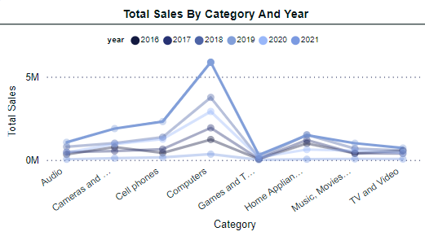
PRODUCT ANALYSIS
Insight Statement 2:
Computers consistently generate the highest sales, with a noticeable peak in 2018. Other categories such as Games and Toys and Home Appliances also show steady sales but are far behind Computers
Problem Statement:
The Sales indicates heavy reliance on the computers category for revenue , this concentration could be risky if the market for computers experiences a downturn or it competitors gain market share.
Solution Statement:
To tackle this issue, it is essential to diversify sales by enhancing the performance of other categories. This could involve investing in marketing campaigns, expanding product line, or innovating within the Games and toys, Home appliances and cell phones categories to boost their sales.

Slide 10
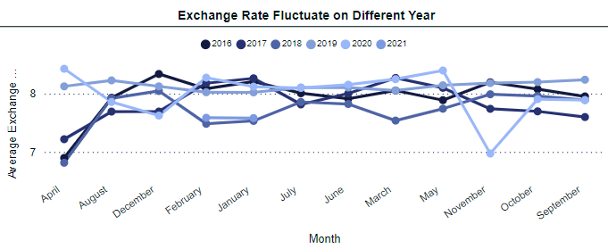
EXCHANGE RATE ANALYSIS
Insight Statement 1:
The average rates have experienced fluctuation over the years from 2016 – 2021. while some years, such as 2021, display more volatility, others like 2017 and 2020 remain relatively stable
Problem Statement:
The fluctuating exchange rates across different years present challenges for financial planning and budgeting. Sudden drop or spikes in exchanges rates could impact international transactions, pricing strategies, and overall profitability, making it difficult for businesses to maintain consistent financial performance
Solution Statement:
To tackle this issue, businesses should consider implementing hedging strategies to protect against adverse movements. Additionally, adjusting pricing strategies to account for potential exchange rate variations and closely monitoring economic indicators can help in making informed financial decisions

Slide 11
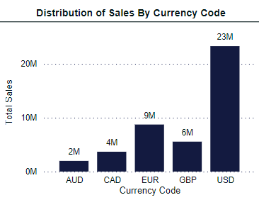
EXCHANGE RATE ANALYSIS
Insight Statement 2:
The majority of sales are conducted in USD, representing a significant portion of total revenue. While other currencies like EUR and GBP also contribute, they fall short of the USD's dominance
Problem Statement:
The company's revenue is heavily concentrated in USD, leaving it vulnerable to fluctuations in exchange rates and potentially limiting market reach. This lack of diversification could lead to financial instability and hinder growth in non-USD markets
Solution Statement:
Expanding sales efforts into other currencies beyond USD would reduce risk and increase revenue potential. Strategies could include adapting pricing and payment options, investing in international marketing campaigns, building strategic partnership
Notes:
Adapting pricing and payment options: Offering prices and payment methods in local currencies to ease customer transactions.
Investing in international marketing campaigns: Targeting specific countries with tailored marketing efforts to increase brand awareness and attract new customers.
Building strategic partnerships: Collaborating with local businesses or distributors to expand reach and expertise in foreign markets.

