Slide 1
Intelligent Health Care Assistant
Using IBM Cloud
Team Members: Aswini Kommina, B Prathap Reddy, C Mohana, C Siva Charan
Guide:

Slide 2
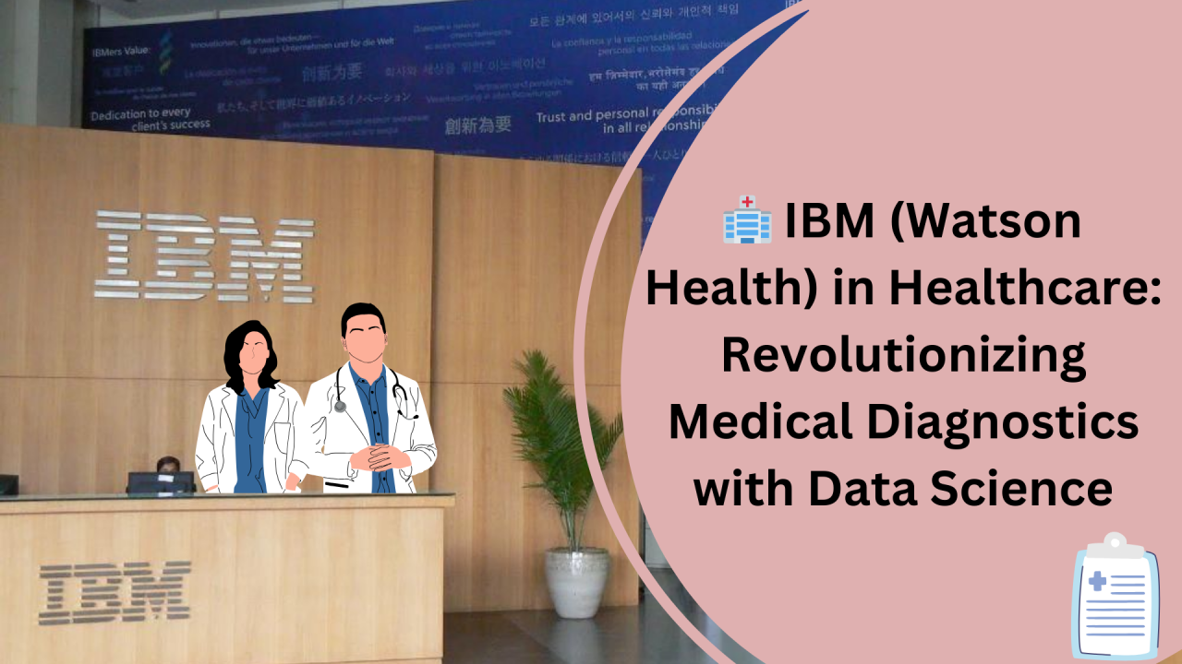
Introduction
This project aims to develop an AI-driven health care assistant using IBM Watson services, focusing on preliminary diagnosis and patient guidance.

Slide 3
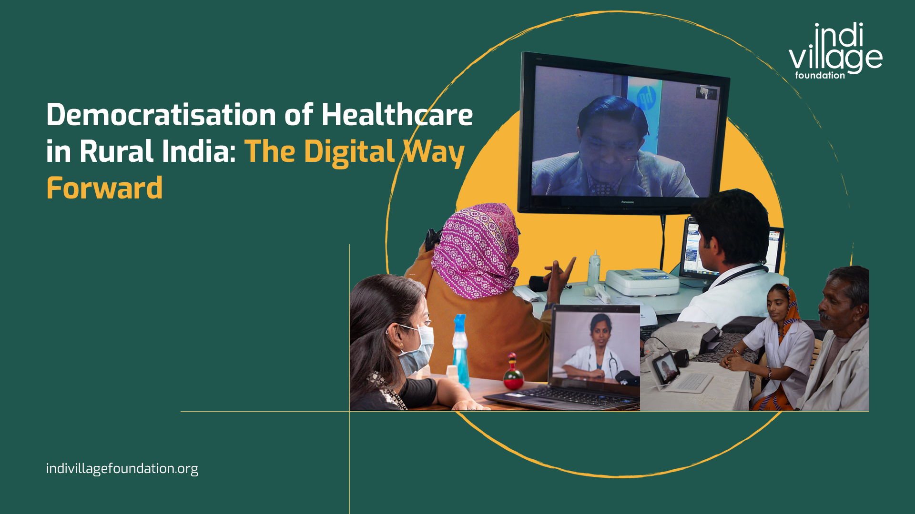
Problem Statement
Access to basic healthcare guidance is limited in rural areas. An AI assistant can help in initial diagnosis and timely decisions.

Slide 4
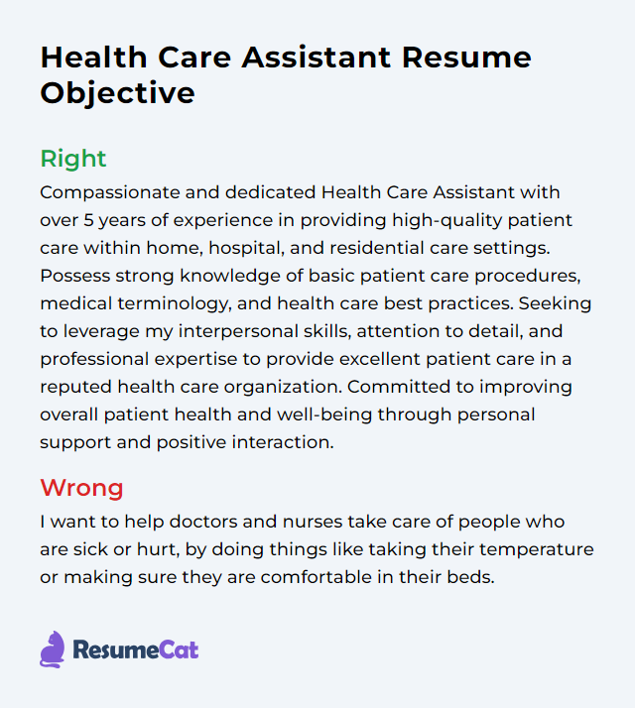
Objectives
- Enable quick preliminary diagnosis
- Provide 24/7 availability
- Reduce burden on hospitals
- Improve access to healthcare in remote areas

Slide 5
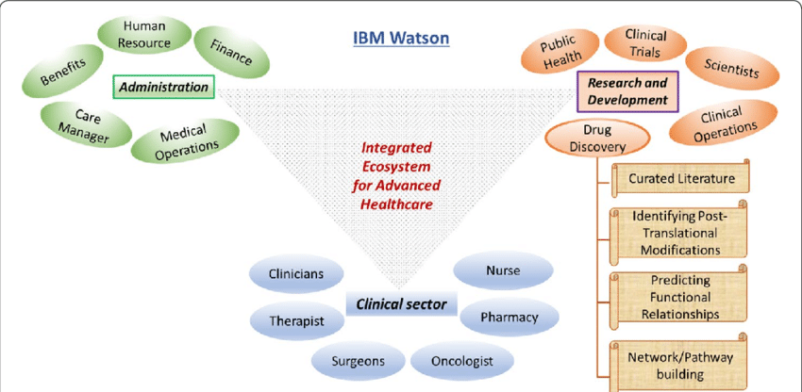
Proposed System
Input symptoms via voice/text
-> Analyze with IBM Watson NLP
-> Provide preliminary diagnosis & suggestions

Slide 6
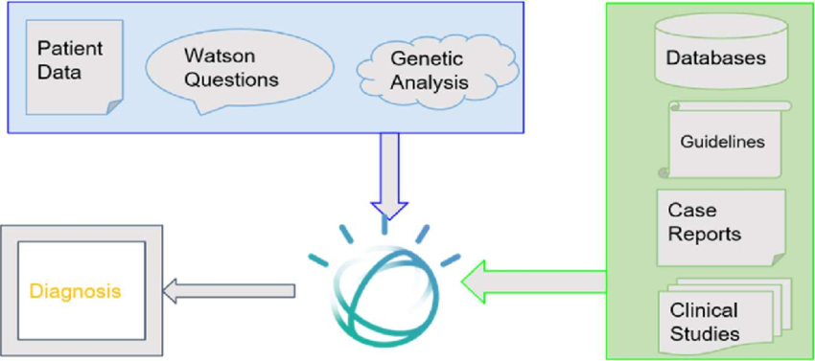
Architecture Diagram
System Flow:
User -> Input Module -> Watson Assistant -> Diagnosis Engine -> Output Suggestions

Slide 7
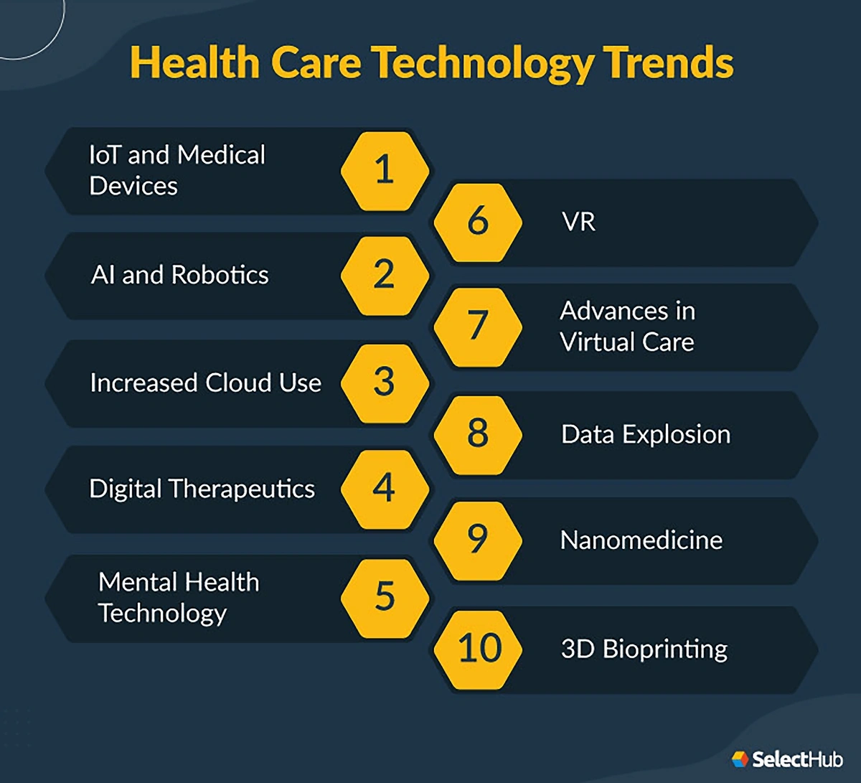
Technologies Used
- IBM Watson Assistant
- IBM Cloud Functions
- Node-RED
- Speech-to-Text APIs
- Cloudant DB
- Python/JavaScript

Slide 8
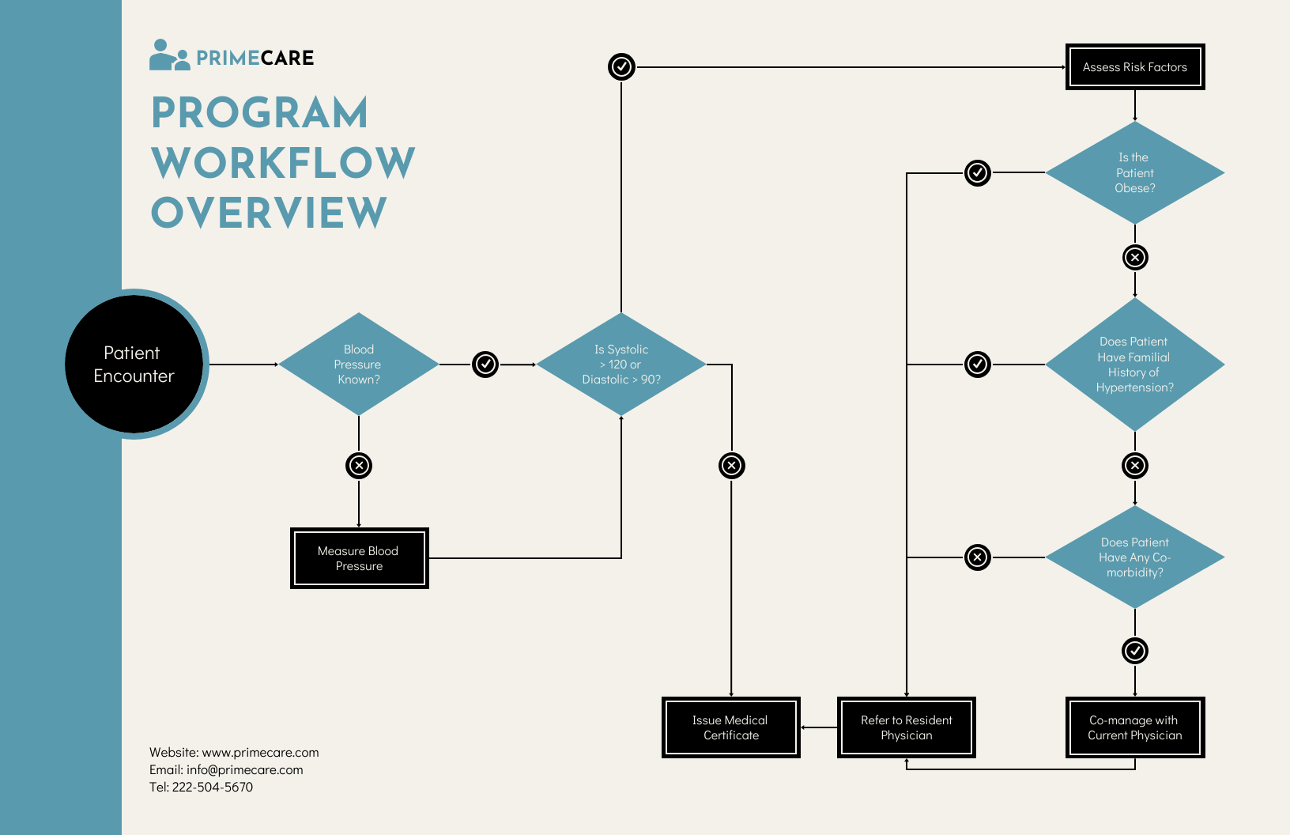
Working Flow
1. Patient speaks or types symptoms
2. Data is processed by Watson NLP
3. Results are analyzed and output provided
4. Suggestions stored in database

Slide 9
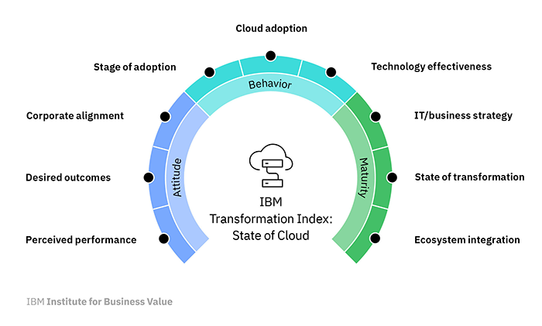
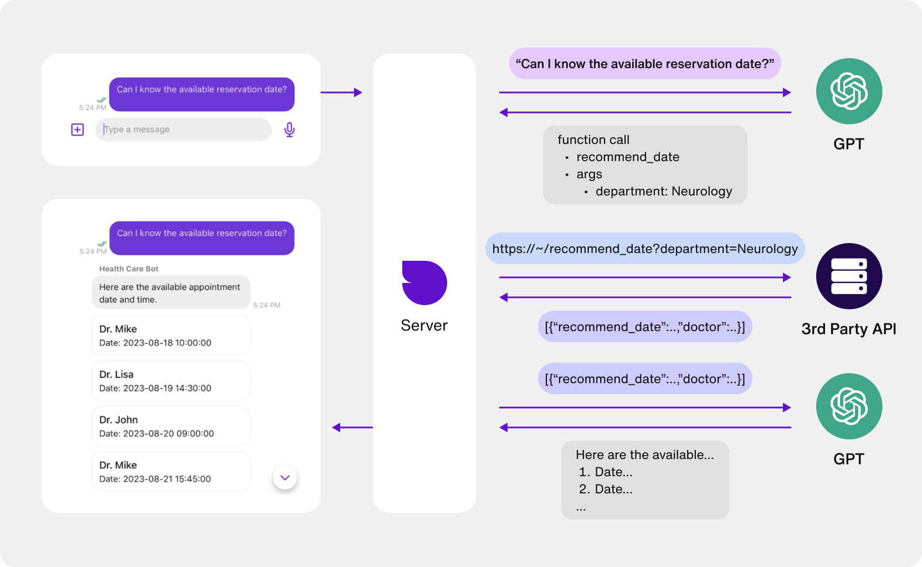
Here, Some Of the Images of the IBM Cloud dashboard, Node-RED flow, and chatbot interface.

Slide 10
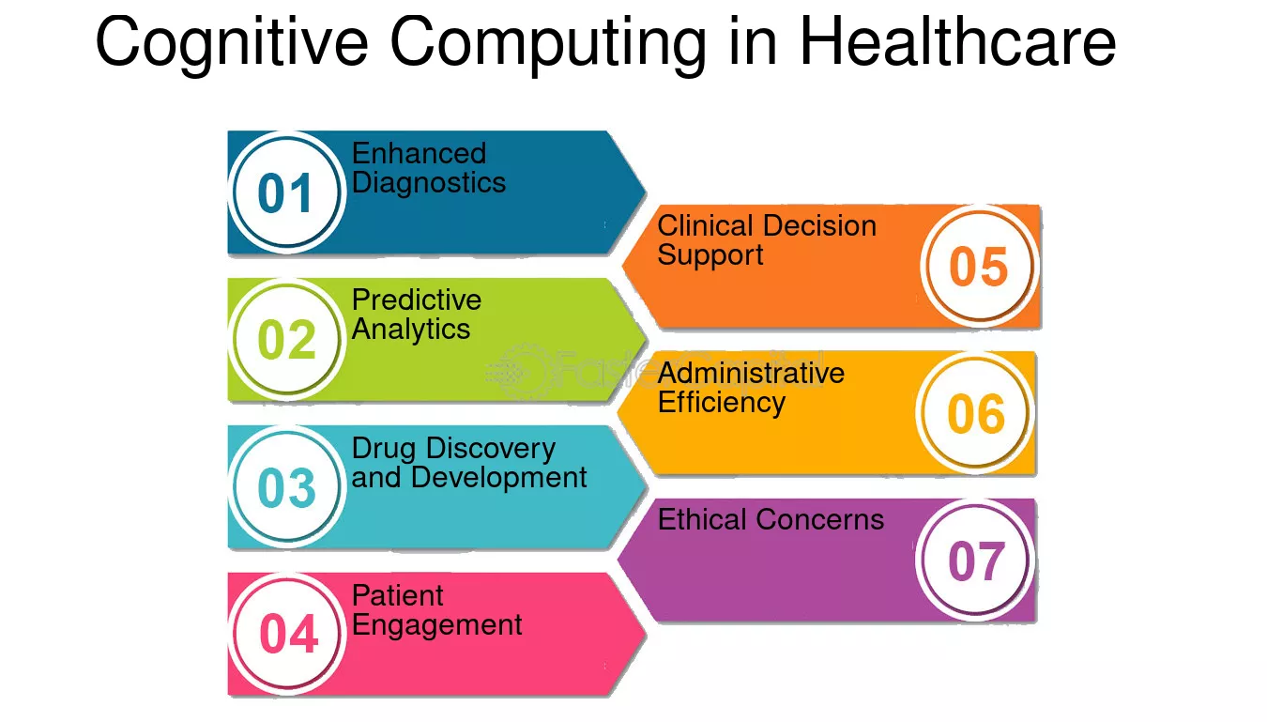
Output & Benefits
- Quick health assessments
- Accessible 24/7
- Cost-effective
- Easy to use
- Scalable solution

Slide 11
Conclusion
Acts as a bridge between patients and doctors
Future Scope:
- Integration with wearables
- Real-time doctor communication
- Multi-language support

