Slide 1
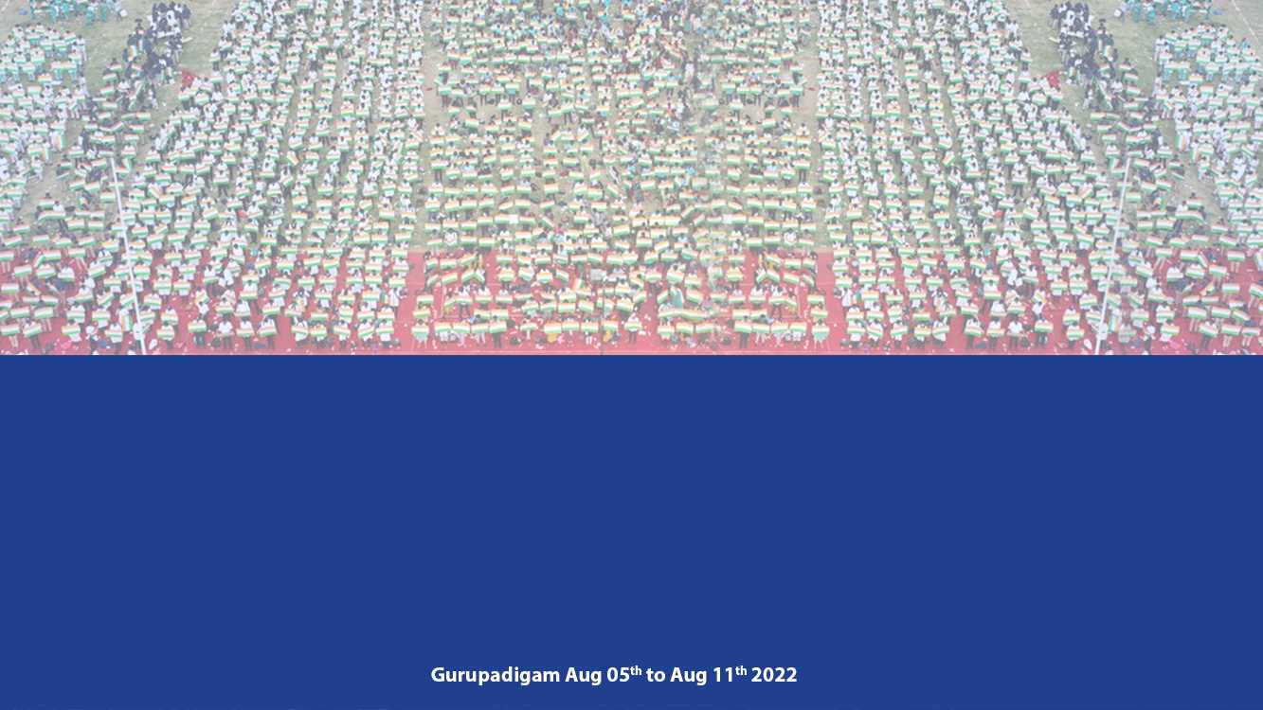
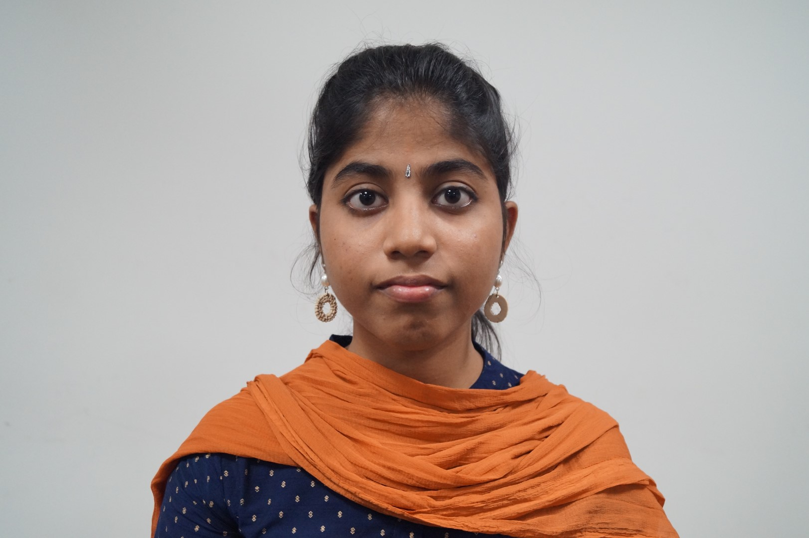
Name:RAMYA A
Register Number:192021010
I Year
Institute of Information Technology and Engineering

Slide 2
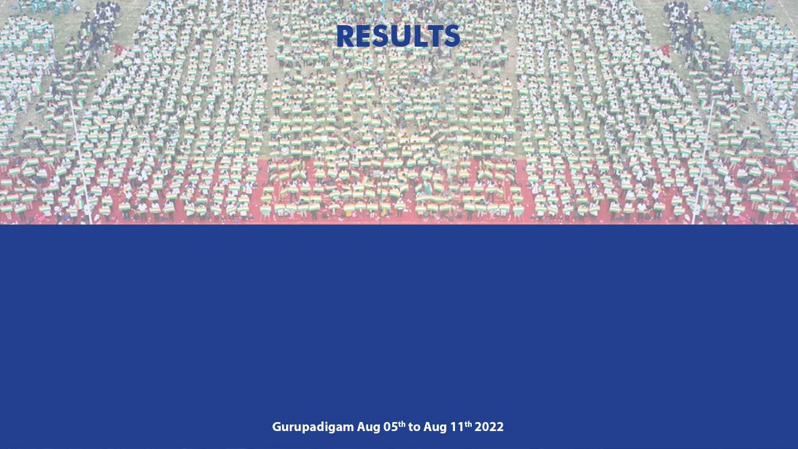
Slot A | Total Marks | Marks Obtained
Test 1 | 25 | 21
Test 2 | 25 | 20
Test 3 | 25 | Not Given

Slide 3
Dear parent
She is regular to mentor mentee meeting and she has secured B Grade in Slot A she must aim for S grade for slot C and D and she has secured good marks in daily test as well. Good that she has attended webinar in the topic Machine intelligence in cloud computing held last week. Overall good performance in academics. All the best and keep it up!! . 2020-21 batch students should finalize their Mini Project-Product development topics and do the corrections if any given by guide.

Slide 4

I WILL TAKE GOOD MARKS IN NEXT TEST
IMPROVE WELL IN STUDYING
MENTEE RESPONSE
PARENTS RESPONSE

