Slide 1

Mr. Data Scientist
MACHINE LEARNING

Slide 2
ALGORITHM : Step by step process
ML ALGORITHM :
An Algorithm is said to be ML Algorithm, if its gets better at a task T under a metric M with more Experience.
TYPES OF MACHINE LEARNING
Regression
Supervise Learning
(Labeled Data)
Un Supervise Learning
( Un-Labeled Data)
Reinforcement Learning
Classification
Clustering

Slide 3
6 JARS of Machine Learning
DATA
TASK
MODEL
LOSS
LEARNING
EVOLUTION METRICS

Slide 4
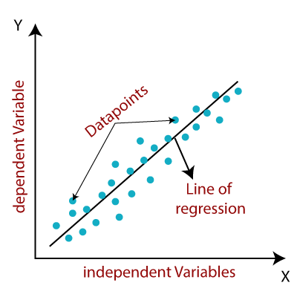
1. Regression
Supervised Learning :
Linear Regression
Syntax: from sklearn.linear_model import LinearRegression
It’s a statistical model for classification, this will help to predict the continuous variable.
Prediction will happen based on the linear line (Line of best fit)
Probability Calculation
Y = a + bX
X – Independent variable
Y – Dependent
a,b – intercept

Slide 5
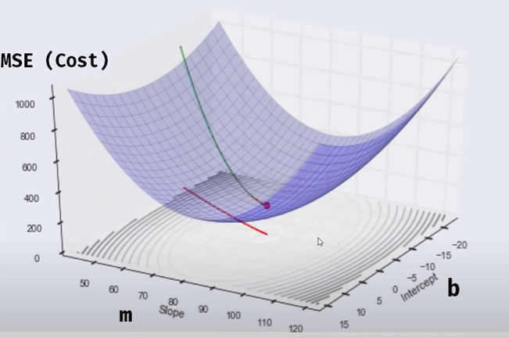
Linear Regression
DATA
TASK
MODEL
LOSS
LEARNING
EVOLUTION METRICS
Collection of Data from various Source
Supervised_Learning
Regression
Mathematical Formula
Y = mx+c
Task Dependent
MSE, MAE
Gradient Descent
R-Square

Slide 6
Machine Learning Algorithms
Regression Algorithm
Linear Regression
It’s a statistical model for classification, this will help to predict the continuous variable.
Most common Regression algorithm.
A valuable numerical measure of association between two variables is the correlation coefficient.
Prediction will happen based on the linear line (Line of best fit)
Probability Calculation
Y = a + bX
X – Independent variable
Y – Dependent
a,b – intercept
Simple Linear Regression – 1 dependent ,1 independent
Multiple linear Regression – 1 dependent ,N independent

Slide 11
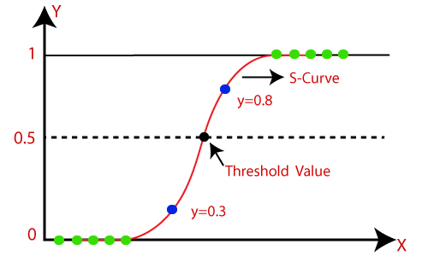

Machine Learning Algorithms
Classification Algorithm
Logistic Regression
It’s a statistical model for classification, This type of analysis can help you predict the likelihood of an event happening or a choice being made.
Logistic Regression effectively work for binary classification.
This model can perform even the data contains minimal observations.
Probability Calculation
Binomial - 2 class classification
Multinomial – More than 2 class classification

Slide 12
Machine Learning Algorithms
Classification Algorithm
Logistic Regression
It’s a statistical model for classification, This type of analysis can help you predict the likelihood of an event happening or a choice being made.
Logistic Regression effectively work for binary classification.
This model can perform even the data contains minimal observations.
Probability Calculation
Binomial - 2 class classification
Multinomial – More than 2 class classification

Slide 13
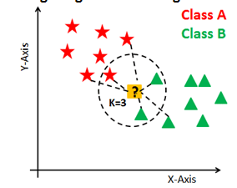



Machine Learning Algorithms
Classification Algorithm
KNN
It’s a statistical non parametric algorithm, ie does not make any assumptions. It’s a one of the lazy machine learning algorithm.
Dependent variable will calculated based on the value of K and the distance calculation between feature values.
Distance Calculation
Euclidean Distance
Manhattan Distance
Minkowski Distance

Slide 14
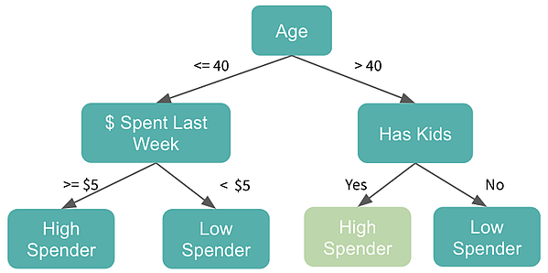

Machine Learning Algorithms
Classification Algorithm
Decision Tree
Ensemble based classification algorithm, it’s a flowchart like method, branches do classification based on gain.
Decision tree’s root node will get selected based on Entropy and Gain value of the feature.
Used to Identify Feature importance, It can perform both regression and classification.
Training dataset are treated as subset.
Calculation
Entropy and Gain calculation

Slide 15
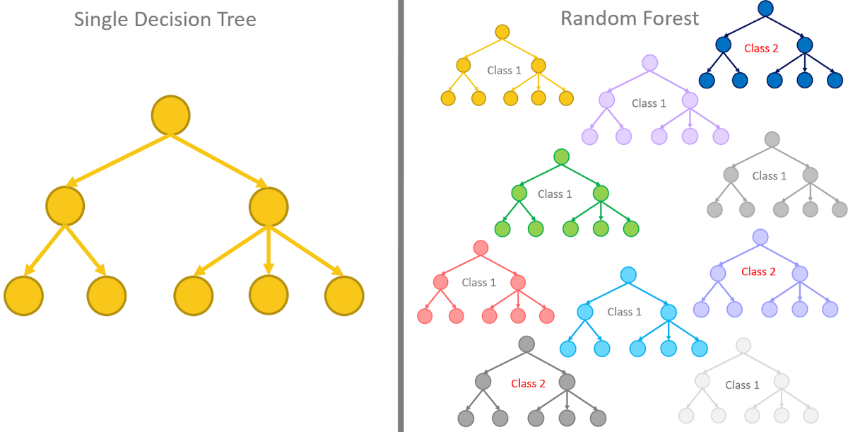
Machine Learning Algorithms
Classification Algorithm
Random Forest
It’s same like decision tree, N number of trees will generated for a single dataset.
Ensemble, bagging based classification algorithm, it’s a flowchart like method, branches do classification based on gain.
Tree root node will get selected based on Entropy and Gain value of the feature.
Used to Identify Feature importance, It can perform both regression and classification.
Training dataset are treated as subset.
Calculation
Entropy and Gain calculation

Slide 16
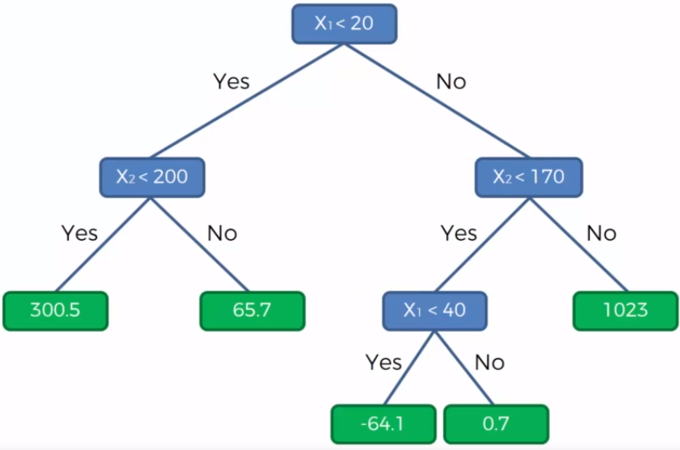
Machine Learning Algorithms
Tree based regression
Decision Tree & Random forest Regressor
Ensemble based regression algorithm, it’s a flowchart like method, branches do classification based on gain.
Decision tree’s root node will get selected based on Entropy and Gain value of the feature. Helps to predict continuous variables and Solve regression problems.
Used to Identify Feature importance, It can perform both regression and classification.
Training dataset are treated as subset.
Calculation
Entropy and Gain calculation

Slide 17
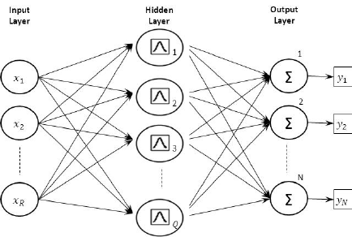
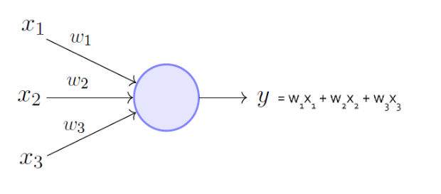

Machine Learning Algorithms
Regression algorithm
Neural Network
It can perform both Regression and classification. NN is a network based architecture.
Three types of layers are there [ Input layer, hidden layer, output layer ]. Hidden layer can have multiple layers that’s called multiple layer perceptron.
Overfitting issues will reduced by adding dropout layer.
Node Activation functions differ based on layers. [Relu, leaky relu, sigmoied, softmax, tanh]
Calculation

