Slide 1
FLASH
UP
Financial Language and Stock Analysis System
NEUTRAL
Event-aware prediction of short-horizon moves in Indian (NSE) stocks, built from five machine learning units.
DOWN
Machine Learning course | Project review
Notes:
Opening. FLASH predicts, for every stock every minute, the probability of UP / NEUTRAL / DOWN over the next 5, 15 and 30 minutes. It was built so that each of the five course units has a real job in the system. Today I will show the architecture, each unit, the results, and what did and did not work.

Slide 2
What FLASH predicts, and why it is hard
Each minute, for 10 NSE stocks, FLASH outputs:
5 min
15 min
30 min
P(UP), P(NEUTRAL), P(DOWN) for the next 5, 15 and 30 minutes
The current market regime: calm, bull, volatile or bear
Its own inference latency, measured per bar on a CPU
"No strong signal" when the top probability is below 0.50
P(UP)
P(UP)
P(UP)
P(NEUTRAL)
P(NEUTRAL)
P(NEUTRAL)
P(DOWN)
P(DOWN)
P(DOWN)
Scope. A university ML project: exactly five model families, no LLM calls, not a trading system. No profit claim is made anywhere in this deck.
Triple-barrier label: price must move more than one volatility-scaled barrier within the horizon to count as UP or DOWN.
Notes:
The question: can price features plus news tell us something about the next 5-30 minutes, and can we do it fast enough to run on every bar. Output is a calibrated probability over three outcomes, not a buy/sell call.

Slide 3
Architecture: a slow news path feeds a fast price path
SLOW PATH async, cached, FinBERT may use GPU
Headline
Link, classify
FinBERT, memory
News cache
Only past events are used as neighbours: an event counts once its outcome is already known.
Moneycontrol text, timestamped
Stock match, event type (rules)
Sentiment, 768-d vector, past-event neighbours
Latest vector per stock, decays with age
read + decay
FAST PATH per bar, CPU, NumPy, no I/O
New bar
PCA
HMM filter
Fusion vector
LightGBM + logistic
Calibrate + gate
14 price features from ring buffers
Compresses slow features
4 regime probabilities, one step
42 columns: price, regime, news, history
One model per horizon, 75/25 blend
Temperature scaling, 0.50 gate
UP
NEUTRAL
DOWN
or NO STRONG SIGNAL
Notes:
Walk left to right. Top lane is slow and async: headline to entity to event type to FinBERT embedding to event memory, cached per stock. Bottom lane is the hot loop: it only does array math, no I/O. The news cache is read, with exponential decay, when the fusion vector is built. Viterbi decoding is offline only, because it looks at the whole sequence; live we use the forward filter which only uses the past.

Slide 4
Each course unit has a real job in the system
1
Probability and Bayes
Rolling mean, variance, covariance, beta. Bayes rule inside the HMM update. Calibration of outputs.
2
Linear models, MLE
Multinomial logistic regression: the baseline (Model A) and a leg of the final blend.
3
Unsupervised learning
PCA compresses features; a Gaussian mixture fitted with EM initialises the regime model.
4
Sequential models
4-state Gaussian HMM; a one-step forward filter gives live regime probabilities.
5
Ensembles
LightGBM blended with logistic over 42 fused features: the final Model D.
Notes:
One slide to orient the rest of the talk. The five units map to five components. I'll take them in order.

Slide 5
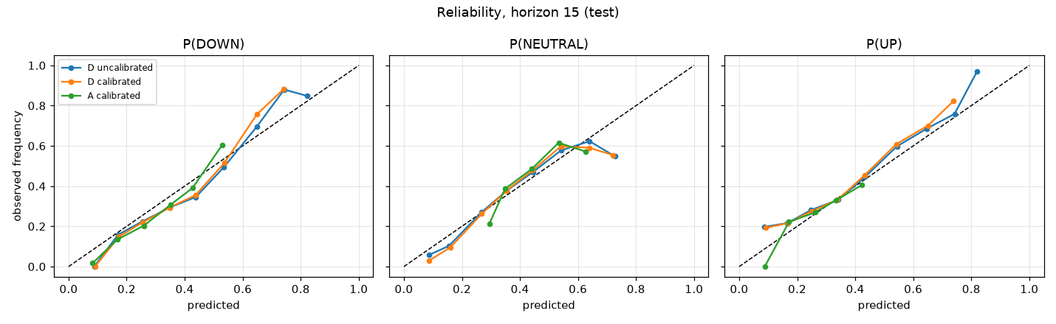
Unit 1: probability keeps the outputs honest
Features: rolling mean, variance and covariance of returns, plus beta against the market.
Bayes rule in the HMM: posterior is proportional to likelihood times prior, prior = previous posterior pushed through the transition matrix.
Calibration: temperature scaling fitted on validation turns scores into frequencies.
Reliability at 15 minutes, synthetic test data. On the diagonal means a stated 60% happens 60% of the time.
0.015
0.02-0.03
P(state | data so far) ∝ P(new bar | state) × P(state | past)
calibration error (ECE), Model D, 15 min, synthetic
ECE on real data, test split, uncalibrated model
Notes:
Three uses of Unit 1. Rolling statistics are the features. The HMM forward step is literally Bayes rule: posterior proportional to likelihood times prior, where the prior is the previous posterior pushed through the transition matrix. And calibration: a raw model score is not a probability until it is mapped to observed frequencies. Image: reliability curves on synthetic test data, close to the diagonal.

Slide 6
Unit 2: a simple logistic model is the bar to beat
Multinomial logistic regression with L2 penalty, fitted by maximum likelihood (cross-entropy).
Inputs: 8 price features only. No news, no regime.
Reused inside Model D as the 25% linear leg of the blend.
Real-data test result: AUC 0.596 / 0.603 / 0.608 at 5 / 15 / 30 min, against 0.606 / 0.609 / 0.606 for the full model.
75 µs
0.60
median latency per bar, all three horizons
real-data test AUC, 15 min
Takeaway
The simple model carries almost all of the measurable signal. That is a result worth reporting, not hiding.
Notes:
Model A is multinomial logistic regression, L2 regularised, fitted by maximum likelihood, on 8 price features only. It is the baseline and the latency reference. A surprising and honest finding: on real data A's AUC is already within about 0.01 of the full model D. The extra complexity buys little.

Slide 7
Unit 3: PCA and a Gaussian mixture seed the regime model
1
2
3
4
Slow features
PCA
Gaussian mixture
HMM start point
8 rolling features: returns, mean, variance, covariance, beta, volatility
Standardise, then keep the fewest components that explain 90% of validation variance
4 components, full covariance, fitted with EM
Mixture means and covariances become the HMM emissions
3 → 4
90%
Fitted on training data only. Choosing the component count on validation is a known, documented source of mild optimism in validation scores; it does not touch the test split.
components kept: synthetic data, then real data
validation variance target
Notes:
The HMM needs a good starting point or EM lands in a poor local optimum. We do PCA on the slow market features, choosing the smallest number of components that explains 90% of the variance on the VALIDATION set. Then a 4-component Gaussian mixture is fitted with EM, and its means and covariances initialise the HMM. Chosen components: 3 on synthetic data, 4 on real data.

Slide 8
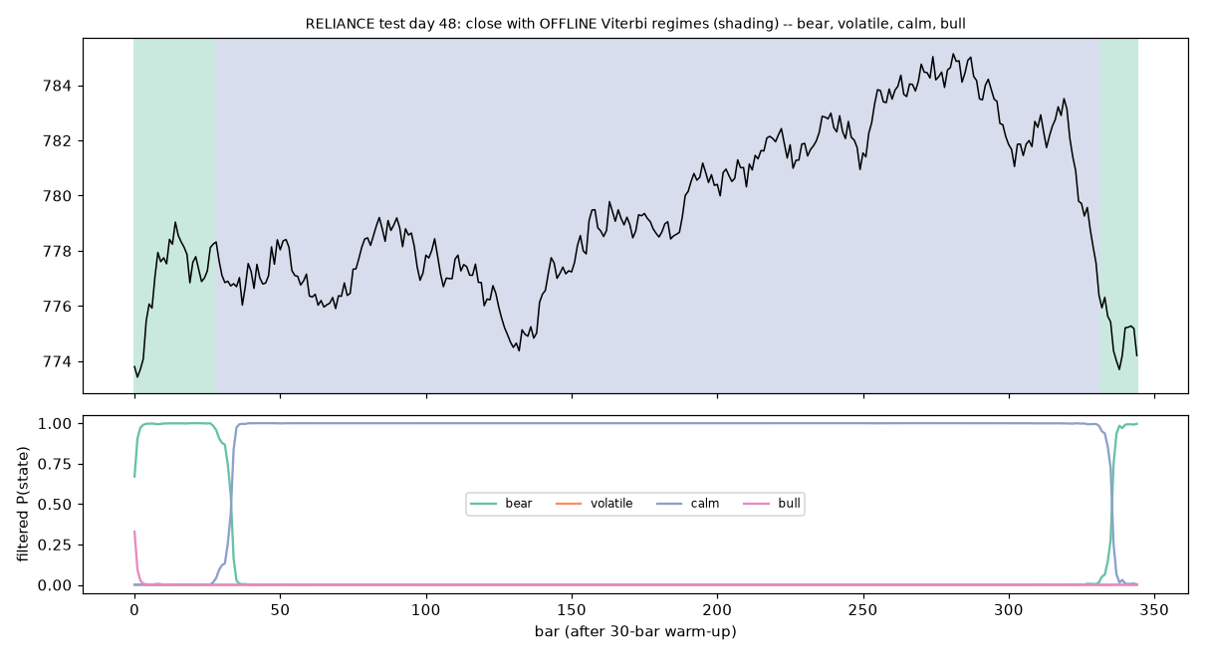
Unit 4: an HMM tracks the market regime, bar by bar
4 hidden states, full-covariance Gaussians, sticky transitions refined by EM.
Live: one scaled forward step per bar gives P(state | bars so far). No future data.
Verified against an independent forward pass and hmmlearn's likelihood.
Viterbi decoding is offline only, for plots like this one.
Regime | Share | Typical run | Vol (bps)
calm | 45% | 102 bars | 6.1
volatile | 20% | 68 bars | 15.4
bear | 20% | 28 bars | 8.3
bull | 15% | 52 bars | 11.1
One test day on synthetic data: price with offline regime shading (top), filtered probabilities (bottom).
Agreement with the true regimes in the synthetic generator: ARI 0.54.
Notes:
A 4-state Gaussian HMM. Live, we do one forward step per bar with a scaling factor, using only the past. We checked that against an independent log-space forward pass and against hmmlearn's own score. Viterbi is used only offline for the plot, because it looks at the whole day. The honest finding: on synthetic data removing the HMM did not reduce accuracy; its value here is interpretability.

Slide 9
Unit 5: the ensemble adds news and past-event memory
LightGBM: shallow trees (7 leaves), low learning rate, early-stopped on validation.
Blended 75/25 with the logistic leg for a smoother, lower-variance estimate.
42 features: 14 price, 4 regime, 11 news, 3 history, 10 derived interactions.
One model per horizon. Recipe found with an automated search on synthetic data.
Notes:
Model D is a LightGBM (small trees, early stopped) blended 75/25 with the L2 logistic, on 42 fused features. The chart is the ablation on the synthetic test set at 15 minutes: A is logistic on price, B is LightGBM on market features, C adds the HMM regime, D adds news and historical-event memory. AUC of 0.5 is chance. Each step helps a little; the big gain is news, as expected since the synthetic generator injects a news reaction.

Slide 10
Data, labels and the checks that stop us fooling ourselves
510k
29k
136
one-minute bars, 10 NSE stocks
Moneycontrol headlines
trading days, Jun 2024 - Jan 2025
Chronological split by whole trading day
Train 82 days
Validation 27
Test 27 (locked)
Triple-barrier label. UP if price first rises by k·σ·√h, DOWN if it first falls that far, otherwise NEUTRAL. σ is the last 30 bars' volatility.
Leakage audit: 8 of 8 pass. Split order, label boundaries, feature causality, price back-fill, news timestamps, event-memory boundaries, regime fit on train only.
Notes:
Real data: 510,000 one-minute bars, 10 large NSE stocks, 136 trading days (June 2024 to January 2025), plus 29,123 Moneycontrol headlines. Splits are chronological by whole day, never shuffled. Labels use a triple barrier. A news item only reaches bars strictly after it was published. We ran an eight-check leakage audit on the real data: all eight passed.

Slide 11
Run 1, synthetic data: the pipeline works, the numbers prove little
0.618 → 0.694
0.654 → 0.590
58 / 58
AUC in the 30 min after news, without vs with news features (15 min horizon)
Brier score on the same bars (lower is better)
automated tests passing
What this shows
What it does not show
Features, labels, alignment and the hot loop are correct (tests compare live and batch paths to 1e-8)
News features help when news carries information
Prices are a random walk with an injected reaction; real markets are less predictable
The synthetic backtest (66-86% hit rate) is an artefact of the generator and means nothing
Notes:
We first built everything on synthetic data: regime-switching prices and templated headlines with an injected price reaction. That proves the code, tests and latency are real. It does NOT prove an edge. In the 30 minutes after a news event, D beats B clearly, but that is partly because we put that reaction into the generator. The backtest looked amazing for the same reason; we say plainly that it is an artefact.

Slide 12
Run 2, real NSE data: modest but real skill on the test split
Brier (lower is better) | 5 min | 15 min | 30 min
Prior frequencies | 0.5295 | 0.5710 | 0.5926
Model A | 0.5175 | 0.5554 | 0.5731
Model D | 0.5145 | 0.5526 | 0.5727
How to read this
Both models beat the prior baseline on Brier at every horizon.
Gains are small: Brier improves by 0.015 to 0.02.
Probabilities were not calibrated on real data.
Notes:
These are the one-shot final test numbers (the test split had been locked until today). Model D beats the prior-frequency baseline on Brier score at all three horizons, and AUC is about 0.61. That is better than chance but small. Note we did not compute confidence intervals on the test set; on validation they were wide enough that the difference between A and D is not significant.

Slide 13
The finding: FLASH sees whether a move comes, not which way
97-99.96%
of argmax predictions are NEUTRAL, because NEUTRAL is the majority label
Why direction is hard
Volatility clusters, so a coming move is forecastable
Direction in liquid large caps is close to efficient at minute scale
Headlines arrive after much of the move
Notes:
Splitting the problem in two explains the bad-looking confusion matrices. Movement AUC (will price move beyond the barrier at all) is about 0.62 to 0.64. Direction AUC (UP vs DOWN, among rows where it moved) is about 0.50 to 0.54, close to a coin flip. Because NEUTRAL is the majority class, argmax predicts NEUTRAL for 97 to 99.96% of rows, so macro-F1 is poor. That is the honest result.

Slide 14
Attempt 1: change the model. It barely moved the numbers
What we tried
Validation ROC-AUC, original vs improved
Two-stage model: movement, then direction
Balanced class weights in LightGBM
Multi-scale features (30 and 60 bar returns, 10 bar volatility)
Cross-stock dispersion and basket momentum
Barrier multiplier lowered from 1.0 to 0.6 and 0.75
Isotonic calibration on a held-out fold
Horizon | Original D | Improved | Change
5 min | 0.5886 | 0.5872 | -0.001
15 min | 0.5916 | 0.5892 | -0.002
30 min | 0.6018 | 0.6096 | +0.008
The model was not the bottleneck. Only the 30-minute two-stage variant improved, and by less than 0.01 AUC. Direction AUC stayed near 0.53.
Notes:
Because results looked weak we tried to fix the model. Two-stage: first predict move vs no move, then direction given a move. Class weights, multi-scale features such as 30 and 60 bar returns, cross-stock dispersion, and a lower barrier multiplier. On validation the AUC differences are within about 0.01, and only the 30 minute two-stage model improved. So the limit is the data, not the model.

Slide 15
Attempt 2: a new dataset, 15 years of daily bars. Same pattern
Test split, Model D | 5 days | 10 days | 20 days
ROC-AUC | 0.620 | 0.630 | 0.631
Brier | 0.558 | 0.596 | 0.616
Brier, prior baseline | 0.575 | 0.618 | 0.641
Movement AUC | 0.651 | 0.668 | 0.690
Direction AUC | 0.502 | 0.534 | 0.518
83k
15 yrs
stock-days, 20 stocks
2010 to 2026
Reading
Beats the prior on Brier at all horizons
Movement is predictable; direction sits at 0.50 to 0.53
Longer history did not fix direction
No news in this run
Train 2010-2020, validation 2020-2023, test 2023-2026. Same five model families, test split scored once.
Notes:
If minute data is too noisy, maybe daily data helps. We downloaded 15 years of daily prices for 20 NSE stocks, about 83,000 stock-days, and ran the same Unit 1 to 5 models. Chronological split, test scored once. Movement is predictable with AUC 0.65 to 0.69, direction is not. Daily news was not available for this dataset, so the news branch is not part of this run. This strongly suggests the limit is market efficiency, not our data granularity.

Slide 16
Speed: about a quarter of a millisecond per bar
75 µs
250 µs
Model A median
Model D median
10,000 bars after 2,000 warm-up, per-bar timer
p99: 97 µs (A), 305 µs (D)
Hot loop is NumPy only: no pandas, no I/O, checked by a test
D costs about 3.3 times A
Notes:
Latency is a real, measurable result and does not depend on the data. Median 75 microseconds for the logistic model and 250 for the full model across all three horizons, on a laptop CPU, with garbage collection off during timing. The three LightGBM predictions dominate. Numbers move by 20 to 30 percent between runs; treat them as an order of magnitude.

Slide 17
How we kept the results honest
58 tests
8 leakage checks
Live hot loop equals batch pipeline to 1e-8. A deliberately leaky aligner is caught by the leakage test.
Split order, label boundaries, feature causality, price back-fill, news timestamps, event memory, regime fit.
Test split locked
Baselines first
Scored exactly once per dataset, after the model was frozen. Nothing was tuned on it.
Majority, prior-frequency and momentum baselines were computed before any model was trained.
Notes:
This slide is why you can trust the numbers even though they are modest. The test split was locked and scored once. 58 tests pass, including one that deliberately uses a leaky aligner to prove the leak checker actually catches leaks.

Slide 18
Takeaways, limits and next steps
What we built
What the data says
Limits and next
All five course units in one working system
Real-data pipeline with leakage audit
250 µs per bar, CPU only
Console and Streamlit demo
Movement is predictable: AUC 0.61 to 0.69
Direction is near chance: 0.50 to 0.54
Same on minute and daily data
A simple logistic model gets most of it
Only 10 stocks, 6 months of minute data
No transaction-cost analysis
Calibrate on an independent window
Trade the movement signal, e.g. volatility, not direction
Notes:
Close with the honest summary. What works: the full pipeline, all five units integrated, fast inference, honest evaluation. What the data says: movement yes, direction no, on two datasets. Limits: validation reused, no transaction-cost analysis, ten stocks. Next steps are concrete and testable.

