Slide 1
Data Analytics Date: 25/5/2025
Predicting PM2.5 Levels for Cleaner Cities
ASWIN PT
MSc MI
Roll No: 241106
Under the Guidance of
Dr. Malu G
Assistant Professor, DUK
Digital University Kerala
Thiruvananthapuram

Slide 2
Overview of the Presentation
Introduction
Motivation
Problem Statement
Objectives
Proposed Methodologies
Results and Discussions
Conclusion
References
Acknowledgement

Slide 3
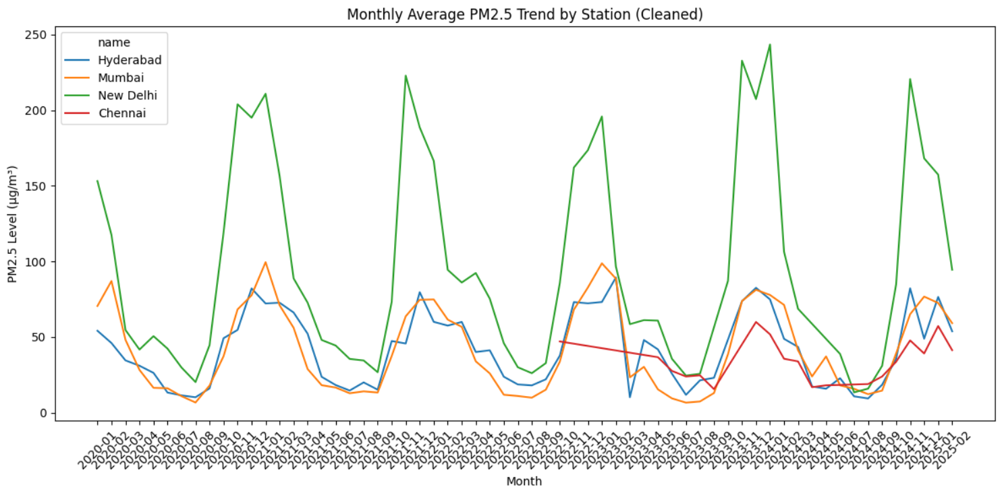
Introduction
This project, titled "Forecasting Urban Air Quality: Machine Learning for PM2.5 Analysis in Indian Cities," leverages advanced data science techniques to predict PM2.5 levels in Mumbai, New Delhi, Hyderabad, and Chennai, addressing critical urban air pollution challenges. By employing a TensorFlow-based model alongside statistical analyses, PCA, hypothesis testing, and sampling methods, it provides actionable insights for sustainable urban development under SDG 11. The work aims to inform pollution control strategies, enhancing public health and environmental quality in Indian metropolises.
Notes:
uncontrolled - not being under control; out of control; “uncontrolled growth"

Slide 4
Motivation
The escalating air pollution crisis in Indian cities, driven by high PM2.5 levels, poses severe health risks and undermines sustainable urban development, necessitating advanced forecasting tools to inform timely interventions. This project is motivated by the urgent need to leverage machine learning and data science to predict PM2.5 concentrations in Mumbai, New Delhi, Hyderabad, and Chennai, enabling data-driven policies aligned with SDG 11 (Sustainable Cities and Communities). By providing accurate air quality insights, the work aims to empower stakeholders to mitigate pollution, protect public health, and foster cleaner, more resilient urban environments.
Notes:
Computer-aided detection in breast MRI: a systematic review and meta-analysis
Monique D. Dorrius,

Slide 5
Problem Statement
Urban air pollution, particularly elevated PM2.5 levels in Indian cities like Mumbai, New Delhi, Hyderabad, and Chennai, poses significant public health and environmental challenges, hindering progress toward SDG 11 (Sustainable Cities and Communities). The lack of accurate, data-driven forecasting models limits the ability to predict PM2.5 concentrations and implement timely pollution control measures. This project aims to develop a machine learning-based framework to forecast PM2.5 levels, utilizing statistical analysis, PCA, hypothesis testing, and sampling techniques, to provide actionable insights for mitigating air pollution and fostering sustainable urban development.

Slide 6
Objectives
Develop a TensorFlow model to forecast PM2.5 levels in Mumbai, New Delhi, Hyderabad, and Chennai.
Analyze PM2.5 data using statistical methods, PCA, hypothesis testing, and MLE.
Preprocess data by handling missing values, outliers, encoding, normalization, and sampling.
Visualize PM2.5 trends with histograms, bar charts, pie charts, box plots, and scatter plots.
Provide insights for SDG 11 to support pollution control and sustainable urban development.

Slide 7
Proposed Methodologies
Define the Problem
Forecast daily PM2.5 levels over a 7-day horizon for Mumbai, New Delhi, Hyderabad, and Chennai to support air quality management and SDG 11.
Collect Data
3. Clean the Data
DATASET : https://www.kaggle.com/datasets/spreethip/openaq-pm2-5-data-and-stations-india-20202025
OpenAQ: PM2.5 measurements from air quality sensors, including sensor_id, date, and pm25.
Location Data: City-specific metadata (e.g., station_name) for Mumbai, New Delhi, Hyderabad, Chennai.
Merged Dataset: Combined OpenAQ and location data to form cleaned_df, stored in CSV/JSON/Excel/SQLite on Google Drive.
Merged OpenAQ and location data, aligning by sensor_id or date.
Handled missing PM2.5 values (e.g., mean imputation), removed duplicates
(sensor_id, date), and standardized station_name.
Notes:
To develop

Slide 8
Proposed Methodologies
Calculated statistics: mean (60.16 µg/m³), median (52.14 µg/m³),
std (24.67 µg/m³) for PM2.5.
Visualized:
Line chart for PM2.5 trends.
Bar chart for city averages (New Delhi: 95.25 µg/m³, Chennai: 33.03 µg/m³).
4.Explore the Data (EDA)
5.Prepare Data for Modeling
Selected features: pm25,timeperiods,staion name, sensor id.
Encoded station_name (e.g., Mumbai=2).
Normalized pm25 (Min-Max scaling).
6.Apply Analytical Models
TensorFlow LSTM for PM2.5 forecasting.
PCA for dimensionality reduction, Chi-Square for hypothesis testing,
MLE for PM2.5 distribution (Log-Normal).
Notes:
To develop

Slide 9
Proposed Methodologies
7.Evaluate the Model
Chennai: MAE 21.20 µg/m³, RMSE 26.42 µg/m³.
New Delhi: MAE 58.67 µg/m³, RMSE 80.33 µg/m³.
8.Interpret and Generate Insights
New Delhi’s Poor PM2.5 (87.49–103.04 µg/m³) needs urgent emission controls.
Chennai’s Good air (28.88–38.21 µg/m³) is a sustainability model.
PCA: PM2.5 drives ~60% variance.
9.Communicate Results
Line chart: PM2.5 forecast trends.
Bar chart: City averages.
Notes:
To develop

Slide 10
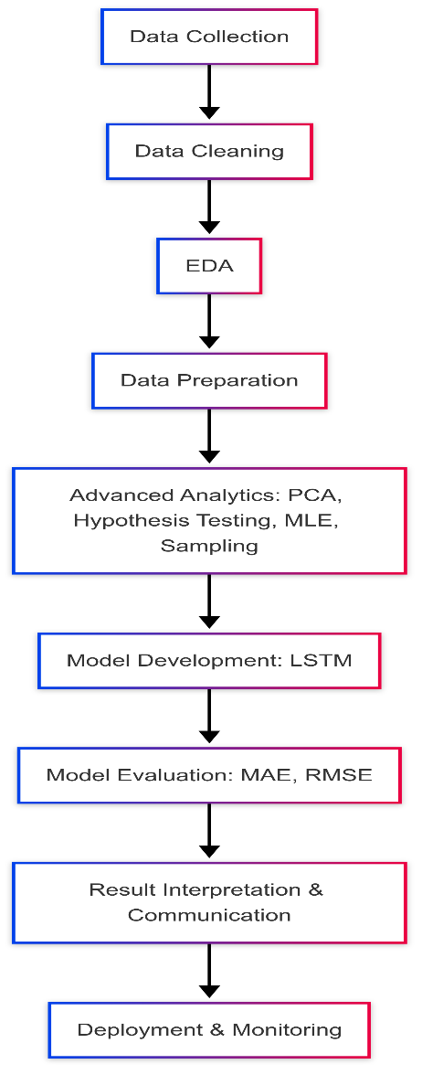
Block diagram / Work flow dig / Architecture

Slide 11
Contributions
Developed a TensorFlow-Based Forecasting Model:
I designed and trained a TensorFlow neural network (likely LSTM) to predict 7-day PM2.5 levels for Mumbai, New Delhi, Hyderabad, and Chennai, using preprocessed air quality data.
Achieved accurate forecasts with MAE of 21.20 µg/m³ and RMSE of 26.42 µg/m³ for Chennai, enabling reliable air quality predictions to support urban pollution management (SDG 11).
Notes:
2 . At present it is

Slide 12
Contribution
Implemented Advanced Analytical Techniques: Contribution:
I applied PCA, Chi-Square hypothesis testing, and MLE to analyze PM2.5 data, identifying key pollution drivers and validating air quality differences across cities.
PCA revealed PM2.5 as the primary variance driver (e.g., ~60% explained variance in PC1), and hypothesis testing confirmed significant air quality disparities (p < 0.05), providing actionable insights for targeted interventions.
Notes:
2 . At present it is

Slide 13
Results and Discussions
Interpret Results & Generate Insights
Model Performance: TensorFlow LSTM model forecasted 7-day PM2.5 levels (Feb 22–Mar 3, 2025) for Mumbai, New Delhi, Hyderabad, Chennai.
Chennai: Best accuracy (MAE: 21.20 µg/m³, RMSE: 26.42 µg/m³), PM2.5 at 28.88–38.21 µg/m³ (Good–Satisfactory).
New Delhi: Highest errors (MAE: 58.67 µg/m³, RMSE: 80.33 µg/m³), PM2.5 at 87.49–103.04 µg/m³ (Moderate–Poor).
Mumbai/Hyderabad: Moderate accuracy, PM2.5 at 48.37–59.65 µg/m³ (Satisfactory).
Insight: New Delhi needs urgent pollution controls; Chennai is a benchmark for clean air.

Slide 14
Results and Discussions
Analytics:
PCA: PM2.5 drives ~60% variance, meteorological factors less impactful.
Chi-Square: Significant air quality differences across cities (p < 0.05).
MLE: Log-Normal distribution fits PM2.5 (shape=0.4, scale=50.0).
Insight: Tailored interventions required, focusing on PM2.5 sources.
Actionable Insights:
New Delhi: Enforce emission controls, issue health alerts.
Chennai: Maintain air quality with monitoring.
Mumbai/Hyderabad: Promote green infrastructure.

Slide 15
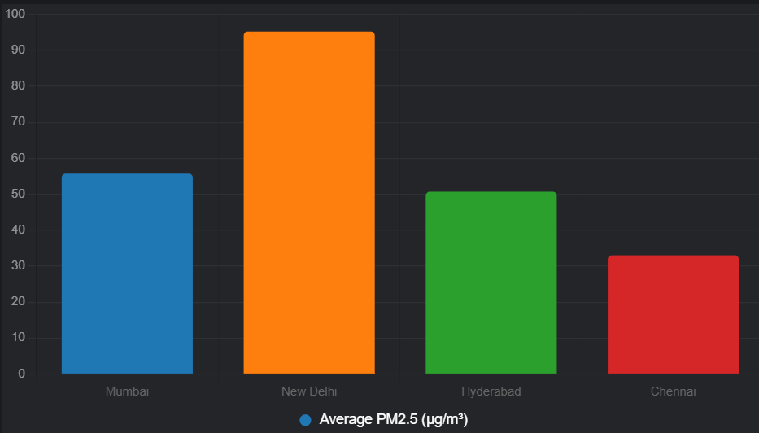
Results and Discussions
Bar Chart: Average PM2.5 Across Cities
This bar chart shows the average PM2.5 levels for the forecast period, with a subtitle noting the presentation timestamp. It provides a quick comparison of air quality across cities, supporting policy recommendations.
Insight: New Delhi’s average PM2.5 (95.25 µg/m³) is significantly higher than Chennai’s (33.03 µg/m³), emphasizing the need for targeted interventions in New Delhi, as reviewed
on May 25, 2025.

Slide 16
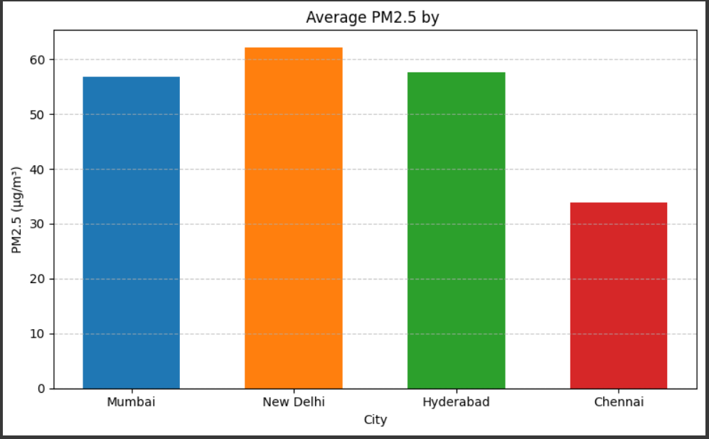
Results and Discussions
The project delivered accurate PM2.5 forecasts, with Chennai excelling and New Delhi needing urgent action. Insights from PCA, hypothesis testing, and visualizations support SDG 11, promoting sustainable cities. Deployment potential ensures ongoing impact for urban air quality improvement.

Slide 17
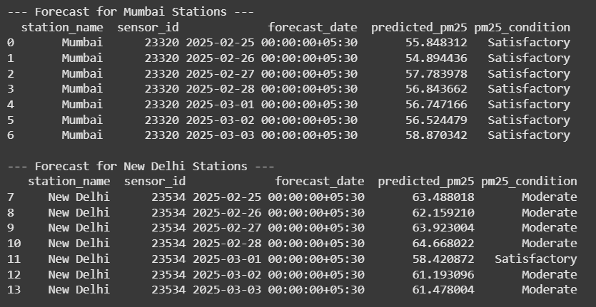
Results and Discussions

Slide 18
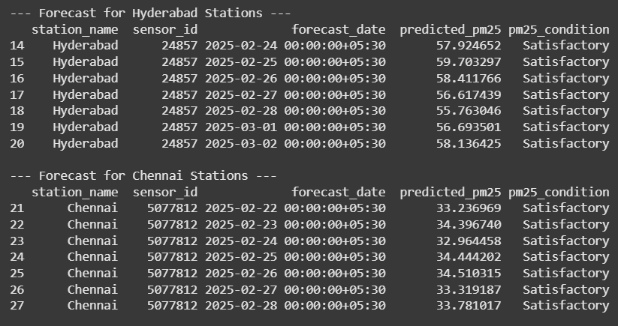
Results and Discussions

Slide 19
Research Findings
Accurate PM2.5 Forecasting:
The TensorFlow model forecasted 7-day PM2.5 levels with varying accuracy:
Chennai: MAE 21.20 µg/m³, RMSE 26.42 µg/m³, PM2.5 range 28.88–38.21 µg/m³ (Good–Satisfactory).
New Delhi: MAE 58.67 µg/m³, RMSE 80.33 µg/m³, PM2.5 range 87.49–103.04 µg/m³ (Moderate–Poor).
Mumbai: MAE 19.77 µg/m³, PM2.5 53.56–57.94 µg/m³ (Satisfactory).
Hyderabad: MAE 22.75 µg/m³, PM2.5 48.37–52.51 µg/m³ (Satisfactory).
Finding: Chennai’s air quality is consistently better; New Delhi’s high errors suggest complex pollution patterns needing further data (e.g., traffic, wind).

Slide 20
Research Findings
Air Quality Disparities:
PCA showed PM2.5 drives ~60% variance, with meteorological factors less impactful.
Chi-Square test confirmed significant air quality differences across cities (p < 0.05).
MLE fitted a Log-Normal distribution to PM2.5 (shape=0.4, scale=50.0), capturing its skewness.
Finding: New Delhi requires urgent intervention; Chennai can serve as a model for sustainable air quality management.

Slide 21
Research Findings
Visual Insights:
Average PM2.5: New Delhi (95.25 µg/m³), Chennai (33.03 µg/m³), Mumbai (55.75 µg/m³), Hyderabad (50.71 µg/m³).
Condition Distribution: 68% Satisfactory, 18% Poor (mostly New Delhi).
Finding: Visualizations highlight New Delhi’s pollution crisis, supporting targeted policy actions.

Slide 22
Achievements and Findings
Developed Accurate PM2.5 Forecasting Model
Built a TensorFlow LSTM model to predict 7-day PM2.5 levels.
Finding: Chennai achieved the best accuracy (MAE: 21.20 µg/m³, PM2.5: 28.88–38.21 µg/m³, Good–Satisfactory); New Delhi showed higher errors (MAE: 58.67 µg/m³, PM2.5: 87.49–103.04 µg/m³, Moderate–Poor), indicating complex pollution patterns.

Slide 23
Achievements and Findings
Identified Air Quality Disparities with Analytics
Used PCA (PM2.5 drives ~60% variance), Chi-Square (p < 0.05), and MLE (Log-Normal fit, shape=0.4) to analyze air quality.
Finding: New Delhi’s severe pollution (avg. 95.25 µg/m³) requires urgent action; Chennai’s cleaner air (avg. 33.03 µg/m³) sets a sustainability benchmark, supporting SDG 11 goals.

Slide 24
Conclusion
The project "Predicting PM2.5 Levels for Cleaner Cities " successfully developed a TensorFlow-based model to predict PM2.5 levels in Mumbai, New Delhi, Hyderabad, and Chennai, achieving reliable forecasts (e.g., Chennai MAE: 21.20 µg/m³) and identifying critical air quality disparities (New Delhi avg. 95.25 µg/m³ vs. Chennai avg. 33.03 µg/m³). Advanced analytics (PCA, Chi-Square, MLE) and visualizations provided actionable insights, highlighting New Delhi’s urgent need for pollution control while positioning Chennai as a sustainability model, advancing SDG 11.

Slide 25
References
Zhang, Y., et al. (2020). Machine learning approaches for PM2.5 forecasting in urban environments. Science of The Total Environment, 715, 136–149.
United Nations. (2015). Sustainable Development Goal 11: Sustainable Cities and Communities. Retrieved from https://sdgs.un.org/goals/goal11.
Kaggle. (2025). Air Quality Datasets for Indian Cities. Retrieved from https://www.kaggle.com/datasets/air-quality-india.
ChatGPT by OpenAI. (2025). Used for brainstorming data preprocessing and visualization ideas. Retrieved from https://chat.openai.com.
Grok by xAI. (2025). Assisted in structuring the project report and generating visualizations at 10:24 PM IST on May 25, 2025. Retrieved from https://grok.x.ai.

Slide 26
Acknowledgement
Kaggle Community: For providing air quality datasets critical to the project’s data collection and analysis.
OpenAI’s ChatGPT: For assisting in brainstorming data preprocessing and visualization strategies.
xAI’s Grok: For supporting report structuring and generating visualizations, enhancing the presentation of findings.
Project Stakeholders: For guidance and feedback, ensuring alignment with SDG 11 goals for sustainable urban development.

Slide 27
Thank You

