Slide 1

Darknet traffic analysis using Machine Learning
INT 625 Internship 3
Final Review
Project Guide
Dr. Pitchumani Angayarkanni
Team Members
1. Aswin Raj B V - E7321008 (MSc. Data Analytics)

Slide 2
ABSTRACT :
Dark web also called as sinkholes, blackholes, network telescopes, and darknet is the environment and the most favourable platform for illegal activities due to hidden IP address and therefore counted as unused address space, which is not available for normal user, and the anonymous behaviour acts as catalyst for criminal or unauthorized behaviour conduction.
It is very difficult to suddenly trace the location of malicious activity origin but by traffic analysis and understanding the patterns, suspicious activities including email communication, audio–video streaming, chatting P2P, browsing data, chatting, and voice over Internet protocol constitute the hidden world web traffic.
Several methods have been deployed to analysis and classify dark web network traffic.
The goal is to build a machine learning model that can accurately classify network traffic flows as either normal or malicious, based on the features extracted from the network traffic data.
This model can then be used in real-world network security applications to detect and prevent malicious activities

Slide 3
LITERATURE REVIEW :
AUTHOR | TITLE | TOOLS & ALGORITHMS | RESULTS
PAPER 1: https://doi.org/10.1007/s10257-023-00626-2 Ammar Almomani Published: 28 Feb 2023 | Darknet traffic analysis, and classification system based on modified stacking ensemble learning algorithms | Logistic Regression KNN SVM Random Forest ANN | The system was tested on a dataset comprising more than 141,000 records analysed from CIC Darknet 2020. The experiment results demonstrated the study’s classifiers’ ability to distinguish between the malignant traffic and benign traffic easily. The classifiers can effectively detect known and unknown threats with high precision and accuracy greater than 99% in the training and 97% in the testing phases, with increments ranging from 4 to 64% by current algorithms.
PAPER 2: https://doi.org/10.3390/electronics10070781 Konstantinos Demertzis Konstantinos Tsiknas Dimitrios Takezis Charalabos Skianis Lazaros Iliadis PUBLISHED: 25 March 2021 | Darknet Traffic Big-Data Analysis and Network Management for Real-Time Automating of the Malicious Intent Detection Process by a Weight Agnostic Neural Networks Framework | Extreme Gradient Boosting (XGB) Linear Discriminant Analysis Linear Discriminant Analysis Ridge Classifier | The Reservoir model (11-17-09) that gave the highest results surpassed the algorithms Light Gradient Boosting Machine, Ridge Classifier, Linear Discriminant Analysis, Quadratic Discriminant Analysis, Logistic Regression, Naïve Bayes, SVM—Linear Kernel, and Ada Boost.

Slide 4
PAPER 3: https://doi.org/10.3390/electronics11040556 Qasem Abu Al-Haija Moez Krichen Wejdan Abu Elhaija PUBLISHED: 12 Feb 2022 | Machine-Learning-Based Darknet Traffic Detection System for IoT Applications | Bagging Decision Tree Ensembles AdaBoost decision tree ensembles (ADA-DT) RUS Boosted decision tree ensembles (RUS-DT) | Performance analysis demonstrates that bagging ensemble techniques (BAG-DT) offer better accuracy and lower error rates than other implemented supervised learning techniques, scoring a 99.50% of classification accuracy with a low inferencing overhead of 9.09 µ second.
PAPER 4: https://ssrn.com/abstract=3949786 Andrew Allhusen Moez Izzat Alsmadi Abdullah Wahbeh Mohammad Al-Ramahi Ahmad Al-Omari PUBLISHED: October 25, 2021 | Dark Web Analytics: A Comparative Study of Feature Selection and Prediction Algorithms | Random Forest K-Neighbour’s Gaussian Multi-layer Perceptron (MLP) | This research focus on evaluating best prediction models while analysing traffic level data coming from the dark web. The Protocol feature was never selected as a feature, regardless of whether Src Port and Dst Port were available. The authors achieved an average prediction accuracy of 98% using Random Forest algorithm for both classification tasks.

Slide 5
Outcome:
An extensive literature survey has been carried out in these papers which covers various Deep Learning techniques to classify traffic categories and got good accuracy used for the data.
Since Machine Learning is convenient to develop extremely difficult or expensive systems, I have used some of the models to find out which model performs well to classify the traffic categories.
Some important and mostly used machine learning method in this project are:
Logistic Regression, Decision Tree Classifier, Random Forest Classifier, SVC,
K Neighbors Classifier.
To accurately classify traffic into different categories using machine learning models and determine the model's performance on different datasets and under different conditions, and to optimize its hyperparameters for better accuracy.

Slide 6

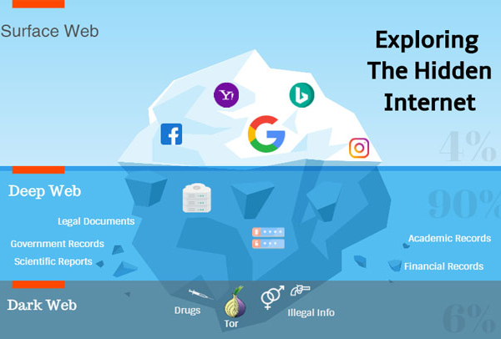
INTRODUCTION:
Darknet:
The Dark Net is a network that is deliberately hidden and inaccessible through the internet with which we are all familiar (the “surface net”). It is accessed with the help of specially designed software which anonymises users' identity and encrypts information sent over the network. It is an encrypted portion of the internet that is not indexed by search engines and requires specific configuration or authorization to access.

Slide 7
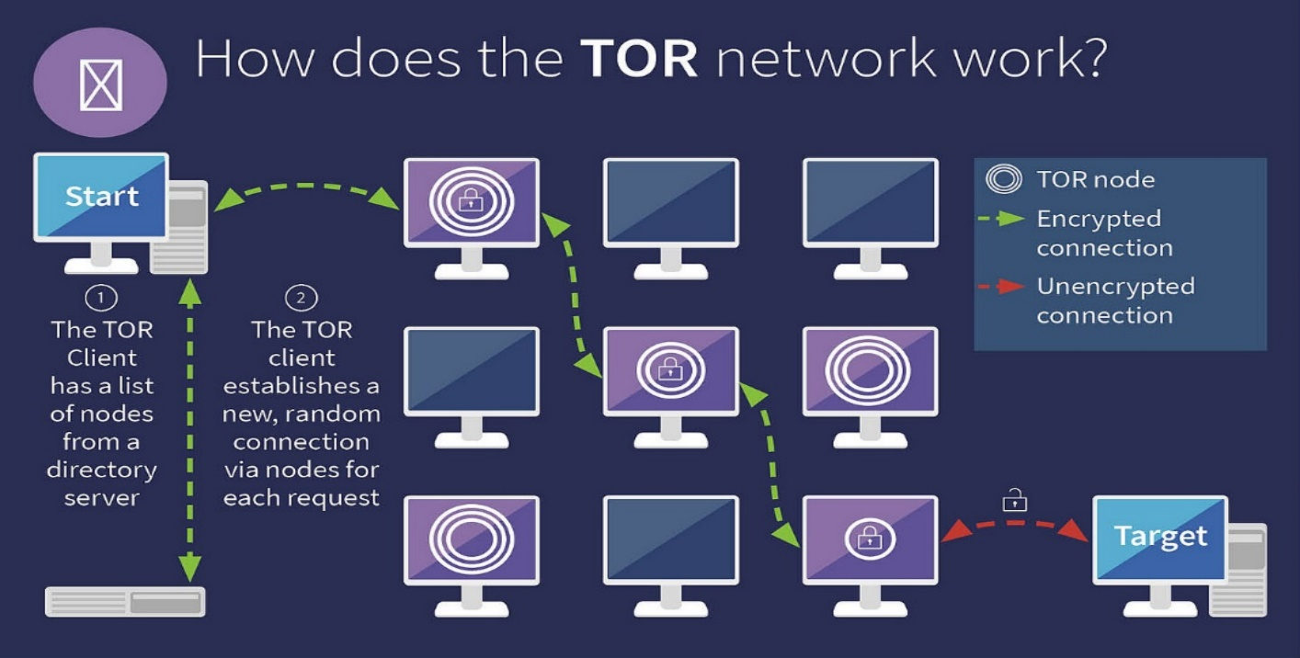
TOR
The 'Dark Web' uses complex systems that anonymise a user's true IP address, making it very difficult to work out which websites a device has visited. It is generally accessed using dedicated software, the best known is called Tor (The Onion Router). Searches or messages sent via the Tor browser do not go directly to their intended destination. Instead, they are relayed through “nodes,” which are other computers operated by Tor users. At each node, a layer of encryption is taken off and the message is then sent on to the next. Each node knows the identity of the previous node and the one that comes next, but does not know the others in the chain.
VPN
Virtual Private Network, a VPN encrypts all device's internet traffic and routes it through a middleman server in a location of your choosing. The VPN hides Tor traffic inside the encrypted tunnel, so only you and the VPN provider can see you are using Tor. A VPN not only increases your security but also ensures your privacy.

Slide 8
Dark Net Traffic:
Darknet traffic refers to the data and communication that occurs over a portion of the internet that is not accessible through traditional search engines or web browsers. This portion of the internet is known as the "darknet" and is only accessible using specialized software or configurations that allow users to maintain anonymity. Darknet traffic may be encrypted or hidden, making it difficult to monitor and track by law enforcement agencies.
Some common types of darknet traffic include:
File-sharing traffic: This type of traffic involves the sharing of files such as movies, music, and software. It is often associated with illegal activities such as copyright infringement.
Illicit marketplace traffic: This type of traffic involves the buying and selling of illegal goods and services, such as drugs, weapons, and stolen data.
Darknet forum traffic: This type of traffic involves discussions and interactions on darknet forums, which can cover a wide range of topics, including hacking, politics, and illegal activities.
Anonymity-seeking traffic: This type of traffic involves individuals who are using the darknet to remain anonymous and avoid detection by law enforcement or other entities.
Cryptocurrency-related traffic: This type of traffic involves the use of cryptocurrencies, such as Bitcoin, for transactions on the darknet.

Slide 9
Traffic Categories
Traffic Category | Applications used
Audio-Stream | Vimeo and YouTube
Browsing | Firefox and Chrome
Chat | ICQ, AIM, Skype, Facebook, and Hangouts
Email | SMTPS, POP3S and IMAPS
P2P | uTorrent and Transmission (BitTorrent)
Transfer | Skype, FTP over SSH (SFTP) and FTP over SSL (FTPS) using FileZilla and an external service
Video-Stream | Vimeo and YouTube
VOIP | Facebook, Skype, and Hangouts voice calls

Slide 10

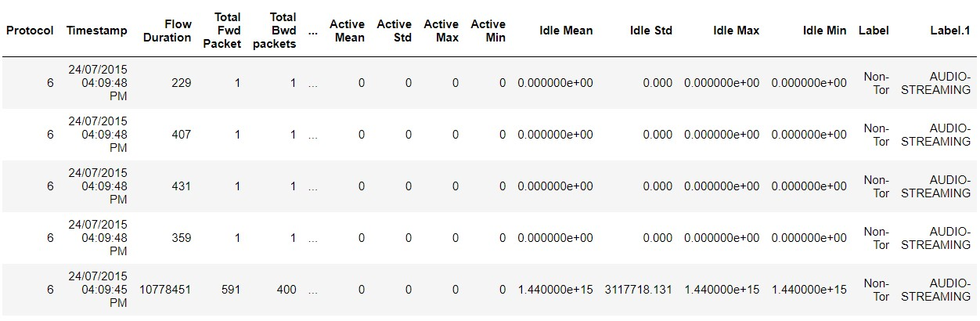
About Dataset:
Dataset Name: CICDarknet2020 dataset
Origin: www.unb.ca
In CICDarknet2020 dataset, a two-layered approach is used to generate benign and darknet traffic at the first layer. The darknet traffic constitutes Audio-Stream, Browsing, Chat, Email, P2P, Transfer, Video-Stream and VOIP (Voice Over IP) which is generated at the second layer. It is a publicly available network traffic dataset that captures various types of network traffic in a darknet environment. A darknet is an isolated network that is not intended to be directly accessible from the public internet, and is often used to monitor and detect malicious activity such as botnet command and control traffic, malware distribution, and other types of cyber attacks. It consists of 50 capture PCAPs of different types of attacks, such as DDoS, botnet, and brute force. The dataset contains 12.6 million packets and can be used to evaluate the effectiveness of machine learning algorithms.
Columns: 85
Rows: 141530

Slide 11

PROBLEM STATEMENT
The goal of this project is to develop and evaluate machine learning algorithms that can effectively detect and classify various types of network attacks in darknet environments using the CIC-Darknet2022 dataset. Specifically, the project aims to improve the accuracy, scalability, and efficiency of intrusion detection systems in detecting and mitigating network attacks, thereby improving the overall security of networked systems.
Investigating the characteristics and patterns of different types of cyber attacks and malware in the dataset to gain insights into their behavior and improve detection and response strategies.
Developing and testing new approaches for feature engineering and feature selection that can improve the accuracy and efficiency of machine learning models.

Slide 12
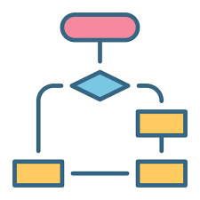
FLOWCHART
Data Collection & Pre-processing
Model Selection & Evaluation
Train, Test split
Model Deployment
Model Tuning

Slide 13
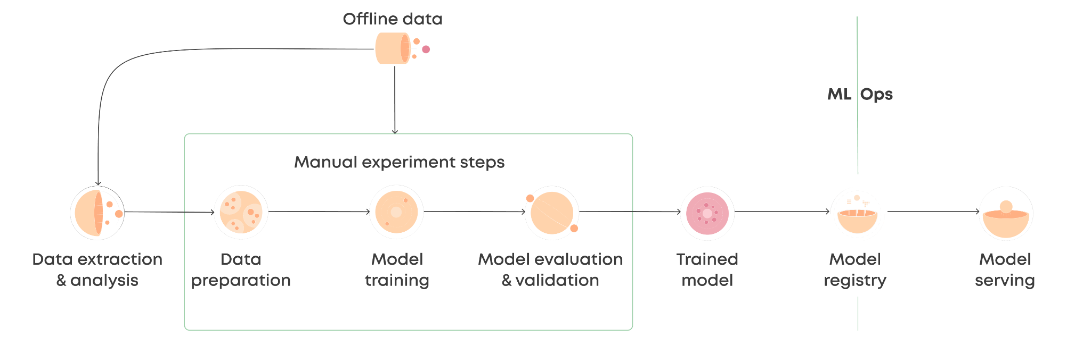
Data Collection: Collect relevant and representative data for your problem.
Data Preparation and Cleaning: Clean, transform, and format your data for use by machine learning algorithms.
Data Splitting: Split your data into training, validation, and testing sets.
Feature Engineering: Select and transform the features (or variables) that will be used to train your model.
Model Selection: Choose the appropriate machine learning algorithm for your problem.
Model Training: Train your selected model using the training data.
Model Evaluation: Evaluate your model's performance on the validation set.
Hyperparameter Tuning: If necessary, adjust the hyperparameters of your model to improve its performance.
Final Model Evaluation: Evaluate your model's performance on the testing set.

Slide 14

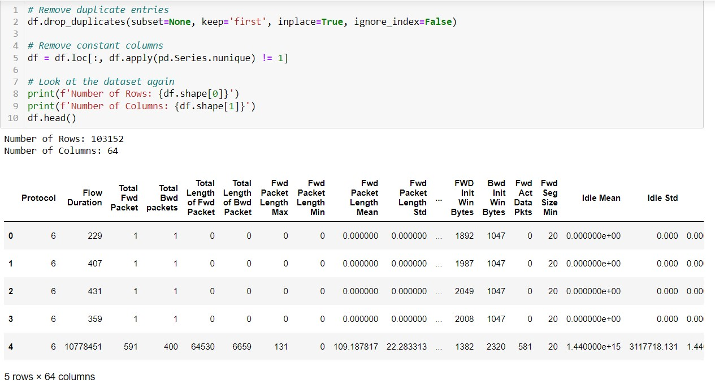
Data Pre-Processing :
Dropping unwanted columns that does not impact the dataset.
Removing the null values.
Typecasting str to int & Float, converting int32 & float32 to int64 & float64.
Standardization & Normalization.

Slide 15
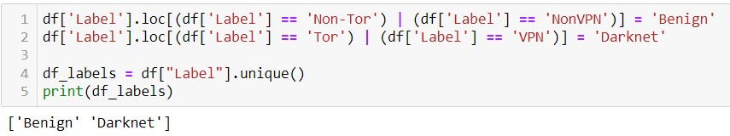
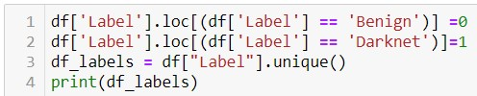

Changing the label names from Non-Tor & Non-VPN to Benign and TOR & VPN to Darknet.
Non-Tor & Non VPN : Benign
Tor & VPN: Darknet
Changing the label names from Benign to ‘0’ and Darknet to ‘1’.
Benign : 0
Darknet: 1

Slide 16
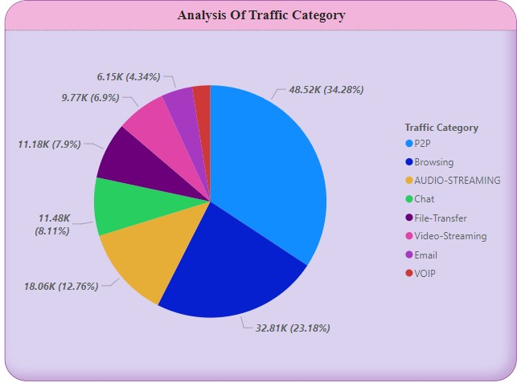
Visual Analysis :
P2P accounted for 34.28% of Traffic.

Slide 17
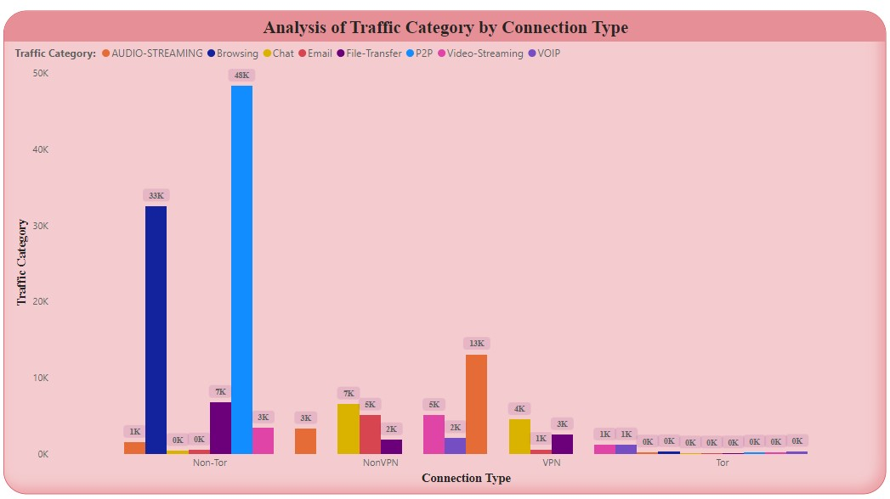
Non-Tor connection is made up 34.13% of Count of Traffic.

Slide 18
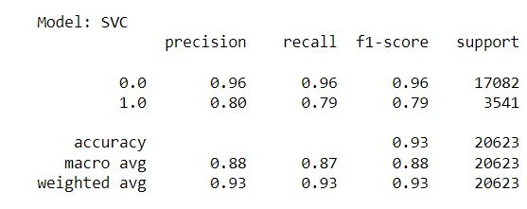
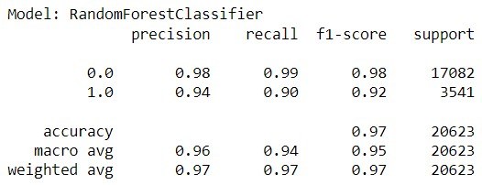
Models Used:
Support Vector Machines (SVM): SVMs are a popular choice for intrusion detection systems (IDS) due to their ability to effectively separate normal and malicious network traffic. They work by mapping data points to a high-dimensional space and identifying the optimal hyperplane that maximizes the margin between the classes.
Random Forest: Random Forest is a popular ensemble learning algorithm that combines multiple decision trees to improve accuracy and reduce overfitting. It has been used for network intrusion detection and has shown promising results in detecting various types of network attacks.

Slide 19
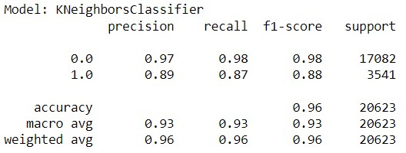
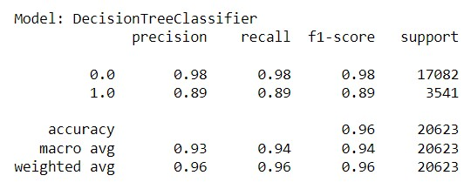
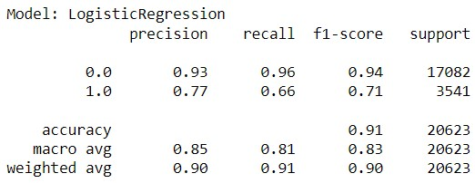
K-Nearest Neighbors (KNN): KNN is a non-parametric algorithm that is often used for classification tasks. It works by identifying the k-nearest neighbors of a data point and classifying it based on the majority class of its neighbors.
Decision Trees: Decision trees are a simple and interpretable machine learning model that can be used for classification tasks. They work by recursively splitting the data into subsets based on the most informative feature.
Logistic regression: It is a commonly used statistical technique in machine learning for binary classification tasks. It can be used for analyzing darknet traffic by predicting whether a given network packet belongs to a legitimate or malicious traffic.

Slide 20
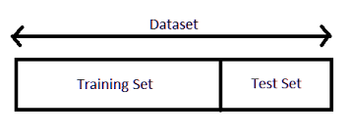
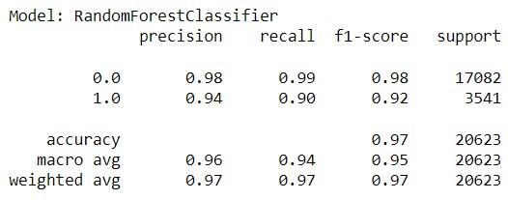
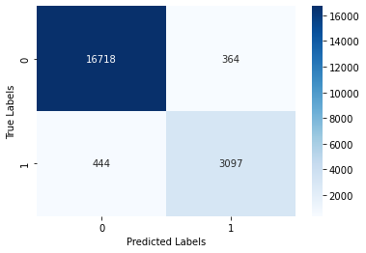
Splitting the data & Model Selection
80% of the data is took for training & 20% for testing.
Fitting the models.
RandomForestClassifier() gives the best accuracy of 97% compared to other models without any hyperparameter tuning.
Confusion Matrix:
The confusion matrix shows that the model made 16718 true positive predictions, 364 false positive predictions, 444 false negative predictions, and 3097 true negative predictions. In this case, the model has high precision and recall for the positive class, but low precision and recall for the negative class.

Slide 21
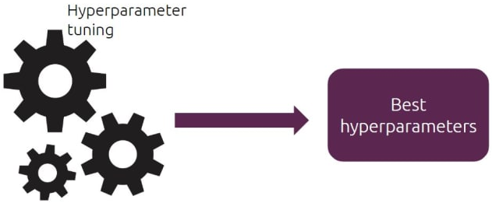
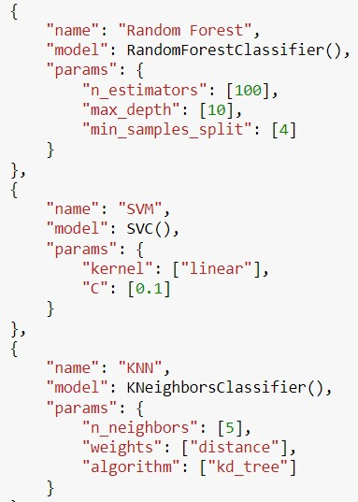
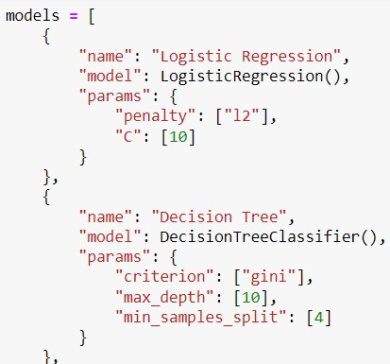
Model Tuning
Using hyperparameters for the models to find which models give best accuracy.

Slide 22
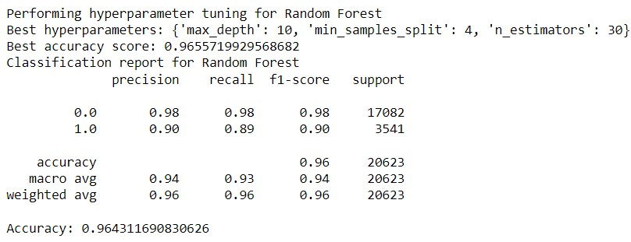
Best Model:
After using hyperparameter tuning for all models RandomForestClassifier() gives the best accuracy of 96%.
Random Forest machine learning model has shown promising results in detecting various types of network attacks with an accuracy of 96%. This high accuracy rate makes Random Forest a strong candidate for network intrusion detection and network security applications.

Slide 23

Results and Discussion
Random Forest machine learning model has shown promising results in detecting various types of network attacks with an accuracy of 96%.
It has been found been found that P2P has the most traffic in a benign network; Chat, File Transfer, Video Streaming has the most traffic in malicious sites.
Accuracy Table:
Model | Accuracy Before Tuning | Accuracy After Tuning
Random Forest | 97% | 96%
SVM | 93% | 94%
KNN | 95% | 95%
Decision Tree | 95% | 95%
Logistic Regression | 91% | 90%
Random Forest Classifier has performed the best for unknown test data.

Slide 24

Future Work:
The project has been developed to accurately classify traffic into different categories.
Further analysis and experimentation will be done to determine the model's performance on different datasets and under different conditions, and to optimize its hyperparameters for better accuracy.

Slide 25
References
Lombardi, M.; Pascale, F.; Santaniello, D. Internet of Things: A General Overview between Architectures, Protocols and Applications. Information 2021, 12, 87.
D. Singh, A. Shukla, and M. Sajwan, “Deep transfer learning framework for the identification of malicious activities to combat cyberattack,” Future Gener. Comput. Syst., vol. 125, pp. 687–697, Dec. 2021, doi:10.1016/j.future.2021.07.015.
L. A. Iliadis and T. Kaifas, “Darknet Traffic Classification using Machine Learning Techniques,” in 2021 10th International Conference on Modern Circuits and Systems Technologies (MOCAST), Jul. 2021, pp. 1–4. doi: 10.1109/MOCAST52088.2021.9493386.
H. Thorat, S. Thakur, and A. Yadav, “Categorization of Illegal Activities on Dark Web using Classification,” vol. 07, no. 05, p. 6, 2020
P. Friedrich, “CIC-Darknet2020 Internet Traffic,” Sep. 24, 2020. https://www.kaggle.com/peterfriedrich1/cicdarknet2020-internet-traffic (accessed Aug. 20, 2021)

Slide 26
Work Log:
Date | Duration in Hrs. | Task Planned | Task Completed | Description of the Task | Scope of the task | Skills Acquired
01.03.2023 - 02.03.2023 | 12 hours | Abstract | Completed | Referring to the concept about the given dataset | abstract done | understanding the dataset
04.03.2023 - 09.03.2023 | 30 hours | Exploring the dataset | Completed | Exploring the dataset in different platforms. | Dataset Found | analysing the Dataset
11.03.2023 - 15.03.2023 | 36 hours | Learning about Dark Net Traffic | Completed | Studying about Dark Net traffic Categories | Got some knowledge about Darknet | Learning about Darknet
27.03.2023 | 6 hours | PPT - 1 | Completed | Creating a ppt based on the completed task Literature review | Finalizing a better ppt | Power Point Tools
28.03.2022 - 30.03.2023 | 28 hours | Data Preparation | Completed | Collection of dataset for the model | Properly oragnised the Dataset | Using Pre-processing techniques
04.04.2023 | 6 hours | Model Selection | Completed | Selecting Random Forest model | Selecting Random Forest model | Machine Learning Python
06.04.2023 - 08.04.2023 | 18 hours | Model Training | Completed | Training the selected Model | To Analyze the Model | Model Training python machine learning architecture
10.04.2023 - 13.04.2023 | 14 hours | Hyperparameter tuning | Completed | optimizing the hyperparameters of the model | To improve Model performance. | Optimization Techniques
17.04.2023 | 6 hours | PPT - 2 | ongoing | Creating a ppt based on the completed task interim review | Finalizing a better ppt | Power Point Tools

Slide 27
Thank you

