Slide 1



PRODUCT PRICE COMPARISON USING
WEB MINING
INT 601-INTERNSHIP PRESENTATION
Final Review
NAME: ASWIN RAJ B.V
UNIQUE ID: E7321008
SUPERVISOR: Prof. Chiranjeevi Nuthalapati

Slide 2
ABSTRACT:
Quality is important for customer satisfaction. Greater the quality higher the price of the product. Every product that we buy will slightly or greatly differ in price, depending on when and where we are buying them from. Comparing prices helps us to find better deals on the same products or find similar products at better prices. Comparing prices across various e-commerce sites will help us save significantly, whether we are buying, clothing, electronic gadgets and other needs. The main objective of this project is to implement Data Mining to scrap necessary data from the site and compare the price of the product. The methodology involves using Selenium (web scrapping tool) to scrap the data, like price, availability, ratings and number of ratings of a product from different e-commerce sites like Amazon, Flipkart, eBay, Snapdeal etc. Converting the scrapped data into a data frame and writing it to an excel file. Performing data wrangling to the dataset and then comparing the best product by calculating the ratings & price of the product from multiple e-commerce sites.

Slide 3
INTRODUCTION
Comparing prices across various e-commerce sites will help us save significantly, whether we are buying, clothing, electronic gadgets and other needs.
Every product that we buy will slightly or greatly differ in price, depending on when and where we are buying them from.
Quality is important for customer satisfaction.
Greater the quality higher the price of the product.
Comparing prices helps us to find better deals on the same products or find similar products at better prices.

Slide 4
WHAT IS WEB SCRAPPING ?
Web scraping is the process of extracting necessary content or data from a website.
To compare the product & price we can use Web Scraping Tools that would be automated, cost less, and work more swiftly.
The tool scraps the underlying HTML code and extracts sample data.

Slide 5
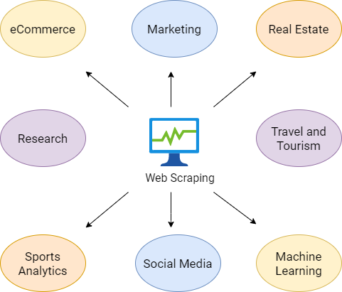
Benefits of Web Mining:
It assists businesses in gathering reliable data
It assists organisations in making well-informed decisions
It is a time- and cost-effective solution when compared to other data applications
E-traders, who sell similar products for relatively consistent prices, are frequent targets.
To remain competitive, they’re motivated to offer the best prices possible, since customers usually go for the lowest cost offering.
To gain an edge, a vendor can use a bot to continuously scrape his competitors’ websites and instantly update his own prices accordingly.
A successful price scraping can result in their offers being prominently featured on comparison websites—used by customers for both research and purchasing.
It enables data scientists to quickly evaluate massive amounts of data.
Data scientists can then use the data to spot fraud, create risk models, and improve product safety
It enables data scientists to create behaviour and trend forecasts and uncover hidden patterns.

Slide 6
CONTEXT & PROBLEM STATEMENT
Data is a universal need to solve business and research problems.
Questionnaires, surveys, interviews, and forms are all data collection methods; however, they don’t quite tap into the biggest data resource available.
The Internet is a huge reservoir of data on every plausible subject.
Unfortunately, most websites do not allow the option to save and retain the data which can be seen on their web pages.
Web scraping solves this problem and enables users to scrape large volumes of the data they need.

Slide 7
OBJECTIVE
The main objective of this project is to implement Web Mining to scrap the price of the same product from different e-commerce sites, compare the price & recommend the website that offers the product for a cheapest rate.
The methodology involves using Selenium (web scrapping tool) to scrap the data, in terms of price of a product from different e-commerce sites.

Slide 8
LITERATURE REVIEW
NAME | APPLICATION | TOOLS & ALGORITHMS | RESULTS
_{Riya Shah} _{Karishma Pathan} _{Anand Masurkar} _{Shweta Rewatkar} _{Prof. (Ms.) P.N. Vengurlekar} _{Published: MAY 2016} | Comparison of E-commerce Products using web mining | Web mining Web crawler MongoDB Django | Samsung Guru E1200 White is compared between e-commerce sites. The price in Snapdeal website is recommended to the customer.
Mahendra Pratap Yadav Vinod Kumar Yadav PUBLISHED: JULY 2012 | Mining the customer behavior using web usage mining in e-commerce | Web mining | Computer products are bought frequently were found based on customer behaviour.
D Lekha D Paul Raj A Kathija Nasreen PUBLISHED: AUGUST 2021 | Product price comparison with the system database by using google vision and raspberry pi | Google Vision Raspberry pi | The market price of Onion and Chilli powder were found to be matching with other market price.

Slide 9
FLOWCHART
01
02
03
Web Scrapping
Data Pre-Processing
Database
05
04
Comparing &
Analyzing
Recommending

Slide 10
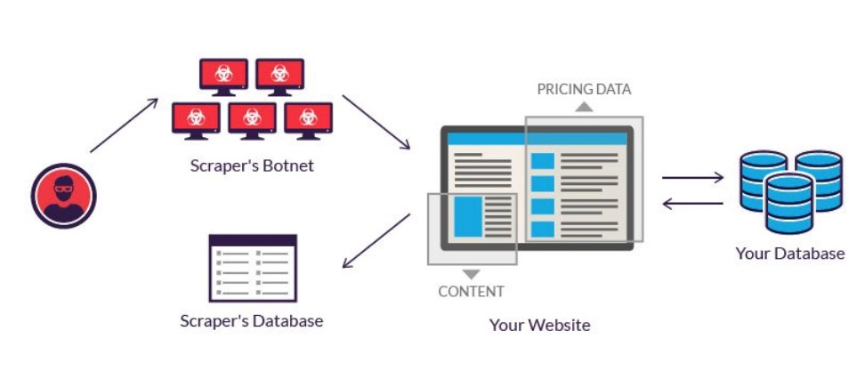
METHODOLOGY:

Slide 11
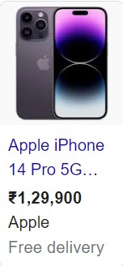
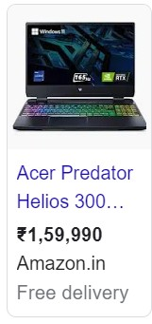
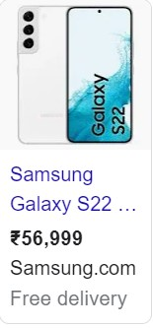
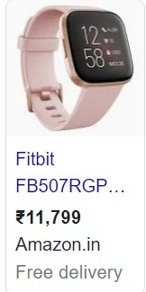
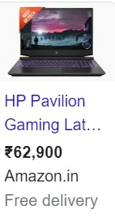
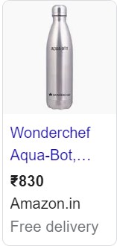
WEB MINING, ANALYSING & RECOMMENDING
WEB MINING:
The necessity of this tool is to recommend cheap product for the customer.
The product used here are “Mobile Phones, Laptop, Earbuds, Fitbit”.
First the user searches the product in the tool built.
Using Selenium, scrapping the data of the searched product through different e-commerce sites.
Websites Scrapped : Flipkart, Amazon, Croma, Gadgetsnow, Smartprix.

Slide 12
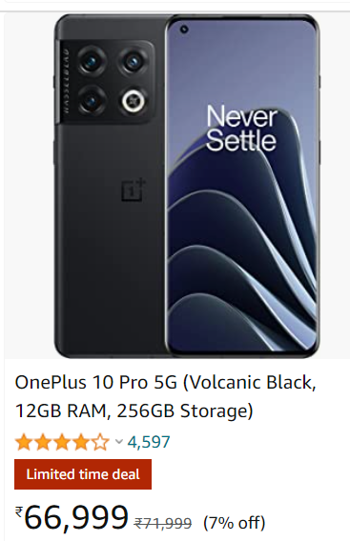
Product Name & Specifications
Rating
Product Price

Slide 13
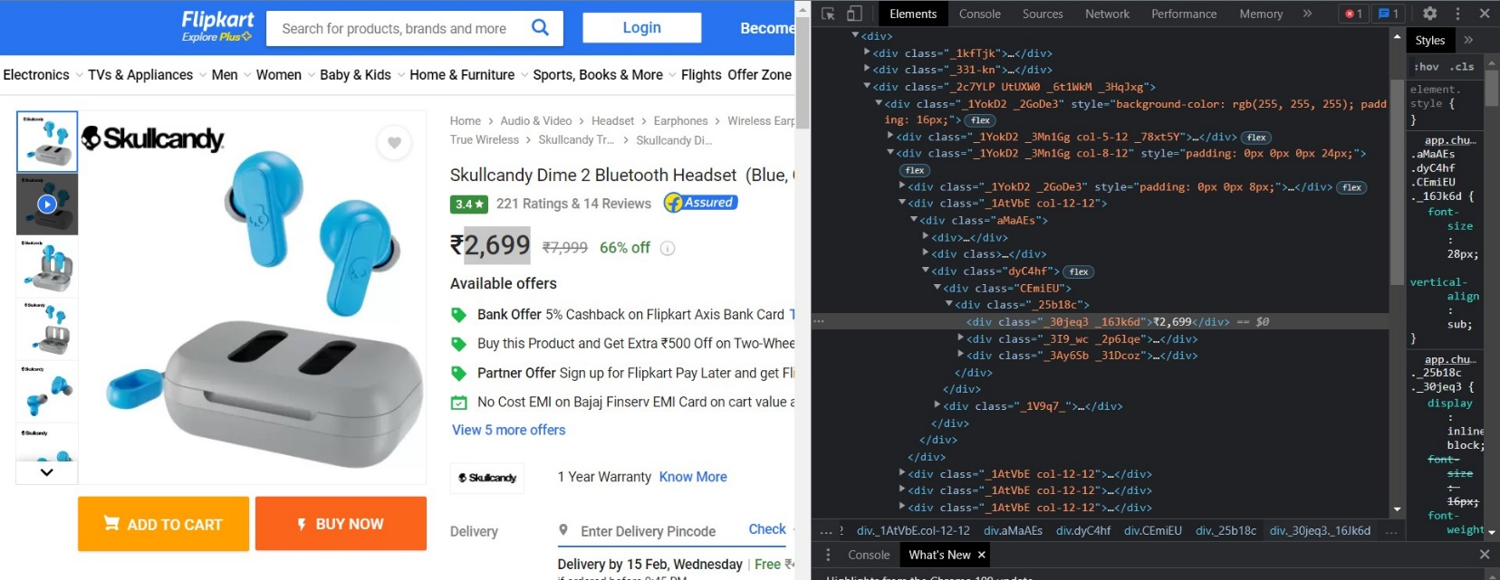
Right click on the content & inspect to get the HTML content of the web-page.
Webpage
HTML content of the webpage after inspecting

Slide 14
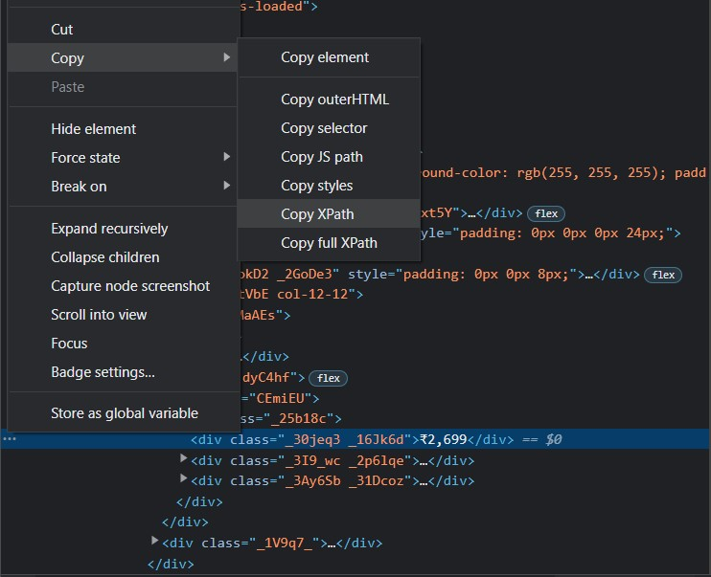
Taking the xpath of the required content for scrapping
The XML Path Language (XPath) is used to uniquely identify or address parts of an XML document. An XPath expression can be used to search through an XML document, and extract information from any part of the document, such as an element or attribute (referred to as a node in XML) in it.
Scrapping the prices for five products in five different e-commerce websites using the xpath.
Scrapping the prices for five products in five different e-commerce websites using the xpath.
S. No: | Websites Used for Scrapping | Products used for Scrapping
1. | Flipkart | Apple iPhone 14 pro
2. | Amazon | Samsung S22
3. | 91mobiles | Fitbit
4. | Gadgetsnow | Skullcandy
5. | Smartprix | Acer Predator laptop

Slide 15

DATA PRE-PROCESSING
The extracted data is stored in a data frame. Preforming data pre-processing techniques to make it efficient for analyzing & recommending.
Removing the rupee symbol, comma & space from the price string & converting it into integer.

Slide 16
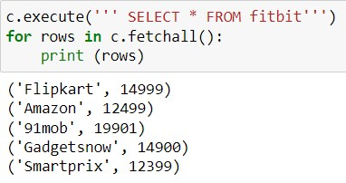
DATABASE
The processed data is now stored in an SQL database for managing data held in a relational database management system (RDBMS), or for stream processing in a relational data stream management system (RDSMS).
It is particularly useful in handling structured data, i.e., data incorporating relations among entities and variables.
Python SQLite3 module is used to integrate the SQLite database with Python.
Storing the website name and its offering price for the scrapped product in SQLite3 database.

Slide 17
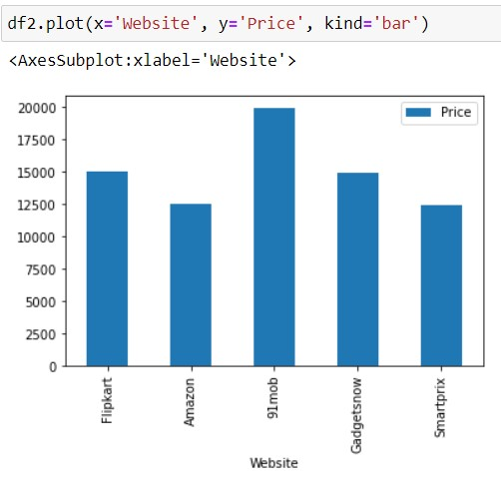
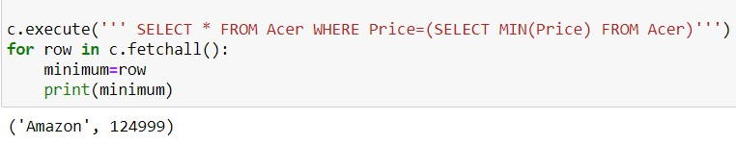
COMPARING & RECOMMENDING
From the processed data the product price and product are compared from the ecommerce sites Product price is compared to get the low to high products.
From the compared result, the cheap & best product’s website is recommended to the customer by analyzing from different e-commerce sites.

Slide 18
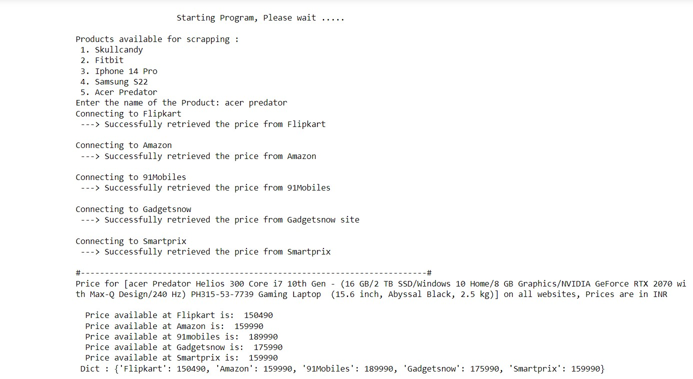
OUTPUT:

Slide 19
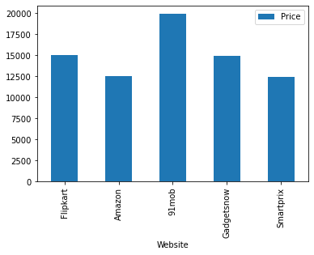
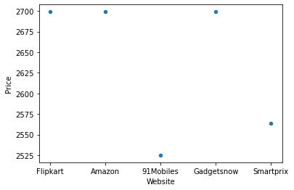
RESULT
Visualization Results:
Product name: FITBIT
Product name: Skullcandy Earbuds

Slide 20
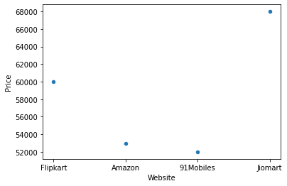
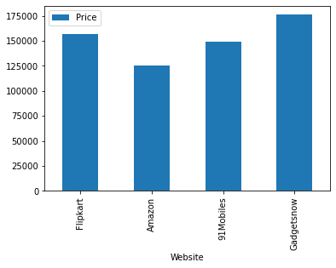
RESULT
Product Name: Samsung S22
Product Name: Acer Predator Laptop

Slide 21
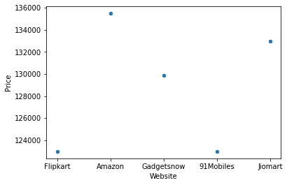
RESULT & RECOMMENDATION
The e-commerce websites that offer cheapest price are recommended.
S. no | Website | Product Name | Product Price
1. | Amazon | Fitbit | 12979
2. | 91mobiles | Skullcandy Earbuds | 2525
3. | 91mobiles | Samsung S22 | 51999
4. | Flipkart, 91mobiles | Iphone 14 pro | 122999
5. | Amazon | Acer Predator Laptop | 124999
Product Name: Apple iPhone 14 pro

Slide 22
FUTURE RESEARCH
The project has been developed and did the comparison using Product price.
In the future, the project aims to analyze the feedback of the customers and the updated specifications of the product using NLP techniques on the basis of business analytics to give a more quality product.

Slide 23
CONCLUSION
Comparison of E-commerce products using web mining in web-based system which will help users in decision making while buying products online.
Instead of tens of thousands of products in a superstore, consumers may choose among millions of ones in an online store to satisfy the personalization demands.

Slide 24
WORKLOG
Project Supervisor: Prof. Chiranjeevi Nuthalapati
Date | Duration in Hrs. | Task Planned | Task Completed | Description of the Task | Scope of the task | Skills Acquired
12.10.2022 - 13.10.2022 | 12 hours | Abstract | Completed | Referring to the concept about the given dataset | abstract done | understanding the dataset
16.10.2022 - 20.10.2022 | 30 hours | Exploring the websites | Completed | Exploring the websites in different platforms. | websites Found | anayzing the websites to scrap
25.10.2022 - 30.10.2022 | 36 hours | Learning selenium | Completed | Studying about selenium and methods of scrapping | Got some knowledge about selenium | Python and required libraries
4.11.2022 - 8.11.2022 | 30 hours | Learning pyauto GUI | Completed | Understanding the GUI | Implementing the GUI in scrapping | Python and Automation
12.11.2022 - 16.11.2022 | 28 hours | PPT - 1 | Completed | Creating a ppt based on the completed task | Finalizing a better ppt | Power point tools
20.11.2022 - 24.11.2022 | 30 hours | Learning SQL | Completed | Studying about SQL and methods of pulling a data | Data warehouseig | Sql commands
2.12.2022 - 4.12.2022 | 18 hours | Scarppig a website | Completed | Scrapping data from a single webiste( ~ Amazon) | Data Collection | Python ,selenium
12.12.2022 - 20.12.2022 | 54 hours | PPT - 2 | Completed | Creating a ppt based on the completed task | Finalizing a better ppt | Power point tools
02.01.2023 - 05.01.2023 | 28 hours | Comparing the Price | Completed | Comparing the prices of a product in multiple websites | Analyizing which webiste is best | Python ,selenium,pyauto GUI

Slide 25
REFERENCES
Riya Shah, Karishma Pathan, Anand Masurkar, Shweta Rewatkar, Prof. (Ms.) P.N. Vengurlekar (2016), “Comparison of E-commerce Products using web mining”, International Journal of Scientific and Research Publications, Volume 6, Issue 5, May 2016 640 ISSN 2250-3153.
Mahendra Pratap Yadav, Mhd Feeroz, Vinod Kumar Yadav (2012), “Mining the customer behaviour using web usage mining in e-commerce”, Computing Communication & Networking Technologies (ICCCNT), 2012 Third International Conference, DOI:10.1109/ICCCNT.2012.6395938.
D Lekha, D Paul Raj, A Kathija Nasreen (Year), “Product price comparison with the system database by using google vision and raspberry pi ” (August 2023)
Wang Bin; Liu Zhijing, "Web mining research", Proceedings of fifth International Conference on Computational Intelligence and Multimedia Applications(ICCIMA 2003) , 2003 , pp: 84 - 89.
Li-na Lu, Hengyi Wei, "Sequential patterns recognition in web log mining", Mini-micro system, Vol. 5, No. 3, pp. 81-83, Feb. 2008.

Slide 26
REFERENCES
Guo, Di, Collector Engine System: A Web Mining Tool for ECommerce, Proceedings of the First International Conference on Innovative Computing, Information and Control (ICICIC'06) DOlcomputer society 0-7695-2616-0106 2006 IEEE Yuewen, LI, Research on E-Commerce Secure Technology DOl 978-1-4244- 3709-2/10 2010 IEEE
Sung-Shun Weng, Mei-Ju Liu, "Personalized product recommendation in e-commerce" , IEEE International Conference on e-Technology, e-Commerce and e-Service(EEE '04), 2004, pp.413- 420, doi: 1O.1109IEEE.2004.1287340.
S.Neelakandan and D.Paulraj, " An automated exploring and learning model for data prediction using balanced CA‑SVM ”, Journal of Ambient Intelligence and Humanized Computing, 2020 (Springer)
S. Ancy, and D.Paulraj “Handling Imbalanced Data With Concept Drift By Applying Dynamic Sampling And Ensemble Classification Model, Computer Communications ” The International Journal For The Computer And Telecommunications Industry, 153, Pp 553 -560 2020 (Elsevier)
D.Lekha, Dr.S.Chakaravarthi, Dr.P.Visu “Food Supply chain Management using Blockchain in Food Tracability” EAI http://dx.doi.org/10.4108/eai.30-6-2021.170253 June 30 2021.

Slide 27
Thank you

