Slide 1


Major Project Branch: CSE – IOT & Cyber Security including Blockchain Technology Department: Data Engineering Semester: VII Section: A Regulation: R23 Course Code: R23MSCSP003
Project Title:
Batch Number:
WayCode: An Asynchronous Mobile Gateway for Autonomous Software Engineering Agents
13
SS. No | Register Number | Student Name
1. | 23331A4745 | Palakonda Aswinsai
2. | 23331A4732 | Marpu Phanindra
3. | 23331A4757 | Salla Mallikarjun
4. | 23331A4710 | Chinthapalli Aswith
Mr. S. Palavalli
Guide Name:
Designation:
Assistant Professor
Project Coordinator:
Designation:
Head of the Department: Dr. V. Jyothi
Designation: Associate Professor
Dr. Y. Home Prasanna Raju
Associate Professor

Slide 2
Abstract
Traditional remote development tools require developers to interact with full desktop IDE layouts on mobile screens, leading to high typing strain, interface clutter, and build failures when network connectivity fluctuates during travel. This project presents WayCode, an asynchronous, mobile-first gateway for automated software engineering workflows. The system features a responsive Next.js Progressive Web Application (PWA) authenticated via Supabase GitHub OAuth 2.0. Instead of editing code files manually, the developer submits high-level functional intents from a smartphone. An asynchronous Redis task queue on a dedicated Linux virtual private server (VPS) decouples request ingestion from task execution. A background worker daemon operates in a sandboxed repository environment using the Gemini API, automatically modifying codebase files, running local syntax checks, and committing changes. Verified commits trigger continuous deployment pipelines on Vercel, while real-time execution status is streamed to the mobile client via Supabase Realtime and out-of-band updates are delivered through the WhatsApp Cloud API. This architecture eliminates viewport constraints and ensures resilient, unattended software development on mobile devices.

Slide 3
Introduction
Domain & Context:
Rapid expansion of automated coding frameworks and cloud-native software engineering.
Growing requirement for remote engineering workflows and fast production hotfixes during transit.
Existing Situation:
Developers rely on desktop IDEs or cloud workspaces (e.g., Codespaces, remote terminals).
Stationary desktop agents require constant active sessions and large displays.
Motivation for WayCode:
Eliminate desktop viewport dependency for routine feature builds and bug fixes.
Offload resource-heavy compilation from mobile devices to persistent cloud infrastructure.
Provide reliable, unattended background execution that survives intermittent mobile networks.

Slide 4
Literature Review/ Background Study
Author & Year | Method / Technology Used | Key Finding | Limitation / Research Gap
Yang et al. (2024) | SWE-agent / Agent-Computer Interfaces (ACIs) | Specialized text tools enable language models to navigate and edit code repositories effectively. | Confined to desktop command-line environments; no mobile architecture.
Jimenez et al. (2024) | SWE-bench / Multi-file evaluation | Evaluated real-world issue resolution across multi-file repositories in sandboxed runtimes. | Benchmarks issue resolution without automated production CI/CD or remote webhook triggers.
Hong et al. (2024) | MetaGPT / Multi-agent SOPs | Standard Operating Procedures (SOPs) improve multi-file code consistency and prevent hallucination. | High token overhead; requires continuous workstation execution sessions.
Qian et al. (2024) | ChatDev / Communicative Software Agents | Multi-agent communication can drive full-cycle software development from natural language. | Assumes synchronous execution on stationary systems without network fault tolerance.
Bhoopchand et al. (2024) | SERA / Soft-Verified Repository Agents | Checkpointing and verification loops improve agent-driven code patch reliability before commits. | Checkpointing and verification loops improve agent-driven code patch reliability before commits.

Slide 5
Problem Statement
Remote development interfaces project complex desktop IDEs onto mobile displays, causing severe viewport constraints, high typing fatigue, and build crashes when network connections drop during travel. Existing cloud solutions are inadequate because they require persistent, desktop-oriented sessions rather than mobile-optimized workflows. WayCode resolves this by replacing direct mobile code editing with natural-language intent submission, offloading all execution, testing, and deployment to an asynchronous cloud pipeline.

Slide 6
Project Objectives
Develop an intent-driven, mobile-responsive Progressive Web Application (PWA) using Next.js and Tailwind CSS that eliminates the need for desktop-style code editors on mobile screens.
Implement a secure authentication and telemetry foundation using Supabase Auth (GitHub OAuth 2.0) and Supabase Realtime for live task streaming.
Construct an asynchronous Redis queue on a Linux VPS to buffer requests and isolate background execution from mobile network disconnects.
Integrate a headless execution daemon using the Gemini API to parse codebases, apply multi-file edits, run local syntax checks, and push commits to GitHub.
Deploy an automated continuous delivery pipeline linked to Vercel webhooks with out-of-band execution alerts sent via the WhatsApp Cloud API.

Slide 7
Project Scope
In-Scope (Included) | Out-of-Scope (Excluded)
Mobile-responsive Next.js PWA client | In-browser code editing or mobile terminal emulation
Supabase Auth with GitHub OAuth token management | Custom on-premise Large Language Model training
Redis task queue on an Ubuntu VPS | Non-Git version control systems (e.g., SVN, Mercurial)
Multi-file code generation and local syntax verification | Automated root-cause analysis for legacy monolithic systems
Mobile Git diff visual inspection before deployment | Native offline compilation on mobile hardware
Automated Vercel production deployment and WhatsApp alerts | Dynamic multi-tenant server infrastructure provisioning

Slide 8
Data Gathered/ Data Used
Category | Source / Entity | Data Format | Schema / Key Attributes
Authentication Data | Supabase GitHub OAuth | JSON Object | User ID, GitHub Username, Email, provider_token
Target Codebase | Cloned GitHub Repositories | Multi-file Directory | Directory tree, package manifests, component files
User Intent | Mobile PWA Input | Plain Text / JSON | Natural-language prompt string, target repository name
Job Queue State | Redis & Supabase PostgreSQL | Key-Value / Relational | Job UUID, Status (PENDING, BUILDING, SUCCESS), Timestamp
Execution Logs | Background Daemon Output | Realtime String Array | Build step logs, syntax check outputs, generated git diff

Slide 9
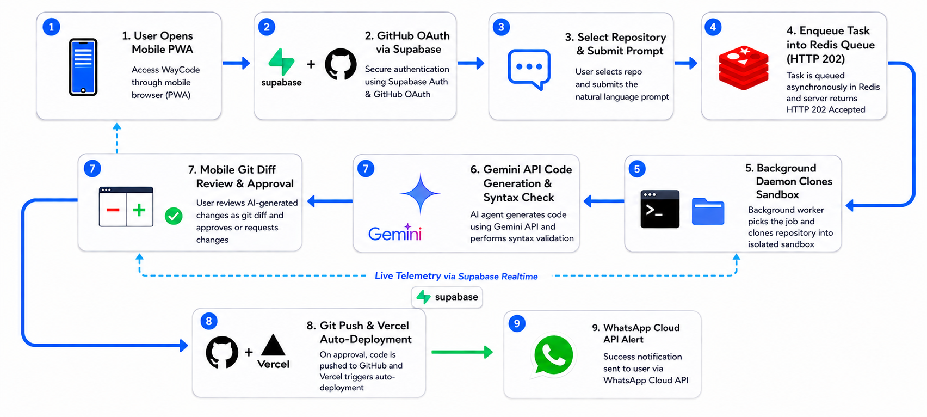
Methodology / System Design

Slide 10
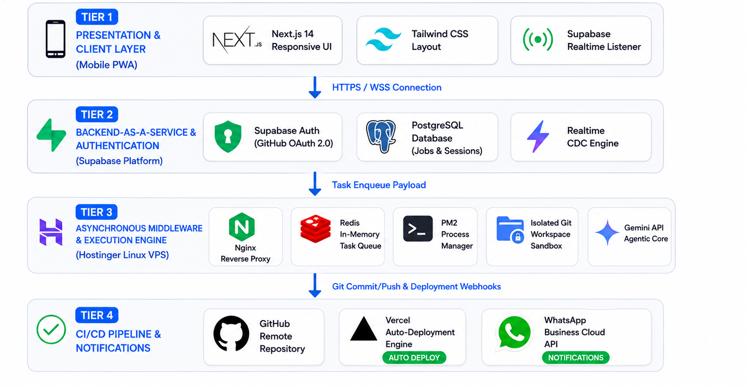
Methodology/ System Design(cont.)

Slide 11
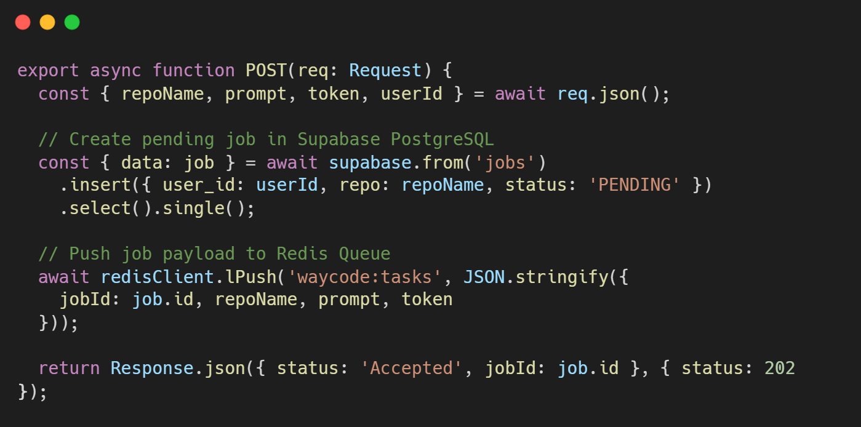
Implementation / Modules
Repository Link: WayCode
Major Modules:
Authentication Module: Handles Supabase GitHub OAuth 2.0 and manages repository write scopes.
Queue Manager: Redis-backed worker managing asynchronous task ingestion and state transitions.
Agent Sandbox Daemon: Clones repositories, runs the Gemini API toolset, and verifies syntax locally.
Deployment & Notification Pipeline: Pushes commits to GitHub, triggers Vercel deployments, and fires WhatsApp API alerts.
Technologies Used: Next.js, Supabase, Redis, Gemini API, Hostinger VPS, PM2, Vercel, WhatsApp Cloud API.
Key Code Snippet (Queue Ingestion & Status Tracking):

Slide 12
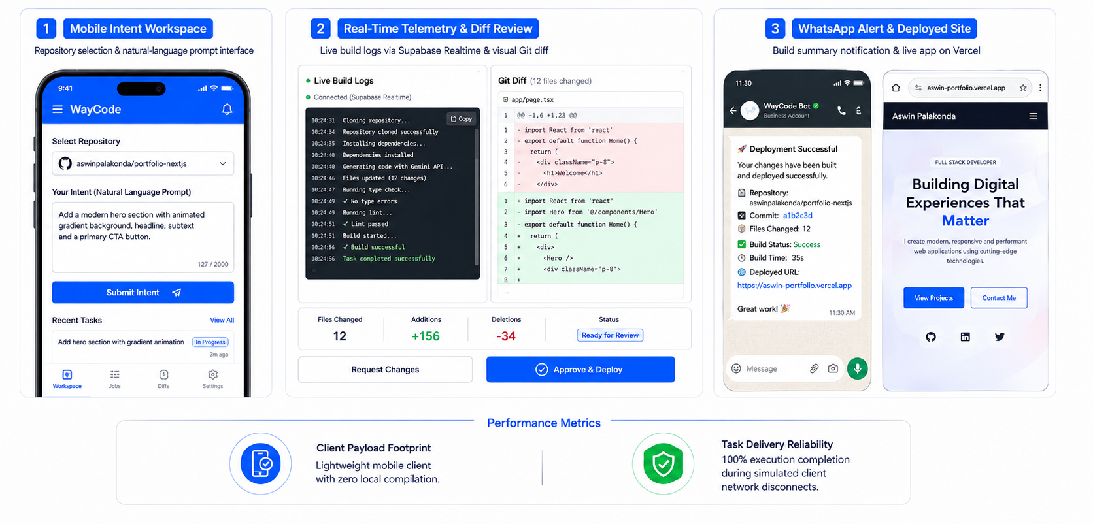
Results (Full) / Screenshots

Slide 13
Impact Assessment
Technical Impact | Social & Developer Impact | Economic Impact
Offloads 100% of code parsing, execution, and syntax verification from mobile devices to cloud infrastructure. | Removes interface fatigue by eliminating dense code editors from small smartphone displays. | Reduces incident response times for critical bugs from hours to minutes.
Ensures reliable background execution during cellular network handovers via Redis queue buffering. | Allows developers to trigger, review, and deploy production hotfixes during transit. | Lowers infrastructure costs by running lightweight headless servers instead of continuous virtual desktop instances.

Slide 14
Challenges Faced
Technical Challenge | Root Cause | Engineering Resolution
Mobile Session Drops | Cellular network handovers terminate long-running synchronous connections. | Implemented an asynchronous Redis queue on the VPS to isolate task execution from client network states.
OAuth Scope Limits | Default Supabase OAuth requests basic read-only access. | Explicitly added the repo scope to the Supabase GitHub OAuth flow to enable repository commit access.
Multi-File Edit Accuracy | Unstructured language model outputs can corrupt existing file trees. | Implemented structured tool functions for targeted line editing and local syntax verification before committing.
Telemetry Server Overhead | Custom WebSocket servers require complex socket tracking and proxy configs. | Integrated Supabase Realtime using Postgres Change Data Capture (CDC) to stream logs directly to the client.

Slide 15
Conclusion
Objectives Achieved: Successfully developed a functional, decoupled mobile gateway that automates multi-file software modifications from smartphones.
Core Finding: Asynchronous decoupling of intent submission from server execution resolves the usability and reliability constraints of mobile development.
System Value: Enables engineers to trigger, supervise, and deploy hotfixes without requiring a desktop workstation.
Overall Contribution: Bridges the gap between stationary automated coding frameworks and mobile developer workflows through persistent cloud orchestration.

Slide 16
Future Work
Voice Intent Integration: Integrate speech-to-text models to support voice-driven feature prompting on mobile devices.
Parallel Multi-Repo Processing: Expand the Redis worker architecture to support concurrent task processing across multiple repositories.
Automated PR & Testing Pipelines: Add support for automated pull request summaries, code review checks, and multi-branch testing suites.

Slide 17
References
J. Yang, C. E. Jimenez, A. Wettig, et al., "SWE-agent: Agent-Computer Interfaces Enable Automated Software Engineering," NeurIPS, 2024.
C. E. Jimenez, J. Yang, A. Wettig, et al., "SWE-bench: Can Language Models Resolve Real-World GitHub Issues?," ICLR, 2024.
S. Hong, M. Zhuge, J. Chen, et al., "MetaGPT: Meta Programming for A Multi-Agent Collaborative Framework," ICLR, 2024.
C. Qian, W. Liu, H. Liu, et al., "ChatDev: Communicative Agents for Software Development," ACL, pp. 835–848, 2024.
P. Bhoopchand, et al., "SERA: Soft-Verified Efficient Repository Agents," arXiv preprint arXiv:2403.04781, 2024.

Slide 18
Any Queries/ Questions?

