Slide 1



NAAN MUDHALVAN PROJECT
PROJECT TITLE : BOOK-STORE USING MERN
TEAM I’D : ITG04
TEAM MEMBERS : ASWITHA B (au211521205020)
DEEPA A (au211521205030)
HARSHITHA G (au211521205052)
DHARSHIKA T (au211521205033)

Slide 2







ABSTRACT
This bookstore website, powered by the MERN stack (MongoDB, Express, React, Node.js), represents a cutting-edge platform that combines speed, scalability, and dynamic user interaction. With real-time search functionality, personalized book recommendations, and a streamlined checkout process, the website offers a unique, tailored experience for book enthusiasts. The use of MongoDB allows for efficient data storage of large book inventories, while React ensures an intuitive, responsive user interface. This modern technology stack positions the website to not only meet current user needs but also adapt to future growth and evolving trends in the online book market.

Slide 3
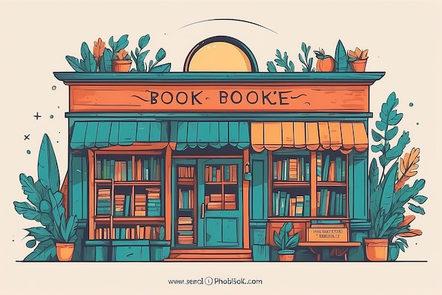
INTRODUCTION
Harnessing the power of the MERN stack, this bookstore website revolutionizes the way users explore and buy books online.
The seamless integration of MongoDB, Express, React, and Node.js provides lightning-fast performance, real-time updates, and smooth navigation, creating an enhanced user experience.
1
2
With a focus on personalization, the platform tailors book recommendations and content to individual users, making it more than just an e-commerce site.
By leveraging the flexibility and efficiency of the MERN stack, this bookstore website sets a new standard for innovation, ensuring scalability and long-term sustainability in the digital book retail space.
3
4

Slide 4


PRE-REQUISTITES
&PROPOSED SYSTEM
1. DEVELOPMENT ENVIRONMENT:
Node.js & npm: Installed to manage packages and run the backend (download from Node.js website).
MongoDB: Install MongoDB locally or use MongoDB Atlas for cloud-hosted solutions.
Code Editor: Recommended: Visual Studio Code (with extensions for linting, React, and MongoDB).
Version Control: Git for source code management (GitHub for project hosting).
Browser: Modern browser like Google Chrome (for React DevTools and testing).
2. LIBRARIES & TOOLS:
React: Install via npx create-react-app.
Express & Node.js: Install via npm (npm install express).
Mongoose: For MongoDB object modeling (npm install mongoose).
Axios/Fetch: For making HTTP requests from the frontend (npm install axios).
JWT (jsonwebtoken): For authentication (npm install jsonwebtoken).
Stripe/PayPal SDK: For payment integration.

Slide 5
ZZZ
Bookstore Website Architecture
1. Frontend (React)
React.js: Dynamic, interactive UI.
Components: Reusable UI elements (Book List, Search, Cart).
Routing: Client-side navigation with React Router.
State Management: Redux or Context API for handling state (cart, user data).
Frontend: Hosted on Netlify/Vercel.
2. Backend (Node.js & Express)
Node.js: JavaScript runtime for server-side execution.
Express.js: Backend framework for API routes (RESTful APIs: GET /books, POST /checkout).
Business Logic: Handles user authentication, book searches, and order processing.
Backend: Node.js/Express deployed on Heroku/AWS.
3. Database (MongoDB)
NoSQL Database: Flexible data storage for books, users, and orders.
Collections:
Books: Title, author, genre, price, stock.
Users: Profiles, login data (JWT).
Orders: Transaction and shipping details.
4. Authentication & Security
JWT (JSON Web Token): For secure user login and session management.
OAuth: Third-party login options (Google, Facebook).
5. Payment Integration
Stripe/PayPal: Secure payment gateway for handling transactions.

Slide 6


PROJECT STRUCTURE
Frontend (/client)
/src:
/components: Reusable UI components (Navbar,
BookList, Cart)
pages: Main pages (Home, Book Details, Checkout)
/context: State management (Redux or Context API)
/services: API calls (Fetching books, placing orders)
/utils: Helper functions (Formatting, filtering)
Backend (/server)
/routes: API routes (Books, Users, Orders)
/models: Database schemas (Book, User, Order Models using Mongoose)
/controllers: Business logic (CRUD operations)
/middleware: Authentication (JWT verification), Error handling
/config: MongoDB connection, API keys
Root Directory
/client – Frontend (React)
/server – Backend (Node.js/Express)
/config – Configuration files (Environment variables, API keys)
/public – Public assets (Images, Icons)

Slide 7
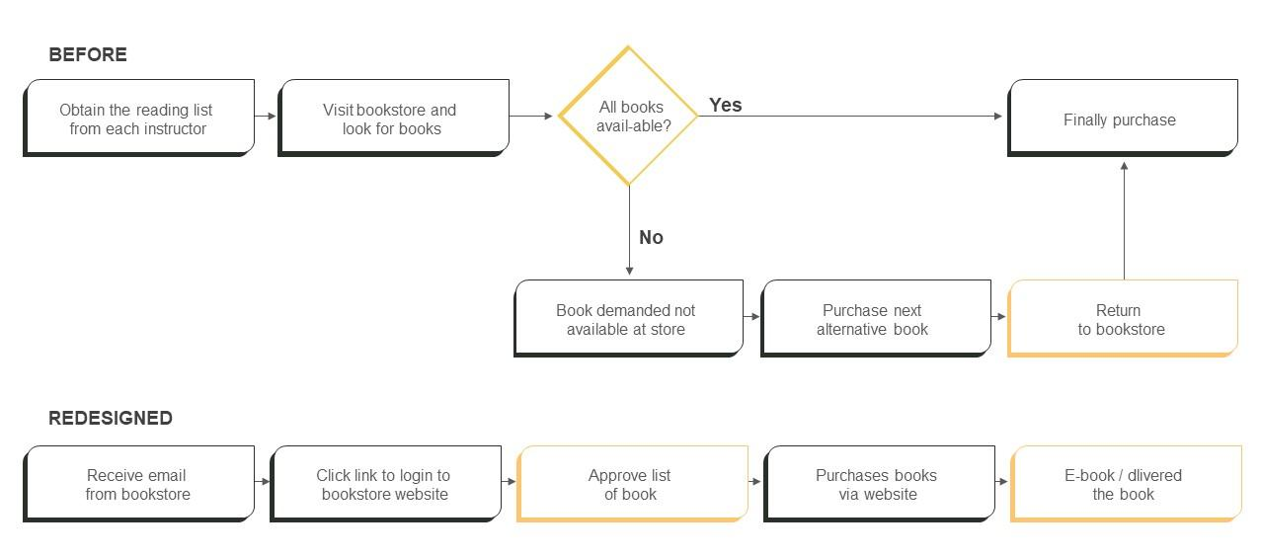
FLOW CHART

Slide 8

VIEW OUR WEBSITE
CLICK HERE FOR EPIC TALES

Slide 9
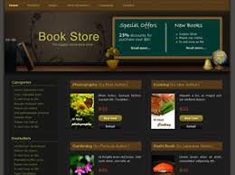

CONCLUSION:
The bookstore website has been crafted to provide an engaging, efficient, and user-friendly platform for book enthusiasts. By combining a broad selection of titles, intuitive search features, and a secure checkout process, it ensures a seamless experience from browsing to purchase. With its responsive design, the website caters to users across all devices, enhancing accessibility and convenience. By prioritizing personalized recommendations and a diverse collection, it aspires to be the go-to destination for readers of all kinds. This platform not only simplifies the process of buying books but also fosters a love for reading, making it a valuable resource for book lovers in the digital age.
-------------------
--------------------

Slide 10
THANK YOU!!!
----------------------------
---------------------------

