Slide 1
UI LIVE CHAT
Make from :
Asya Dikova-Kirova (AsyaDikova)
Veselin Milyovski (dhtveso)
Vladimir Valchev (VladimirV92)
Ilian Ganchosov (Plotso)

Slide 2
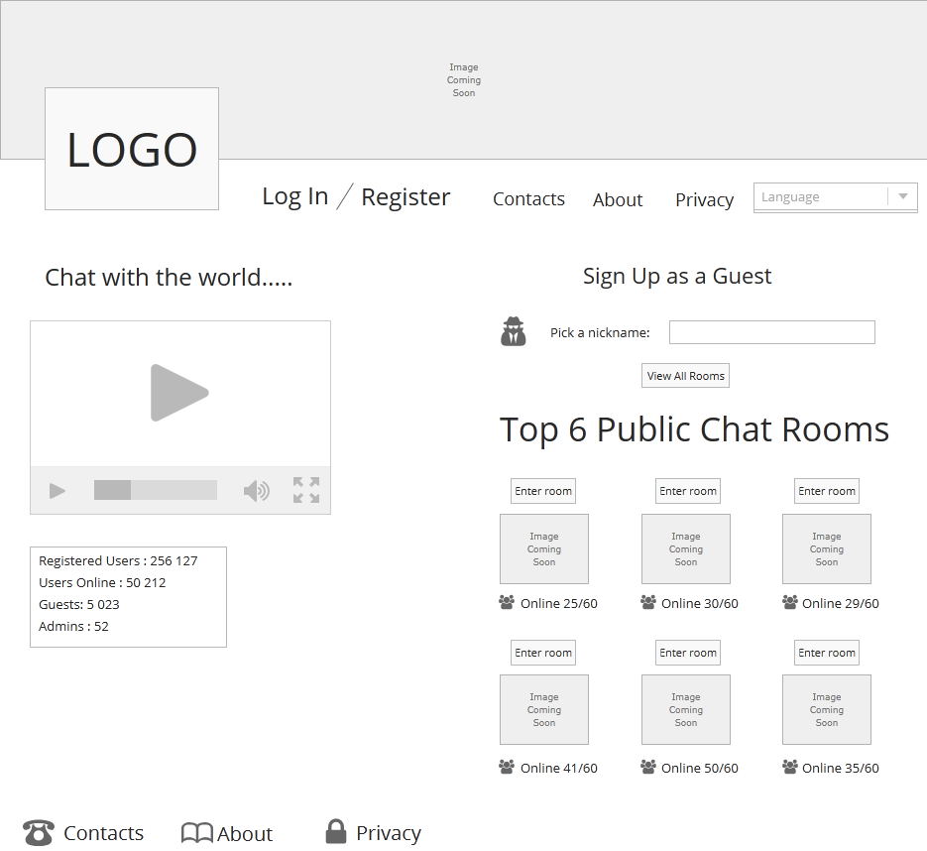
Home Page

Slide 3
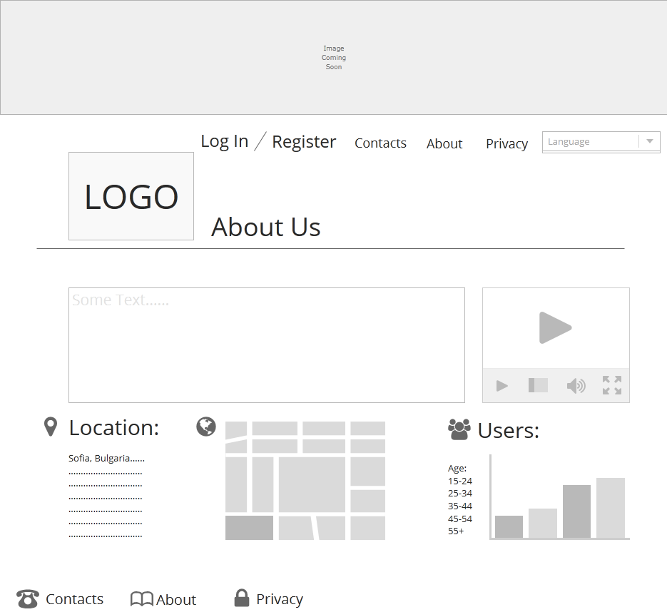
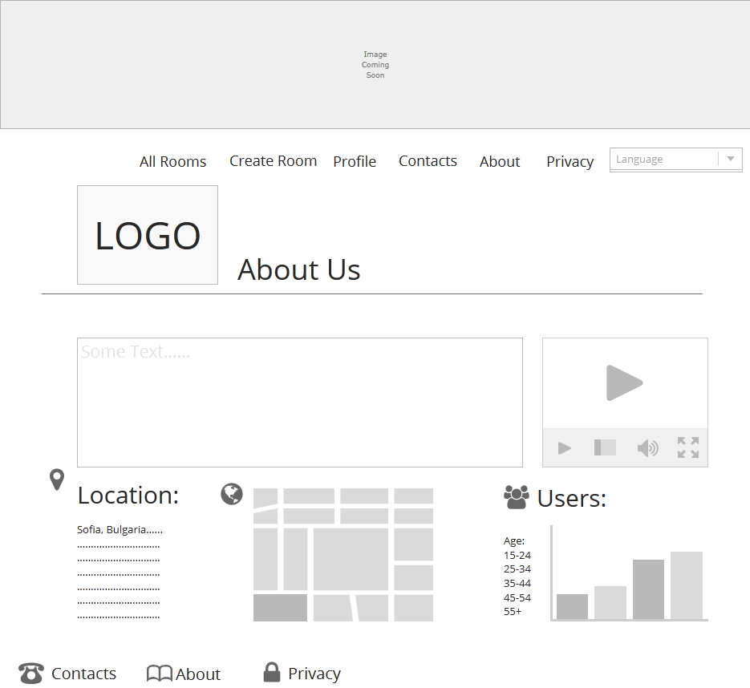
About US Page
For guest
For user

Slide 4
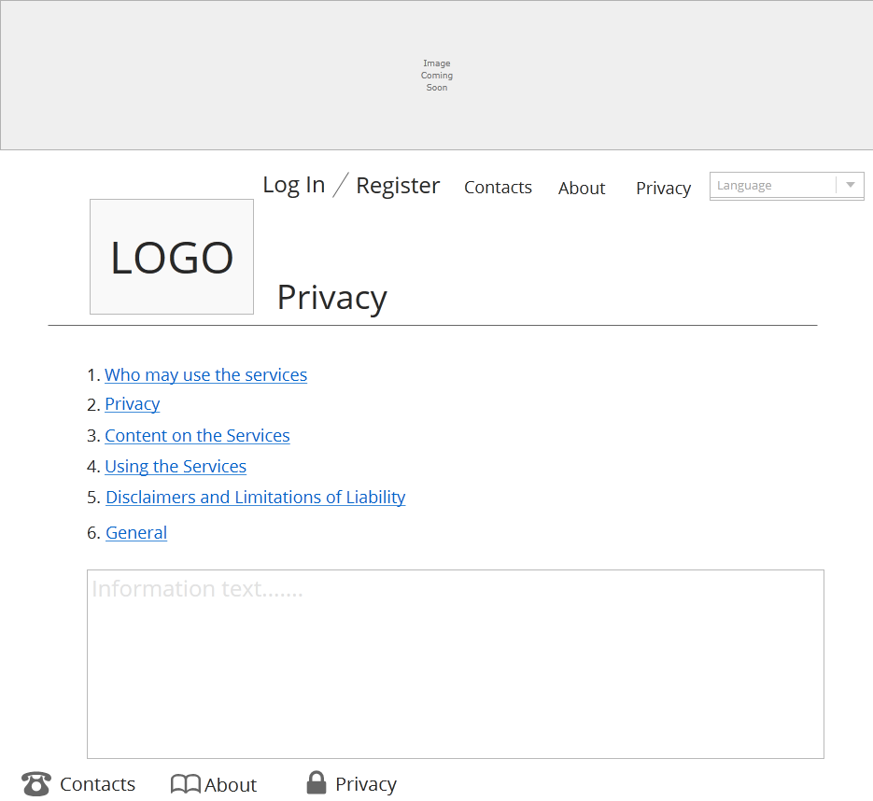
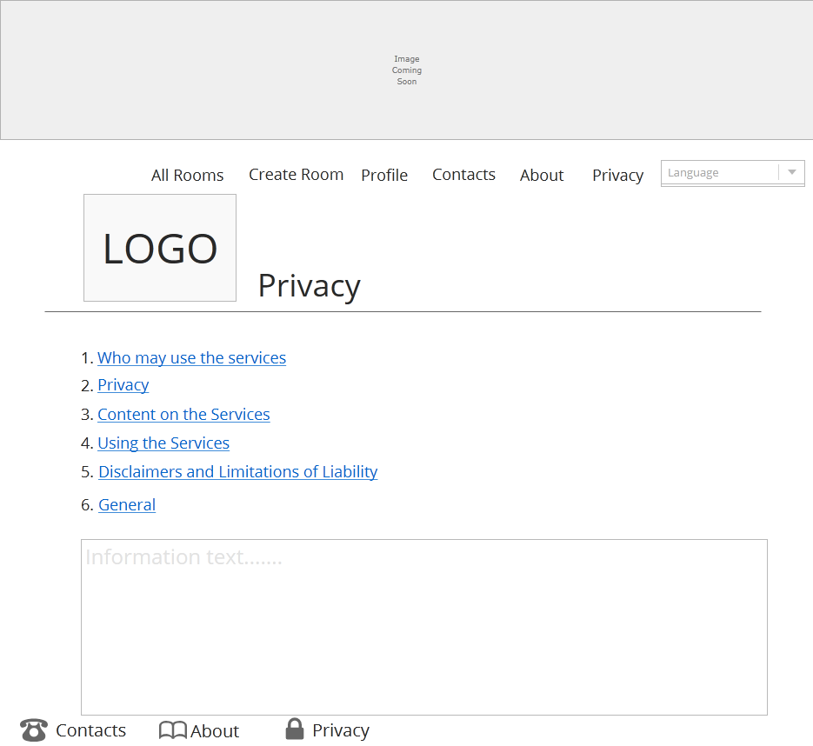
PRIVACY Page
For guest
For LOGGED user

Slide 5
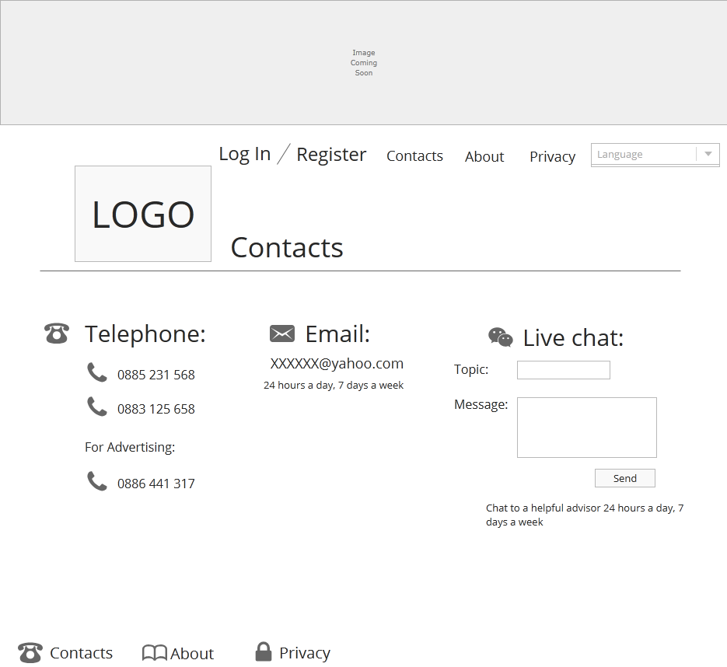
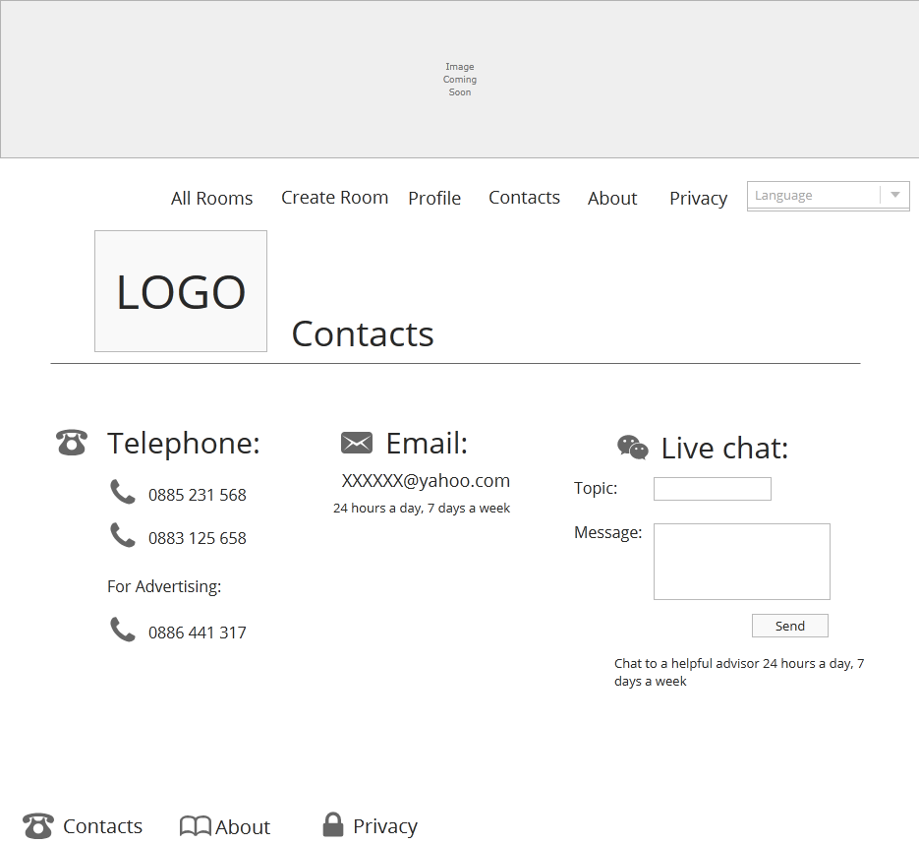
CONTACT Page
For guest
For LOGGED user

Slide 6
Register/login Page
register
login

Slide 7
USER PROFILE Page
For LOGGED user
User profile Page
Logout

Slide 8
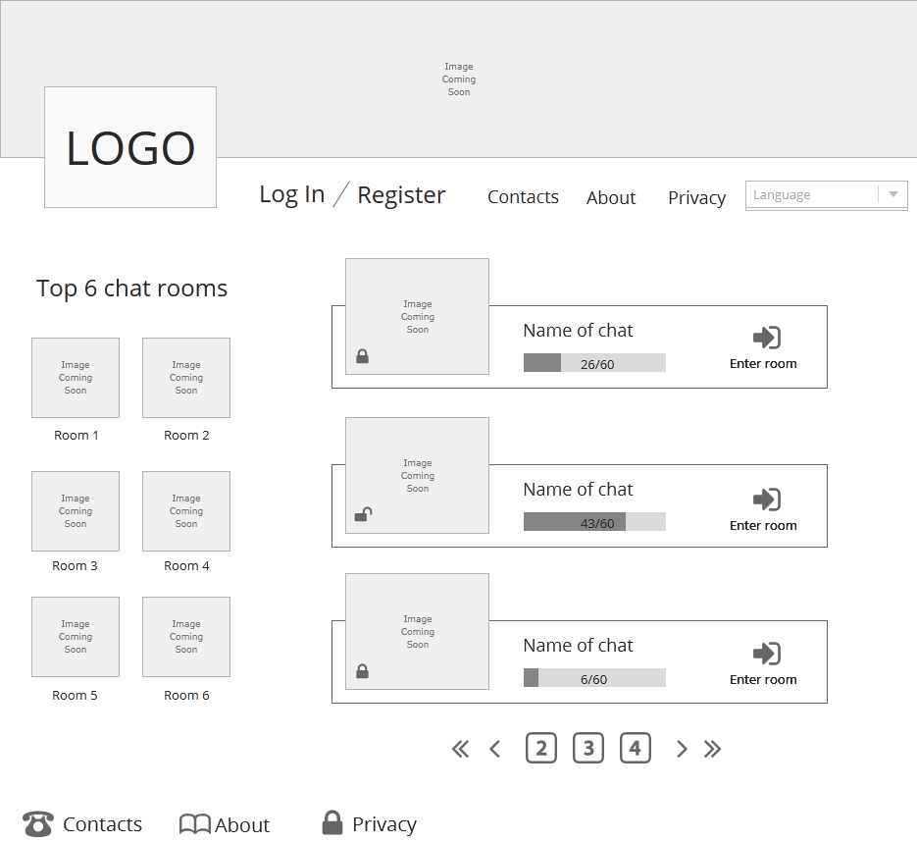
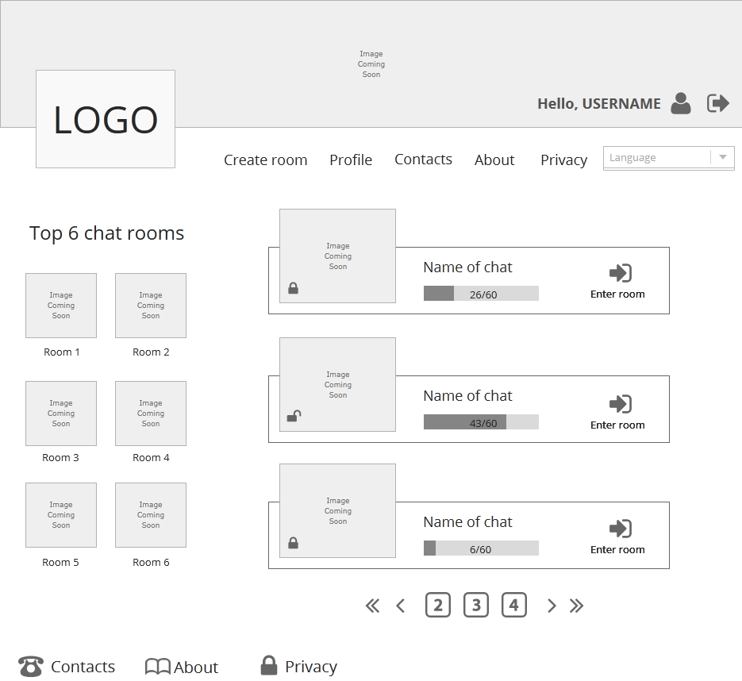
All Chat room Page
For guest
For LOGGED user

Slide 9
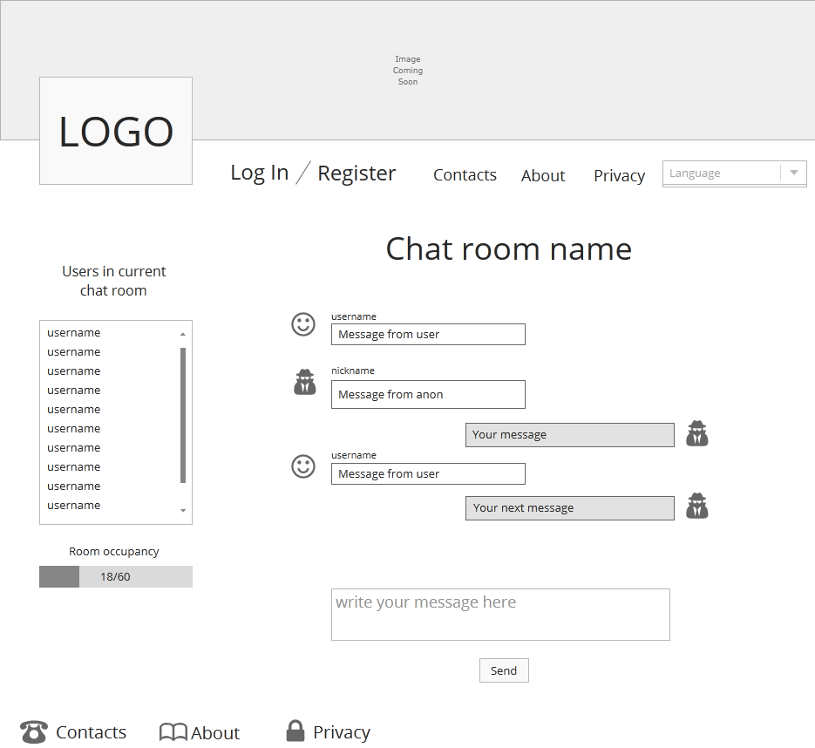
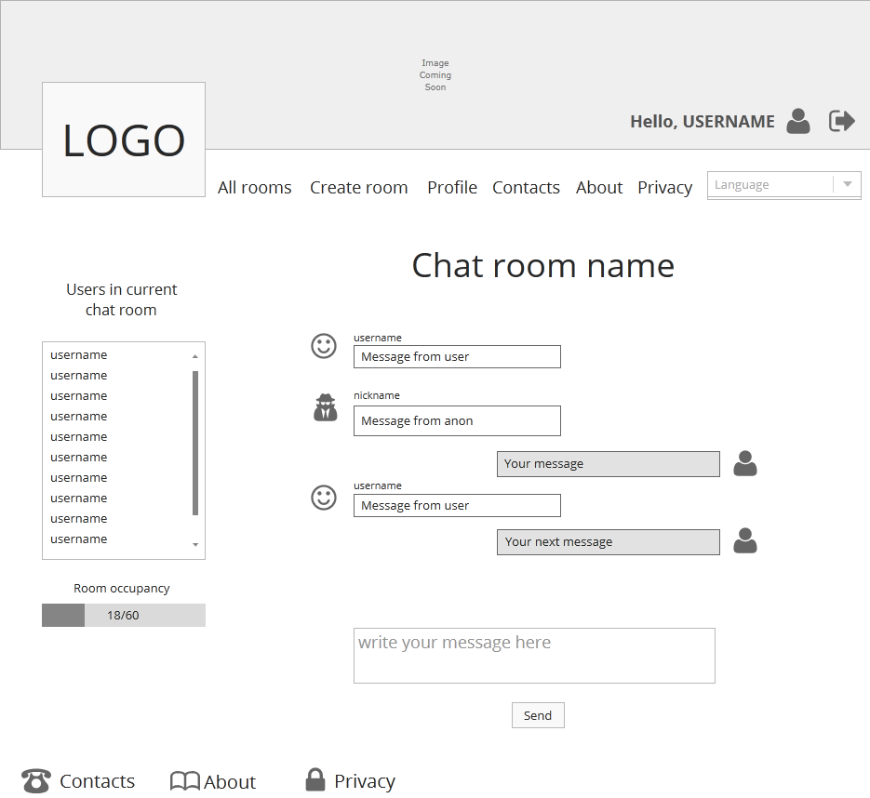
CHAT room Page
For guest
For LOGGED user

Slide 10
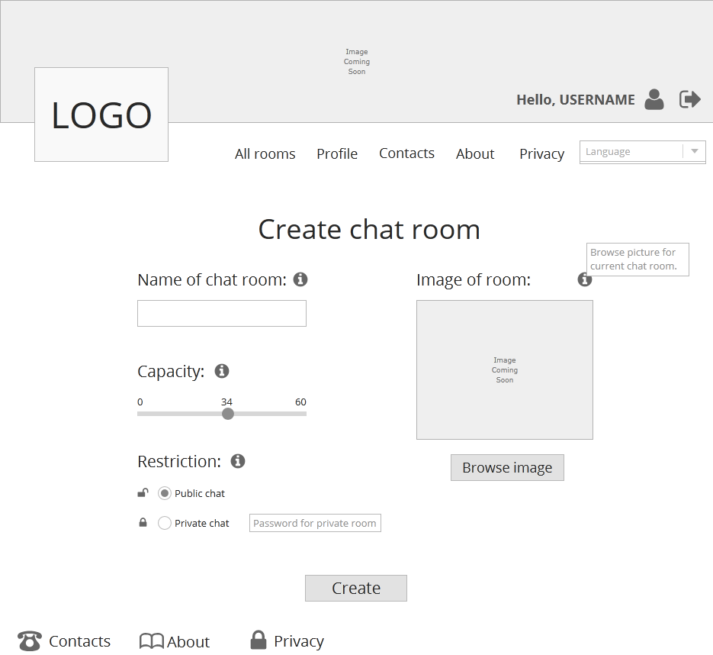
Create chat room Page
For LOGGED user
InfoRMATION

Slide 11
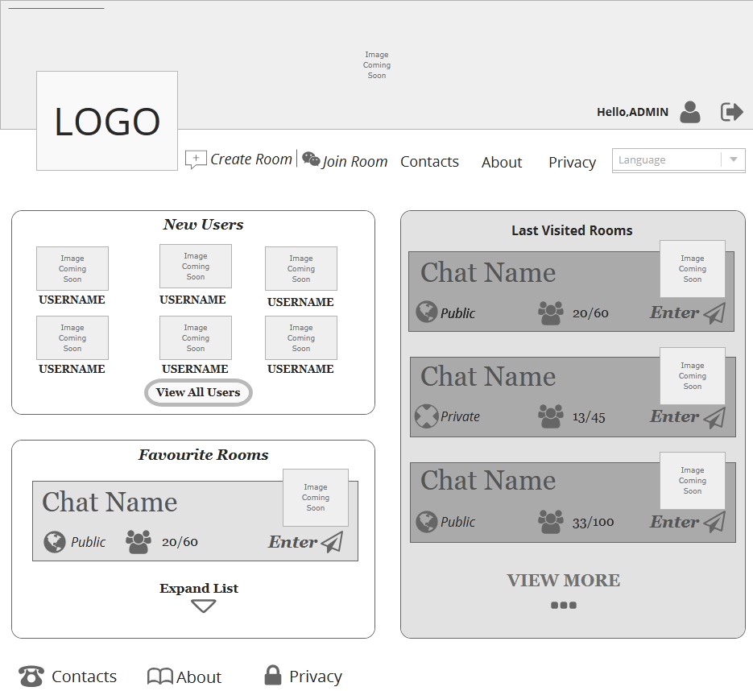
Admin home Page
Just for administrator

Slide 12
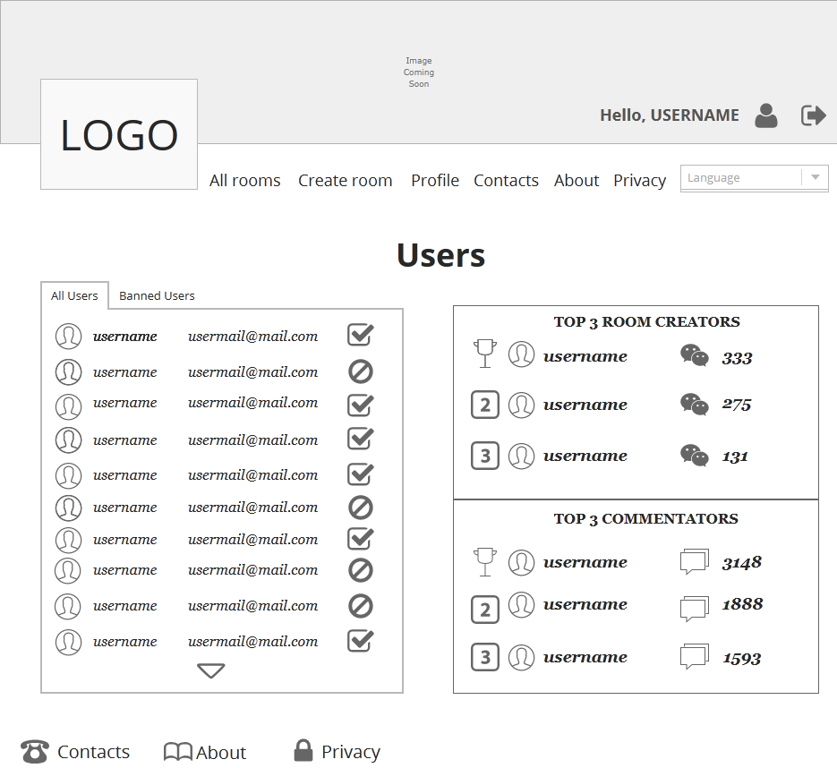
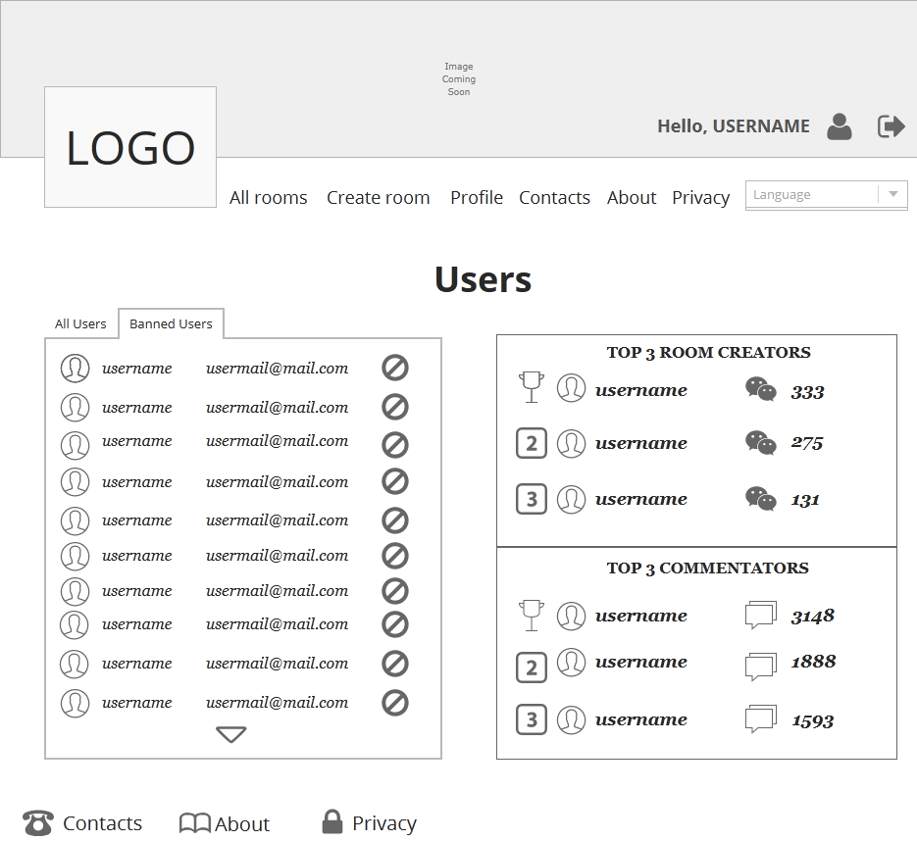
Admin USERs Page
all users
Banned users

Slide 13
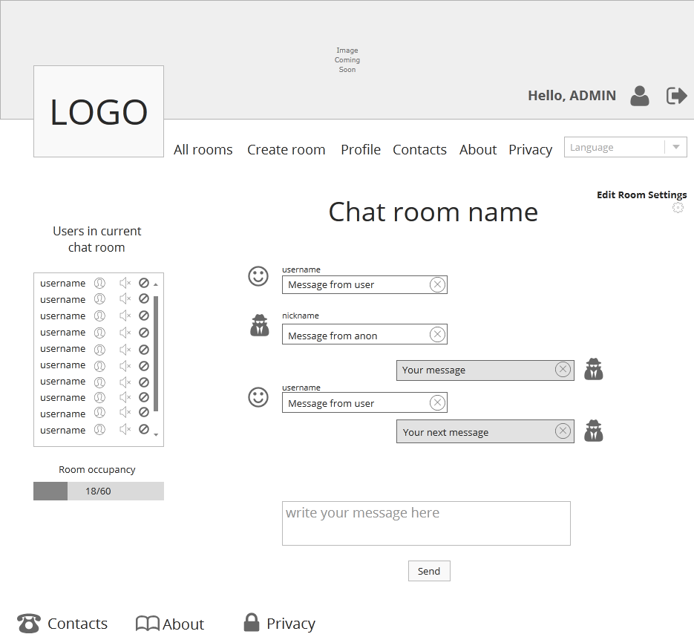
Admin chat room Page
Just for administrator

Slide 14
conclusion
THANKS for your attention

