Slide 1












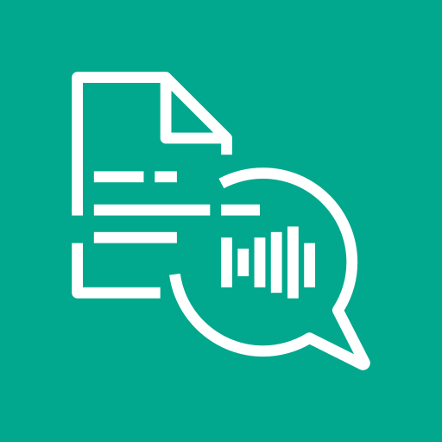

CallDine
Complete architecture and workflow map
Workflow arrows show processing order. FastAPI coordinates AWS calls, tool execution and data access.
SQLModel repositories
Customer + admin
Next.js frontend + API
FastAPI API routes
Application services
Controlled database reads and writes
SQLite operational data
Chat, voice, orders, menu, bookings
Session cookie forwarded as bearer token
Authentication and request validation
Chat, voice, knowledge, menu, orders, reservations
Users, messages, orders, stock, tables, jobs, voice settings
A. Restaurant knowledge ingestion
D. Complete voice conversation
Chime SDK
FastAPI Knowledge Service + in-process BackgroundTasks
Chime setup: FastAPI creates meeting + attendee; browser joins Chime directly
1. Admin uploads PDF
2. Amazon S3 stores PDF
3. Amazon Textract extracts text
1. Customer microphone
2. Upload + Transcribe
3. Transcript to Chat Service
4. Bedrock + backend tools
Next.js forwards the PDF to FastAPI
knowledge/ + SQLite processing job
FastAPI starts, polls and fetches all pages
PCM turn captured after silence
FastAPI calls Transcribe Streaming
Browser posts transcript to FastAPI
History, tool selection, execution
6. Store embeddings in Qdrant
5. Amazon Titan Text Embeddings V2
4. Text chunking in FastAPI
7. Browser playback
6. Polly neural speech
5. Return cleaned answer
Vectors + text + document metadata; cosine distance
Normalized, 1,024-D text embeddings
1,000-character chunks, no overlap
Play MP3, then resume listening
FastAPI requests neural MP3 audio
Remove formatting and internal IDs
B. Knowledge search and RAG
Turn-based audio. Chime media is separate from the Transcribe input path.
search-knowledge executes in FastAPI; the model never queries Qdrant directly
E. Recordings and file storage
Question
Query embedding
Vector search
Tool result
Grounded answer
Browser audio mixer
WebM recording
Bedrock requests knowledge search
Amazon Titan Embeddings V2
FastAPI returns top four text chunks
FastAPI returns retrieved text
Answer using restaurant source text
Microphone + assistant playback
MediaRecorder completes the call
FastAPI → Amazon S3
Save WebM; keep key in SQLite
S3 prefixes: knowledge/ for PDFs, images/menu/ for menu images, audios/calls/ for recordings.
C. Bedrock GPT-OSS 20B and business tools
F. Planned SageMaker forecasting
Memory → Converse → tool selection → FastAPI execution → results → answer (up to 4 tool rounds)
Historical category demand → S3 dataset → DeepAR training/inference → backend rules → admin
search-knowledge
Restaurant facts through RAG
search-menu
Current dishes, prices and stock
check-order-items
Quantities, stock and subtotal
create-order-draft
Draft after address approval
confirm-order
Recheck stock, confirm, reduce stock
check-table-availability
Capacity and two-hour overlaps
Order history + S3
SageMaker DeepAR
FastAPI + admin dashboard
create-reservation-draft
Save unconfirmed booking details
confirm-reservation
Recheck, assign table and confirm
Daily category time series
Train and forecast seven days
Forecasts and recommendations
Amazon Bedrock Guardrails (optional chat policy)
PLANNED: current dashboard uses static demo values. Training and inference are not connected.
Prompt-injection / jailbreak filtering; harmful-content and blocked-word policies; safe blocked response.
CloudWatch + Secrets Manager: client helpers only. MCP: separate stdio prototype with a fixed demo user. AWS hosting and live operation: unverified.
Notes:
The full map covers application runtime, operational persistence, PDF ingestion, Titan text embeddings, Qdrant storage and retrieval, Bedrock tool execution, the eight business tools, the complete voice loop, Chime session setup, recordings and S3 prefixes, and planned SageMaker forecasting. Workflow arrows show logical stages; backend services coordinate calls. Bedrock never connects directly to SQLite or Qdrant. Qdrant runs in Docker. Optional Guardrails attach to chat requests; policy configuration was not verified. Order and booking approval relies on model-supplied flags and backend business validation; concurrency and idempotency guarantees are not established. Knowledge processing is in-process rather than an external queue. Native token streaming applies only to some answer paths. Voice playback is turn-based. The separate MCP adapter is not part of the main chat path.
Source: CallDine repository scanned 12 September 2026. AWS icons: https://aws.amazon.com/architecture/icons/ . AWS logo: https://a0.awsstatic.com/libra-css/images/logos/aws_logo_smile_1200x630.png . Next.js logo: https://assets.vercel.com/image/upload/v1662130559/nextjs/Icon_light_background.png . FastAPI icon: https://github.com/fastapi/fastapi/blob/master/docs/en/docs/img/icon-white.svg . CallDine logo: Frontend/components/ui/Logo.tsx. Brand colors: Frontend/app/globals.css. Guardrails policy documentation: https://docs.aws.amazon.com/bedrock/latest/userguide/guardrails-components.html and https://docs.aws.amazon.com/bedrock/latest/userguide/guardrails-prompt-attack.html . Policies are configuration-dependent and not verified as enabled in this AWS account. SQLite logo: https://sqlite.org/images/sqlite370_banner.gif . Qdrant logo: https://github.com/qdrant/qdrant/blob/master/docs/logo.svg . Docker logo: https://www.docker.com/company/newsroom/media-resources/ .

