Slide 1





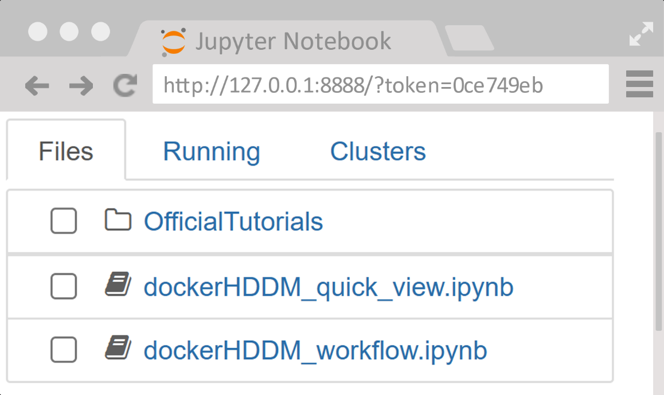


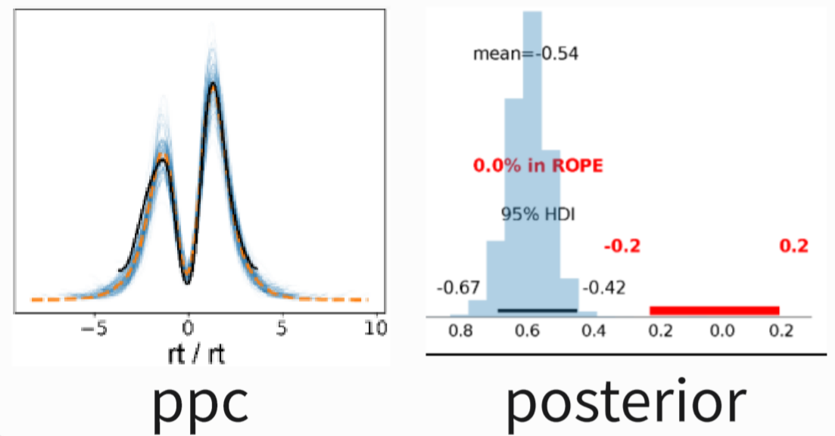
1. Install docker
1.1 To download and install docker, visit the official Docker website (https://docs.docker.com/get-docker/)
1.2 To test the docker installation by command line: docker run hello-world
Note: the windows user should configure WSL (Windows Subsystem for Linux)(https://docs.docker.com/desktop/wsl/)
2. Pull and run dockerHDDM
2.1 Open terminal & Run command line
2.2 Open URL &Enter jupyter
Terminal
user@DESKTOP:/$ docker pull hcp4715/dockerHDDM
user@DESKTOP:/$ docker run -p 8888:8888 -it --rm hcp4715/dockerHDDM jupyter notebook
[C 06:50:52.342 NotebookApp]
To access the notebook, open this file in a browser:
file:///home/jovyan/.local/share/jupyter/runtime/nbserver-7-open.html
Or copy and paste one of these URLs:
http://92ea06ad8c6d:8888/?token=0ce749eb
or http://127.0.0.1:8888/?token=0ce749eb
3. HDDM analysis workflow
Define models
3.1 Define models
data
In [1]:
m1=hddm.HDDM(data)
m1
m1
· · ·
mn
3.2 Fitting model
In [2]:
infdata1=m1.sample(500,chains=4)
sampling
3.3 Diagnosis
In [3]:
az.summay(infdata1)
az.plot_trace(infdata1)
infdata1
infdata2
infdatan
3.4 Comparison
diagnosis
comparison
In [4]:
models={"m1":infdata1, "m2":infdata2}
az.compare(models)
infdata?
winning model
3.5 Evaluation
evaluation
inference
In [5]:
az.plot_ppc(infdata1,...)
3.6 Inference
In [6]:
az.plot_posterior(infdata1)

