Slide 1
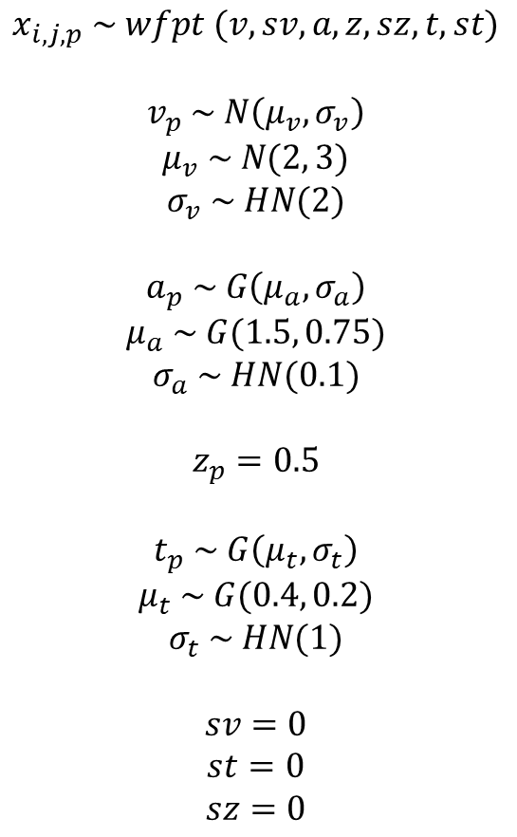
M0: HDDM(data)
$$x_{i,j,p} \sim wfpt (v, sv, a, z, sz,t, st)$$
$$v_{p} \sim N\left(μ_{v}, σ_{v}\right)$$
$$μ_{v} \sim N(2, 3)$$
$$σ_{v} \sim HN(2)$$
$$a_{p} \sim G\left(μ_{a}, σ_{a}\right)$$
$$μ_{a} \sim G(1.5, 0.75)$$
$$σ_{a} \sim HN(0.1)$$
$$z_{p}=0.5$$
$$t_{p} \sim G\left(μ_{t}, σ_{t}\right)$$
$$μ_{t} \sim G(0.4, 0.2)$$
$$σ_{t} \sim HN(1)$$
$$sv=0$$
$$st=0$$
$$sz=0$$

Slide 2
















M0: HDDM(data)
$$μ_{v}$$
$$σ_{v}$$
$$μ_{a}$$
$$σ_{a}$$
$$z=0$$
$$μ_{t}$$
$$σ_{t}$$
$$v_{p}$$
$$a_{p}$$
$$t_{p}$$
$$sv=0$$
$$st=0$$
$$x_{i,p}$$
$$i=1, …, N_{p}$$
$$p=1, …, P$$
$$sz=0$$
Notes:
hddm.HDDM(data)

Slide 3
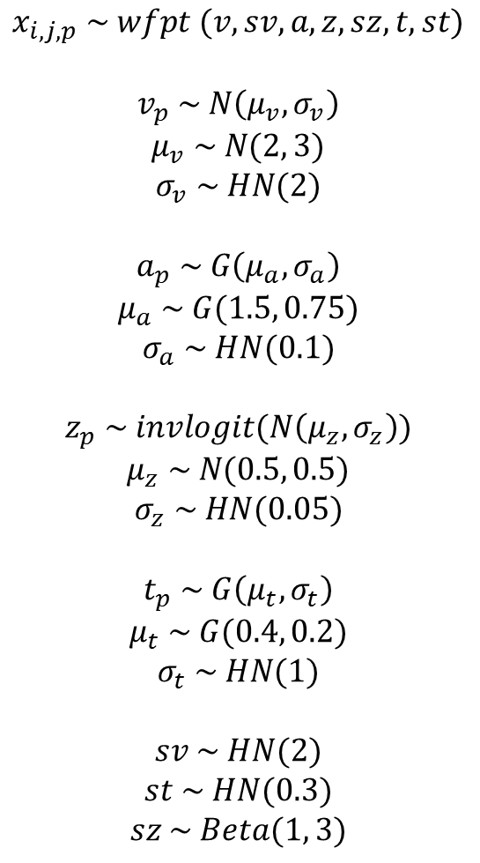
M1: HDDM(data, include=[‘z’, ‘sv’, ‘sz’, ‘st’])
$$x_{i,j,p} \sim wfpt (v, sv, a, z, sz,t, st)$$
$$v_{p} \sim N\left(μ_{v}, σ_{v}\right)$$
$$μ_{v} \sim N(2, 3)$$
$$σ_{v} \sim HN(2)$$
$$a_{p} \sim G\left(μ_{a}, σ_{a}\right)$$
$$μ_{a} \sim G(1.5, 0.75)$$
$$σ_{a} \sim HN(0.1)$$
$$z_{p} \sim invlogit(N\left(μ_{z}, σ_{z}\right))$$
$$μ_{z} \sim N(0.5, 0.5)$$
$$σ_{z} \sim HN(0.05)$$
$$t_{p} \sim G\left(μ_{t}, σ_{t}\right)$$
$$μ_{t} \sim G(0.4, 0.2)$$
$$σ_{t} \sim HN(1)$$
$$sv \sim HN(2)$$
$$st \sim HN(0.3)$$
$$sz \sim Beta(1, 3)$$

Slide 4






M1: HDDM(data, include=[‘z’, ‘sv’, ‘sz’, ‘st’])
$$μ_{v}$$
$$σ_{v}$$
$$μ_{a}$$
$$σ_{a}$$
$$μ_{z}$$
$$σ_{z}$$
$$μ_{t}$$
$$σ_{t}$$
$$v_{p}$$
$$a_{p}$$
$$z_{p}$$
$$t_{p}$$
$$sv$$
$$st$$
$$x_{i,p}$$
$$i=1, …, N_{p}$$
$$sz$$
$$p=1, …, P$$

Slide 5
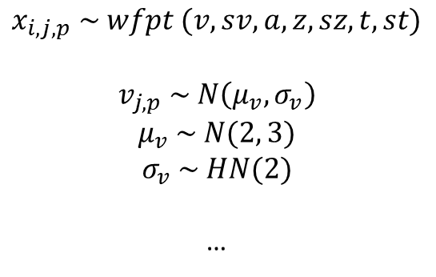
M2: HDDM(data, depends_on = {“v”: “conf”} , include=[‘z’, ‘sv’, ‘sz’, ‘st’])
$$x_{i,j,p} \sim wfpt (v, sv, a, z, sz,t, st)$$
$$v_{j,p} \sim N\left(μ_{v}, σ_{v}\right)$$
$$μ_{v} \sim N(2, 3)$$
$$σ_{v} \sim HN(2)$$
…

Slide 6











M2: HDDM(data, depends_on = {“v”: “conf”} , include=[‘z’, ‘sv’, ‘sz’, ‘st’])
$$μ_{v}$$
$$σ_{v}$$
$$μ_{a}$$
$$σ_{a}$$
$$μ_{z}$$
$$σ_{z}$$
$$μ_{t}$$
$$σ_{t}$$
$$a_{p}$$
$$z_{p}$$
$$t_{p}$$
$$sv$$
$$v_{j,p}$$
$$st$$
$$x_{i,j,p}$$
$$j=1, …, C_{j}$$
$$i=1, …, N_{j,p}$$
$$sz$$
$$p=1, …, P$$

Slide 7
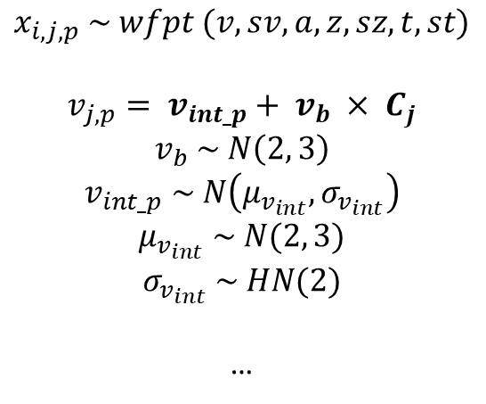
M3: HDDMRegressor(data, “v ~ C(conf, Treatment(‘LC’))”,
group_only_regressors=True,
keep_regressor_trace=True,
include=[‘z’, ‘sv’, ‘sz’, ‘st’])
$$x_{i,j,p} \sim wfpt (v, sv, a, z, sz,t, st)$$
$$v_{j,p}= v_{int_p}+ v_{b} × C_{j}$$
$$v_{b} \sim N\left(2, 3\right)$$
$$v_{int_p} \sim N\left(μ_{v_{int}}, σ_{v_{int}}\right)$$
$$μ_{v_{int}} \sim N(2, 3)$$
$$σ_{v_{int}} \sim HN(2)$$
…
Design matrix of “v ~ C(conf, Treatment(‘LC’))”:

Slide 8

















M3: HDDMRegressor(data, “v ~ C(conf, Treatment(‘LC’))”, group_only_regressors=True, include=[‘z’, ‘sv’, ‘sz’, ‘st’])
$$σ_{v}$$
$$μ_{v_int}$$
$$σ_{v_int}$$
$$μ_{a}$$
$$σ_{a}$$
$$μ_{z}$$
$$σ_{z}$$
$$μ_{t}$$
$$σ_{t}$$
$$z_{p}$$
$$v_{int_p}$$
$$a_{p}$$
$$t_{p}$$
$$sv$$
$$st$$
$$v_{j,p}$$
$$x_{i,j,p}$$
$$i=1, …,N_{j,p}$$
$$j=1, …, C_{j}$$
$$sz$$
$$p=1, …, S_{p}$$
Notes:
hddm.HDDMRegressor(data, “v ~ C(conf, Treatment(‘LC’))”, group_only_regressors=True)

Slide 9
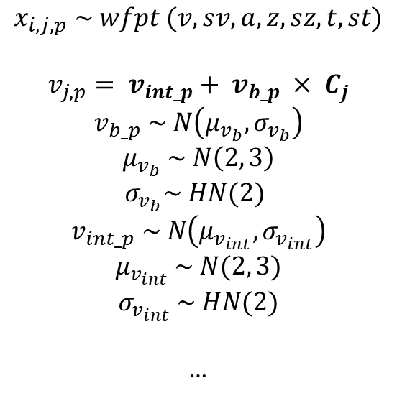
M4: HDDMRegressor(data, “v ~ C(conf, Treatment(‘LC’))”,
group_only_regressors=False,
keep_regressor_trace=True,
include=[‘z’, ‘sv’, ‘sz’, ‘st’])
$$x_{i,j,p} \sim wfpt (v, sv, a, z, sz,t, st)$$
$$v_{j,p}= v_{int_p}+ v_{b_p} × C_{j}$$
$$v_{b_p} \sim N\left(μ_{v_{b}}, σ_{v_{b}}\right)$$
$$μ_{v_{b}} \sim N\left(2, 3\right)$$
$σ_{v_{b}}\sim HN(2)$
$$v_{int_p} \sim N\left(μ_{v_{int}}, σ_{v_{int}}\right)$$
$$μ_{v_{int}} \sim N(2, 3)$$
$$σ_{v_{int}} \sim HN(2)$$
…
Design matrix of “a ~ theta:C(conf, Treatment('LC'))”:

Slide 10























$$μ_{v_b}$$
$$σ_{v_b}$$
$$μ_{v_int}$$
$$σ_{v_int}$$
$$μ_{a}$$
$$σ_{a}$$
$$μ_{z}$$
$$σ_{z}$$
$$μ_{t}$$
$$σ_{t}$$
$$v_{b_p}$$
$$v_{int_p}$$
$$a_{p}$$
$$z_{p}$$
$$t_{p}$$
$$sv$$
$$st$$
$$v_{j,p}$$
$$x_{i,j,p}$$
$$i=1, …,N_{j,p}$$
$$j=1, …, C_{j}$$
$$sz$$
$$p=1, …, S$$
Notes:
hddm.HDDMRegressor(data, “v ~ C(conf, Treatment(‘LC’))”, group_only_regressors=True)
M4: HDDMRegressor(data, “v ~ C(conf, Treatment(‘LC’))”, group_only_regressors=False, include=[‘z’, ‘sv’, ‘sz’, ‘st’])

Slide 11
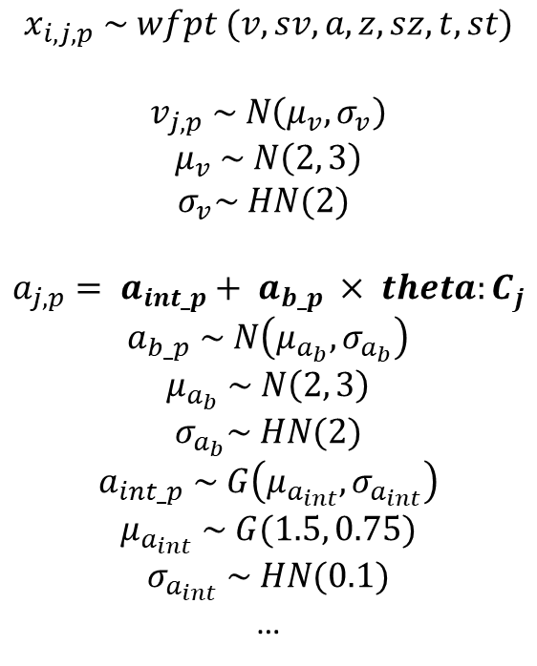
M5: HDDMRegressor(data, ["a ~ theta:C(conf, Treatment('LC'))"], depends_on=[‘v’: ‘conf’], include=[‘z’, ‘sv’, ‘sz’, ‘st’],
group_only_regressors = False)
$$x_{i,j,p} \sim wfpt (v, sv, a, z, sz,t, st)$$
$$v_{j, p} \sim N\left(μ_{v}, σ_{v}\right)$$
$$μ_{v} \sim N\left(2, 3\right)$$
$σ_{v}\sim HN(2)$
$$a_{j,p}= a_{int_p}+ a_{b_p} × {theta:C}_{j}$$
$$a_{b_p} \sim N\left(μ_{a_{b}}, σ_{a_{b}}\right)$$
$$μ_{a_{b}} \sim N\left(2, 3\right)$$
$$σ_{a_{b}}\sim HN(2)$$
$$a_{int_p} \sim G\left(μ_{a_{int}}, σ_{a_{int}}\right)$$
$$μ_{a_{int}} \sim G(1.5, 0.75)$$
$$σ_{a_{int}} \sim HN(0.1)$$
…
Design matrix of “a ~ theta:C(conf, Treatment('LC'))”:

Slide 12














M5: HDDMRegressor(data, ["a ~ theta:C(conf, Treatment('LC'))"], depends_on=[‘v’: ‘conf’], include=[‘z’, ‘sv’, ‘sz’, ‘st’],
group_only_regressors = False)
$$μ_{v}$$
$$σ_{v}$$
$$μ_{a_b}$$
$$σ_{a_b}$$
$$μ_{a_int}$$
$$σ_{a_int}$$
$$μ_{z}$$
$$σ_{z}$$
$$μ_{t}$$
$$σ_{t}$$
$$a_{b_p}$$
$$a_{int_p}$$
$$z_{p}$$
$$t_{p}$$
$$sv$$
$$v_{j,p}$$
$$a_{j,p}$$
$$st$$
$$x_{i,j,p}$$
$$j=1, …, C_{j}$$
$$i=1, …, N_{j,p}$$
$$sz$$
$$p=1, …, P$$

Slide 13
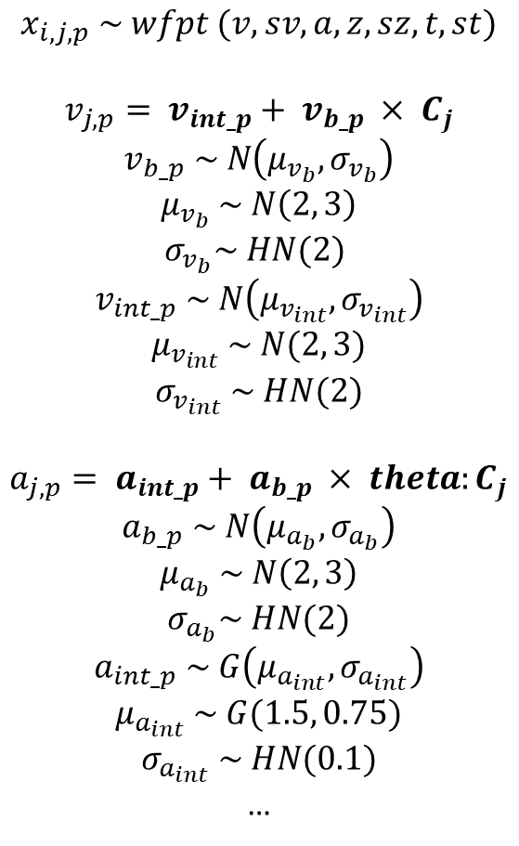
M6: HDDMRegressor(data, include=[‘z’, ‘sv’, ‘sz’, ‘st’], ["a ~ theta:C(conf, Treatment('LC'))", “v ~ C(conf, Treatment('LC'))"] ,
group_only_regressors = False)
$$x_{i,j,p} \sim wfpt (v, sv, a, z, sz,t, st)$$
$$v_{j,p}= v_{int_p}+ v_{b_p} × C_{j}$$
$$v_{b_p} \sim N\left(μ_{v_{b}}, σ_{v_{b}}\right)$$
$$μ_{v_{b}} \sim N\left(2, 3\right)$$
$σ_{v_{b}}\sim HN(2)$
$$v_{int_p} \sim N\left(μ_{v_{int}}, σ_{v_{int}}\right)$$
$$μ_{v_{int}} \sim N(2, 3)$$
$$σ_{v_{int}} \sim HN(2)$$
$$a_{j,p}= a_{int_p}+ a_{b_p} × {theta:C}_{j}$$
$$a_{b_p} \sim N\left(μ_{a_{b}}, σ_{a_{b}}\right)$$
$$μ_{a_{b}} \sim N\left(2, 3\right)$$
$$σ_{a_{b}}\sim HN(2)$$
$$a_{int_p} \sim G\left(μ_{a_{int}}, σ_{a_{int}}\right)$$
$$μ_{a_{int}} \sim G(1.5, 0.75)$$
$$σ_{a_{int}} \sim HN(0.1)$$
…
Design matrix of “v ~ C(conf, Treatment('LC’))”:
Design matrix of “a ~ theta:C(conf, Treatment('LC'))”:

Slide 14

















M6: HDDMRegressor(data, include=[‘z’, ‘sv’, ‘sz’, ‘st’], ["a ~ theta:C(conf, Treatment('LC'))", “v ~ C(conf, Treatment('LC'))"] '))"],
group_only_regressors = False)
$$μ_{v_b}$$
$$σ_{v_b}$$
$$μ_{v_int}$$
$$σ_{v_int}$$
$$μ_{a_b}$$
$$σ_{a_b}$$
$$μ_{a_int}$$
$$σ_{a_int}$$
$$μ_{z}$$
$$σ_{z}$$
$$μ_{t}$$
$$σ_{t}$$
$$v_{b_p}$$
$$v_{int_p}$$
$$a_{b_p}$$
$$a_{int_p}$$
$$z_{p}$$
$$t_{p}$$
$$sv$$
$$v_{j,p}$$
$$a_{j,p}$$
$$st$$
$$x_{i,j,p}$$
$$j=1, …, C_{j}$$
$$i=1, …, N_{j,p}$$
$$sz$$
$$p=1, …, P$$

Slide 16
Prior
Prior predictive
Prior pred
[size: chains × draws × index]
pointwise log lik
[size: chains × draws × index]
model specification
(# of params)
MCMC
Posterior traces
[size: chains × draws × params]
pointwise log_lik
Data
(index, subj, rt, resp, cond1..
Posterior predictive
Posterior pred
[size: chains × draws × index]

Slide 17






M0_0: hddm.HDDM(data)
$$μ_{v}$$
$$σ_{v}$$
$$μ_{a}$$
$$σ_{a}$$
$$z=0$$
$$μ_{t}$$
$$σ_{t}$$
$$v_{j}$$
$$a_{j}$$
$$t_{j}$$
$$sv=0$$
$$st=0$$
$$x_{i,j}$$
$$i=1, …, N$$
$$j=1, …, S$$
$$sz=0$$
Notes:
hddm.HDDM(data)

Slide 18
M2: HDDM(data, depends_on = {“v”: “conf”})
$$μ_{v}$$
$$σ_{v}$$
$$μ_{a}$$
$$σ_{a}$$
$$z=0$$
$$μ_{t}$$
$$σ_{t}$$
$$a_{p}$$
$$t_{p}$$
$$sv=0$$
$$v_{j,p}$$
$$st=0$$
$$x_{i,j,p}$$
$$j=1, …, C_{j}$$
$$i=1, …, N_{j,p}$$
$$p=1, …, P$$
$$sz=0$$

Slide 19

M1_1: HDDM(data, depends_on = {“v”: “conf”, “a”: “conf”} , include=[‘z’, ‘sv’, ‘sz’, ‘st’])
$$μ_{v}$$
$$σ_{v}$$
$$μ_{a}$$
$$σ_{a}$$
$$μ_{z}$$
$$σ_{z}$$
$$μ_{t}$$
$$σ_{t}$$
$$z_{p}$$
$$t_{p}$$
$$sv$$
$$v_{j,p}$$
$$a_{j,p}$$
$$st$$
$$x_{i,j,p}$$
$$j=1, …, C_{j}$$
$$i=1, …, N_{j,p}$$
$$sz$$
$$p=1, …, P$$

