Slide 1










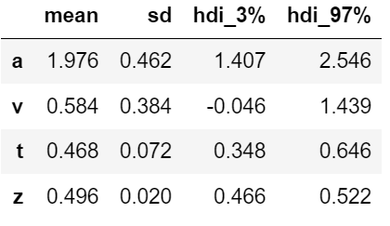
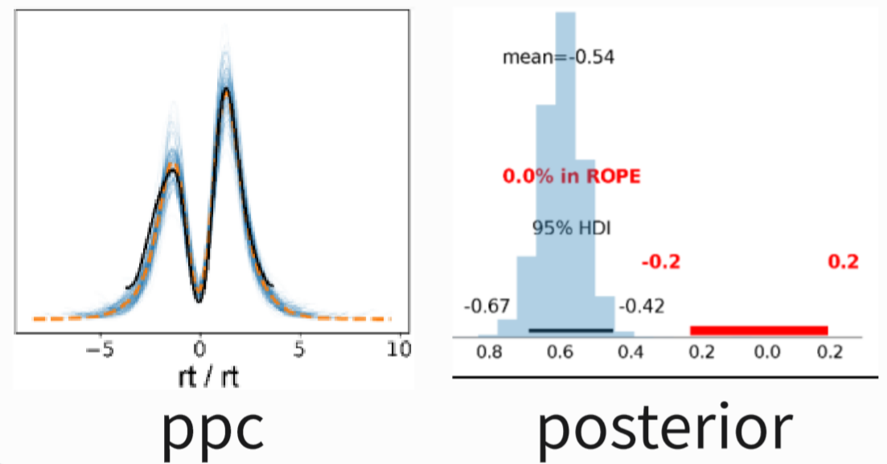
A
2.1 Download & install docker
B
To download and install docker, visit the official Docker website (https://docs.docker.com/get-docker/).
The windows user could use wsl (https://docs.docker.com/desktop/wsl/)
To test the docker installation by command line: docker run hello-world
#1
#1
Pull and run dockerHDDM
#2
To pull and run dockerHDDM (details in section 2) require terminal line basics (https://www.freecodecamp.org/news/command-line-for-beginners/) and basic docker commands (https://dev.to/roselinebassey/docker-for-beginners-basic-docker-commands-2n89)
#2
2.2 Pull image
:docker pull hcp4715/hddm
2.3 Run container
:docker run hcp4715/hddm
If you are not familiar with the jupyter IDE and python code, you can try it online without installing it beforehand: https://jupyter.org/try-jupyter/retro/ notebooks/?path=notebooks/Intro.ipynb
If you successfully run the dockerHDDM container and go to jupyter, you'll be greeted with the sight of figure5.
#3
3. dockerHDDM workflow
#3
3.1 Define models
In [1]:
model=hddm.HDDM(data)
#4
If you are not familiar with the basic code of HDDM, such as specifying and fitting model, you can refer to the jupyter notebook provided in the HDDM_official_tutorial folder:
HDDM_basic_tutorial.ipynb: provides basic code examples on how to build and fitting the DDM in hierarchical structure.
HDDM_regression_stimcoding.ipynb: shows how to allow parameters to vary with experimental conditions
Posterior_Predictive_Checks.ipynb: demonstrates how to evaluate the predictive performance of a model.
LAN_Tutorial.ipynb: exhibits the use of neural network methods to deal with complex models with free likelihood.
3.1 Fitting model
#4
In [2]:
infdata=model.sample(500)
3.3 & 3.4 Diagnosis & Evaluation
In [3]:
az.summay(infdata)
az.plot_ppc(infdata,...)
az.compare(m1,m2,...)
#5
3.5 Inference
In [4]:
az.plot_posterior(infdata)
#5
New features in DockerHDDM about how to use Arviz tools to implement analysis workflow, code examples stored in dockerHDDM_tutorial folder:
dockerHDDM_quick_view.ipynb: shows how to parallelize the computation of multiple MCMC chains, model loglikelihood and ppc, and return inference data for Arviz analysis (see section 3).
dockerHDDM_workflow.ipynb: include the workflow analyzed in the article (see section 4), which serves as a reference for the DDM analysis process, mainly for analyzing the inference data returned by the fitted model.
Results

Slide 2
A
2.1 Download & install docker
B
To download and install docker, visit the official Docker website (https://docs.docker.com/get-docker/).
The windows user could use wsl (https://docs.docker.com/desktop/wsl/)
To test the docker installation by command line: docker run hello-world
#1
#1
Pull and run dockerHDDM
#2
To pull and run dockerHDDM (details in section 2) require terminal line basics (https://www.freecodecamp.org/news/command-line-for-beginners/) and basic docker commands (https://dev.to/roselinebassey/docker-for-beginners-basic-docker-commands-2n89)
#2
2.2 Pull image
:docker pull hcp4715/hddm
2.3 Run container
:docker run hcp4715/hddm
If you are not familiar with the jupyter IDE and python code, you can try it online without installing it beforehand: https://jupyter.org/try-jupyter/retro/ notebooks/?path=notebooks/Intro.ipynb
If you successfully run the dockerHDDM container and go to jupyter, you'll be greeted with the sight of figure5.
#3
3. dockerHDDM workflow
#3
3.1 Define models
In [1]:
#4
model=hddm.HDDM(data)
If you are not familiar with the basic code of HDDM, such as specifying and fitting model, you can refer to the jupyter notebook provided in the HDDM_official_tutorial folder:
HDDM_basic_tutorial.ipynb: provides basic code examples on how to build and fitting the DDM in hierarchical structure.
HDDM_regression_stimcoding.ipynb: shows how to allow parameters to vary with experimental conditions
Posterior_Predictive_Checks.ipynb: demonstrates how to evaluate the predictive performance of a model.
LAN_Tutorial.ipynb: exhibits the use of neural network methods to deal with complex models with free likelihood.
3.1 Fitting model
#4
In [2]:
infdata=model.sample(500)
3.3 Diagnostic
In [3]:
arviz.plot_trace(infdata)
arviz.summay(infdata)
#5
3.4 & 3.5 Prediction and inference
In [4]:
arviz.plot_posterior(infdata)
arviz.plot_ppc(infdata,...)
#5
New features in DockerHDDM about how to use Arviz tools to implement analysis workflow, code examples stored in dockerHDDM_tutorial folder:
dockerHDDM_quick_view.ipynb: shows how to parallelize the computation of multiple MCMC chains, model loglikelihood and ppc, and return inference data for Arviz analysis (see section 3).
dockerHDDM_workflow.ipynb: include the workflow analyzed in the article (see section 4), which serves as a reference for the DDM analysis process, mainly for analyzing the inference data returned by the fitted model.
Results

Slide 3
A
B
2.1 Download & install docker
To download and install docker, visit the official Docker website (https://docs.docker.com/get-docker/).
The windows user could use wsl (https://docs.docker.com/desktop/wsl/)
To test the docker installation by command line: docker run hello-world
#1
#1
Pull and run dockerHDDM
#2
To pull and run dockerHDDM (details in section 2) require terminal line basics (https://www.freecodecamp.org/news/command-line-for-beginners/) and basic docker commands (https://dev.to/roselinebassey/docker-for-beginners-basic-docker-commands-2n89)
2.2 Pull image
#2
:docker pull hcp4715/hddm
2.3 Run container
:docker run hcp4715/hddm
If you are not familiar with the jupyter IDE and python code, you can try it online without installing it beforehand: https://jupyter.org/try-jupyter/retro/ notebooks/?path=notebooks/Intro.ipynb
If you successfully run the dockerHDDM container and go to jupyter, you'll be greeted with the sight of figure5.
#3
3. dockerHDDM workflow
#3
#4
3.1 Define models
In [1]:
model=hddm.HDDM(data)
If you are not familiar with the basic code of HDDM, you can refer to the jupyter notebook provided in the HDDM_official_tutorial folder:
HDDM_basic_tutorial.ipynb: provides basic code examples on how to build and fitting the DDM in hierarchical structure.
HDDM_regression_stimcoding.ipynb: shows how to allow parameters to vary with experimental conditions
Posterior_Predictive_Checks.ipynb: demonstrates how to evaluate the predictive performance of a model.
LAN_Tutorial.ipynb: exhibits the use of neural network methods to deal with complex models with free likelihood.
#5
#4
3.1 Fitting model
In [2]:
infdata=model.sample(500)
3.3 Diagnostic
In [3]:
arviz.plot_trace(infdata)
arviz.summay(infdata)
3.4 & 3.5 Prediction and inference
In [4]:
arviz.plot_posterior(infdata)
arviz.plot_ppc(infdata,...)
#5
A quick view of the new features of DockerHDDM and the workflow analyzed in this article are stored in the dockerHDDM_tutorial folder:
dockerHDDM_quick_view.ipynb: shows how to parallelize the computation of multiple MCMC chains, model loglikelihood and ppc, and return inference data for Arviz analysis (see section 3).
dockerHDDM_workflow.ipynb: include the workflow analyzed in the article (see section 4), which serves as a reference for the DDM analysis process, mainly for analyzing the inference data returned by the fitted model.
Results

Slide 4



0. Download & install docker
[✎#1]
[✎#1]
To download and install docker, visit the official Docker website (https://docs.docker.com/get-docker/).
The windows user could use wsl (https://docs.docker.com/desktop/wsl/)
To test the docker installation by command line: docker run hello-world
[✎#2]
1. Pull image docker pull hcp4715/hddm
[✎#2]
To pull and run dockerHDDM (details in section 2) require terminal line basics (https://www.freecodecamp.org/news/command-line-for-beginners/) and basic docker commands (https://dev.to/roselinebassey/docker-for-beginners-basic-docker-commands-2n89)
2. Run container
docker run hcp4715/hddm
dockerHDDM
[✎#3]
[✎#3]
If you are not familiar with the jupyter IDE and python code, you can try it online without installing it beforehand https://jupyter.org/try-jupyter/retro/ notebooks/?path=notebooks/Intro.ipynb
If you successfully run the dockerHDDM container and go to jupyter, you'll be greeted with the sight of figure5.
3. HDDM workflow
[✎#4]
Define model
Model = hddm.HDDM(data)
If you are not familiar with the basic code of HDDM, you can refer to the jupyter notebook provided in the HDDM_official_tutorial folder:
HDDM_basic_tutorial.ipynb: provides basic code examples on how to build and fitting the DDM in hierarchical structure.
HDDM_regression_stimcoding.ipynb: shows how to allow parameters to vary with experimental conditions
Posterior_Predictive_Checks.ipynb: demonstrates how to evaluate the predictive performance of a model.
LAN_Tutorial.ipynb: exhibits the use of neural network methods to deal with complex models with free likelihood.
Fitting model
Infdata = Model.sample(500, chains=4)
[✎#4]
Infdata
Diagnostic & Analysis
arviz.summay(Infdata)
arviz.plot_posterior(Infdata)
[✎#5]
[✎#5]
A quick view of the new features of DockerHDDM and the workflow analyzed in this article are stored in the dockerHDDM_tutorial folder:
dockerHDDM_quick_view.ipynb: shows how to parallelize the computation of multiple MCMC chains, model loglikelihood and ppc, and return inference data for Arviz analysis (see section 3).
dockerHDDM_workflow.ipynb: include the workflow analyzed in the article (see section 4), which serves as a reference for the DDM analysis process, mainly for analyzing the inference data returned by the fitted model.
results and figures

Slide 5



0. Download & install docker
[✎#1]
[✎#1]
To download and install docker, visit the official Docker website (https://docs.docker.com/get-docker/).
The windows user could use wsl (https://docs.docker.com/desktop/wsl/)
To test the docker installation by command line: docker run hello-world
Docker Hub
[✎#2]
1. Pull image docker pull hcp4715/hddm
[✎#2]
Local data
To pull and run dockerHDDM (details in section 2) require terminal line basics (https://www.freecodecamp.org/news/command-line-for-beginners/) and basic docker commands (https://dev.to/roselinebassey/docker-for-beginners-basic-docker-commands-2n89)
2. Run container
docker run hcp4715/hddm
dockerHDDM
[✎#3]
[✎#3]
If you are not familiar with the jupyter IDE and python code, you can try it online without installing it beforehand https://jupyter.org/try-jupyter/retro/ notebooks/?path=notebooks/Intro.ipynb
If you successfully run the dockerHDDM container and go to jupyter, you'll be greeted with the sight of figure5.
3. HDDM workflow
[✎#4]
Define model
Model = hddm.HDDM(data)
If you are not familiar with the basic code of HDDM, you can refer to the jupyter notebook provided in the HDDM_official_tutorial folder:
HDDM_basic_tutorial.ipynb: provides basic code examples on how to build and fitting the DDM in hierarchical structure.
HDDM_regression_stimcoding.ipynb: shows how to allow parameters to vary with experimental conditions
Posterior_Predictive_Checks.ipynb: demonstrates how to evaluate the predictive performance of a model.
LAN_Tutorial.ipynb: exhibits the use of neural network methods to deal with complex models with free likelihood.
Fitting model
Infdata = Model.sample(500, chains=4)
[✎#4]
Infdata
Diagnostic & Analysis
arviz.summay(Infdata)
arviz.plot_posterior(Infdata)
· · ·
[✎#5]
[✎#5]
A quick view of the new features of DockerHDDM and the workflow analyzed in this article are stored in the dockerHDDM_tutorial folder:
dockerHDDM_quick_view.ipynb: shows how to parallelize the computation of multiple MCMC chains, model loglikelihood and ppc, and return inference data for Arviz analysis (see section 3).
dockerHDDM_workflow.ipynb: include the workflow analyzed in the article (see section 4), which serves as a reference for the DDM analysis process, mainly for analyzing the inference data returned by the fitted model.
results and figures

Slide 6
0. Download & install docker
[✎#1]
[✎#1]
To download and install docker, visit the official Docker website (https://docs.docker.com/get-docker/).
The windows user could use wsl (https://docs.docker.com/desktop/wsl/)
To test the docker installation by command line: docker run hello-world
Docker Hub
[✎#2]
1. Pull image docker pull hcp4715/hddm
[✎#2]
Local data
To pull and run dockerHDDM (details in section 2) require terminal line basics (https://www.freecodecamp.org/news/command-line-for-beginners/) and basic docker commands (https://dev.to/roselinebassey/docker-for-beginners-basic-docker-commands-2n89)
2. Run container
docker run hcp4715/hddm
dockerHDDM
[✎#3]
[✎#3]
If you are not familiar with the jupyter IDE and python code, you can try it online without installing it beforehand https://jupyter.org/try-jupyter/retro/notebooks/?path=notebooks/Intro.ipynb
If you successfully run the dockerHDDM container and go to jupyter, you'll be greeted with the sight of figure5.
3. HDDM workflow
Define model
Model = hddm.HDDM(data)
[✎#4]
[✎#4]
If you are not familiar with the basic code of HDDM, you can refer to the jupyter notebook provided in the HDDM_official_tutorial folder:
HDDM_basic_tutorial.ipynb: provides basic code examples on how to build and fitting the DDM in hierarchical structure.
HDDM_regression_stimcoding.ipynb: shows how to allow parameters to vary with experimental conditions
Posterior_Predictive_Checks.ipynb: demonstrates how to evaluate the predictive performance of a model.
LAN_Tutorial.ipynb: exhibits the use of neural network methods to deal with complex models with free likelihood.
Fitting model
Infdata = Model.sample(500, chains=4)
Infdata
[✎#5]
Diagnostic & Analysis
arviz.summay(Infdata)
arviz.plot_posterior(Infdata)
· · ·
A quick view of the new features of DockerHDDM and the workflow analyzed in this article are stored in the dockerHDDM_tutorial folder:
dockerHDDM_quick_view.ipynb: shows how to parallelize the computation of multiple MCMC chains, model loglikelihood and ppc, and return inference data for Arviz analysis (see section 3).
dockerHDDM_workflow.ipynb: include the workflow analyzed in the article (see section 4), which serves as a reference for the DDM analysis process, mainly for analyzing the inference data returned by the fitted model.
[✎#5]
results and figures

