Slide 1





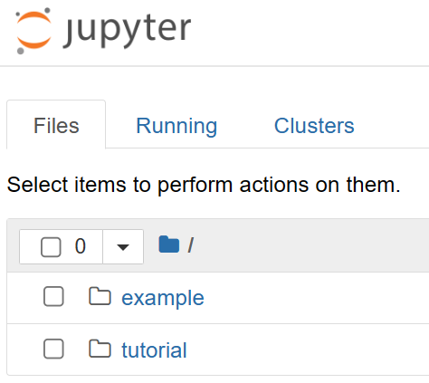


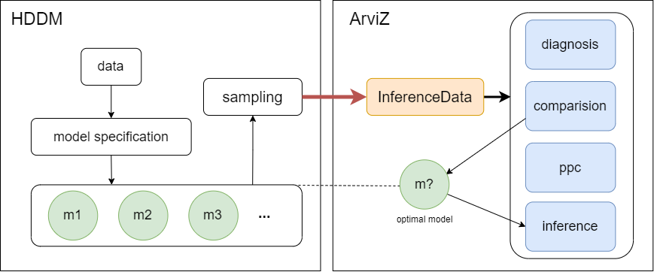

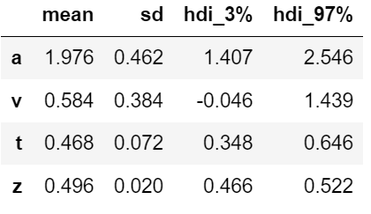
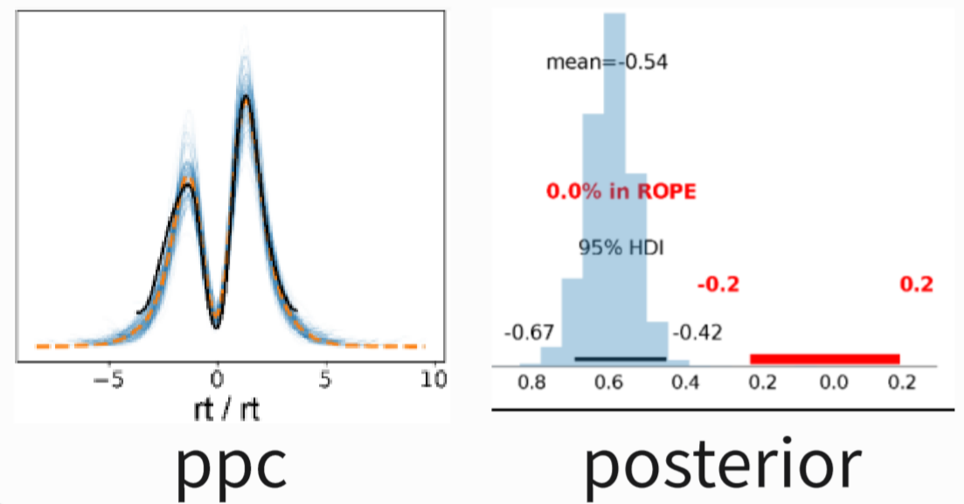
Install docker
user@DESKTOP:/$ docker pull hcp4715
user@DESKTOP:/$ docker run -p 8888:8888 -it --rm hcp4715/hddm jupyter notebook
[I 06:50:52.339 NotebookApp] Serving notebooks from local directory: /home/jovyan
[I 06:50:52.339 NotebookApp] Jupyter Notebook 6.4.12 is running at:
[I 06:50:52.339 NotebookApp] Use Control-C to stop this server and shut down all kernels (twice to skip confirmation).
[C 06:50:52.342 NotebookApp]
To access the notebook, open this file in a browser:
file:///home/jovyan/.local/share/jupyter/runtime/nbserver-7-open.html
Or copy and paste one of these URLs:
http://92ea06ad8c6d:8888/?token=0ce749eb149fe594d8879dbaeabd9e
or http://127.0.0.1:8888/?token=0ce749eb149fe594d8879dbaeabd9
Open terminal
Open URL & Enter jupyter
Pull image
:docker pull hcp4715/hddm
Run container
:docker run hcp4715/hddm
Open jupyter notebook
HDDM workflow
Define models
In [1]:
m1=hddm.HDDM(data)
m2=hddm.HDDM(data,…)
···
Fitting model
In [2]:
infdata1=m1.sample(500,chains=4)
infdata2=m2.sample(500,chains=4)
···
Diagnosis
In [3]:
az.summay(infdata1)
az.plot_trace(infdata1)
···
Comparison
In [4]:
models={ "model1":infdata1, "model2":infdata2, ···}
az.compare(models)
Evaluation
Results
In [5]:
az.plot_ppc(infdata1,...)
···
Inference
In [6]:
az.plot_posterior(infdata1)
···

Slide 2
user@DESKTOP:/$ docker pull hcp4715
user@DESKTOP:/$ docker run -p 8888:8888 -it --rm hcp4715/hddm jupyter notebook
[I 06:50:52.339 NotebookApp] Serving notebooks from local directory: /home/jovyan
[I 06:50:52.339 NotebookApp] Jupyter Notebook 6.4.12 is running at:
[I 06:50:52.339 NotebookApp] Use Control-C to stop this server and shut down all kernels (twice to skip confirmation).
[C 06:50:52.342 NotebookApp]
To access the notebook, open this file in a browser:
file:///home/jovyan/.local/share/jupyter/runtime/nbserver-7-open.html
Or copy and paste one of these URLs:
http://92ea06ad8c6d:8888/?token=0ce749eb149fe594d8879dbaeabd9e
or http://127.0.0.1:8888/?token=0ce749eb149fe594d8879dbaeabd9
Install docker
Open terminal
HDDM workflow
Pull image
Define models
:docker pull hcp4715/hddm
Open URL & Enter jupyter
In [1]:
m1=hddm.HDDM(data)
m2=hddm.HDDM(data,…)
···
Run container
Fitting model
:docker run hcp4715/hddm
In [2]:
infdata1=m1.sample(500,chains=4)
infdata2=m2.sample(500,chains=4)
···
Diagnosis
In [3]:
az.summay(infdata1)
az.plot_trace(infdata1)
···
Comparison
In [4]:
models={ "model1":infdata1, "model2":infdata2, ···}
az.compare(models)
Evaluation
In [5]:
az.plot_ppc(infdata1,...)
···
Inference
Results
In [6]:
az.plot_posterior(infdata1)
···

Slide 3
HDDM workflow
Define models
In [1]:
m1=hddm.HDDM(data)
m2=hddm.HDDM(data,…)
···
Fitting model
In [2]:
infdata1=m1.sample(500,chains=4)
infdata2=m2.sample(500,chains=4)
···
Results
Diagnosis
In [3]:
az.summay(infdata1)
az.plot_trace(infdata1)
···
Comparison
In [4]:
models={ "model1":infdata1, "model2":infdata2, ···}
az.compare(models)
Install docker
Open terminal
Evaluation
Pull image
In [5]:
az.plot_ppc(infdata1,...)
···
:docker pull hcp4715/hddm
Open URL & Enter jupyter
Inference
Run container
In [6]:
az.plot_posterior(infdata1)
···
:docker run hcp4715/hddm
user@DESKTOP:/$ docker pull hcp4715
user@DESKTOP:/$ docker run -p 8888:8888 -it --rm hcp4715/hddm jupyter notebook
[I 06:50:52.339 NotebookApp] Serving notebooks from local directory: /home/jovyan
[I 06:50:52.339 NotebookApp] Jupyter Notebook 6.4.12 is running at:
[I 06:50:52.339 NotebookApp] Use Control-C to stop this server and shut down all kernels (twice to skip confirmation).
[C 06:50:52.342 NotebookApp]
To access the notebook, open this file in a browser:
file:///home/jovyan/.local/share/jupyter/runtime/nbserver-7-open.html
Or copy and paste one of these URLs:
http://92ea06ad8c6d:8888/?token=0ce749eb149fe594d8879dbaeabd9e
or http://127.0.0.1:8888/?token=0ce749eb149fe594d8879dbaeabd9

Slide 4
user@DESKTOP:/$ docker pull hcp4715
user@DESKTOP:/$ docker run -p 8888:8888 –v /home/custom_workflow/tutorial:/home/jovyan/work -it --rm hcp4715/hddm jupyter notebook
[I 06:50:51.594 NotebookApp] Writing notebook server cookie secret to /home/jovyan/.local/share/jupyter/runtime/notebook_cookie_secret
[I 2023-09-18 06:50:52.335 LabApp] JupyterLab extension loaded from /opt/conda/lib/python3.8/site-packages/jupyterlab
[I 2023-09-18 06:50:52.335 LabApp] JupyterLab application directory is /opt/conda/share/jupyter/lab
[I 06:50:52.339 NotebookApp] Serving notebooks from local directory: /home/jovyan
[I 06:50:52.339 NotebookApp] Jupyter Notebook 6.4.12 is running at:
[I 06:50:52.339 NotebookApp] http://92ea06ad8c6d:8888/?token=0ce749eb149fe594d8879dbaeabd9edbb24e2f339169d3da
[I 06:50:52.339 NotebookApp] or http://127.0.0.1:8888/?token=0ce749eb149fe594d8879dbaeabd9edbb24e2f339169d3da
[I 06:50:52.339 NotebookApp] Use Control-C to stop this server and shut down all kernels (twice to skip confirmation).
[C 06:50:52.342 NotebookApp]
To access the notebook, open this file in a browser:
file:///home/jovyan/.local/share/jupyter/runtime/nbserver-7-open.html
Or copy and paste one of these URLs:
http://92ea06ad8c6d:8888/?token=0ce749eb149fe594d8879dbaeabd9edbb24e2f339169d3da
or http://127.0.0.1:8888/?token=0ce749eb149fe594d8879dbaeabd9edbb24e2f339169d3da

