Slide 1

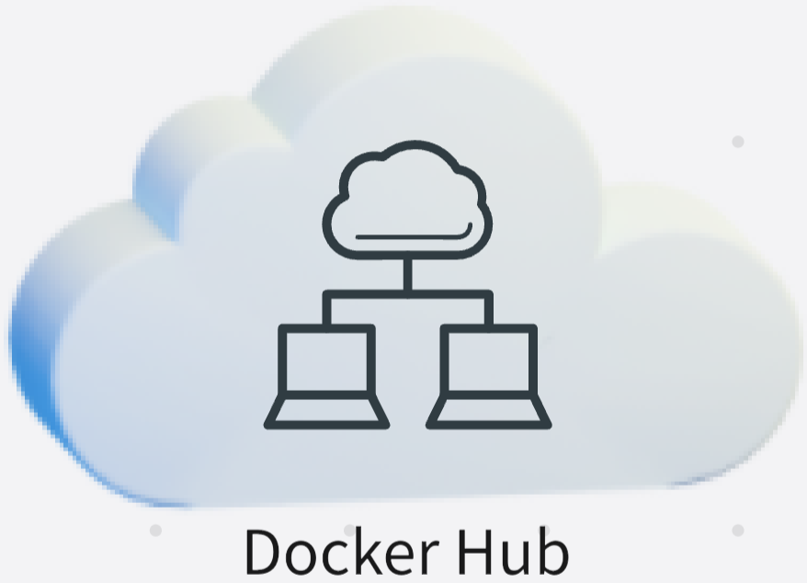




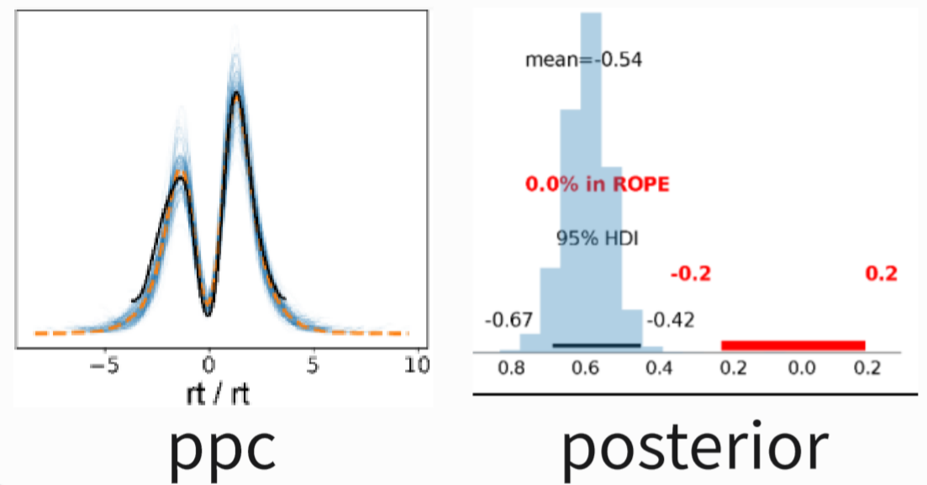
0. download & Install docker
[✎#1]
[✎#2]
1. Pull image docker pull hcp4715/hddm
2. Run container
docker run hcp4715/hddm
[✎#3]
3. HDDM workflow
Define model
Model = hddm.HDDM(data)
[✎#4]
Fitting model
Infdata = Model.sample(500, chains=4)
Infdata
Diagnostic & Analysis
arviz.summay(Infdata)
arviz.plot_posterior(Infdata) …
[✎#5]
results and figures

Slide 2
3. HDDM workflow
Define model
Model = hddm.HDDM(data)
0. download & Install docker
[✎#4]
[✎#1]
Fitting model
Infdata = Model.sample(500, chains=4)
[✎#2]
1. Pull image docker pull hcp4715/hddm
Infdata
2. Run container
docker run hcp4715/hddm
Diagnostic & Analysis
arviz.summay(Infdata)
arviz.plot_posterior(Infdata) …
[✎#3]
[✎#5]
results and figures

Slide 3



0. Preparation for environment
Install docker
Download and install docker: https://docs.docker.com/get-docker/
The windows user could use wsl: https://docs.docker.com/desktop/wsl/
Test the docker by command line: docker run hello-world
3. Workflow
Define model
Model = hddm.HDDM(data)
1. Pull and run dockerHDDM
Fitting model
Infdata = Model.sample(500, chains=4)
Pull image docker pull hcp4715/hddm
dockerHDDM
InferenceData
Run container
docker pull hcp4715/hddm
Jupyter (IDE)
Diagnostic & Analysis
arviz.summay(Infdata)
arviz.plot_posterior(Infdata) …
The reference about command lines
The basics of the terminal command line：https://www.freecodecamp.org/news/command-line-for-beginners/
The basic command in docker: https://dev.to/roselinebassey/docker-for-beginners-basic-docker-commands-2n89
Online try Jupyter and Python: https://jupyter.org/try-jupyter/retro/notebooks/?path=notebooks/Intro.ipynb
results and figures

