Slide 1
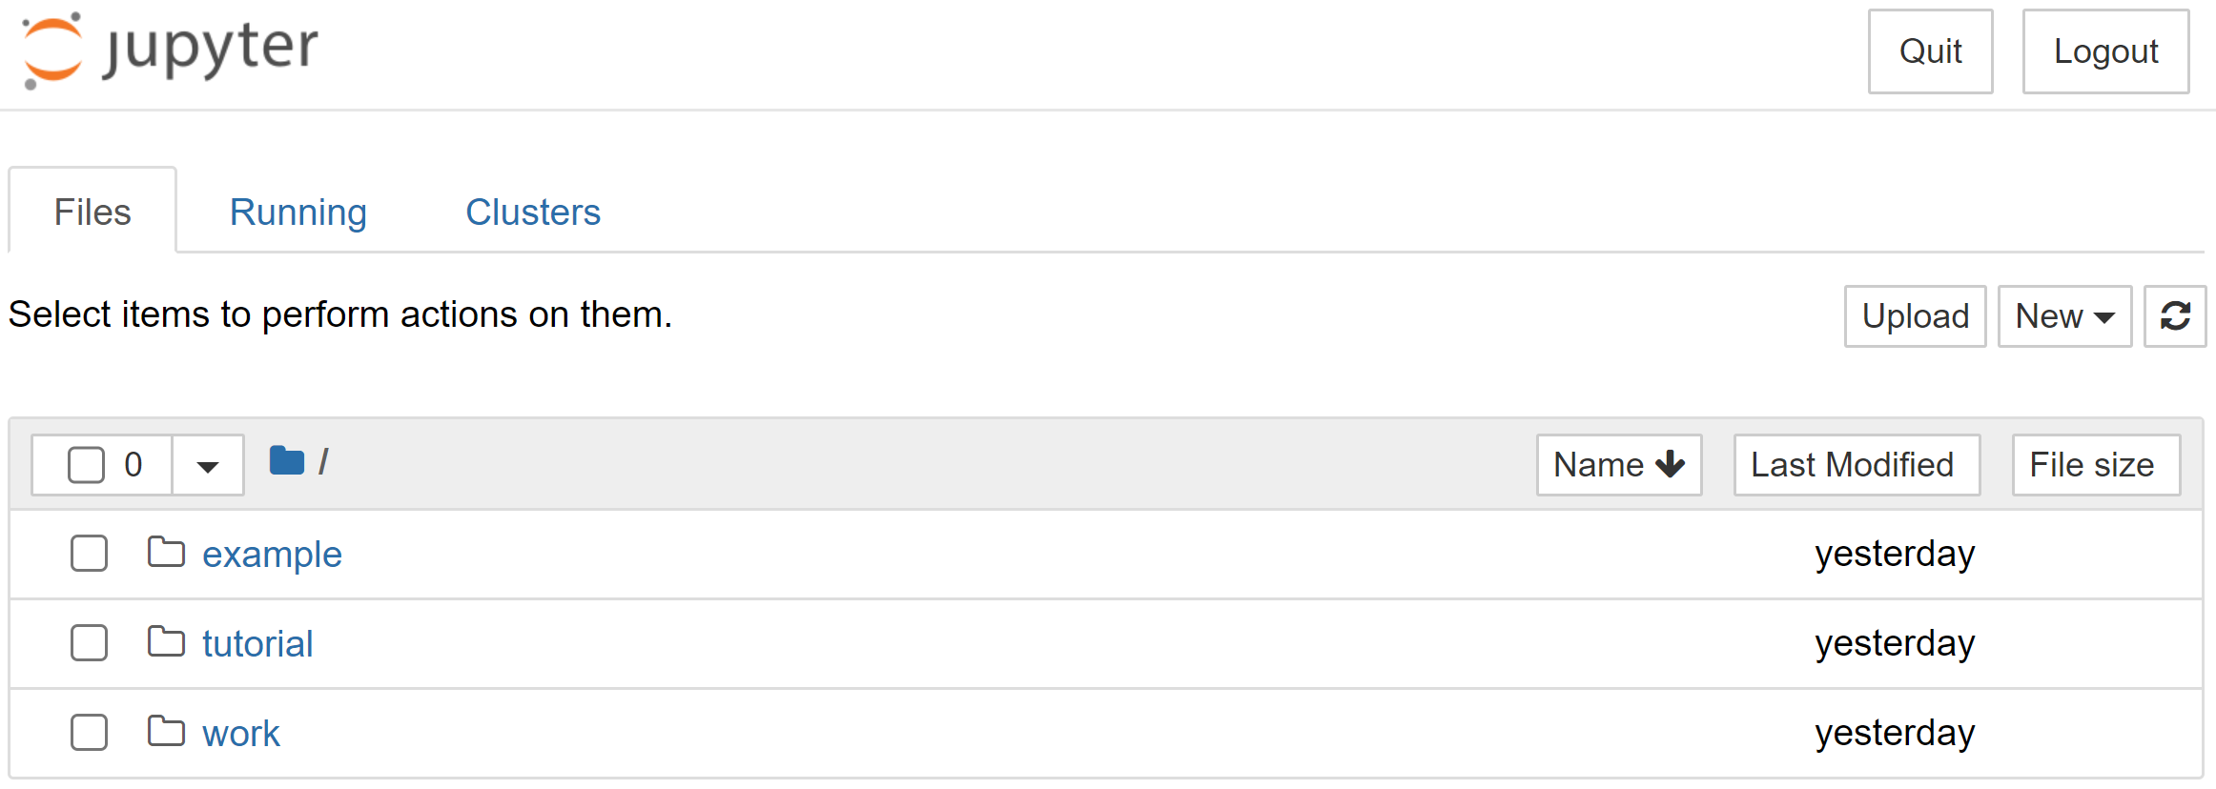
A
epool@DESKTOP-EPOOL:/$ docker run -p 8888:8888 –v /home/custom_workflow/tutorial:/home/jovyan/work -it --rm hcp4715/hddm:latest jupyter notebook
[I 06:50:51.594 NotebookApp] Writing notebook server cookie secret to /home/jovyan/.local/share/jupyter/runtime/notebook_cookie_secret
[I 2023-09-18 06:50:52.335 LabApp] JupyterLab extension loaded from /opt/conda/lib/python3.8/site-packages/jupyterlab
[I 2023-09-18 06:50:52.335 LabApp] JupyterLab application directory is /opt/conda/share/jupyter/lab
[I 06:50:52.339 NotebookApp] Serving notebooks from local directory: /home/jovyan
[I 06:50:52.339 NotebookApp] Jupyter Notebook 6.4.12 is running at:
[I 06:50:52.339 NotebookApp] http://92ea06ad8c6d:8888/?token=0ce749eb149fe594d8879dbaeabd9edbb24e2f339169d3da
[I 06:50:52.339 NotebookApp] or http://127.0.0.1:8888/?token=0ce749eb149fe594d8879dbaeabd9edbb24e2f339169d3da
[I 06:50:52.339 NotebookApp] Use Control-C to stop this server and shut down all kernels (twice to skip confirmation).
[C 06:50:52.342 NotebookApp]
To access the notebook, open this file in a browser:
file:///home/jovyan/.local/share/jupyter/runtime/nbserver-7-open.html
Or copy and paste one of these URLs:
http://92ea06ad8c6d:8888/?token=0ce749eb149fe594d8879dbaeabd9edbb24e2f339169d3da
or http://127.0.0.1:8888/?token=0ce749eb149fe594d8879dbaeabd9edbb24e2f339169d3da
B

