Slide 1
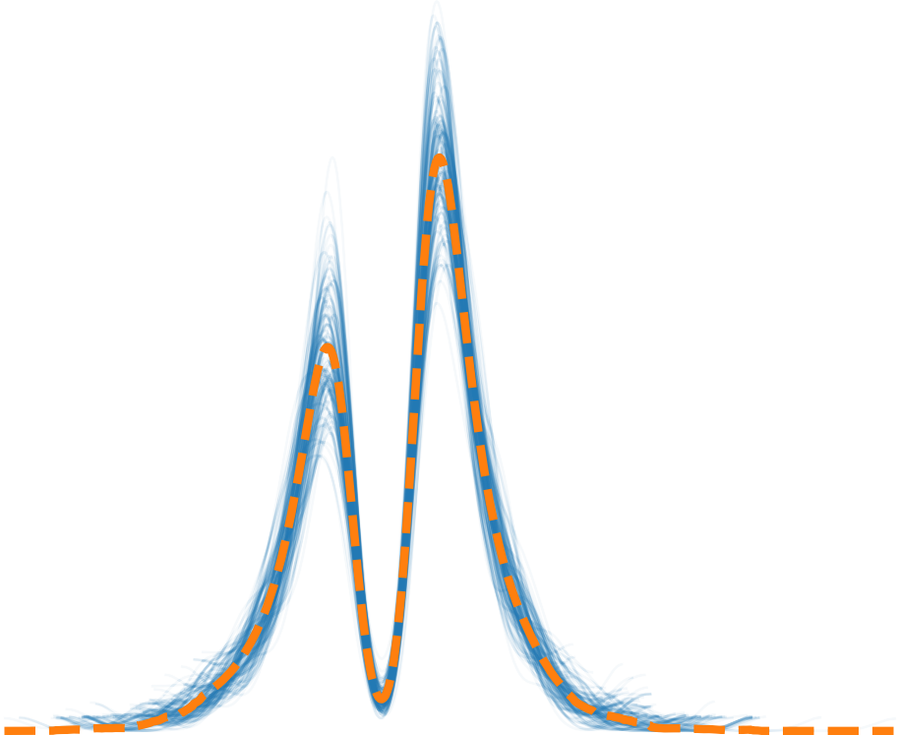
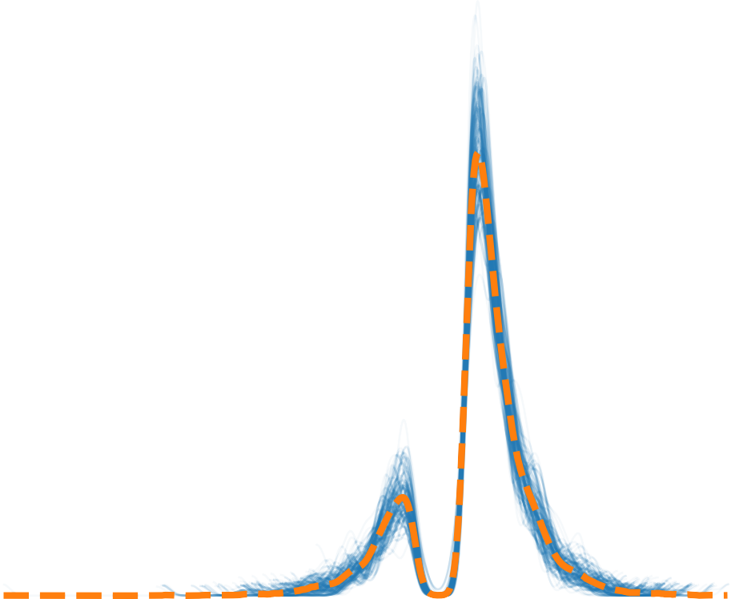
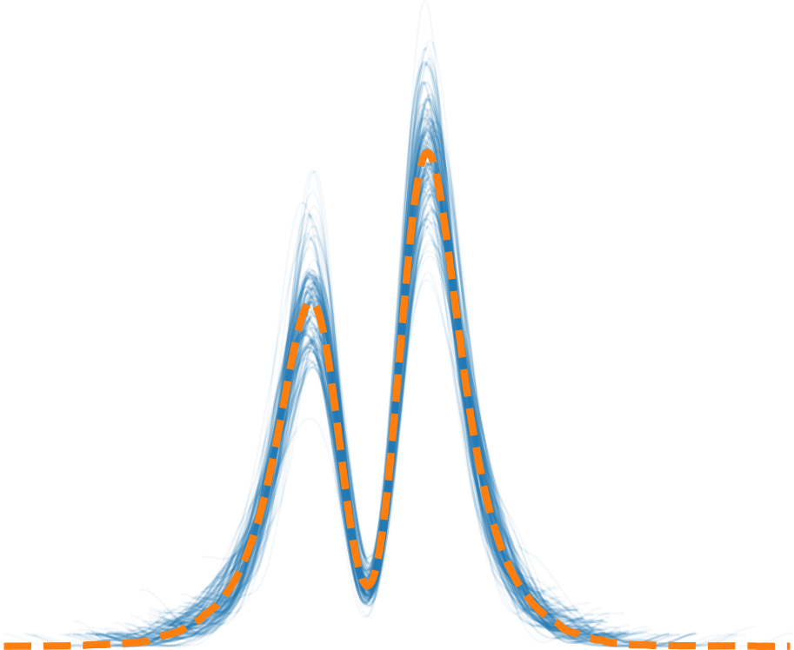
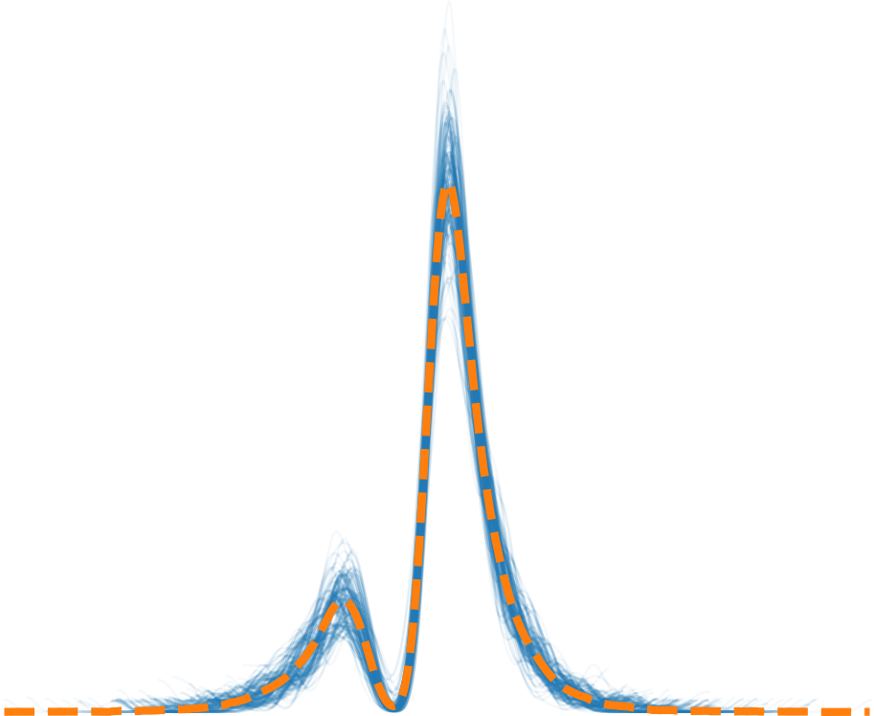
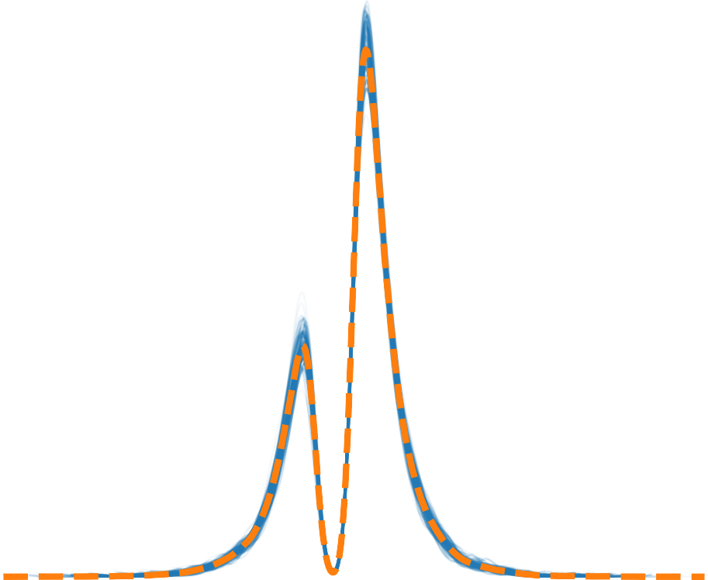
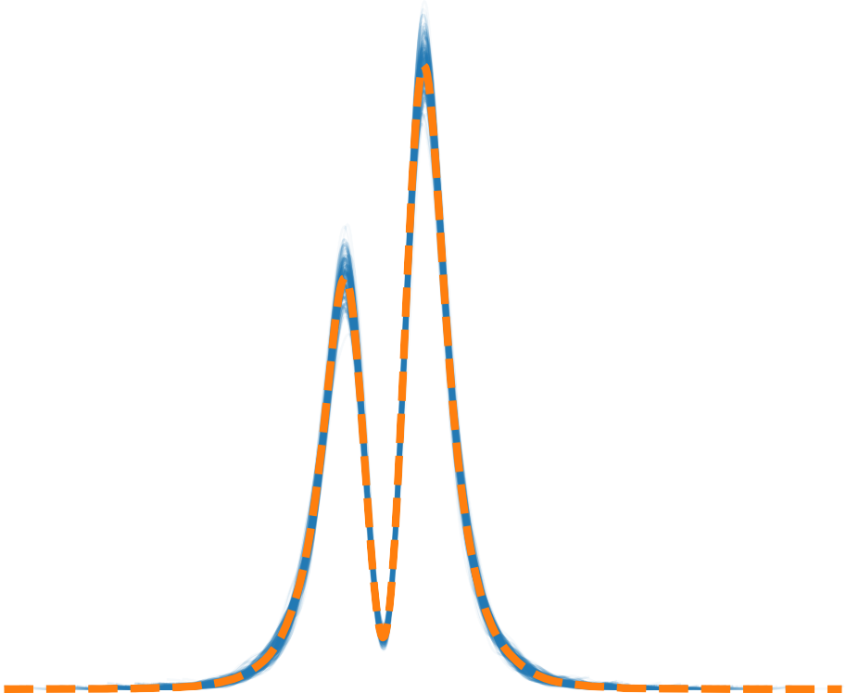
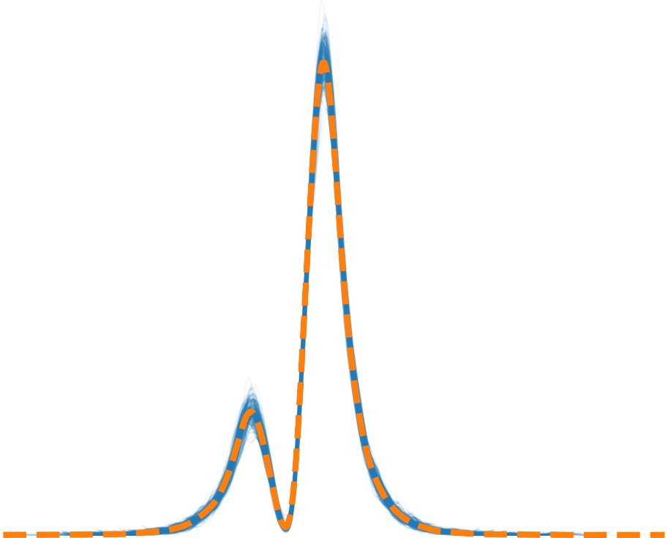
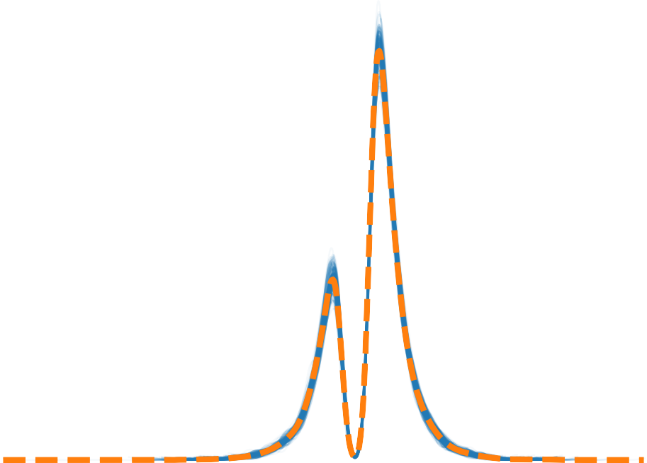
A
axes = az.plot_ppc(m0_infdata, var_names= 'rt’, coords={'obs_id': [3,11]}, num_pp_samples=100, flatten=[])
axes = az.plot_ppc(m4_infdata, var_names= 'rt’, coords={'obs_id': [3,11]}, num_pp_samples=100, flatten=[])
5
0
5
10
15
10
5
0
5
10
5
0
5
10
10
5
0
5
10
rt / rt
3
rt / rt
11
rt / rt
3
rt / rt
11
B
axes = az.plot_ppc(m0_infdata, var_names= ‘rt’, coords={‘obs_id’: [‘LC’,’HC’]}, num_pp_samples=100, flatten=[])
axes = az.plot_ppc(m4_infdata, var_names= ‘rt’, coords={‘obs_id’: [‘LC’,’HC’]}, num_pp_samples=100, flatten=[])
10
5
0
5
10
15
10
5
0
5
10
10
5
0
5
10
5
0
5
10
rt / rt
LC
rt / rt
HC
rt / rt
LC
rt / rt
HC
Posterior predictive
Observed
Posterior predictive mean

