Slide 1
Bootstrap professor Brenda Lopez Cabrera
Atoosa Ahmadinajaf Abadi (604542)

Slide 2
Table of contents
01
02
03
04
05
06
Introduction
Implementing Bootstrap in Python
Types of bootstrap scheme
Choice of statistic
Deriving confidence intervals from the bootstrap distribution
Pros and Cons of the Method

Slide 3
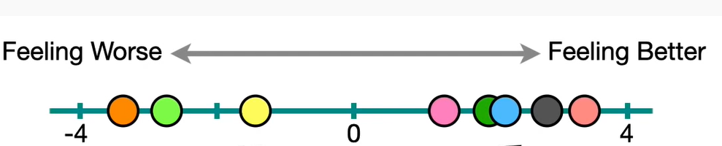
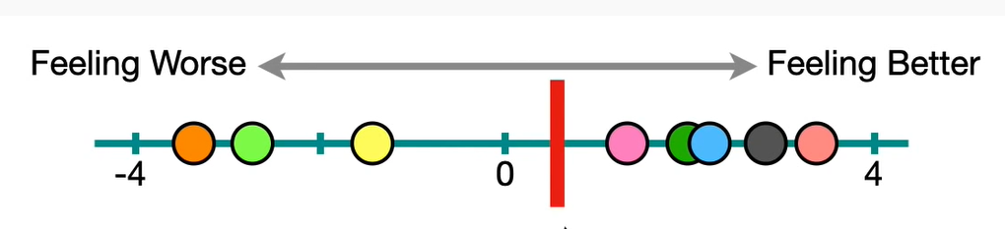
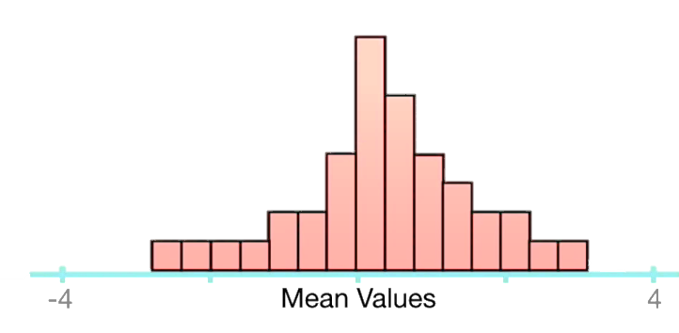
1. Introduction

Slide 4
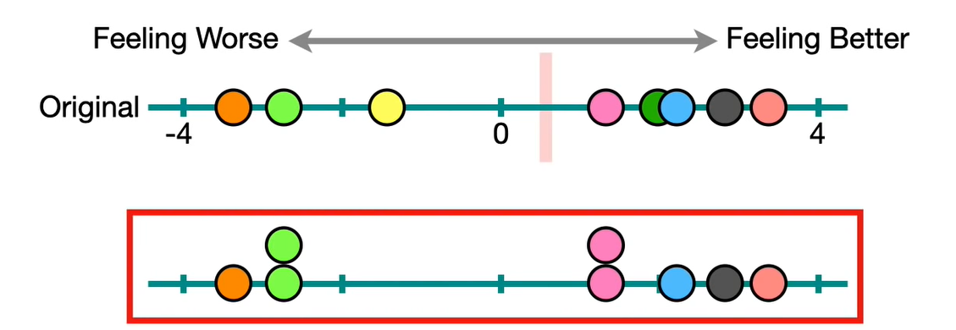
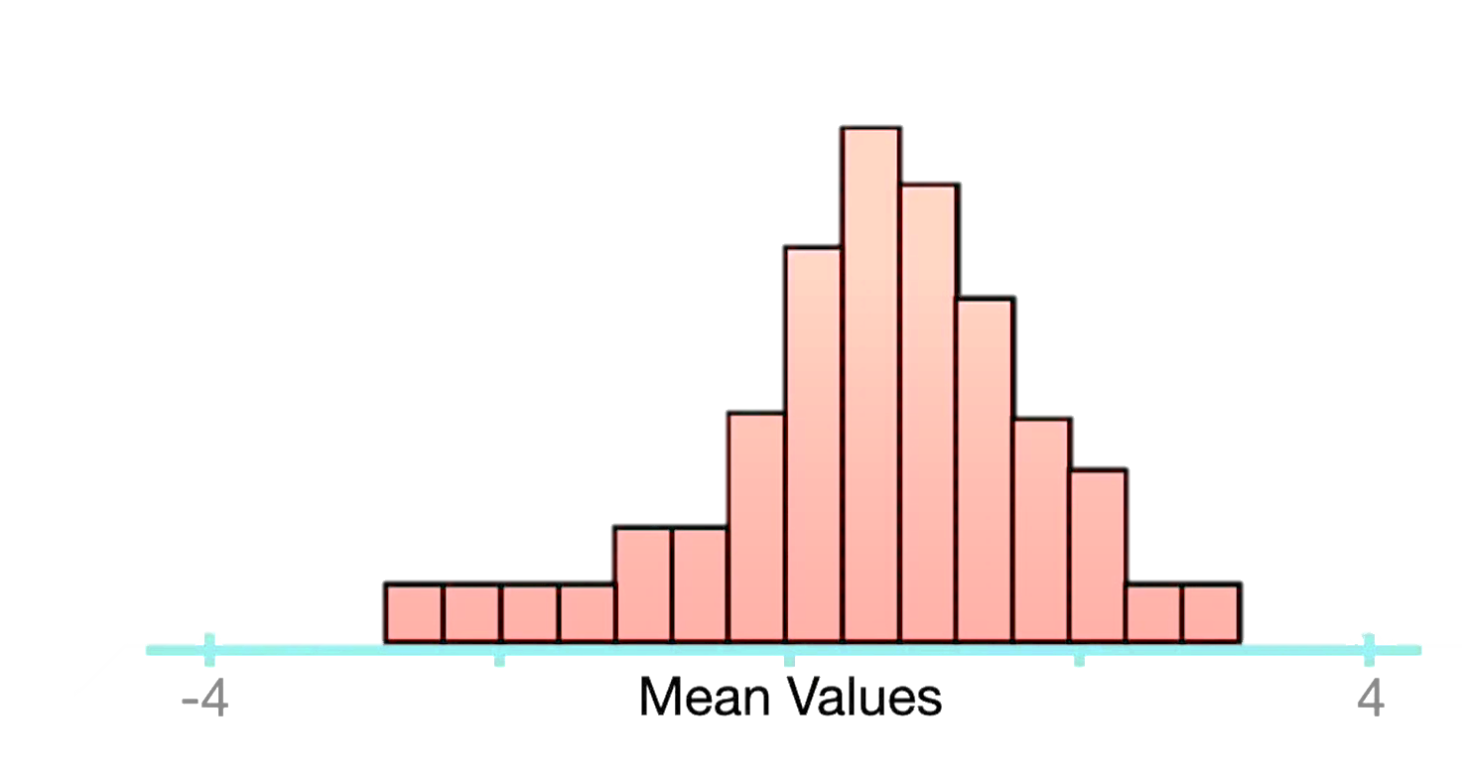
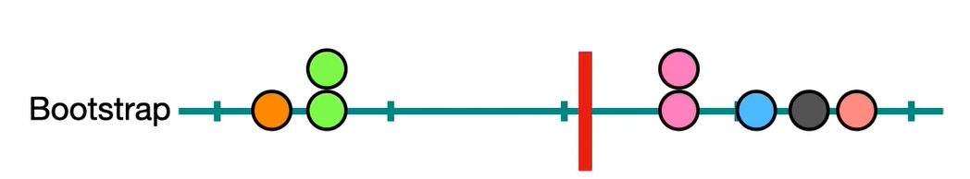
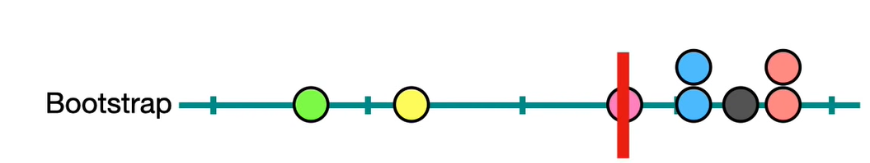
1. Introduction
The bootstrap method is a resampling technique used to estimate statistics on a population by sampling a dataset with replacement.

Slide 5
1. Introduction
Statistical inference depends on the sampling distribution. The sampling distribution depends on :
the underlying population(s),
the sampling procedure, and
the statistic, such as X.
The bootstrap principle is to plug in an estimate for the population, then mimic the real life sampling procedure and statistic calculation. The bootstrap distribution depends on:
an estimate for the population(s),
the sampling procedure, and
the statistic, such as X.

Slide 6
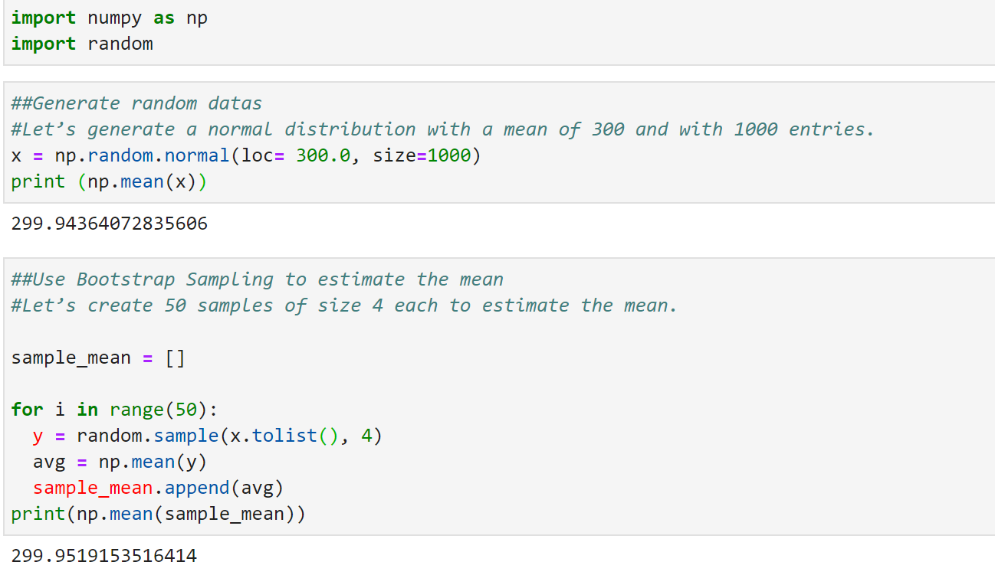
2. Implementing Bootstrap in Python

Slide 7
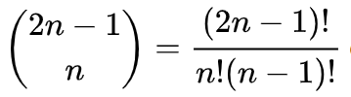

3. Types of bootstrap scheme
Case resampling
resample the data with replacement
the statistic of interest is computed from the resample
repeat this routine many times to get a more precise estimate of the Bootstrap distribution of the statistic.
Bayesian bootstrap
creates new data sets through reweighting the initial data
Given a set of N data points, the weighting assigned to data point i in a new data set D^{J} :

Slide 8
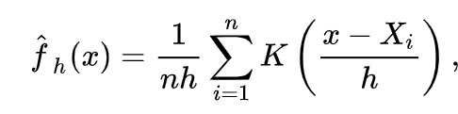

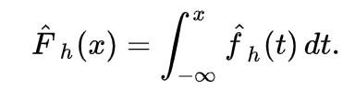

3. Types of bootstrap scheme
Smooth bootstrap
A small amount of (usually normally distributed) zero-centered random noise is added onto each resampled observation.
K is symmetric kernel density function with unit variance
is standard kernel estimator
h is the smoothing parameter
is corresponding distribution function estimator
Block bootstrap
is used when the data, or the errors in a model, are correlated.
replicates the correlation by resampling inside blocks of data
Mainly usage with data correlated in time (i.e. time series)

Slide 9
4. Choice of statistic
Population parameters are estimated with many point estimators like :
mean-unbiased minimum-variance estimators
median-unbiased estimators
Bayesian estimators (for example, the posterior distribution's mode, median, mean)
maximum-likelihood estimators
A Bayesian point estimator and a maximum-likelihood estimator have good performance when the sample size is infinite

Slide 10





5. Deriving confidence intervals from the bootstrap distribution
The bootstrap distribution of a parameter-estimator has been used to calculate confidence intervals for its population-parameter
Bias: The bootstrap distribution and the sample may disagree systematically, in which case bias may occur.
There are several methods for constructing confidence intervals from the bootstrap distribution of a real parameter:
Basic bootstrap(Reverse Percentile Interval) : simply takes the empirical quantiles from the bootstrap distribution of the parameter :
Percentile bootstrap : is proceeds in a similar way to the basic bootstrap, using percentiles of the bootstrap distribution, but with a different formula :
denotes the percentile of the bootstrapped coefficients
denotes the percentile of the bootstrapped coefficients

Slide 11

6. Pros and Cons of the Method
its simplicity
is an appropriate way to control the stability of the results
avoids the cost of repeating the experiment to get other groups of sample data
depends heavily on the estimator used
can lead to inconsistency.
can be time-consuming

Slide 12
Sources
DiCiccio TJ, Efron B (1996) Bootstrap confidence intervals (with Discussion). Statistical Science 11: 189–228
Hinkley, David (1994-08-01). "[Bootstrap: More than a Stab in the Dark?]: Comment". StatisticalScience. 9 (3). doi:10.1214/ss/1177010387. ISSN 0883-4237.
Efron B., R. J. Tibshirani, An introduction to the bootstrap, Chapman & Hall/CRC 1998
WANG, SUOJIN (1995). "Optimizing the smoothed bootstrap". Ann. Inst. Statist. Math. 47: 65–80. doi:10.1007/BF00773412. S2CID 122041565.
Davison, A. C.; Hinkley, D. V. (1997). Bootstrap methods and their application. Cambridge Series in Statistical and Probabilistic Mathematics. Cambridge University Press. ISBN 0-521-57391-2.
Efron, B.; Tibshirani, R. (1993). An Introduction to the Bootstrap. Boca Raton, FL: Chapman & Hall/CRC
2011 John Wiley & Sons, Inc. WIREs Comp Stat 2011 3 497–526 DOI: 10.1002/wics.182

