Slide 1
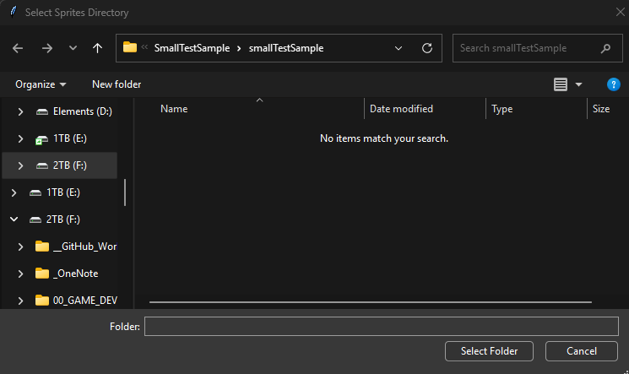

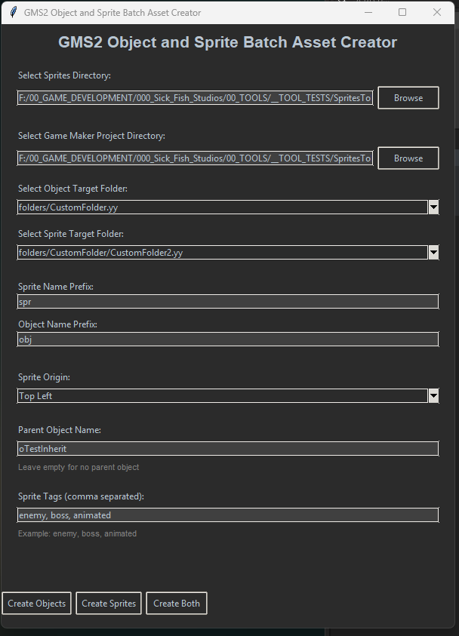
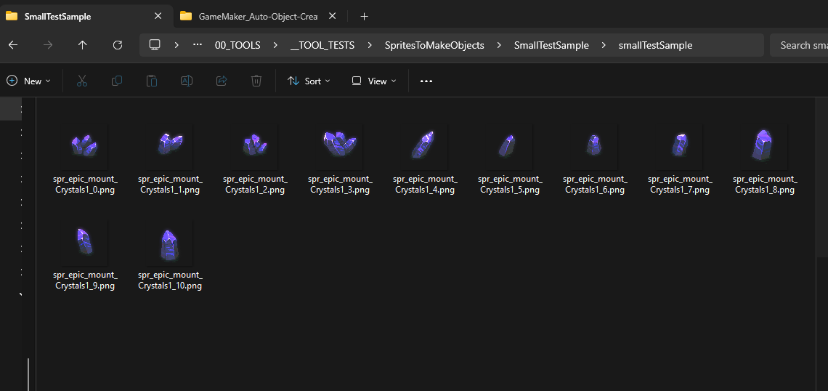
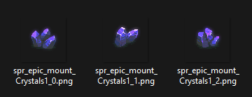
Select Browse under the Select Sprites Directory section
Navigate to the folder that contains the sprites you want to use to create sprites and or object assets in your game maker project.
Sprites should be named with a prefix like s or spr. It can be anything, but all sprite names need to begin with it.
The folder you use should only contain sprites for import.

Slide 2
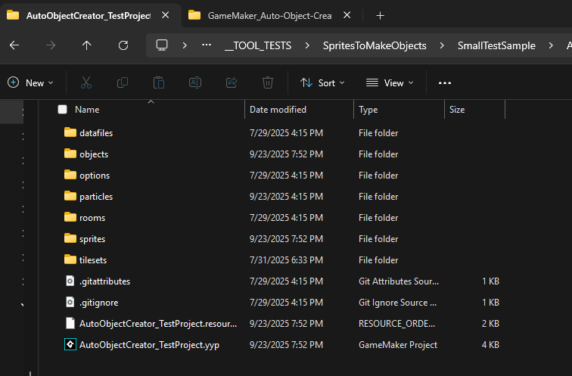

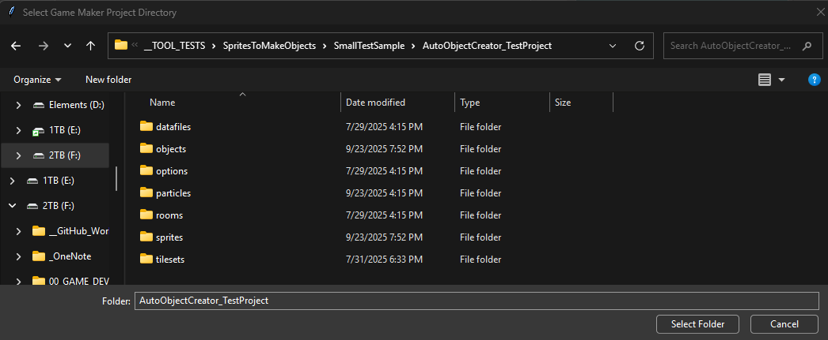
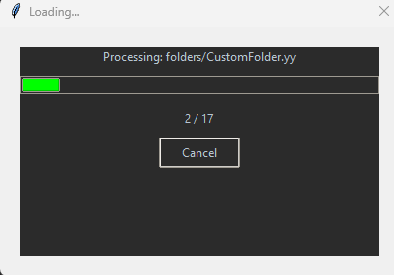
Select Browse under the Select Game Maker Project Directory section.
Game Maker project folder in file explorer
Navigate to the Game Maker project directory that the new assets will be added to.
Click Select Folder. The project file will load and get all the Game Maker folders that exist in the project.

Slide 3
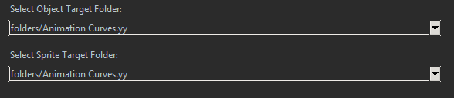
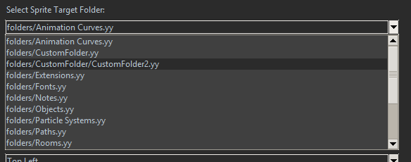
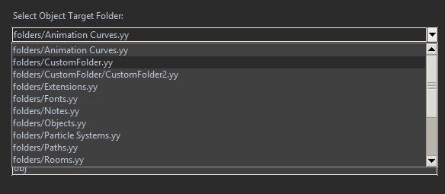
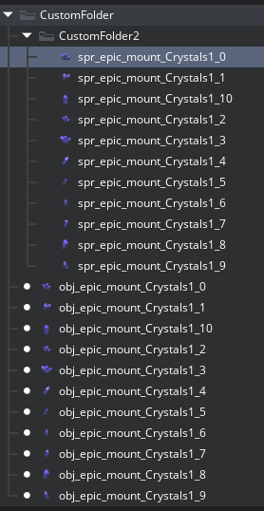
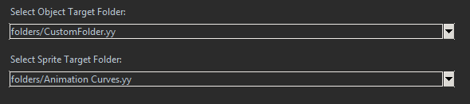
Select Object / Sprite target folders with the dropdown selection menu.
Object & Sprite assets created in the Game Maker project will be put in these folders
Example: Sprites & Objects that were created in the Game Maker project selected folders

Slide 4
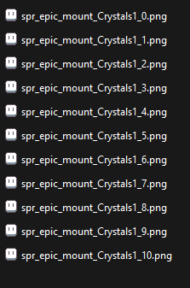

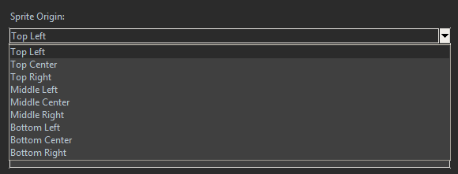
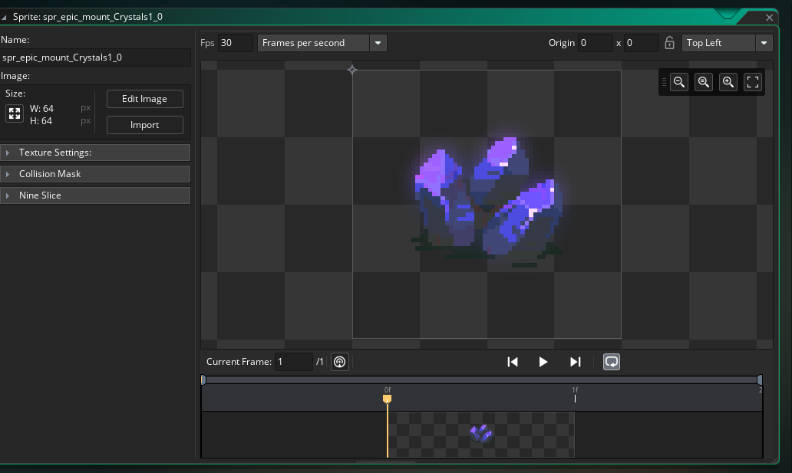
Enter Object / Sprite name prefix into the Name Prefix fields.
The Sprite Name prefix should be the same that is used when naming the files
Select the sprite origin point from the dropdown selection.

Slide 5

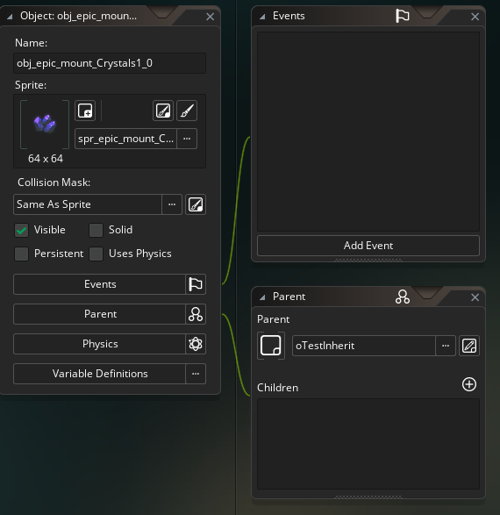
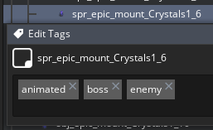

Enter optional Parent Object name and an optional list of Tags.
You can either choose to give the name of a Parent object that exists in the project, leave empty for no Parent Object, or type in a new name for a Parent object
  When using an existing Parent Object it'll set all the new objects as children of the given object
  When typing in the name of a new parent object it'll create a blank object in game maker and set all the new objects as children of the new Parent object
  Leave blank for no Parent

Slide 6

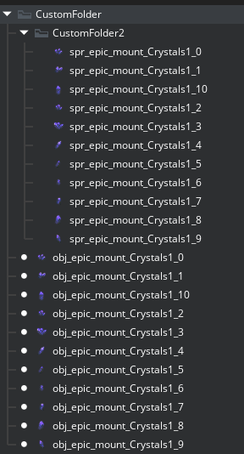
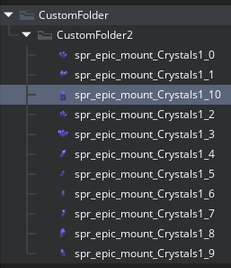
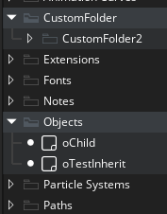
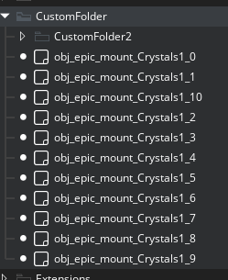
Create Objects, Create Sprites, Create Both (Sprites & Objects)
Clicking Create Object will create object assets with the same name as the sprites that were in the directory set in Select Sprite Directory
If sprites exist in your project with the same name, they will automatically be set as the sprite of the newly created Object
If tags were set, they will only be applied to the new objects
The existing sprites will not change their origin point to the selection set in the Batch Asset Creator
Game Maker Project Asset Browser
With existing sprites in project
If sprites with the same name don’t exist in the project the object assets will be created but will have no sprite set to them
Game Maker Project Asset Browser
No existing sprites in project

Slide 7
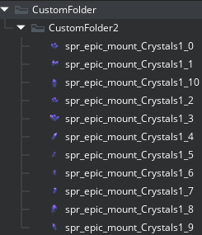
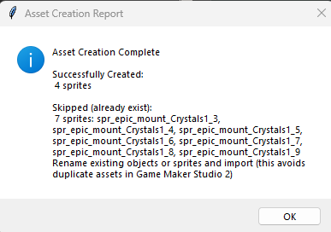
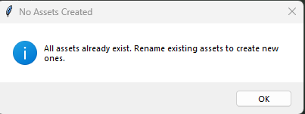
Create Objects, Create Sprites, Create Both (Sprites & Objects)
Clicking Create Sprites will create sprite assets with the same name as the sprites that were in the directory set in Select Sprite Directory
Sprites will be created in the Game Maker project
Tags set
Origin point set
Game Maker Project Asset Browser
No existing sprites in project
If sprites with the same name exist in the project you’ll receive either a message instructing you to rename the sprites or a report of which sprites could be created and the names of the ones that were skipped.

Slide 8
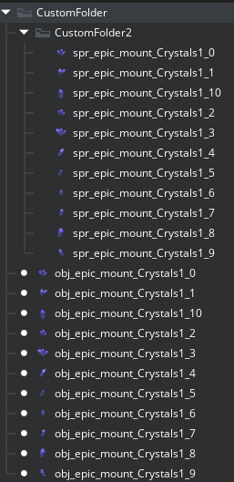
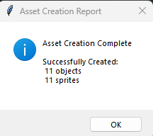
Create Objects, Create Sprites, Create Both (Sprites & Objects)
Clicking Create Both will create object assets & sprite assets with the same name as the sprites that were in the directory set in Select Sprite Directory
If tags were set, they will be applied to both the Objects & Sprites
The origin point of sprites will be set to your selection
Parent Object
  Created if no parent of the same name exists
  Set to existing parent by the name specified
  Nothing if left blank
Game Maker Project Asset Browser
No existing assets

